Slide 1
THE OMS SHOW 2023
OMS STILL GOING STRONG!
THE 55th GEM SHOW
Pictures by Dave Manchin
&
Margaret Henson
Presented by Wes Lingerfelt
September 12, 2023

Slide 2
This presentation is aimed at reflections and an effort to improve the SHOW!

Slide 3
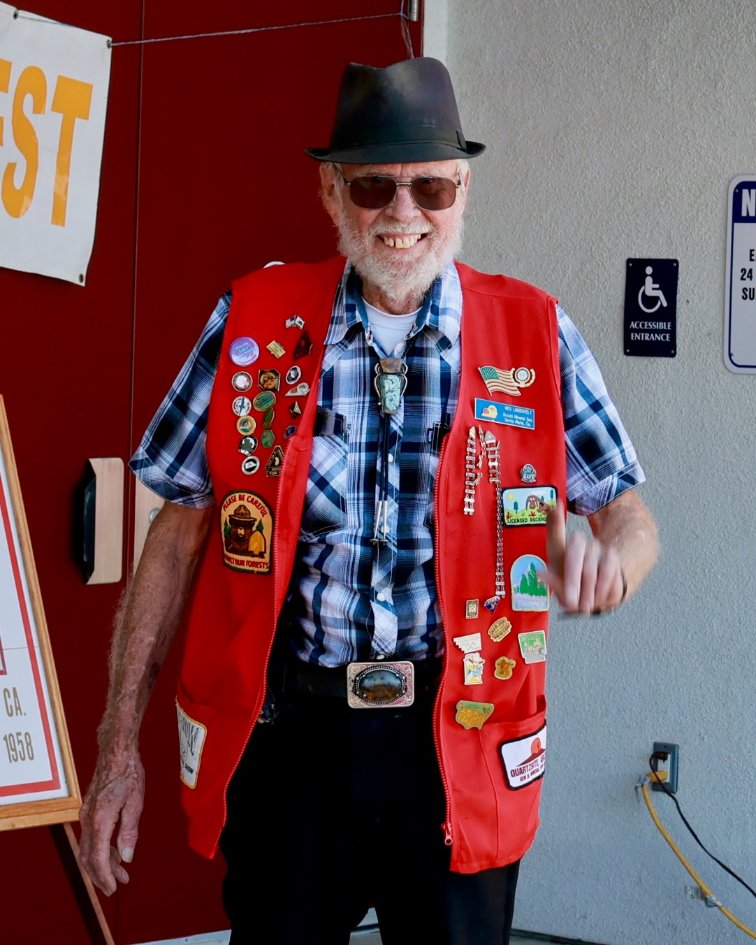
DO NOT MISUNDERSTAND WHAT YOU ARE ABOUT TO SEE!
There is no significance to the order of the following Pictures!

Slide 4
These are the Members who provided outstanding support to the show.
They made the show a great success! The biggest show we have ever done!
Thank you for your hard work!

Slide 5
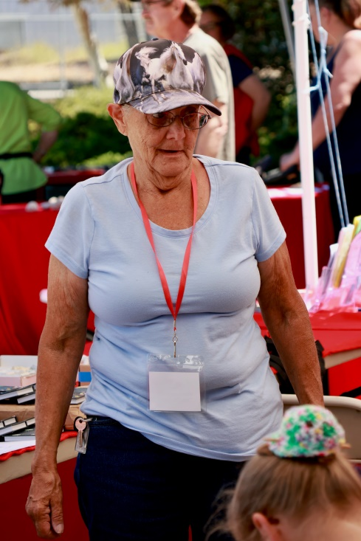
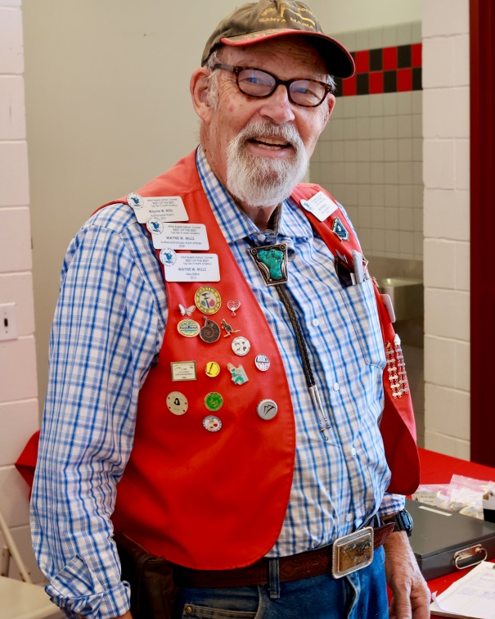
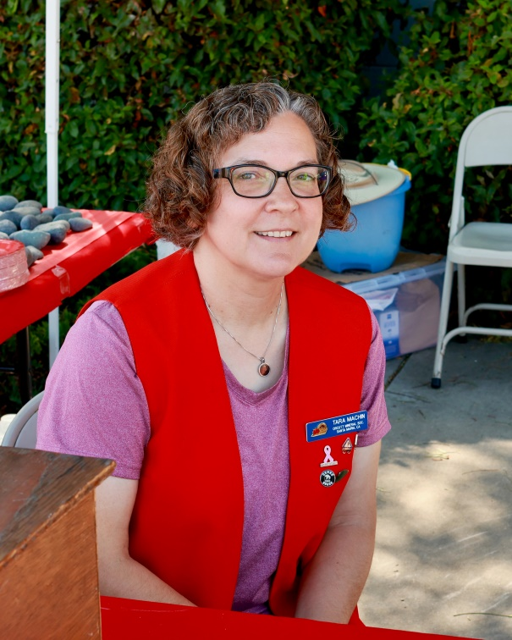
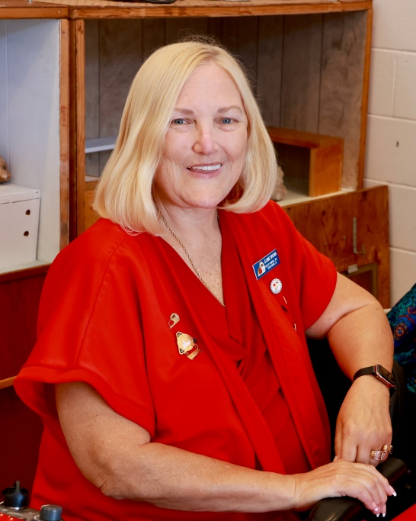
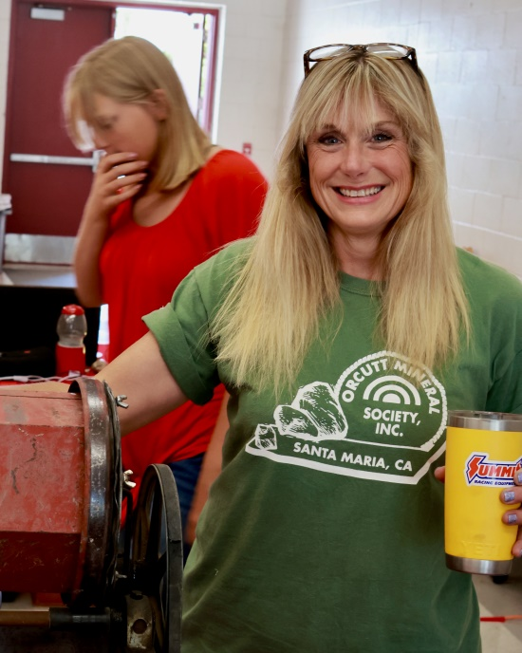
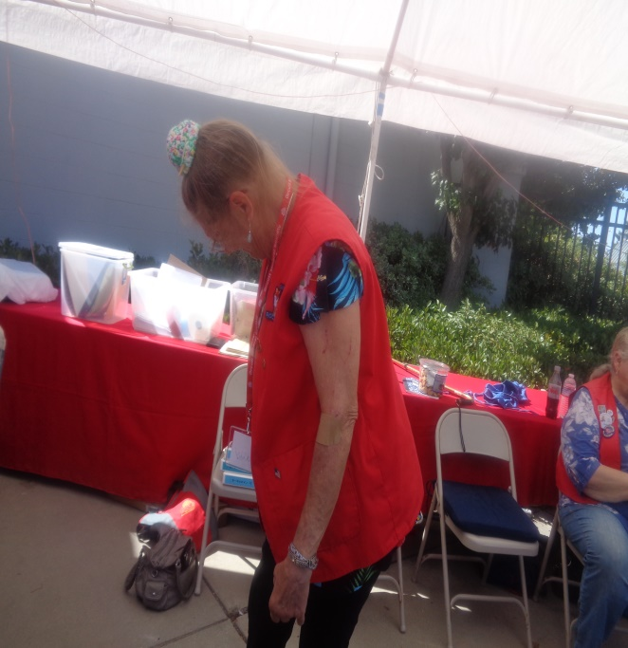

Slide 6
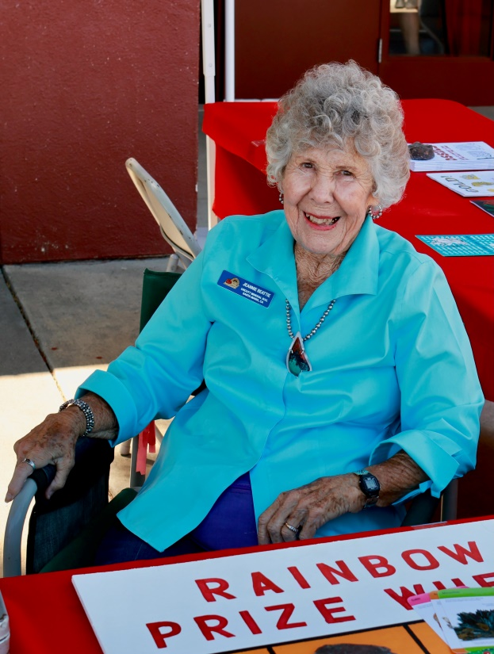
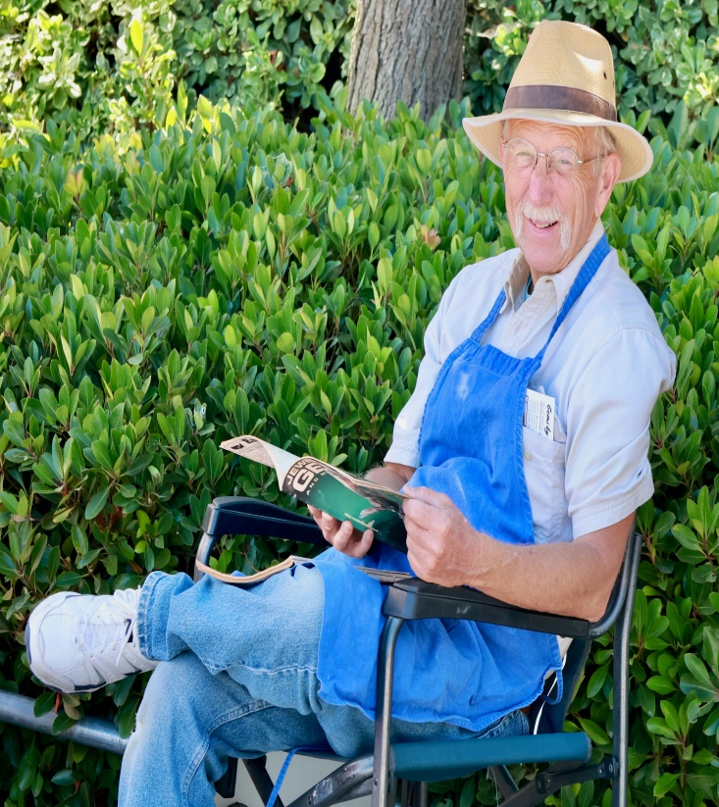
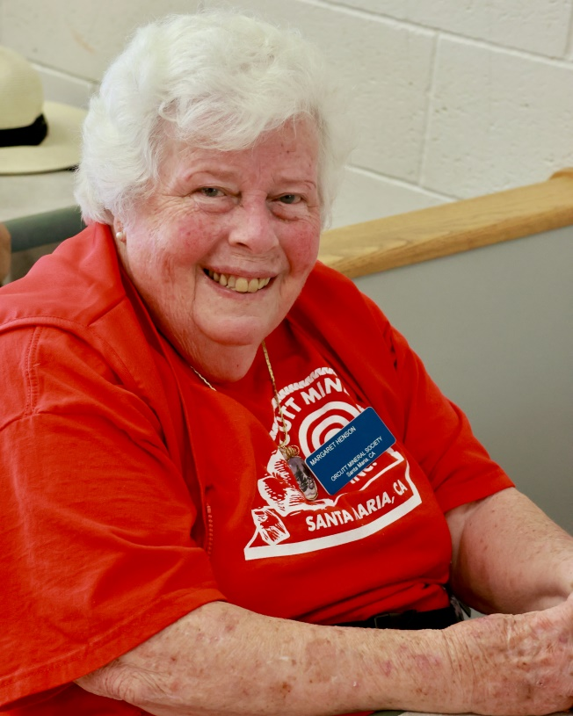
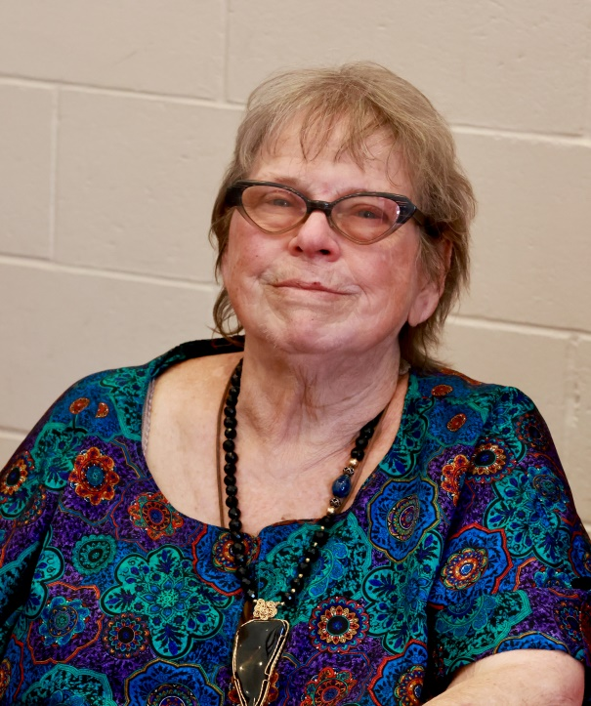
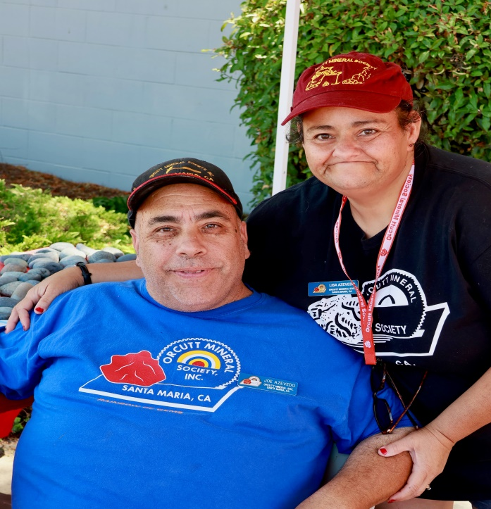
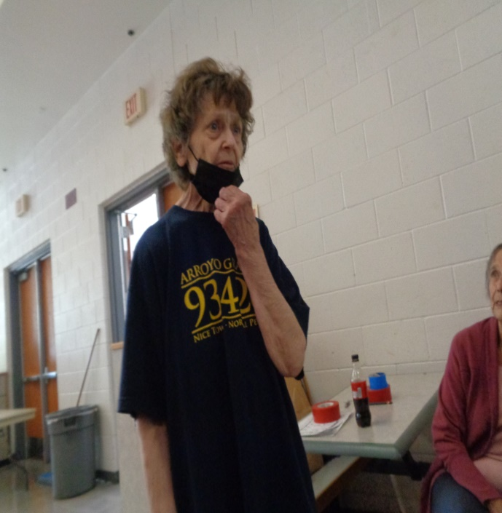

Slide 7
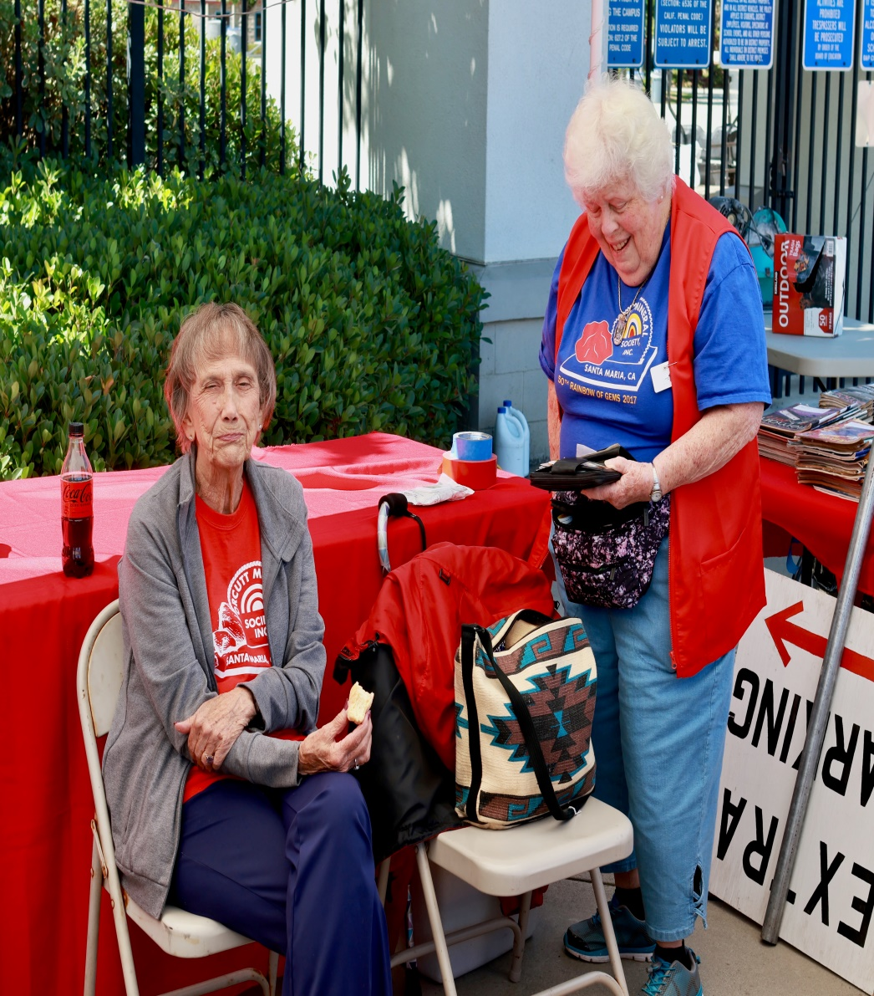
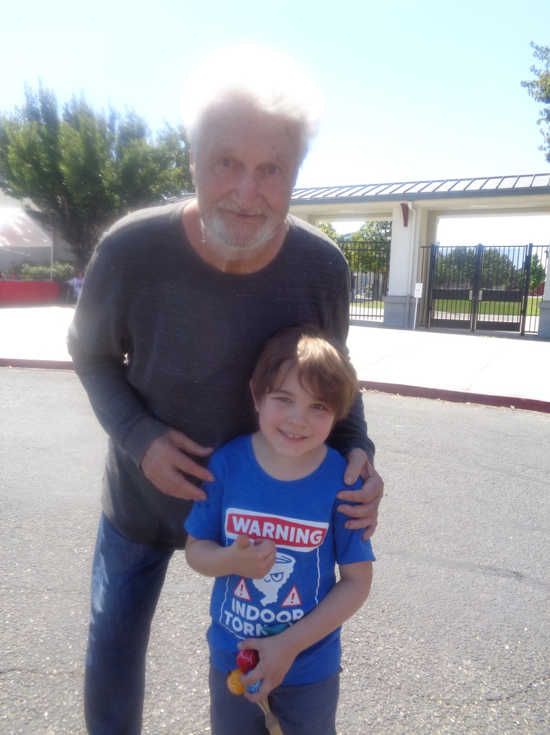

Slide 8
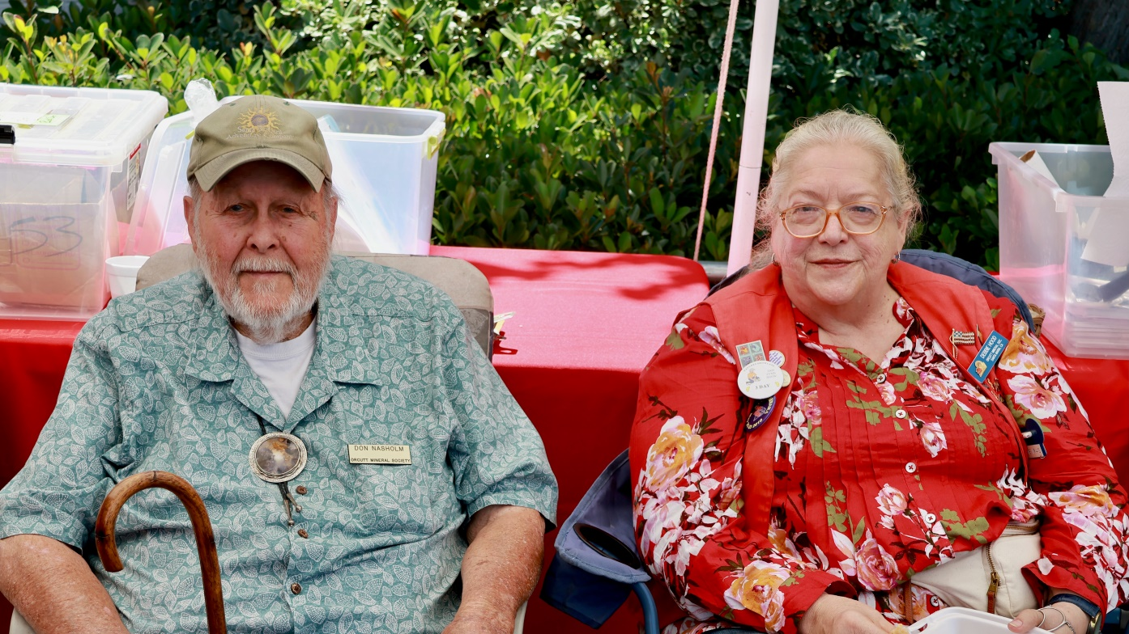
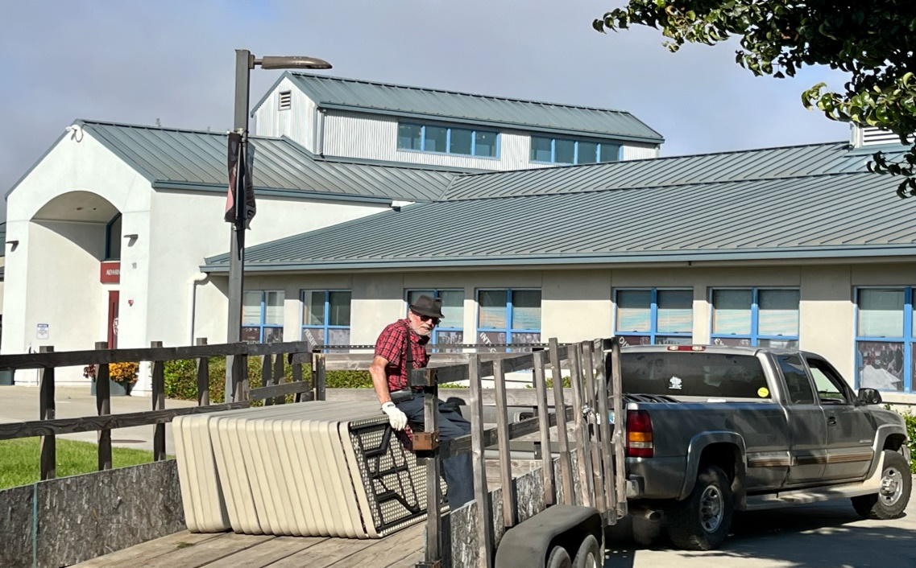

Slide 9
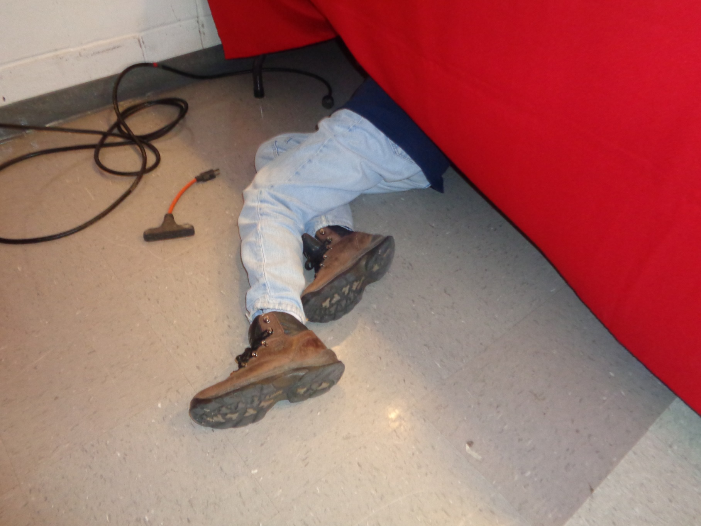
This is called Dedication! Thank you Sylvia!

Slide 11
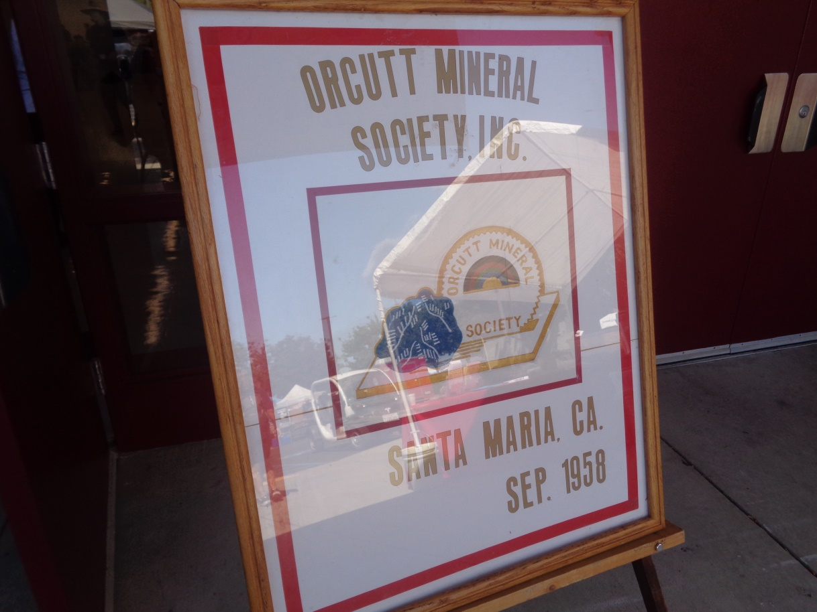
Now we journey around the show with visitors and vendors

Slide 12
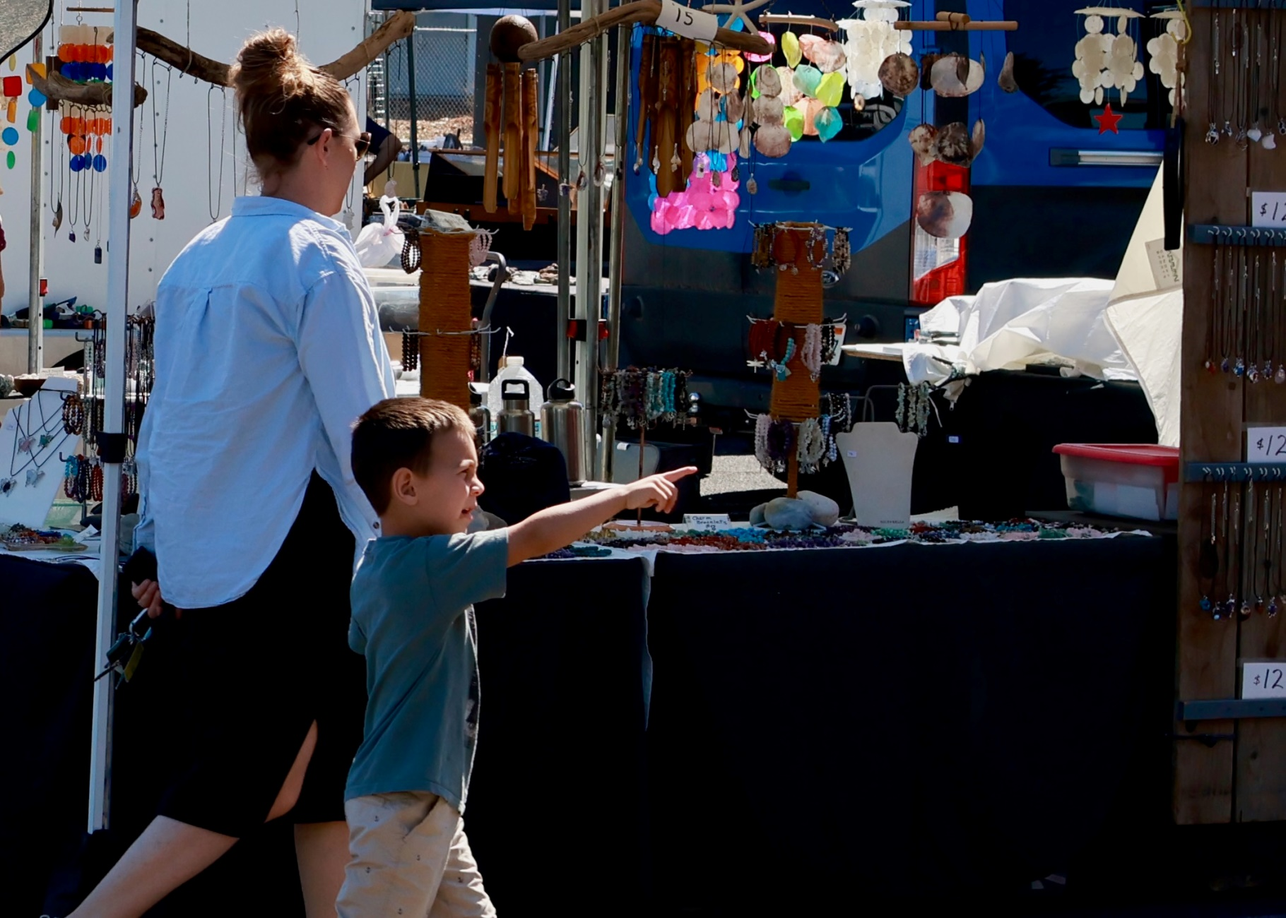
You can see the enthusiasm!

Slide 13
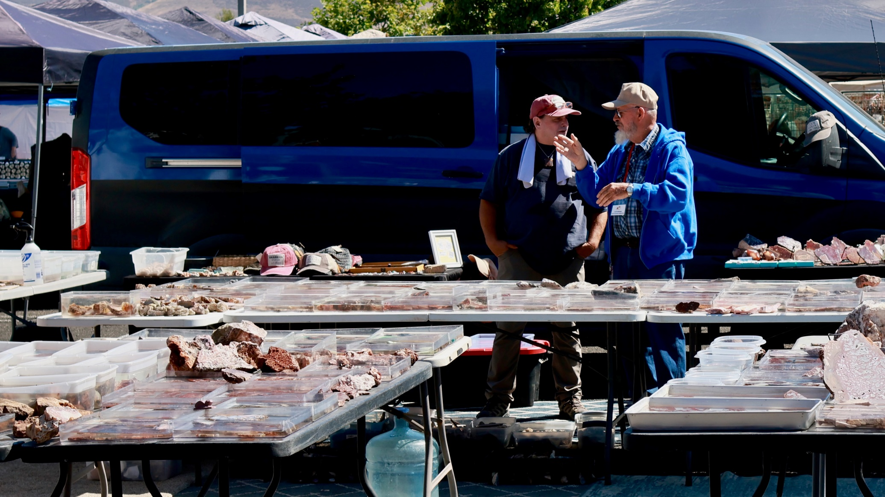
The vendors had quality material!

Slide 14
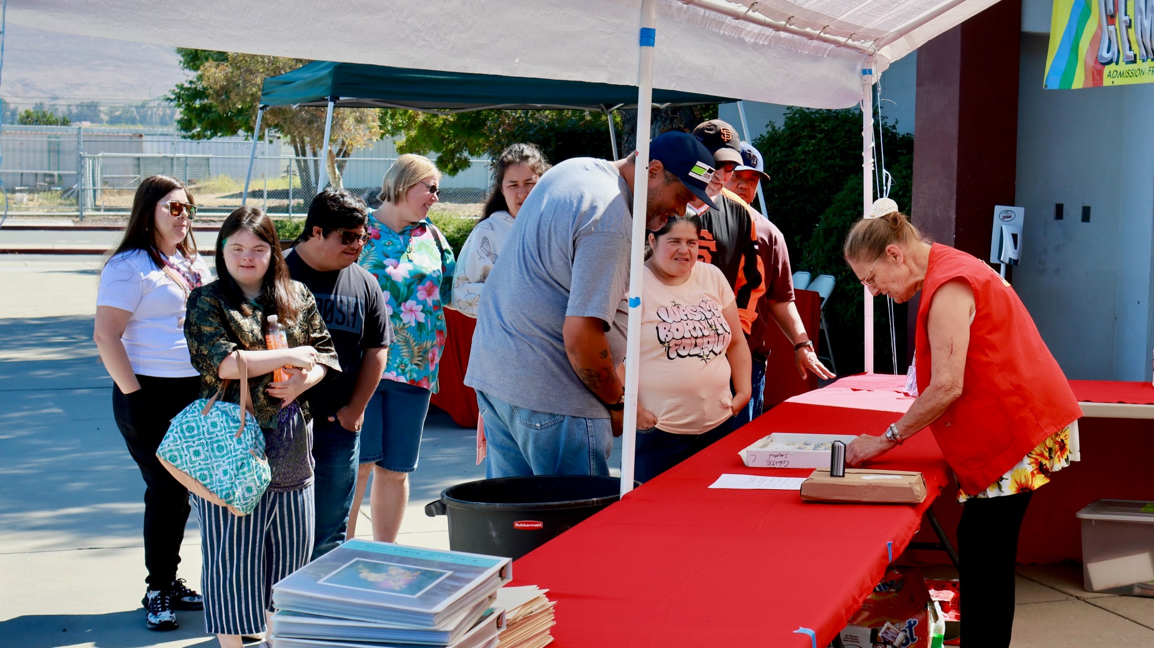
The Hospitality booth was very busy!

Slide 15
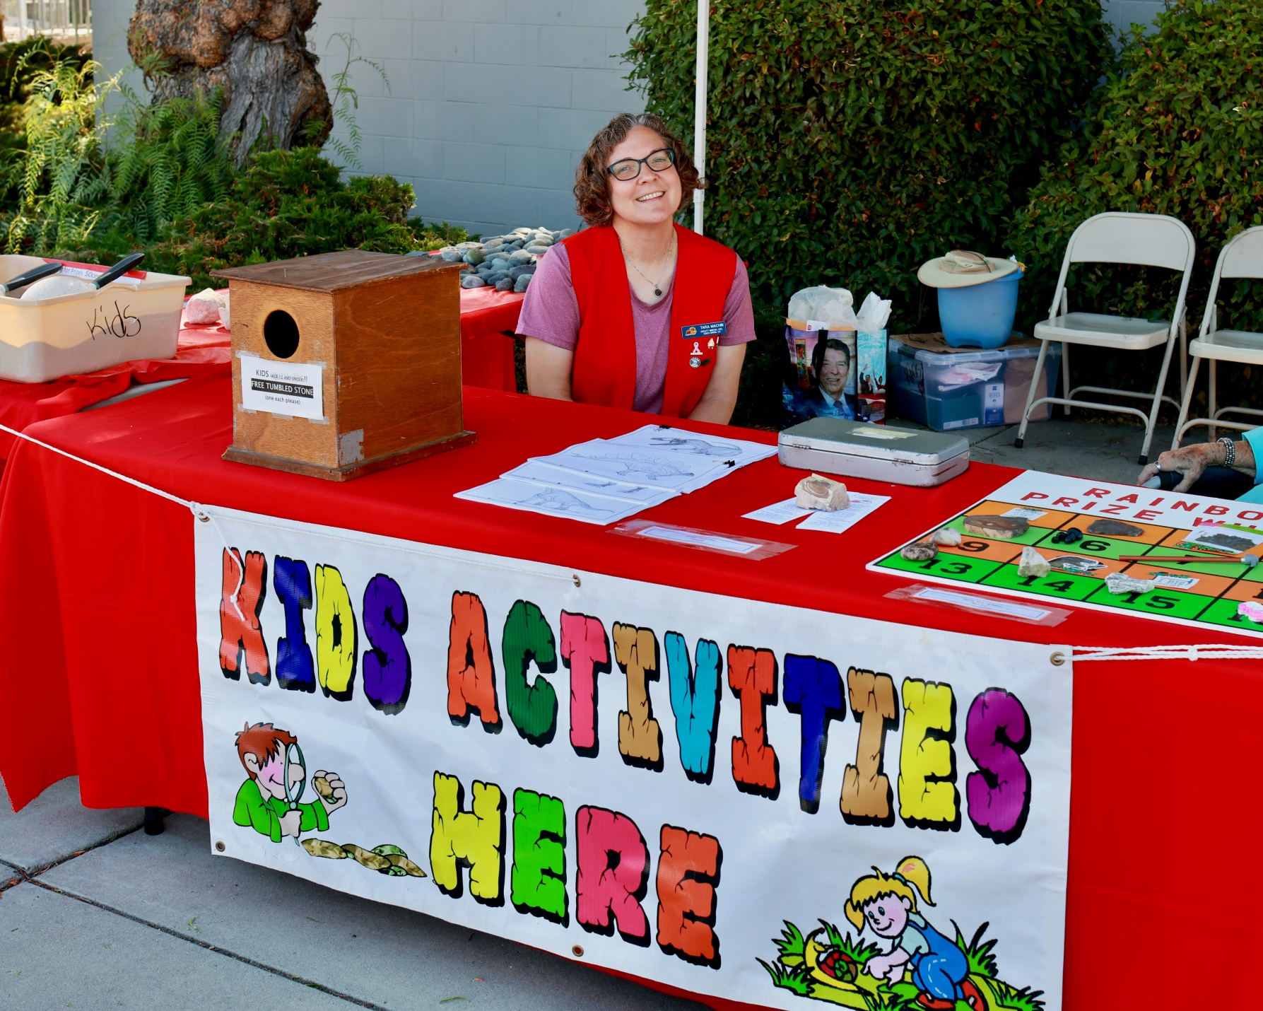
This booth was a very big hit!

Slide 16
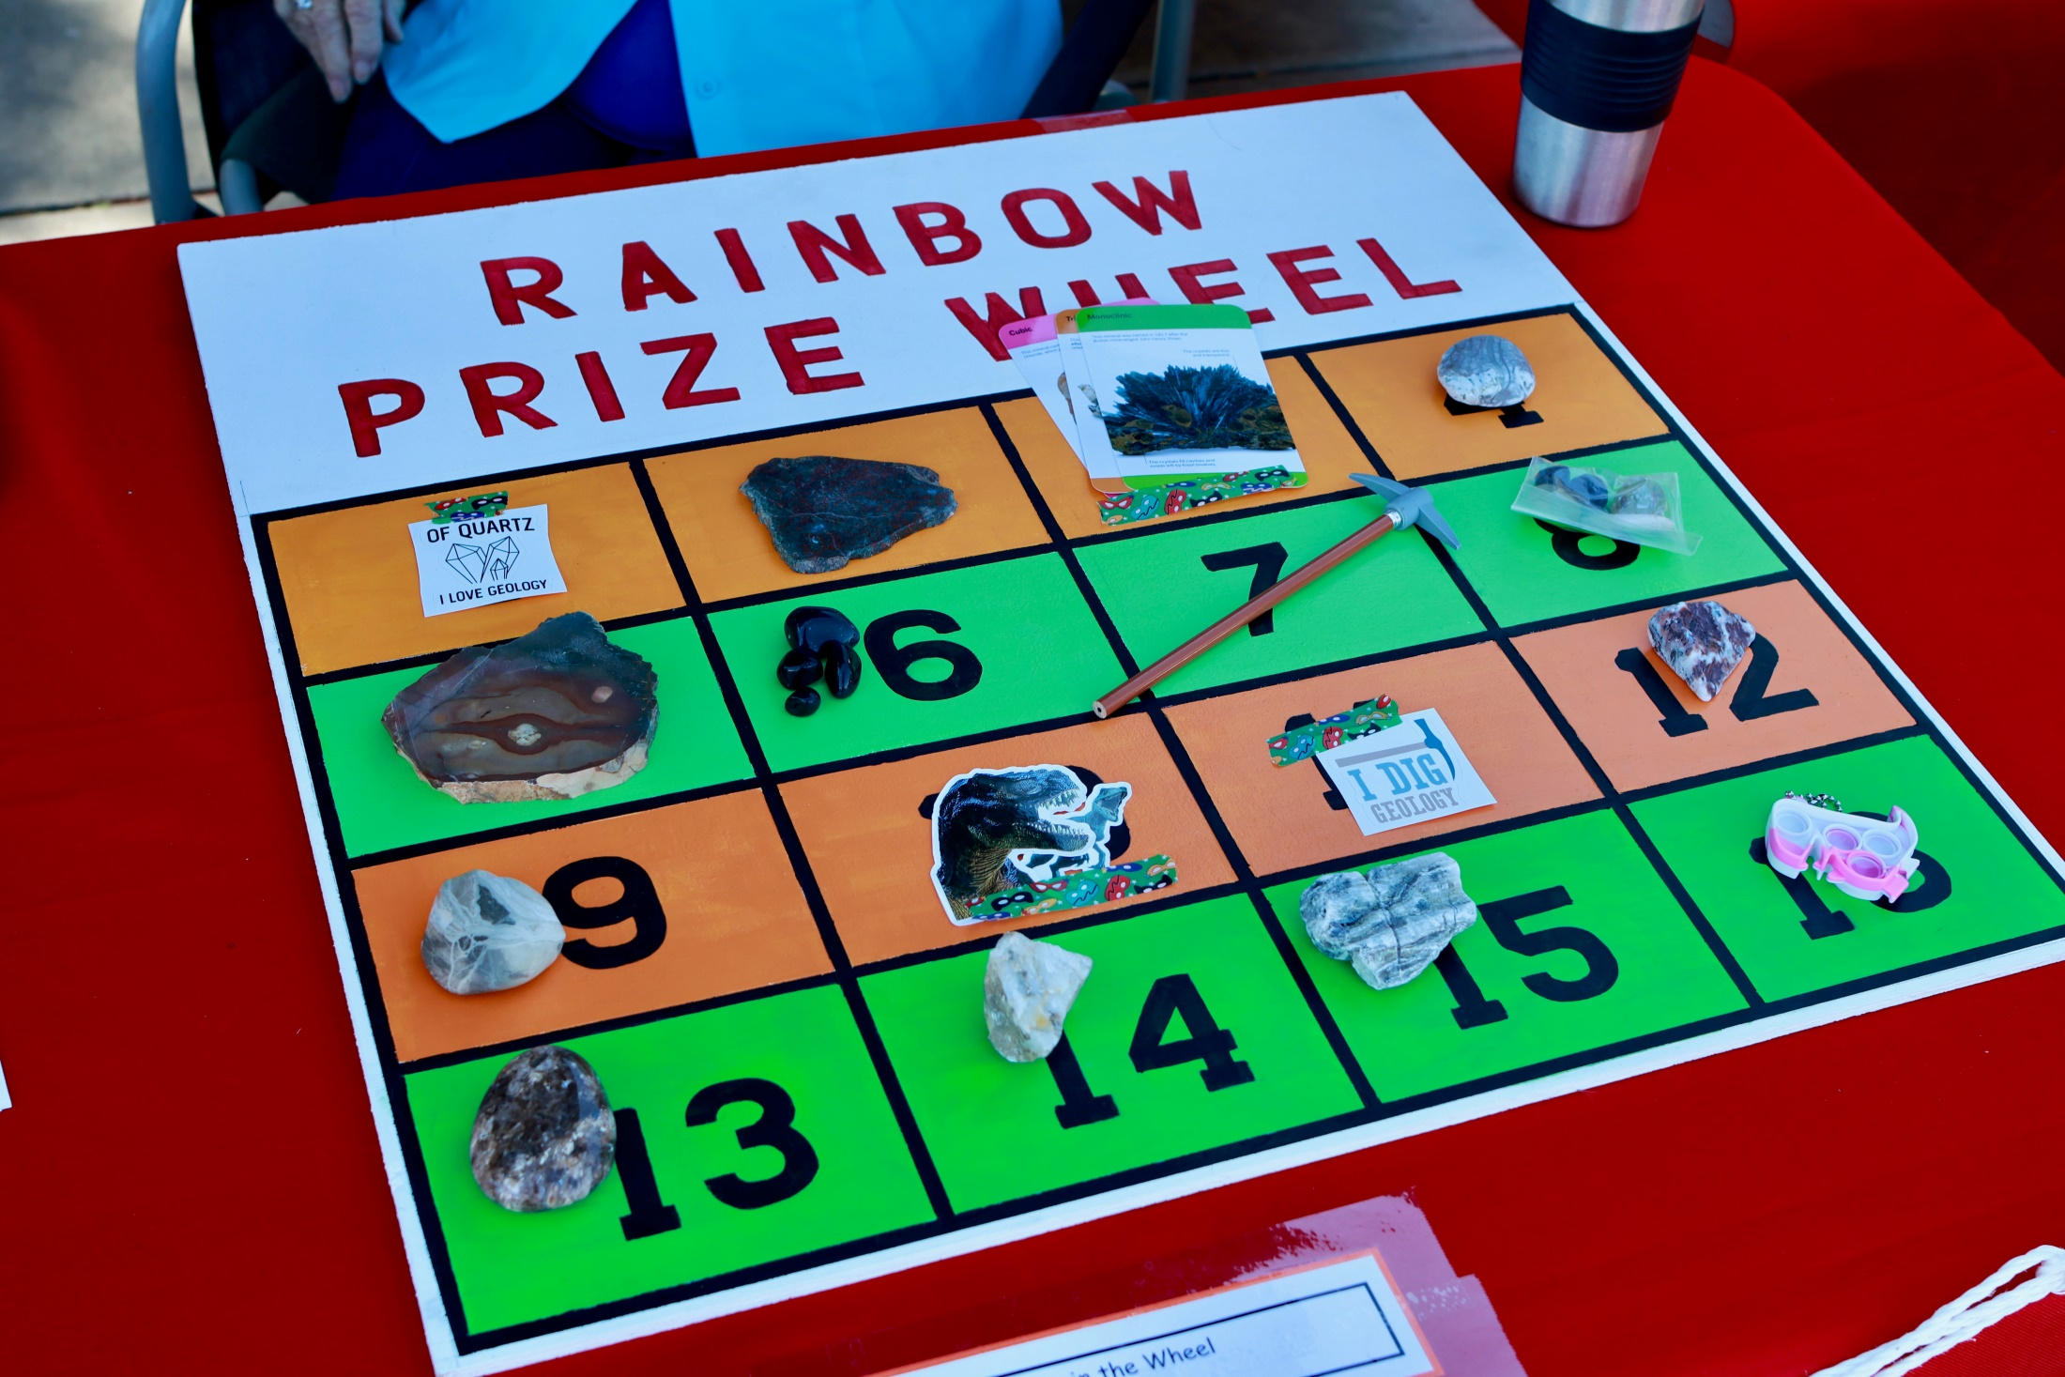

Slide 17
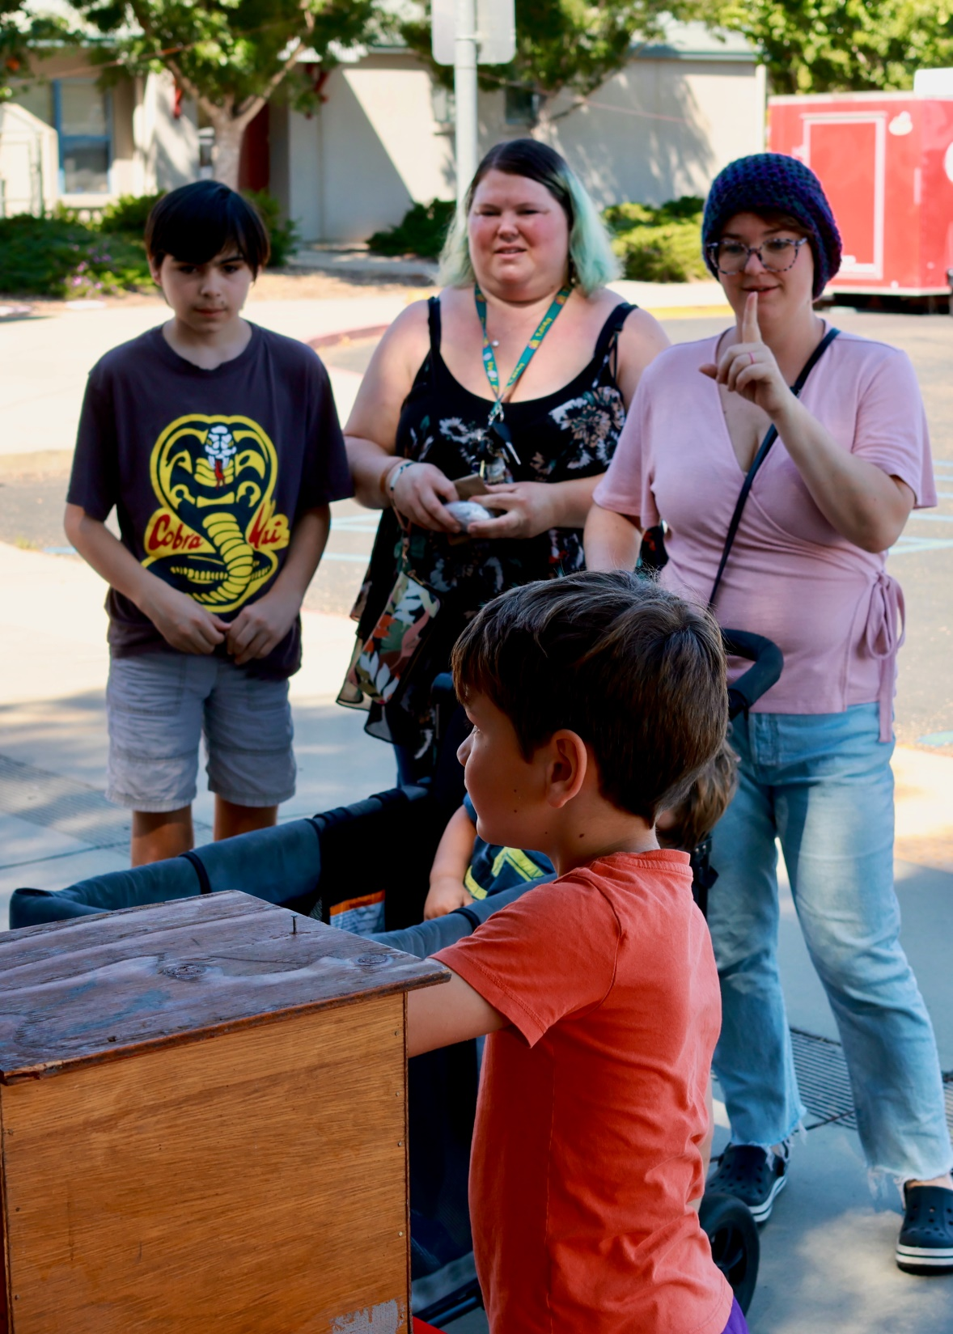

Slide 18
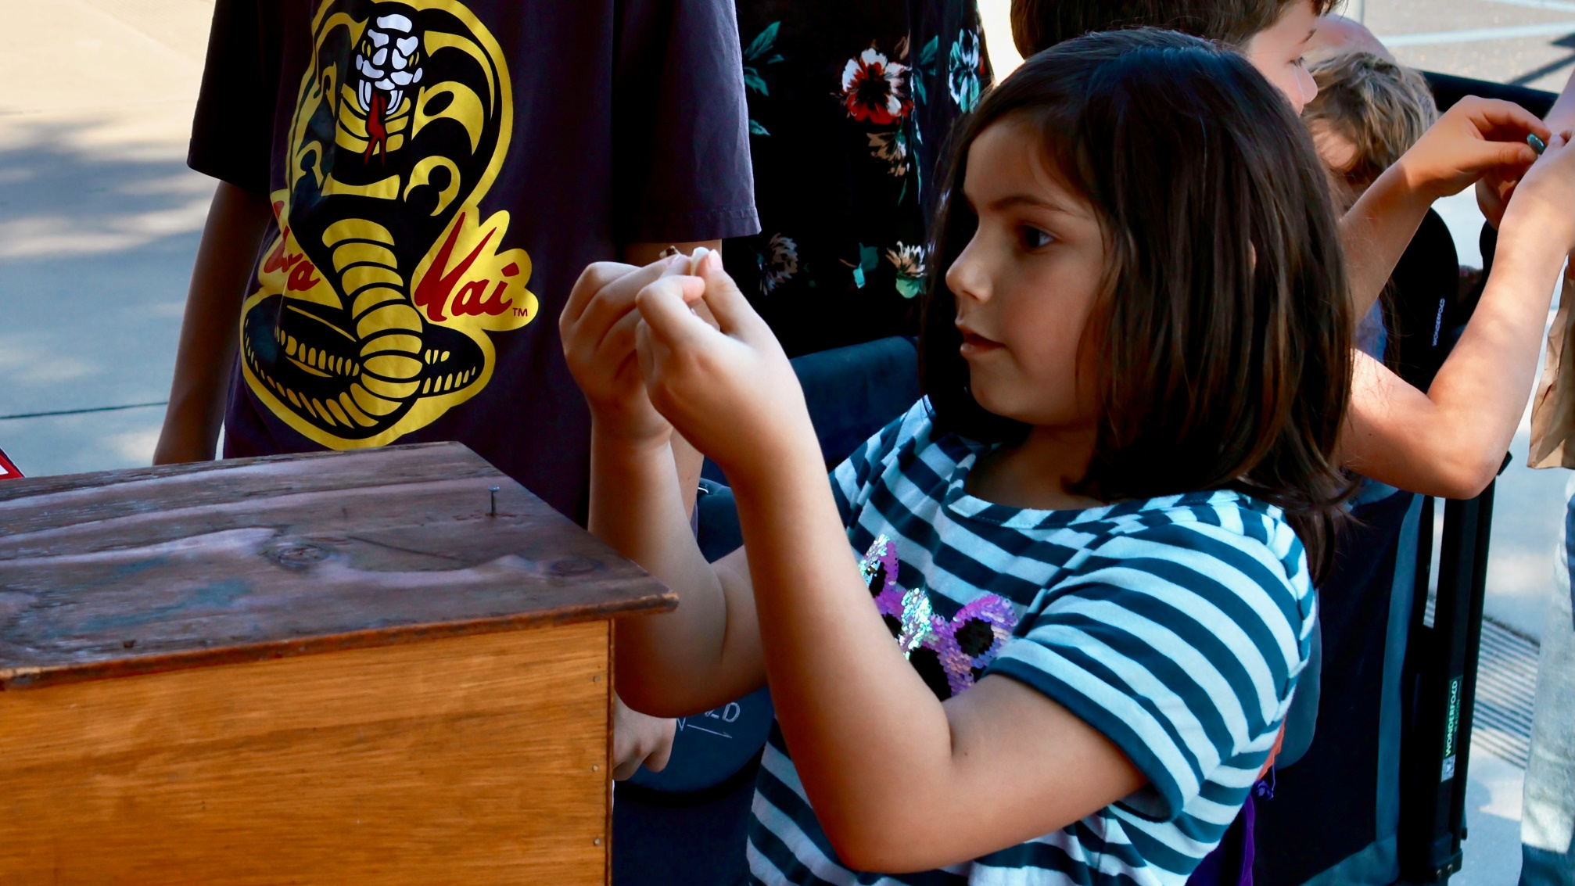
A free rock that she will cherish for ever!

Slide 19
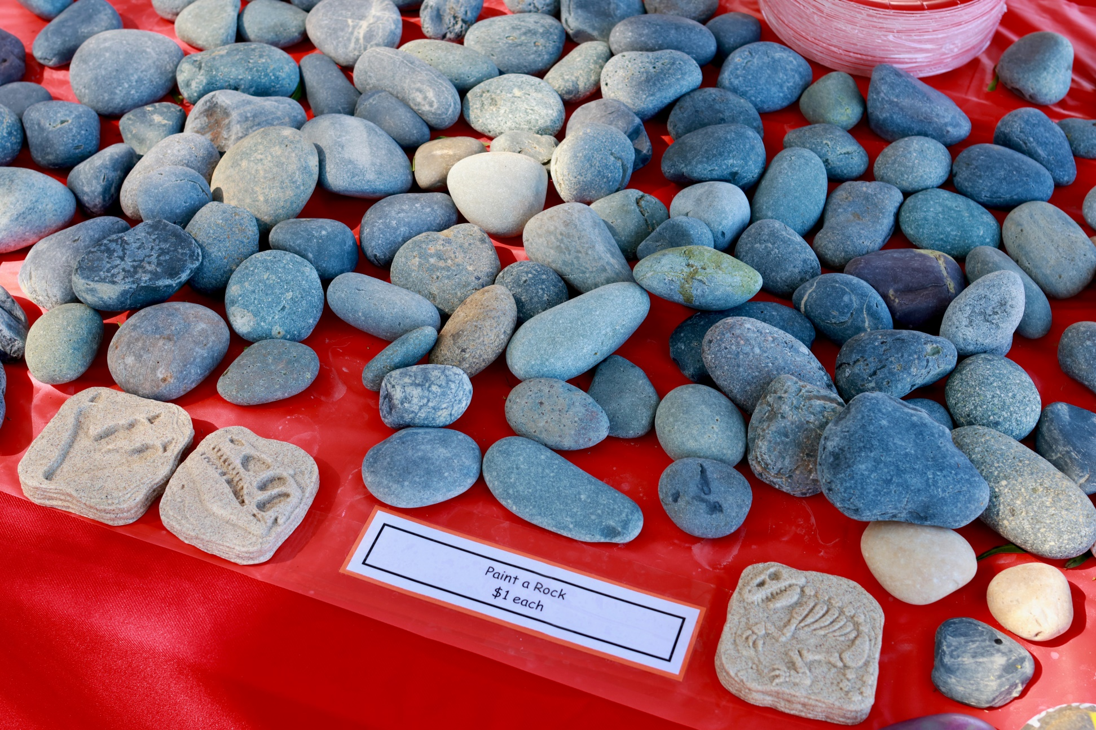
Kids love to paint on rocks!

Slide 20
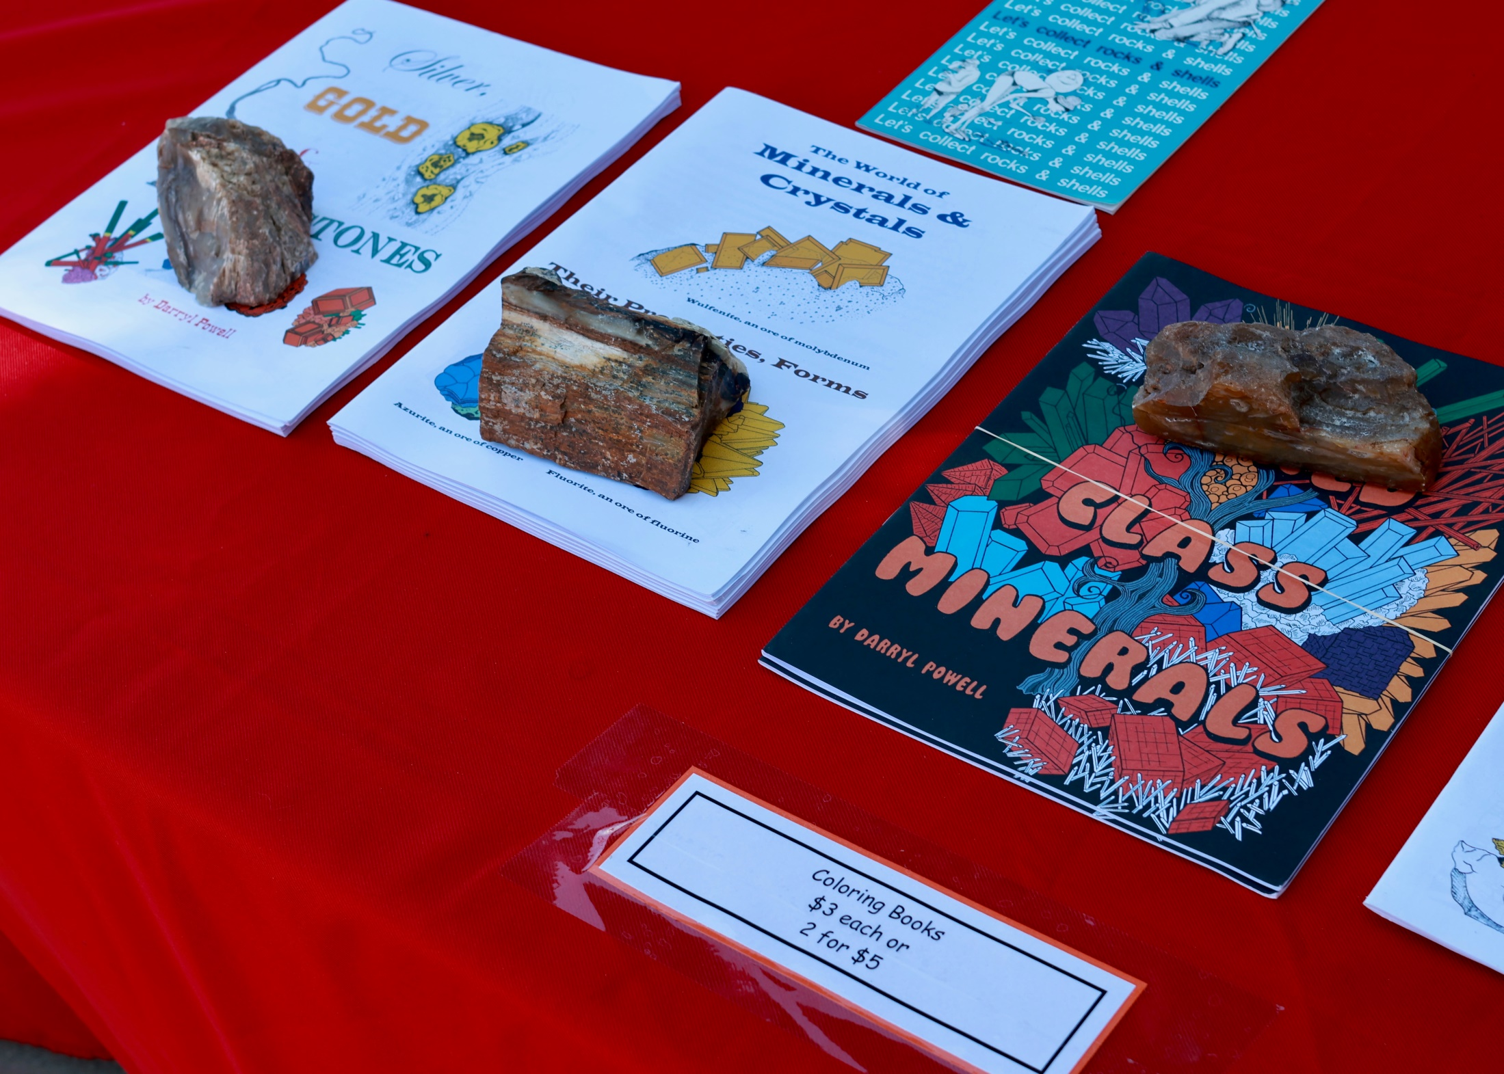

Slide 21
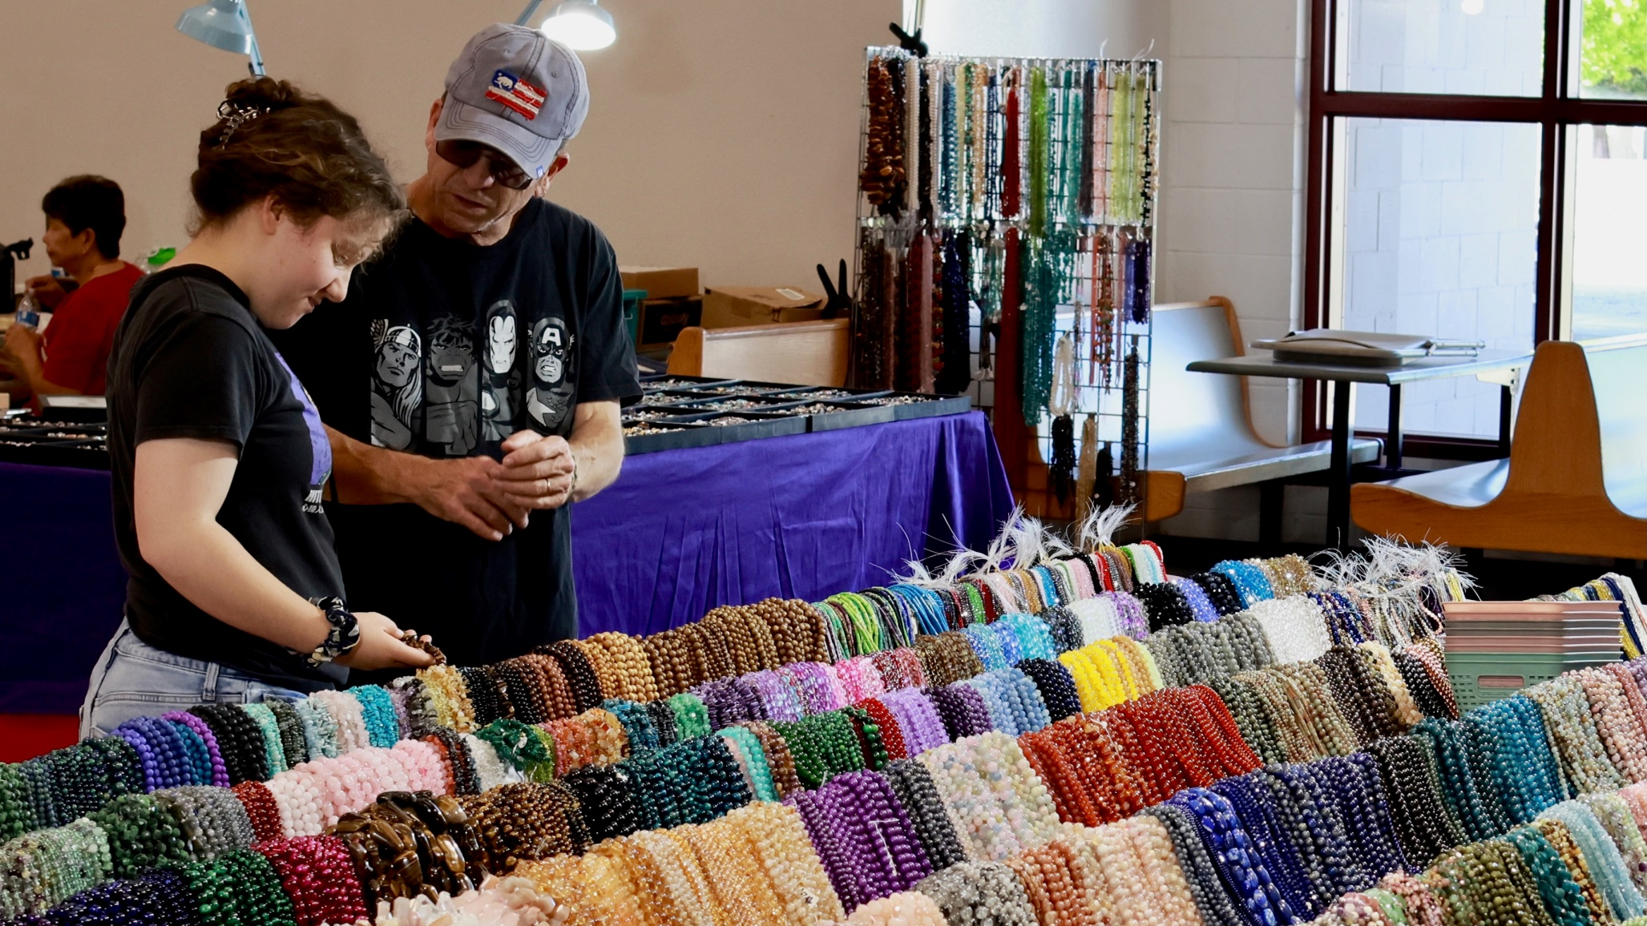
BEADS, BEADS, AND MORE BEADS!

Slide 22
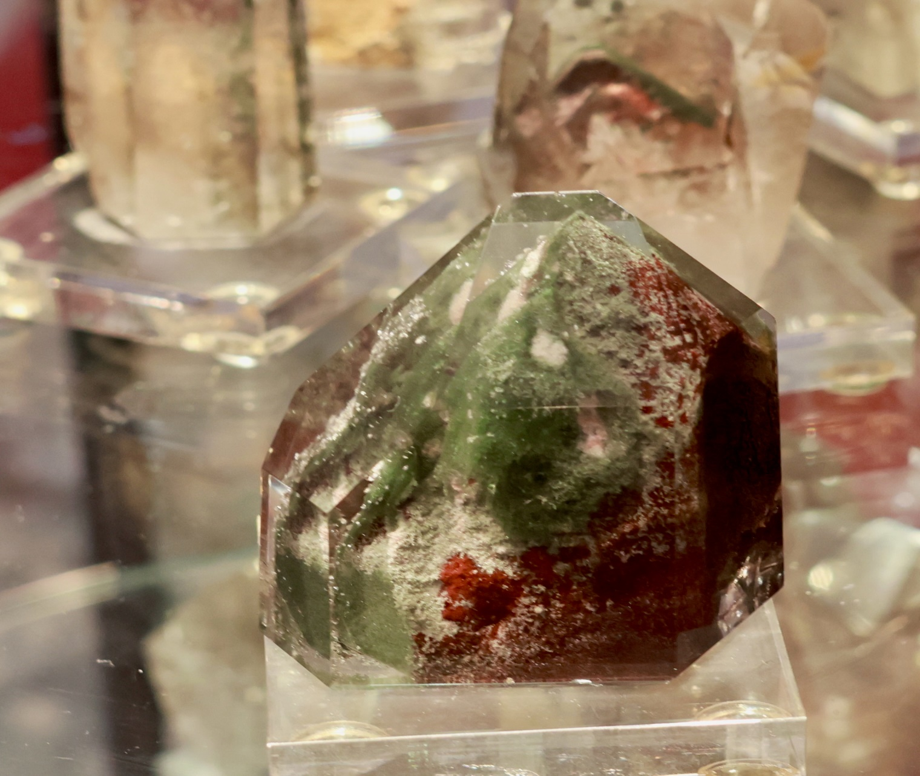
An unusual included Quartz crystal!

Slide 23
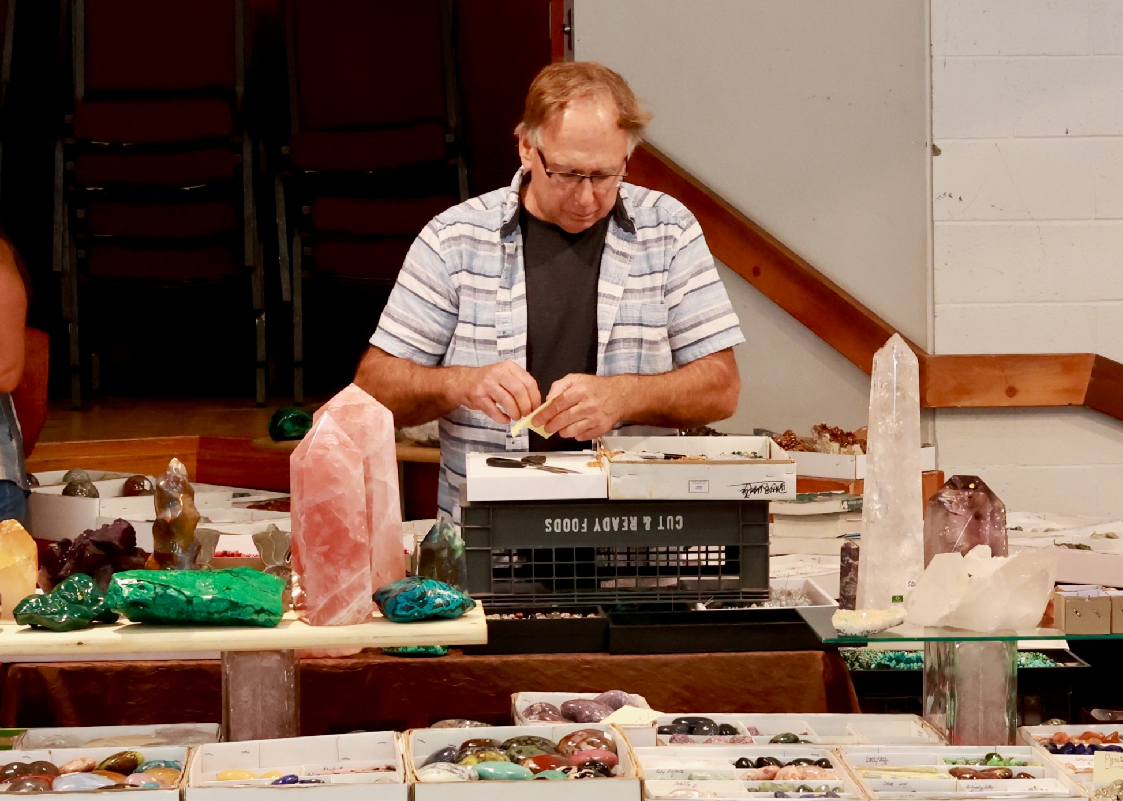
Dave has been one of our dealers for many years!

Slide 24
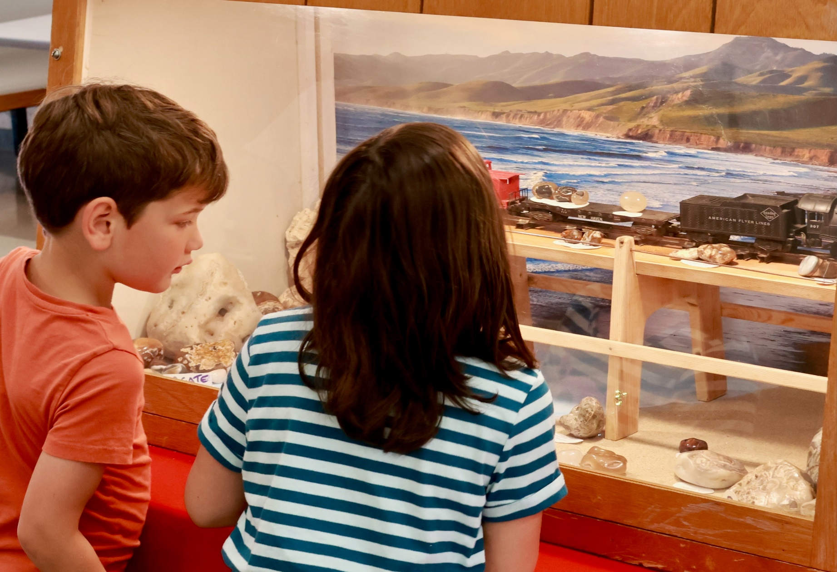
Joey Nichols drew lots of attention. Not bad for a first timer!

Slide 25
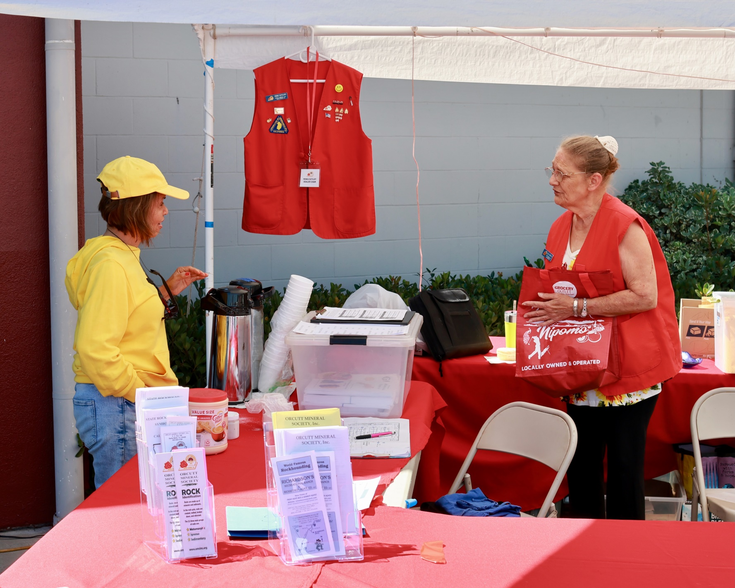
Free coffee for everyone!

Slide 26
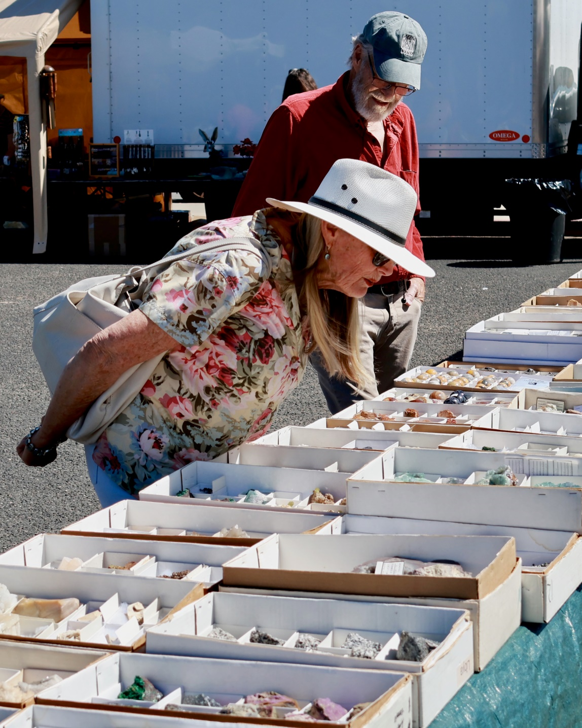
Dale’s Minerals has been with us forever it seems!

Slide 27
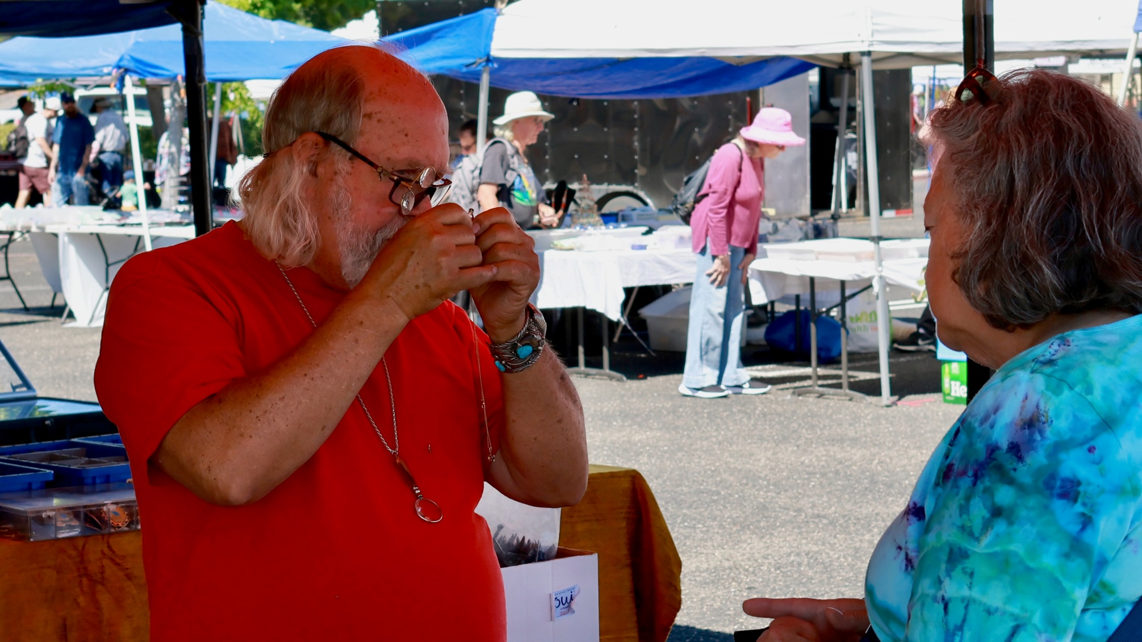
Vendor Scott Smith looking for a stamp! Thanks for the tall ladder Scott!

Slide 28
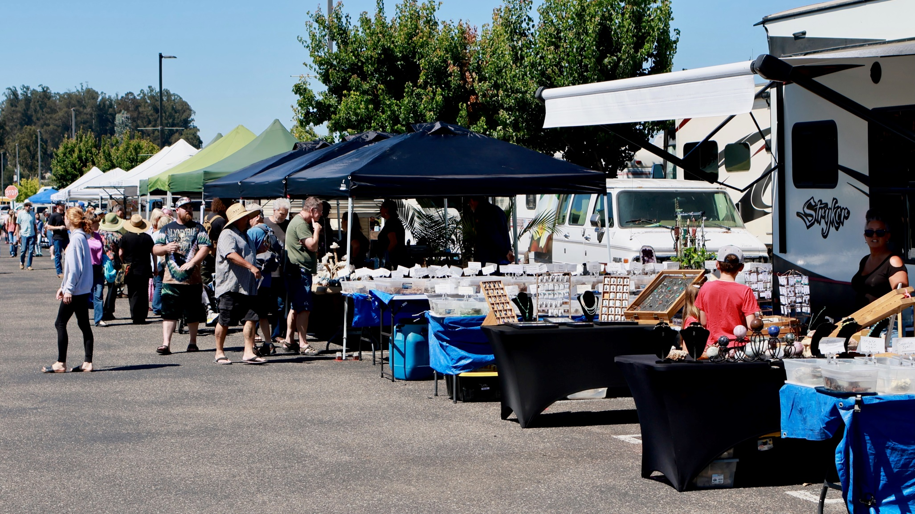
The Mystic Nature booth (Center) was always busy!

Slide 29
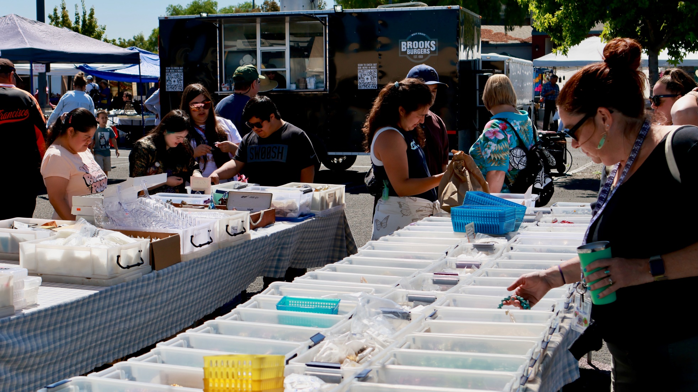
The show was well attended. The Burger Vendor had great Hamburgers and tater Tots

Slide 30
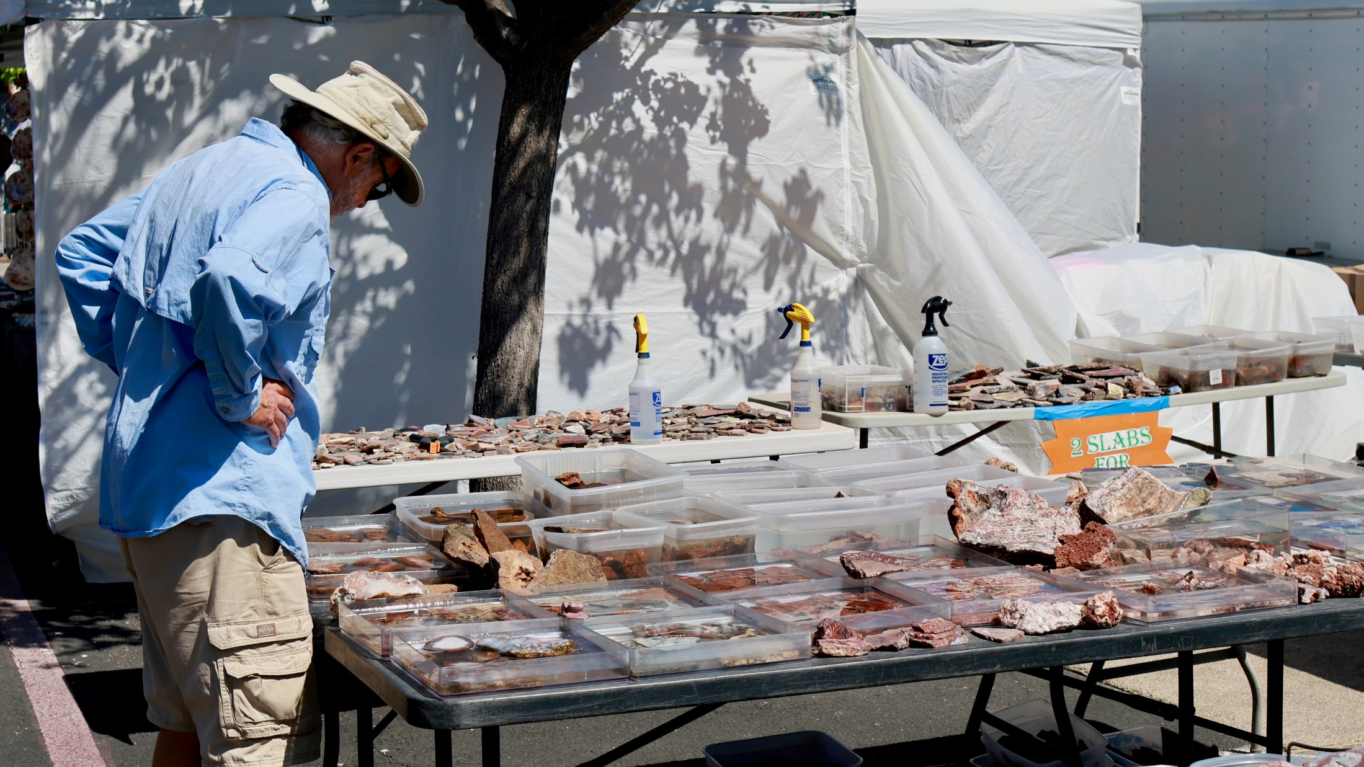

Slide 31
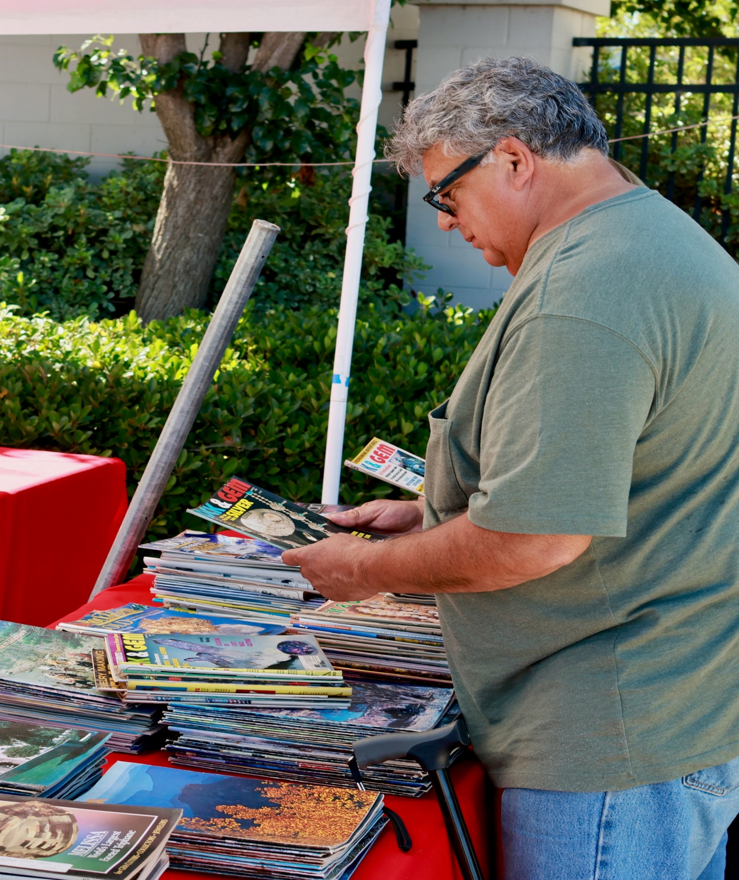
We sold a lot of magazines!

Slide 32
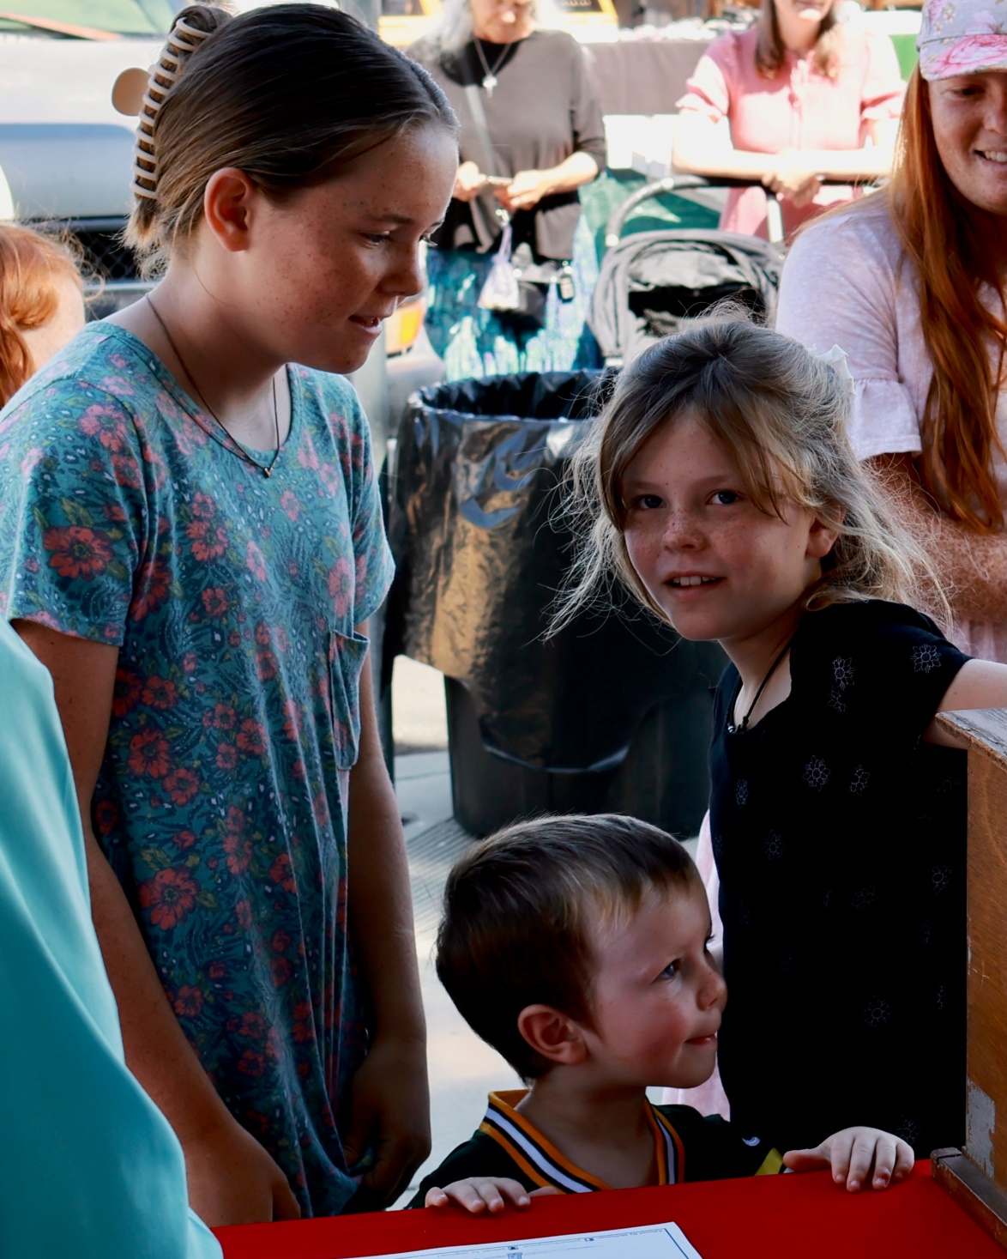
Future Rockhounds?
Isn’t this one of the reasons we do this?

Slide 33
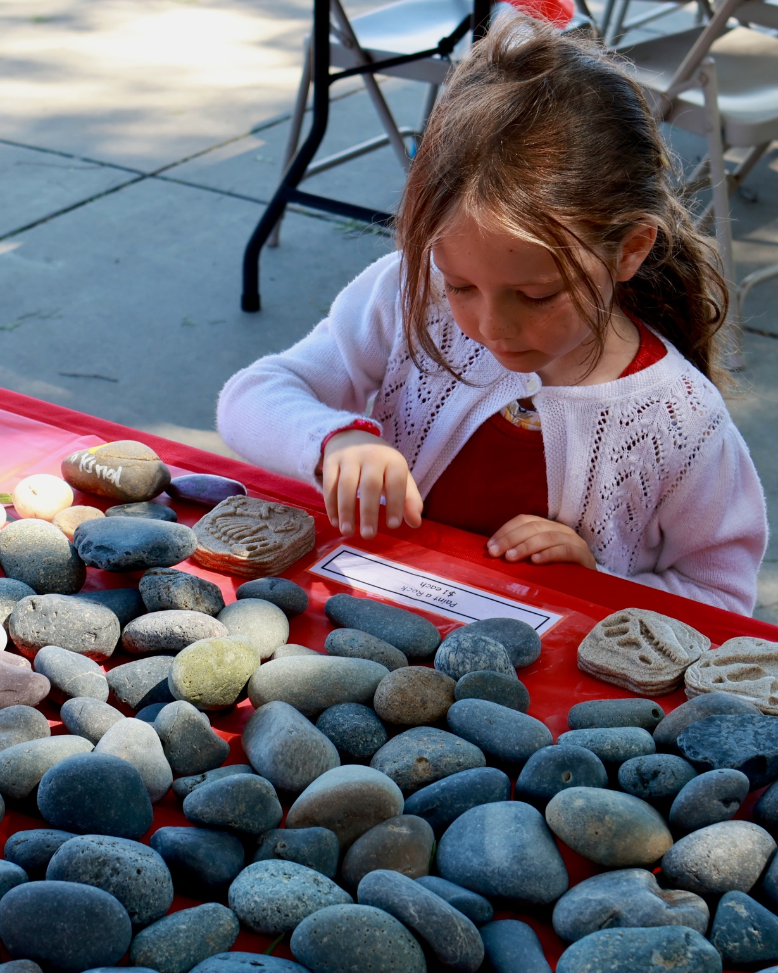

Slide 34
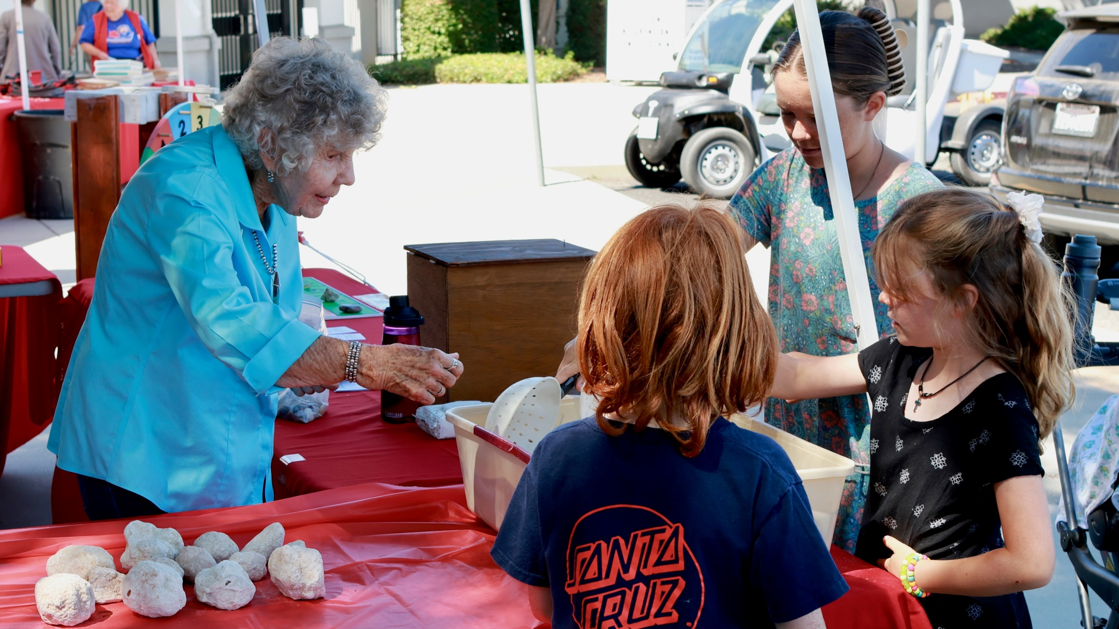

Slide 35
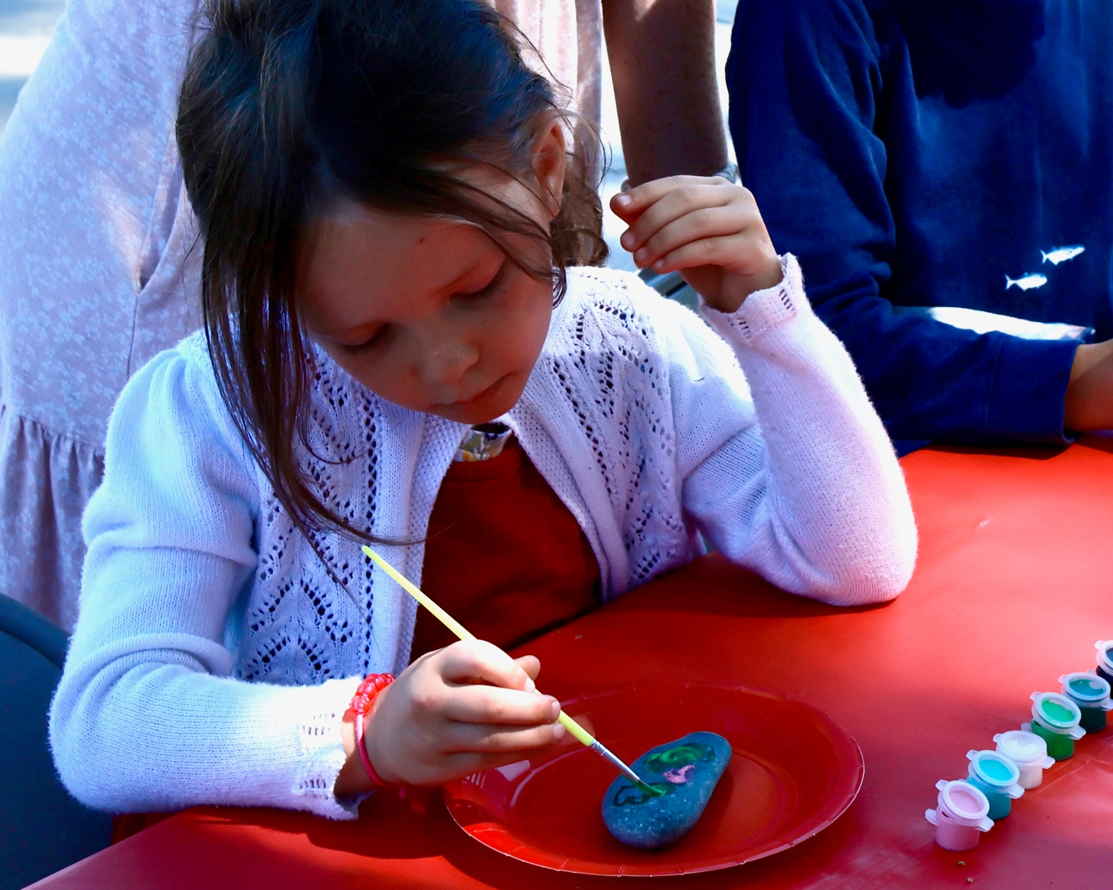

Slide 36
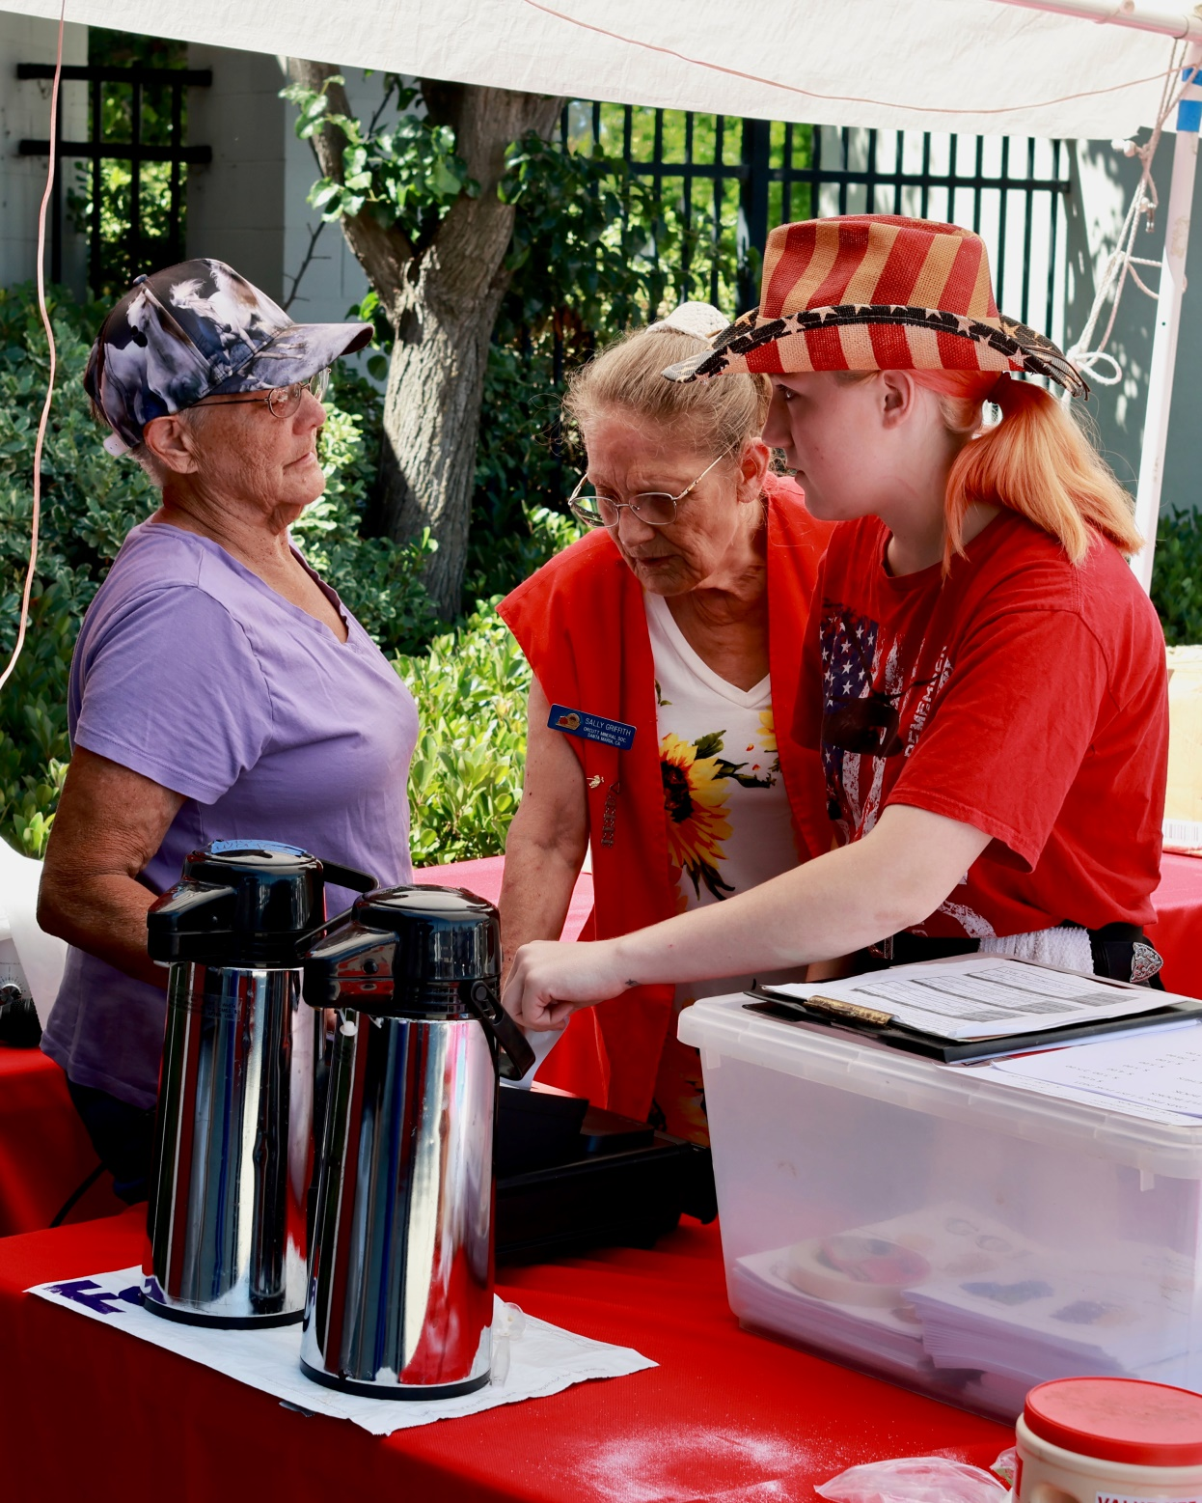

Slide 37
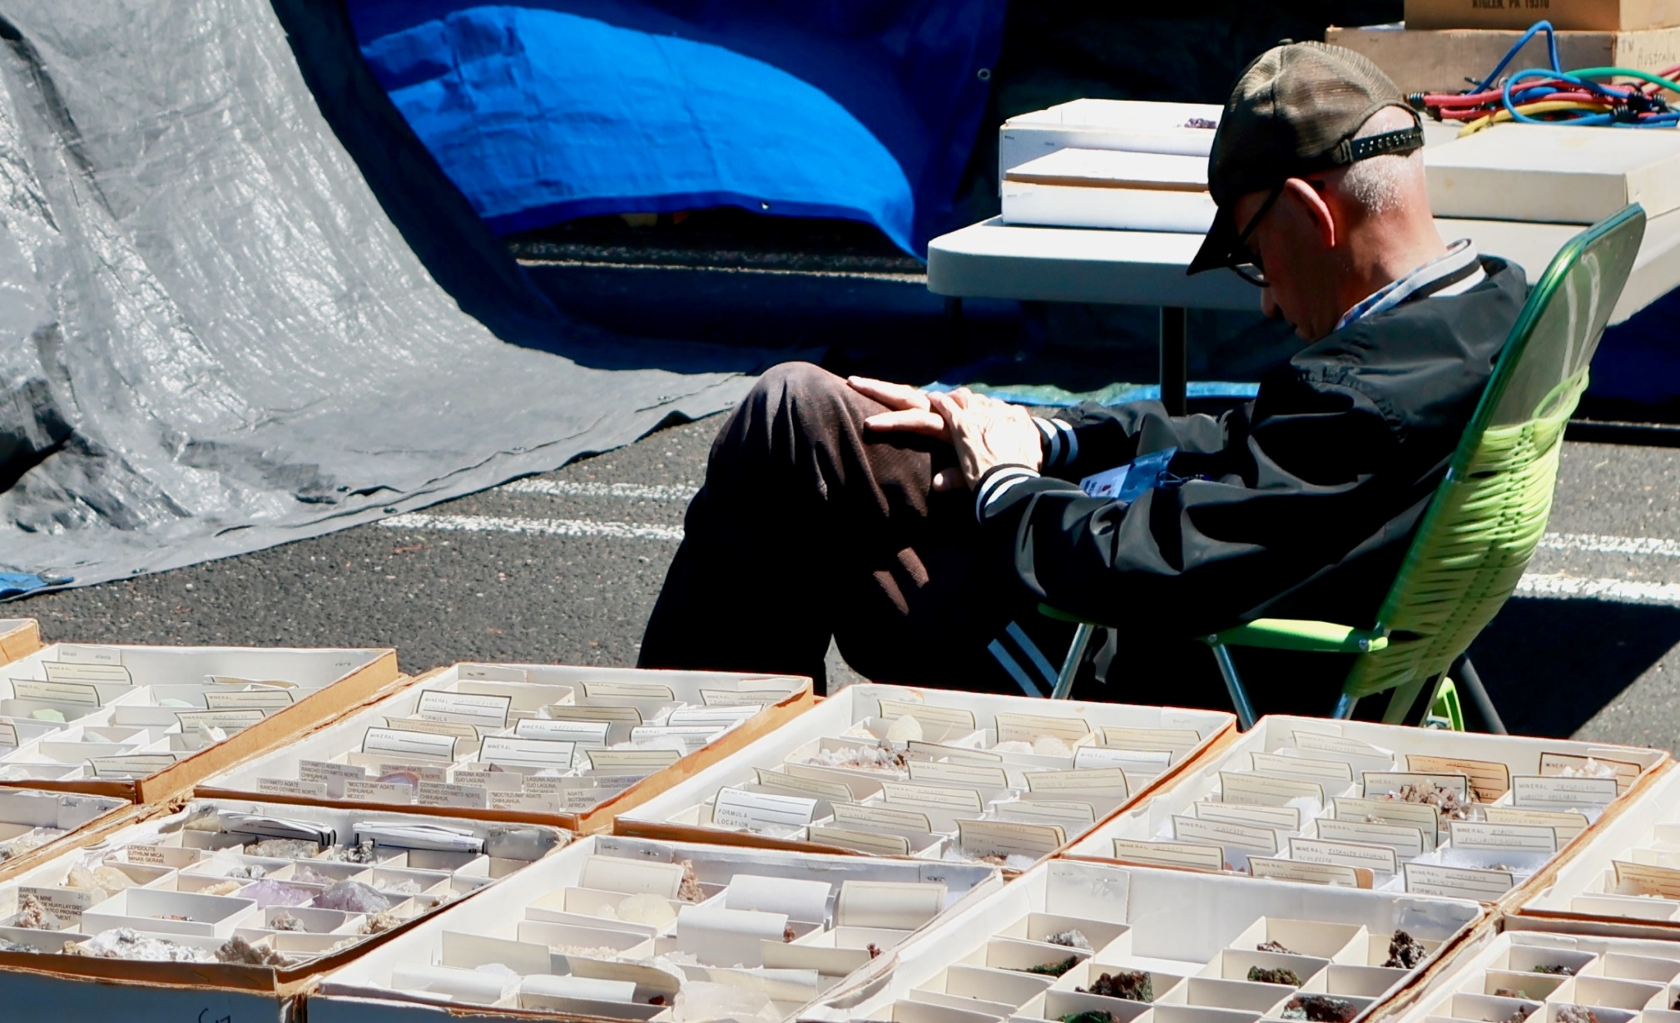
This is how you sell Minerals!

Slide 38
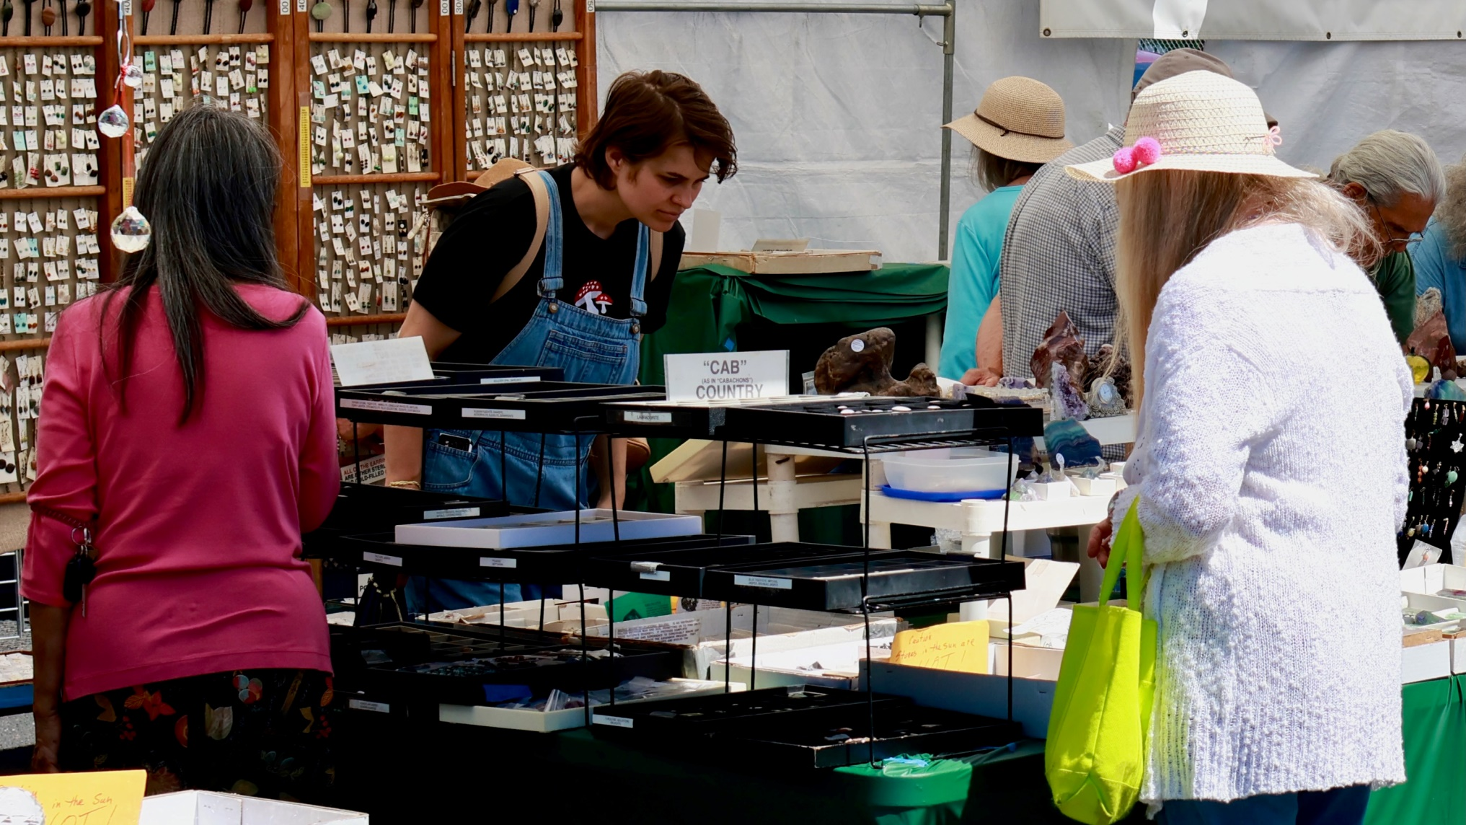

Slide 39
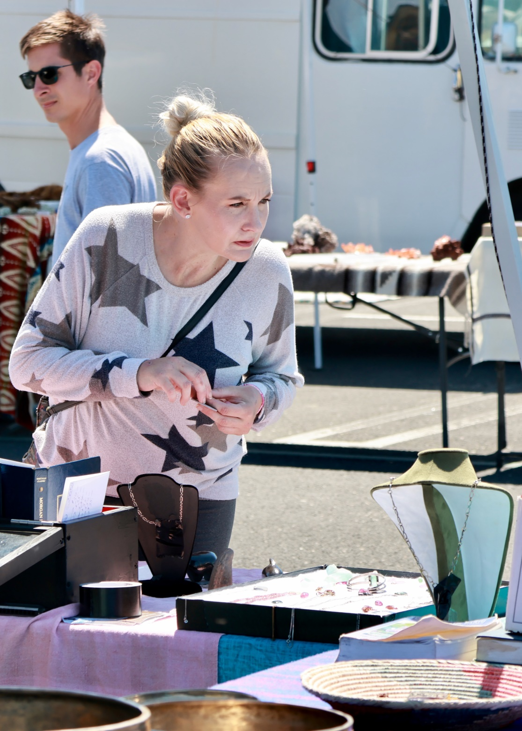

Slide 40
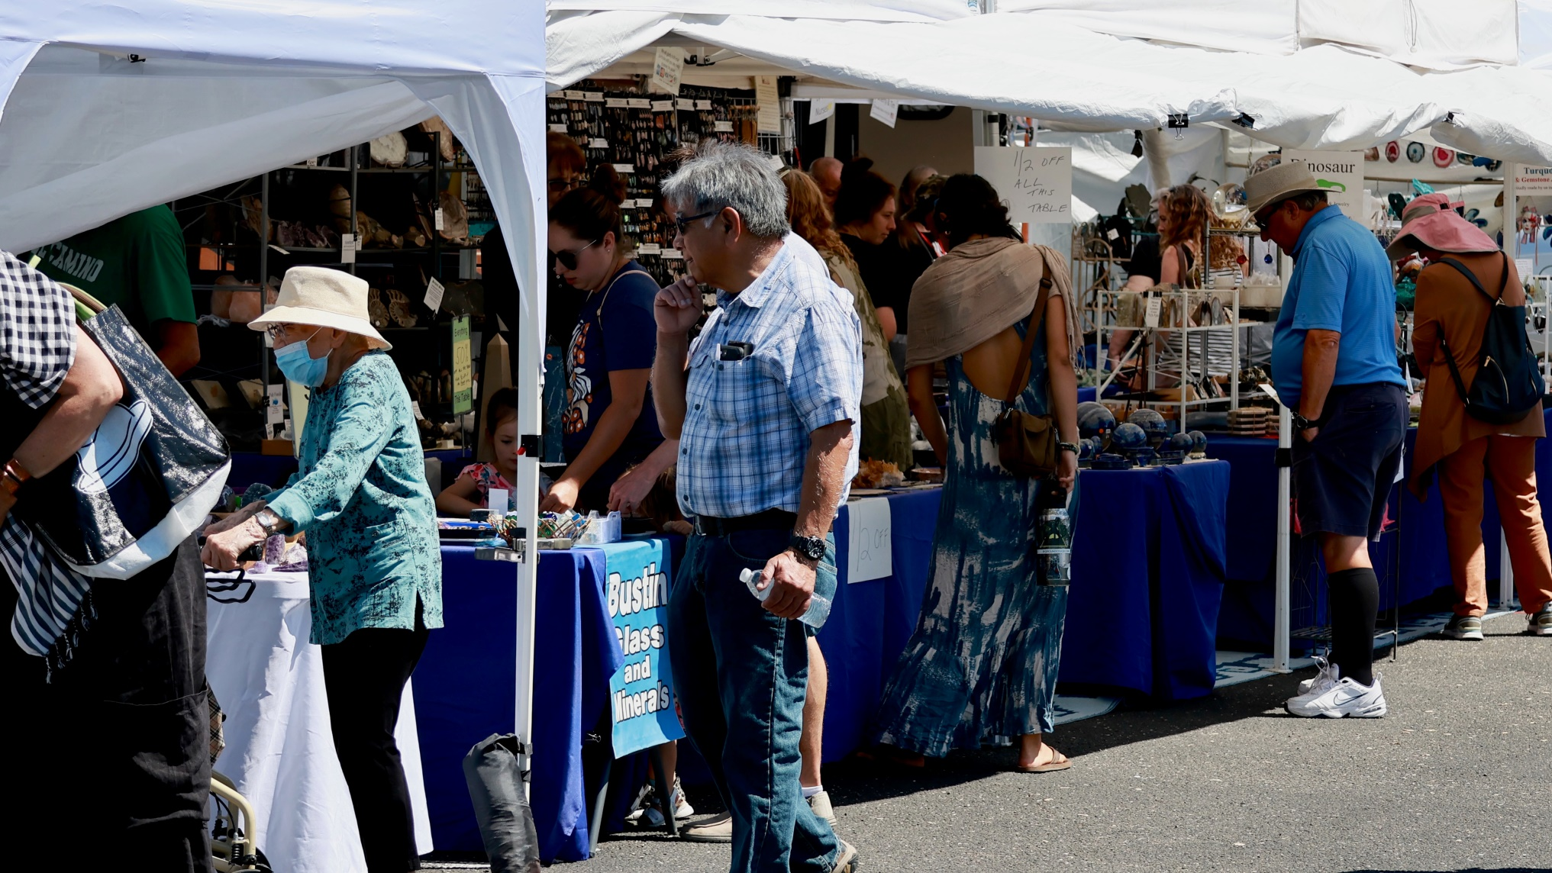
This scene reminds me of Quartzsite coming up in January!

Slide 41
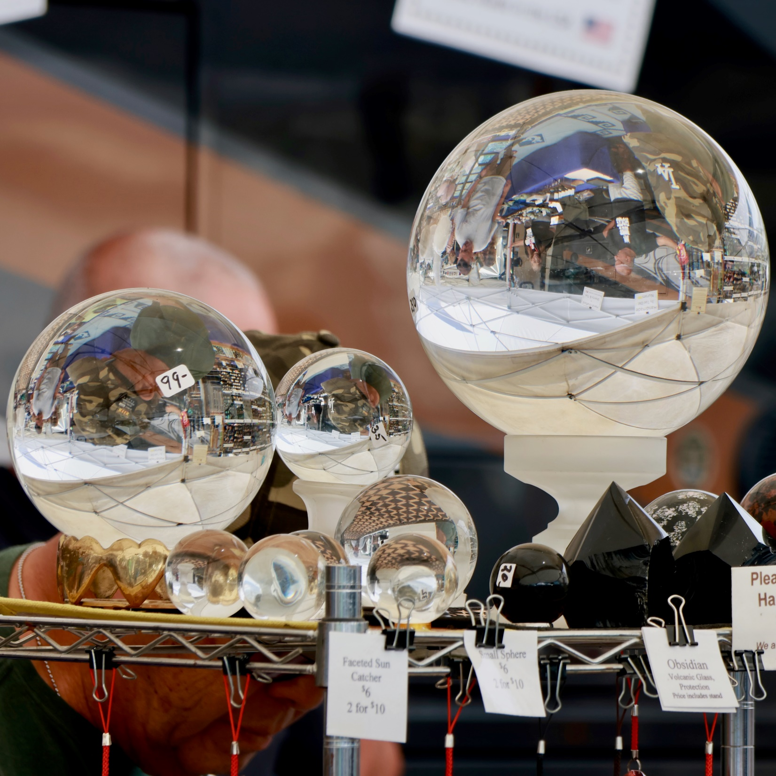

Slide 42
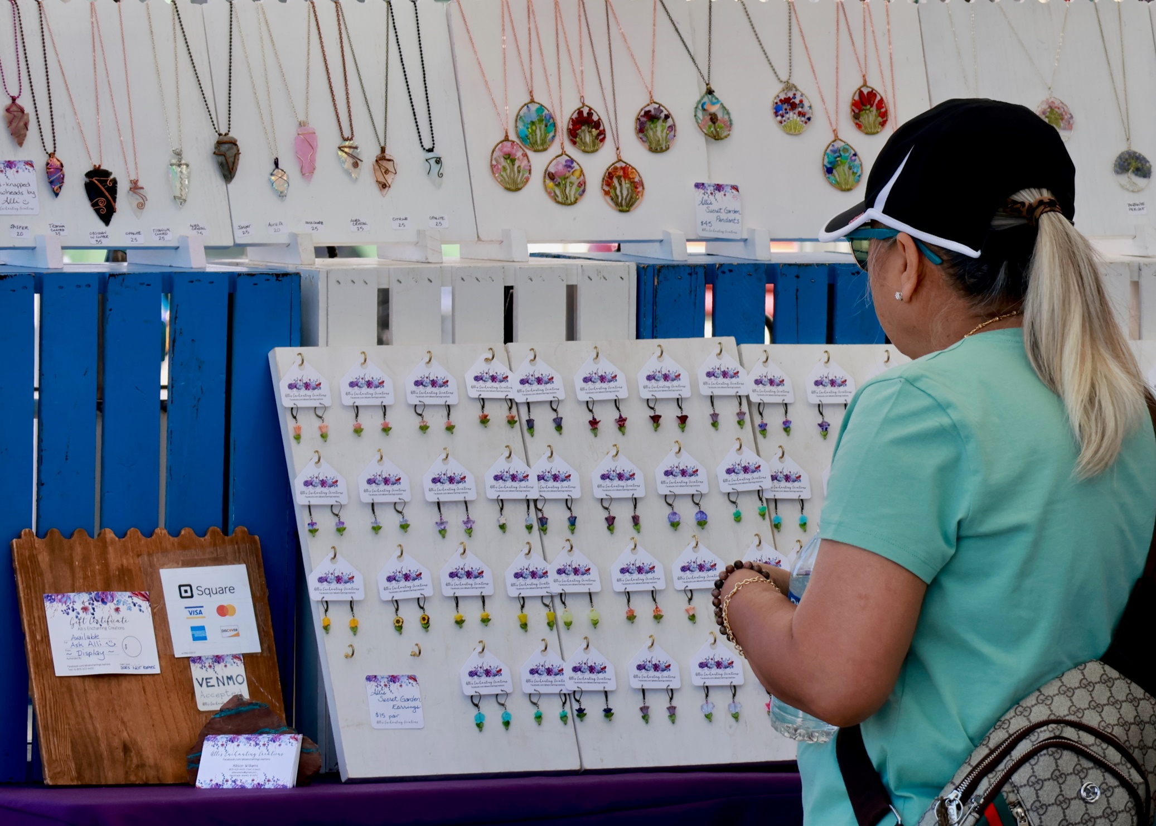

Slide 43
Taking care of an ouwee!

Slide 45
Break time in Hospitality!

Slide 46
Cary Holtz has this youngsters undivided attention!

Slide 47
Cutting Geodes was easy; Agates not so much!

Slide 49
It was crowded at times!

Slide 50
One of Ralph Bishop’s many Deedeeites!

Slide 51
Ralph’s Smokey Crystal!

Slide 52
Ralph’s large Ocean Jasper plate I really regret selling to him!

Slide 53
California’s State Rock!

Slide 54
Wire Art by Jeannie Lingerfelt!

Slide 55
Inside David Nelson’s Black Light Booth!

Slide 56
Ralph Bishop’s Petrified log surrounded by algae!

Slide 61
Need a big banner and sign for sales of water and soda

Slide 62
Meet the Post Master of Nipomo, Mike

Slide 63
USPS NIPOMO came to the show!

Slide 66
The tall guy in the middle (His name is Brock) came from Bakersfield.

Slide 67
Dave Manchin’s pictures are a real asset!

Slide 71
Potential new member Dan Diaz case

Slide 72
Some pretty rare stuff!

Slide 74
Honorary member Ralph Bishop and son Zack

Slide 76
Raffle Time!

Slide 77
Logging the Raffle winners!

Slide 78
What happened here?

Slide 79
I ask for input about the show; here are the responses I received!

Slide 80
The show was great! I think it went better than last year!
Comments from the Vendors -
1. It was too hot.
2. We really need to get some younger people interested in rocks, everyone is getting old.
My personal comments -
1. We need a sign for Hospitality. Last year and this year people didn’t know where the hospitality tent was. Vendors came to the kids booth asking for directions, people were wandering the parking lot looking for the tent. They really need a banner with our Logo on it.
2. Putting up a table for the kids turned out to be a huge hit. It was the shadiest place to sit and I sold a lot of rocks so that people could sit in the shade and paint.
3. We really need someone to be a hospitality greeter. Someone to welcome the vendors. We should have passed out all the vendor packets before Sunday. If they don’t come to the hospitality tent (Mostly since they can’t find it), we should have personally took their badges out to them. We also need someone doing research about how people found out about the show and if our advertising is working. They can pass out fliers for our club, etc. etc. I would volunteer to do this, but I have big plans for the kid’s booth.
4. The kid’s booth went super well. Having the extra table showed me that most families had a Dad sitting with the kids while the Mom shopped. I think that we can have more activities for the kids so that they aren’t bored at the show and Moms will have more time to shop!.
5. THOSE STINKIN’ TABLES! — God I hate them! I don’t know the answer, but we need help with those.

Slide 81
Special Shout Outs -
1. Renea did an amazing job with the vendors, the ice, the trash, and more.
2. Joey for helping everyday with whatever needed to be done.
3. Wes for being patient and explaining all the ins and outs of the show so that we could all learn how to do it in the future.
4. Cary and Kathy Holst for filling all the blank volunteer holes in the sign up sheet.
5. Everyone that helped without complaint
Special Stories -
1. We had a guy come to the kid’s booth with his kids. He said that 40 years ago he pulled a rock out of the wooden box at the kids booth. He says that he still has the rock after all these years. It was a special story that he could share with us and his kids. Super cool.
2. I broke a $100 bill for a guy at the kid's booth. He asked me what we were doing and I told him that we were raising money for our rock club and for scholarships for geology students. He handed me back $50 as a donation. It made me wonder if people coming to the show realized that it was a fundraiser for our club. That would be another job for the hospitality greeter.
3. We also had another guy donate $20 so that kids could have free spins! Lovely.

Slide 82
And here is another response I received:
I felt we were short on displays and Demonstrators. Maybe send out display signup sheets with the dealer applications. Maybe send out requests for demonstrators a couple of months before the show to folks who have done that at previous shows (Fenders, Mary R, and ??) Also, I think we need to
communicate to our visitors somehow, and often that there are inside displays and Dealers. Encourage more help for our three booths!
These comments have merit but Be very aware of the power requirements for Demonstrators! It is limited!

Slide 83
And Another!
It was mentioned to me that at least 3 venders had dogs that ran loose during the show!
Secondly, There was a Vendor that exercised poor driving skills inside the court yard behind the Olympic Hall. We need to better control that!

Slide 84
AND NOW FOR MY COMMENTS!
Over all the show was a big success, However there is always room for improvement. The show could not have happened without the full support of our newest members and they came through!
There is one nagging problem that makes the event harder to produce! There was not a detailed work plan that covered the setup, operational period and tear down of the Show covering the event span. This plan should specify time and place for everything. What comes from the Storage Locker and when?
Tables first, skirting second with electrical layout followed by the cases. Where do workers need to be and when? (We had the trailer over at the Locker but the workers were at the Olympic hall). We need to get the school admin more involved with our schedule; They can’t wait until the last minute to give us approval. We have the Corporate knowledge to get this done and done right!

Slide 85
THE END!

