Slide 1
TOWER OF LONDON, THE CROWN JEWELS AND THE BANQUETING HOUSE
These slides are from the estate of Paul Berthelot who found the English culture and architecture intriguing. He acquired these images while stationed in England serving in the US Air Force.

Slide 2
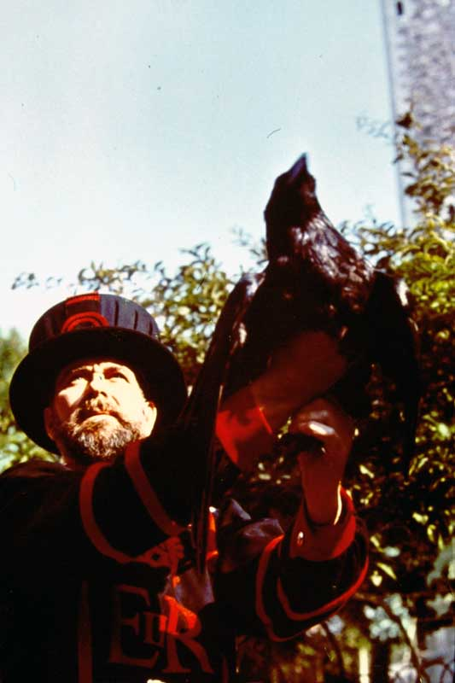
T5. Tower of London – The Ravenmaster.

Slide 3
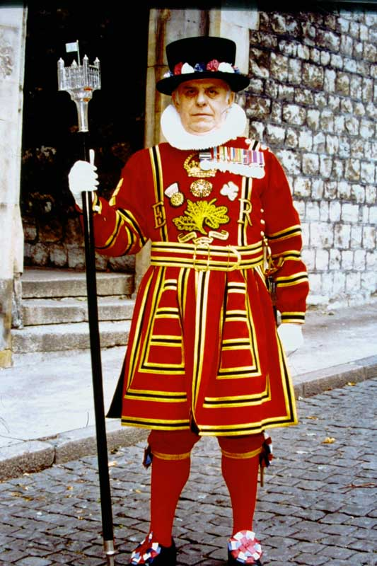
T6. Tower of London – Chief Yeoman Warder in ceremonial dress.

Slide 4
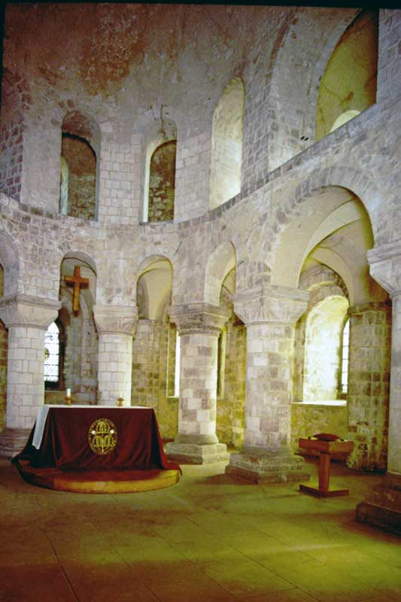
T7. Tower of London – The Chapel of St. John.

Slide 5
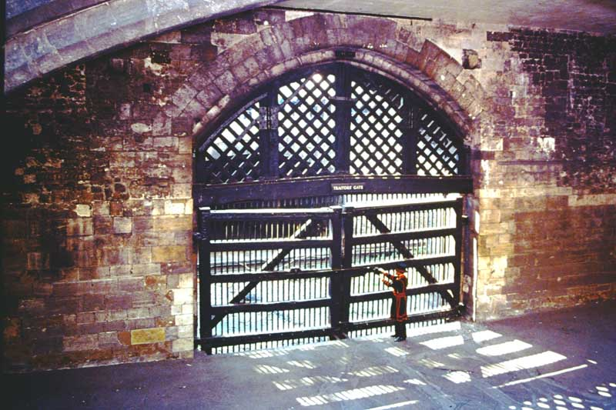
T8. Tower of London – Traitor’s Gate.

Slide 6
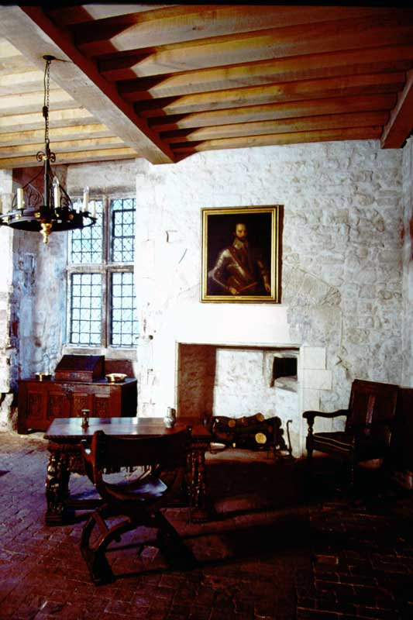
T9. Tower of London – Lower Chamber in the Bloody Tower.

Slide 7
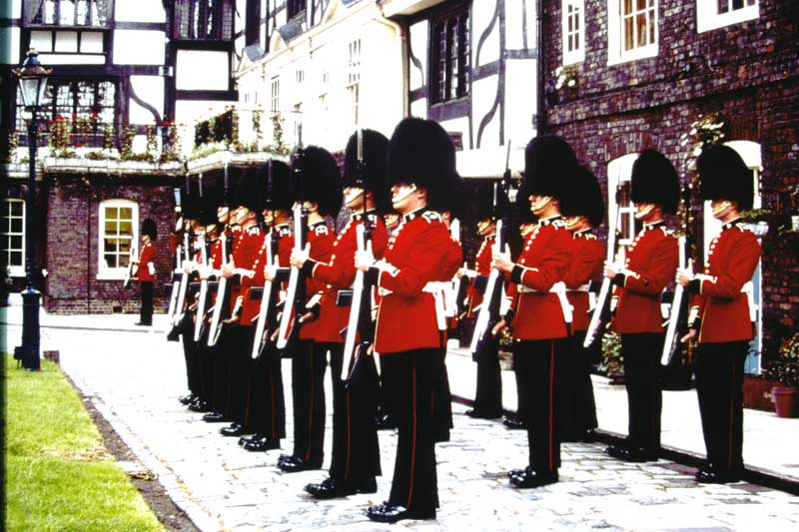
T10. Tower of London – The Changing of the Guard.

Slide 8
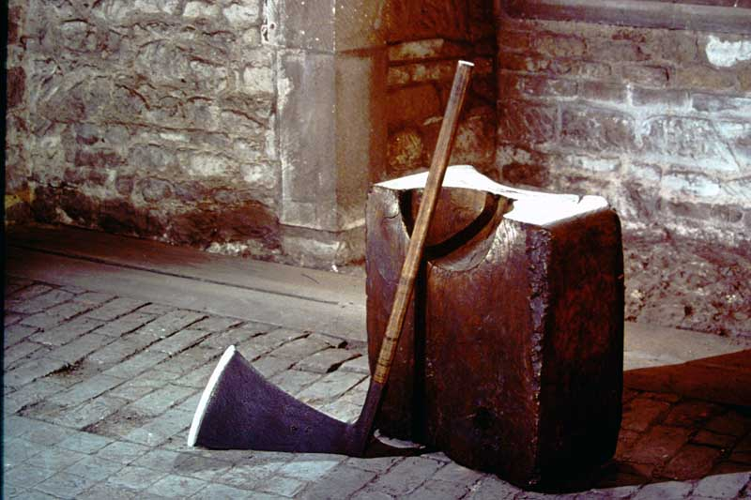
T11. Tower of London – Block and Axe.

Slide 9
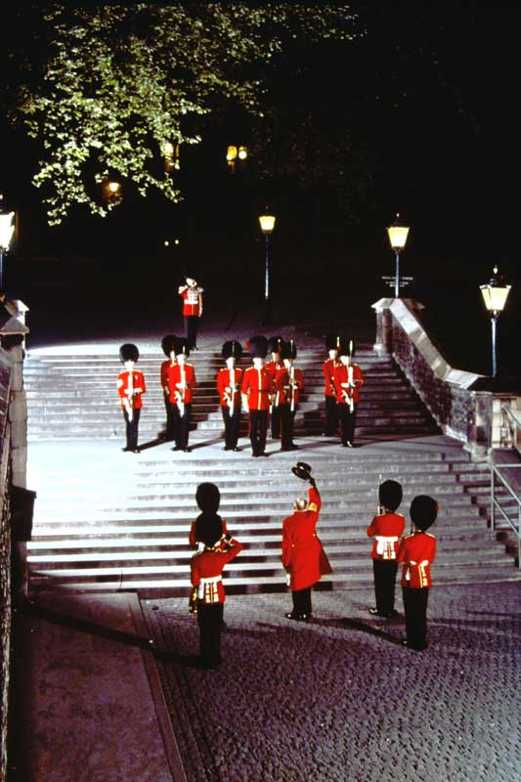
T12. Tower of London – Ceremony of the Keys.

Slide 10
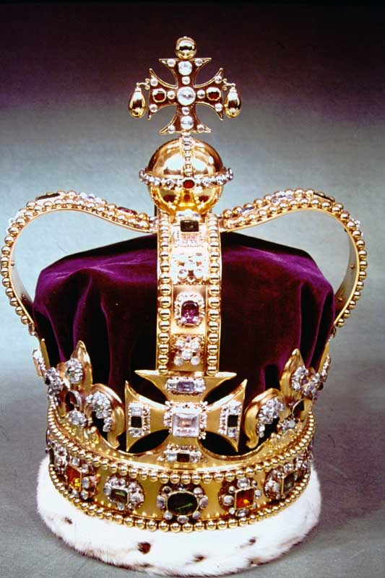
CJ1. The Crown Jewels. St. Edward’s Crown.

Slide 11
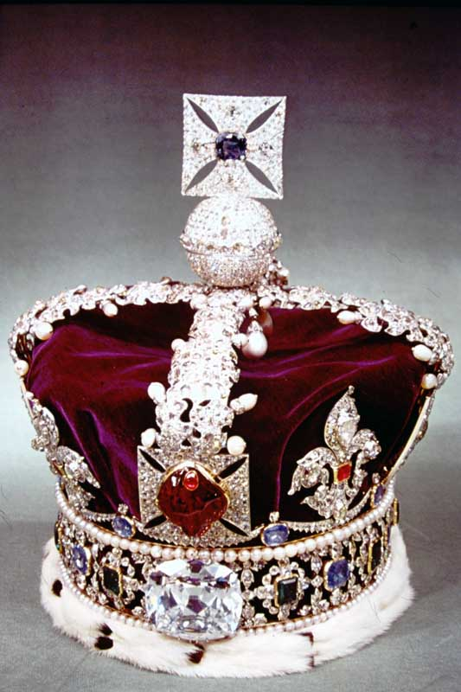
CJ2. The Crown Jewels. Imperial State Crown.

Slide 12
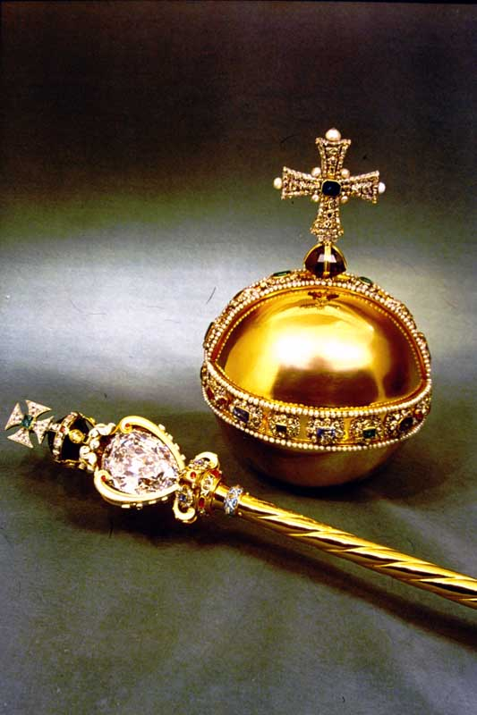
CJ3. The Crown Jewels. Sovereign’s Orb and Scepter.

Slide 13
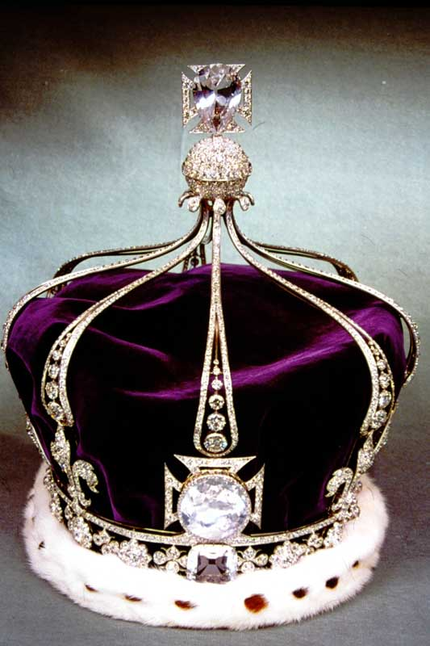
CJ4. The Crown Jewels. State Crown of Queen Mary.

Slide 14
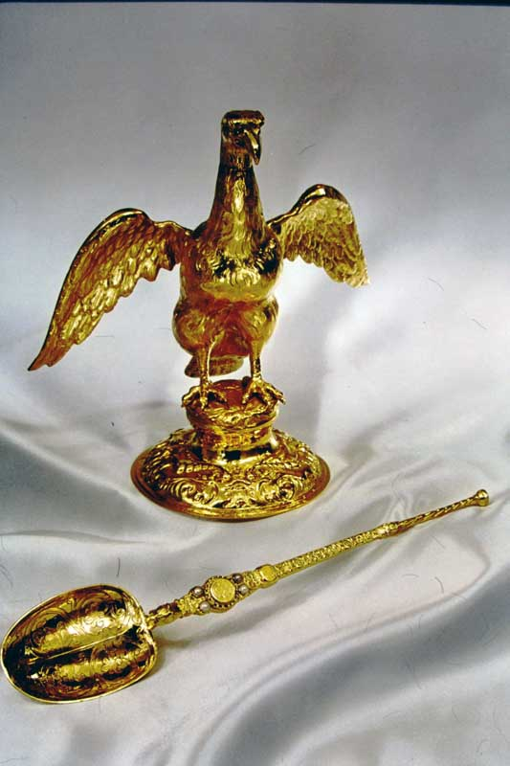
CJ5. The Crown Jewels. Ampulia and Anointing Spoon.

Slide 15
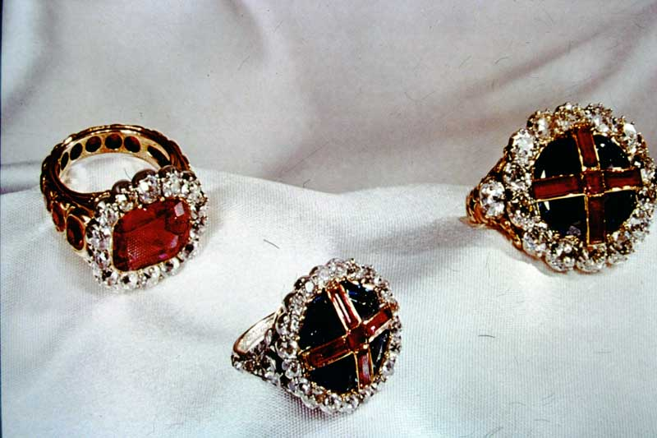
CJ6. The Crown Jewels. Coronation Rings.

Slide 16
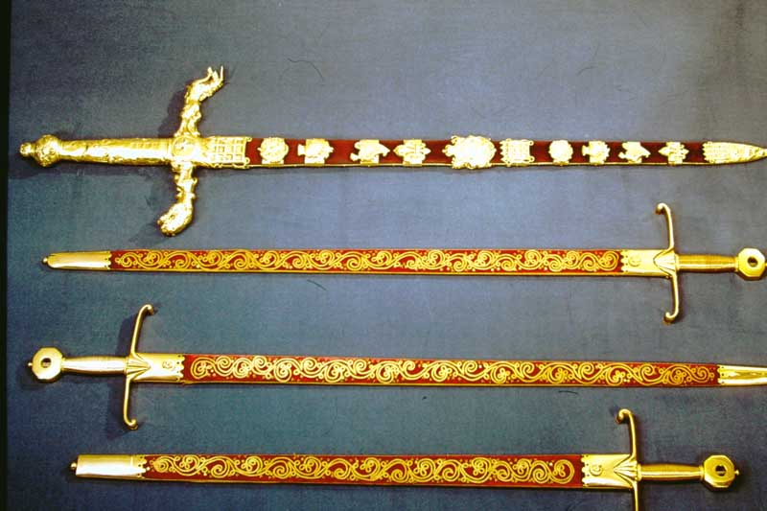
CJ7. The Crown Jewels. Swords of State.

Slide 17
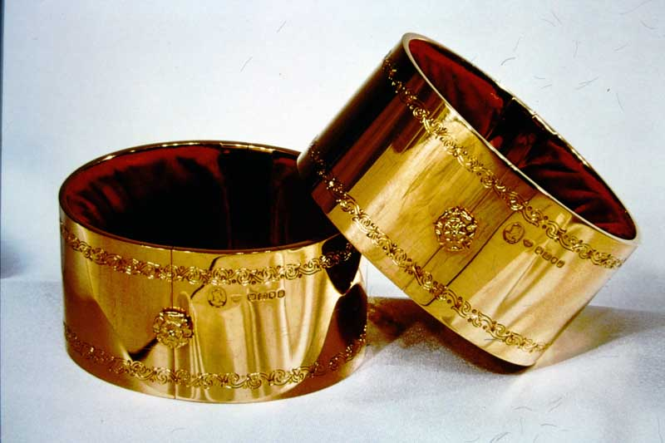
CJ8. The Crown Jewels. The Armills.

Slide 18
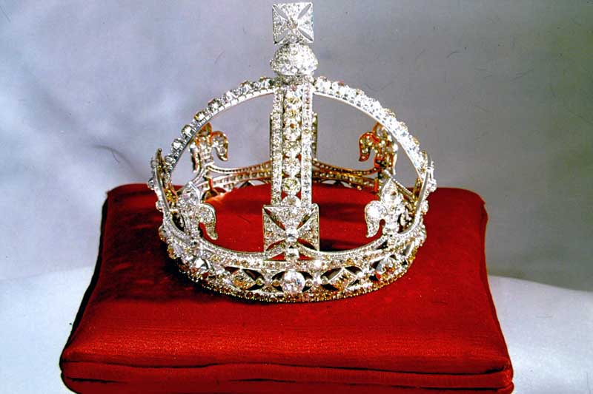
CJ10. The Crown Jewels. Queen Victoria’s Small Crown.

Slide 19
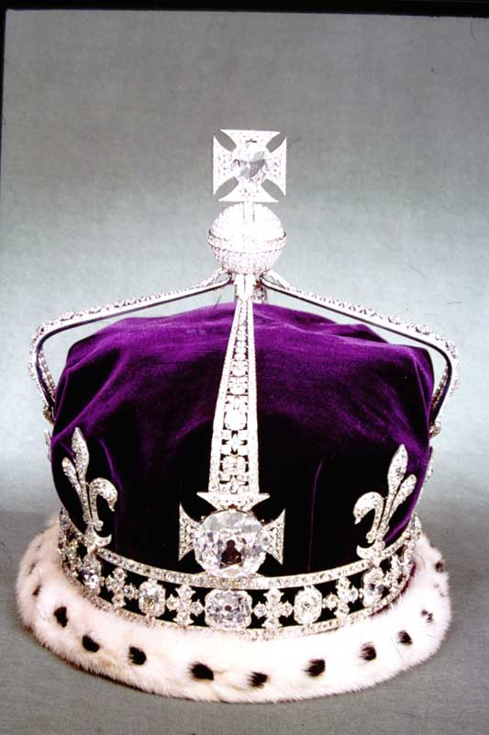
CJ11. The Crown Jewels. Queen Elizabeth the Queen Mother’s Crown.

Slide 20
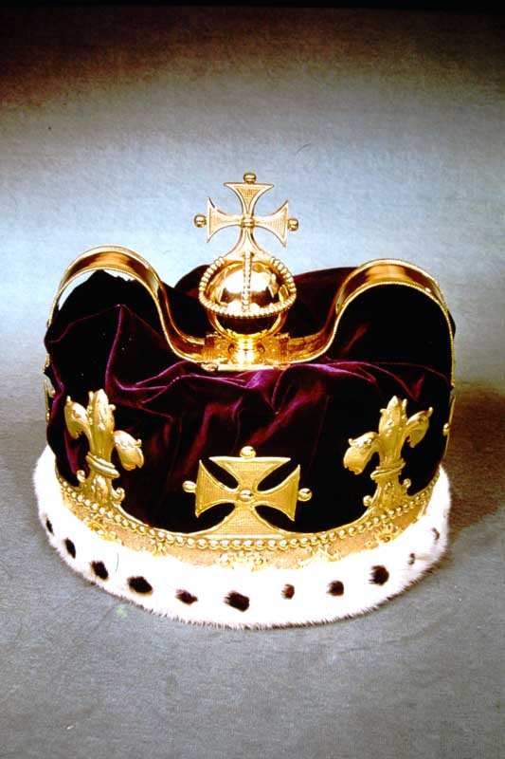
CJ12. The Crown Jewels. The Prince of Wales’s Crown.

Slide 21
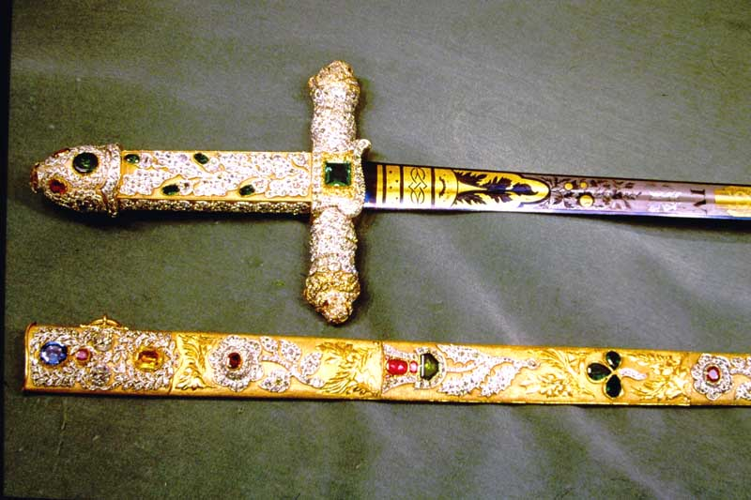
CJ15. The Crown Jewels. The Jeweled Sword of State.

Slide 22
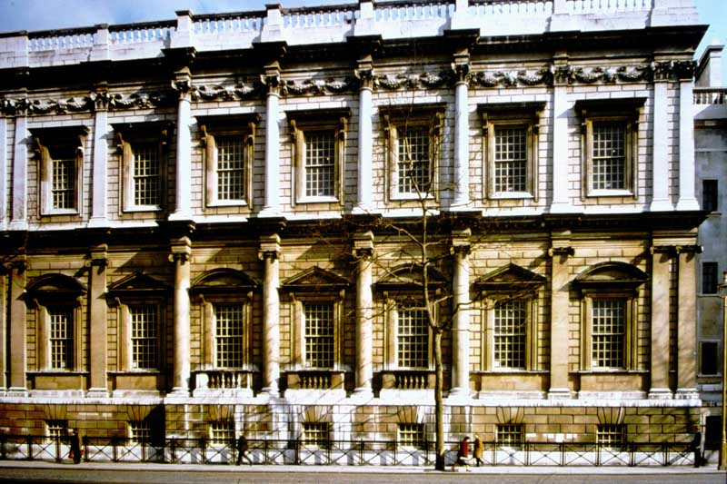
BH1. Banqueting House, Whitehall. Exterior.

Slide 23
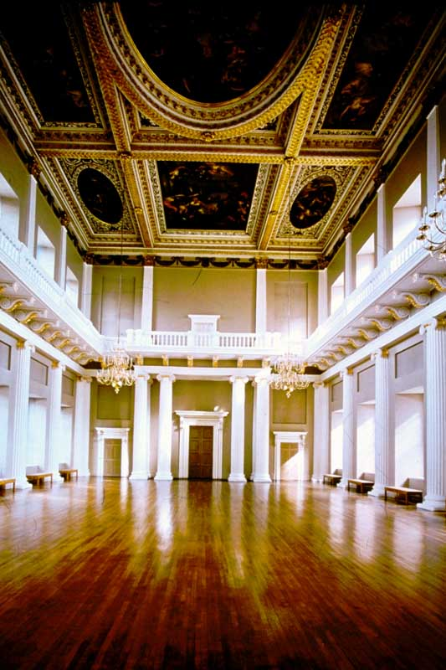
BH2. Banqueting House, Whitehall.
Interior looking north, showing the painted ceiling by Rubens.

Slide 24
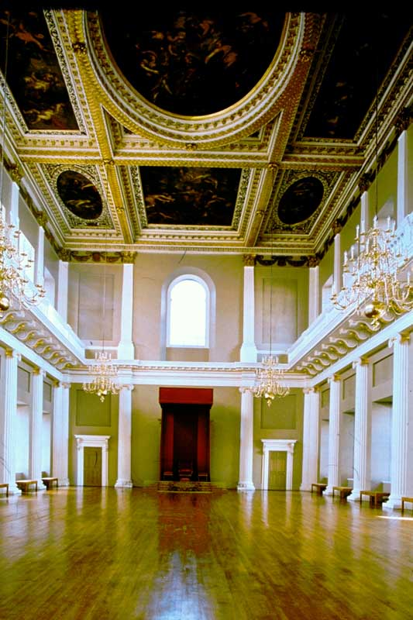
BH3. Banqueting House, Whitehall.
Interior looking south, showing the painted ceiling by Rubens.

Slide 25
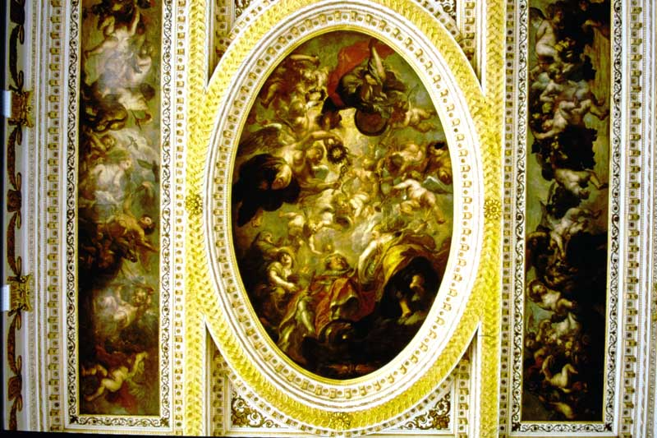
BH4. Banqueting House, Whitehall. Ceiling detail – The Apotheosis of James I, surrounded by procession of cherubs.

Slide 26
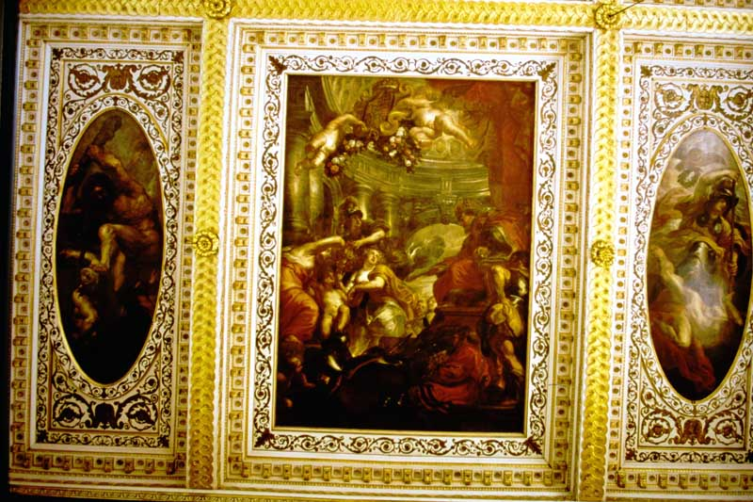
BH5. Banqueting House, Whitehall. The Union of England and Scotland with (L) Hercules and Envy, (R), Minerva and Ignorance.

Slide 27
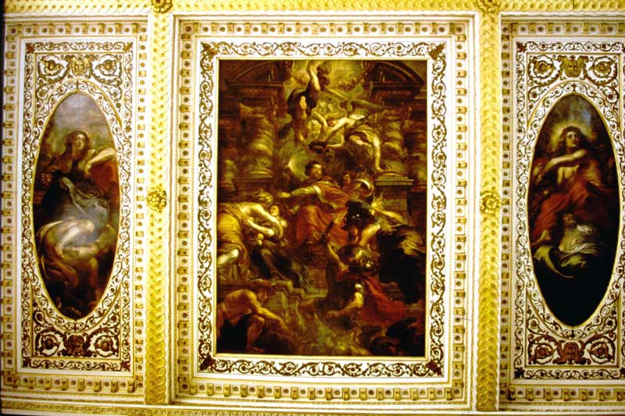
BH6. Banqueting House, Whitehall. The Benefits of the Government of James I, with (L), Abundance and Avarice, (R), Reason and Intemperate Discord.

Slide 28
END OF BOX 9.

