Slide 1
SULGRAVE MANOR – NORTHAMPTONSHIRE (Slide box # 3)
Includes other facilities and slides
These slides are from the estate of Paul Berthelot who found the English culture and architecture intriguing. He acquired these images while stationed in England serving in the US Air Force.

Slide 2
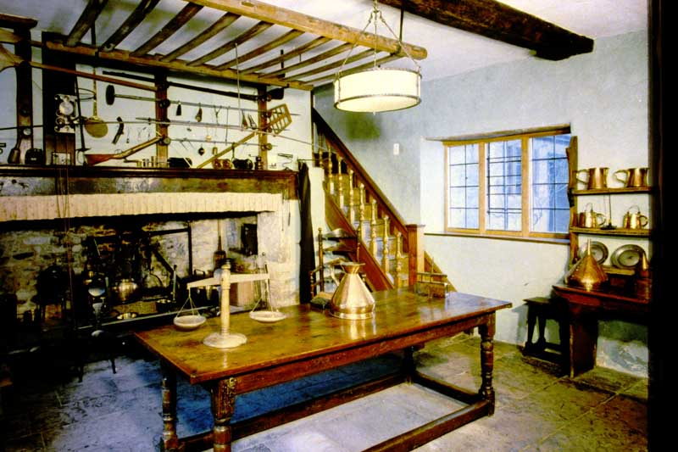
Photo # 1 The Great Kitchen

Slide 3
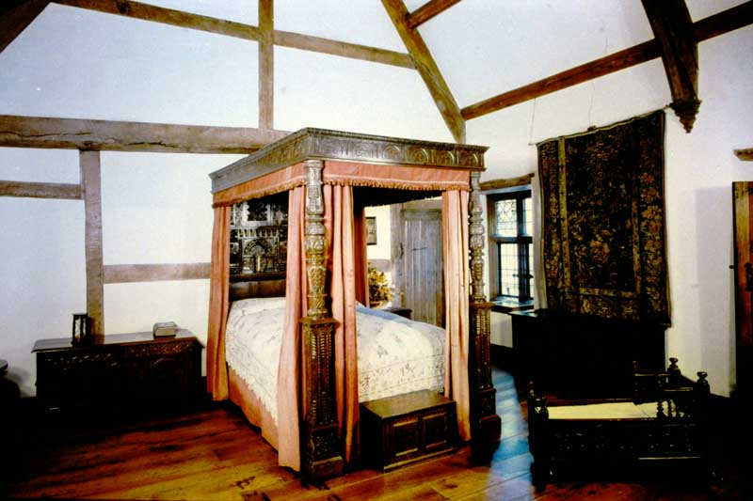
Photo # 2 The Great Chamber

Slide 4
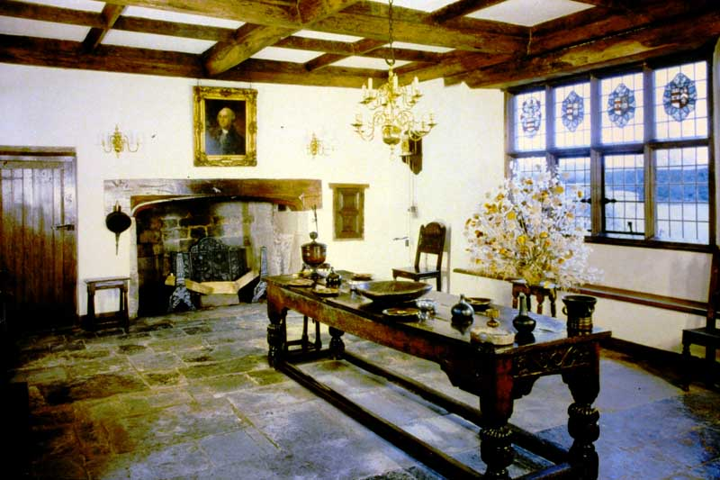
Photo # 3 The Great Hall

Slide 5
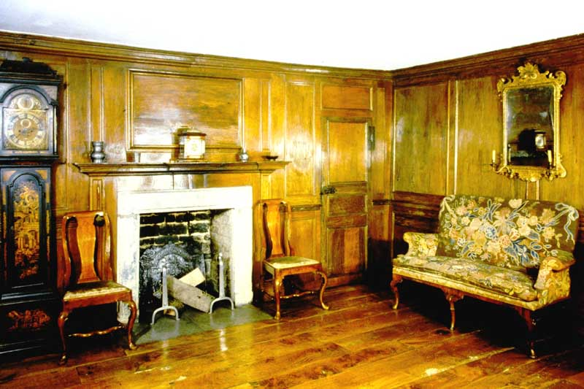
Photo # 4 The Oak Parlour

Slide 6
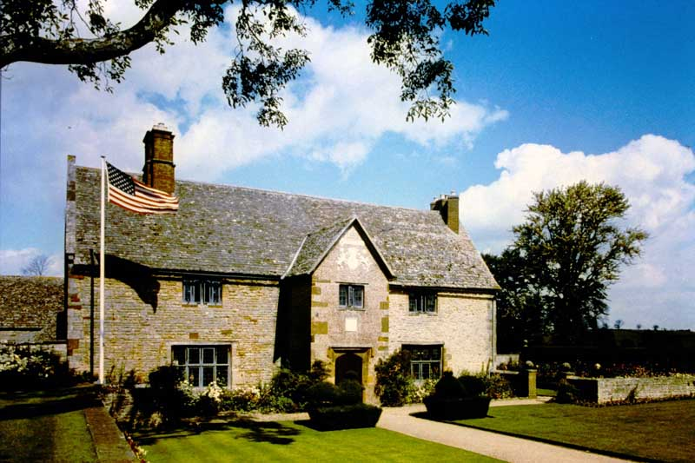
Photo # 5 Exterior View

Slide 7
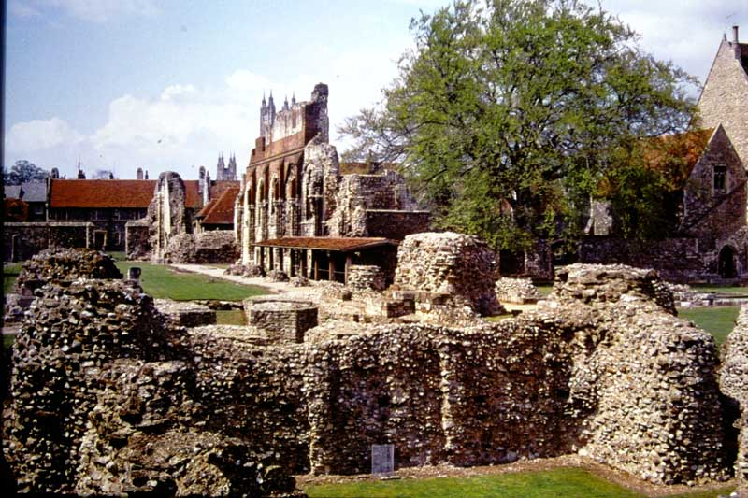
Photo # 368 St. Augustine’s Abbey, Canterbury, Kent view looking west – Crypt under Quire in foreground.

Slide 8
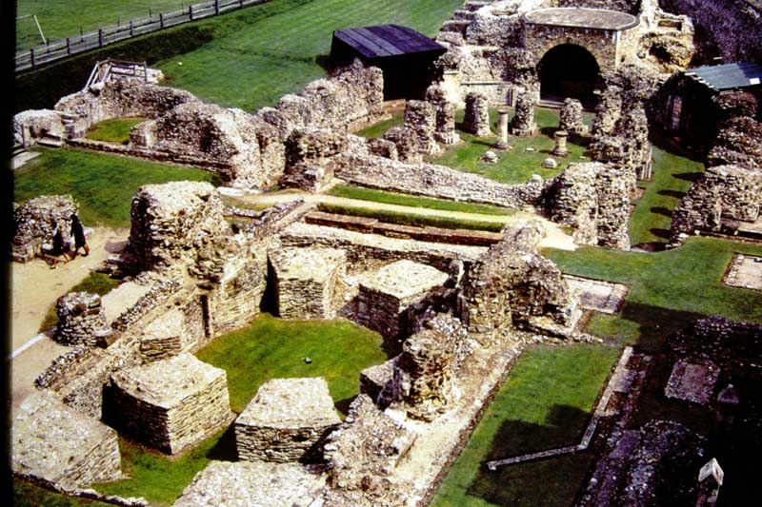
Photo # 369 St. Augustine’s Abbey, Canterbury, Kent. Bird’s-eye view, looking north-east

Slide 9
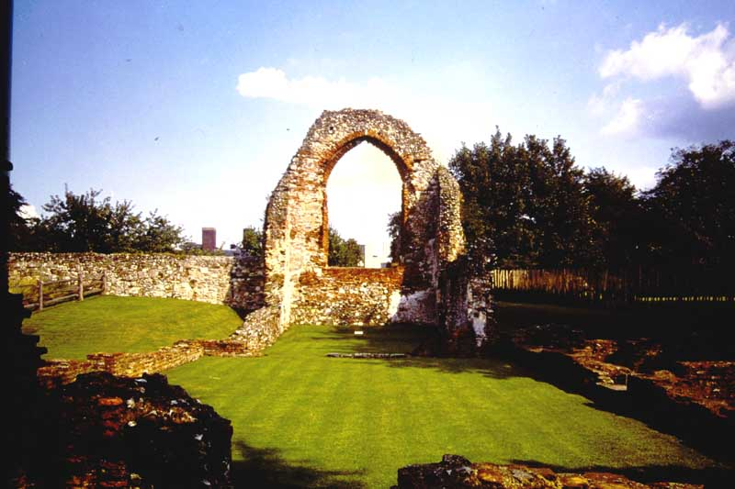
Photo # 512 St. Pancras Church, Canterbury, Kent General View.

Slide 10
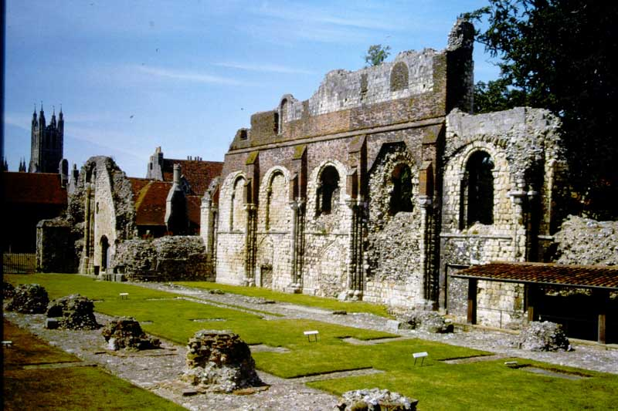
Photo # S85-27 St. Augustine’s Abbey, Canterbury, Kent. Nave, looking north-west

Slide 11
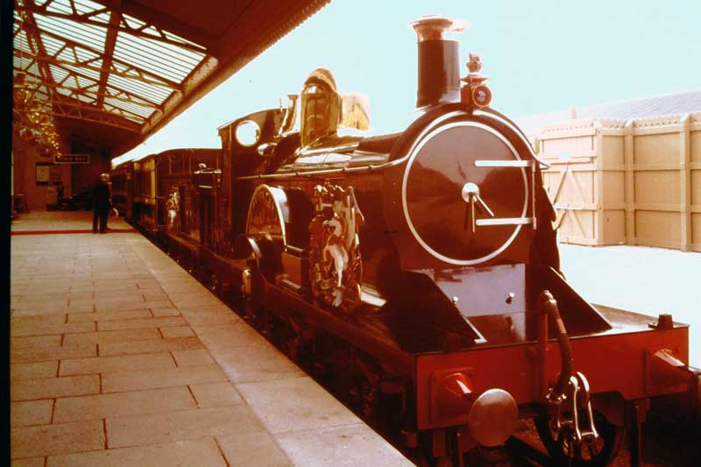
The Royal Train “The Queen” Madame Tussaud’s Royalty & Railways Exhibition, Windsor

Slide 12
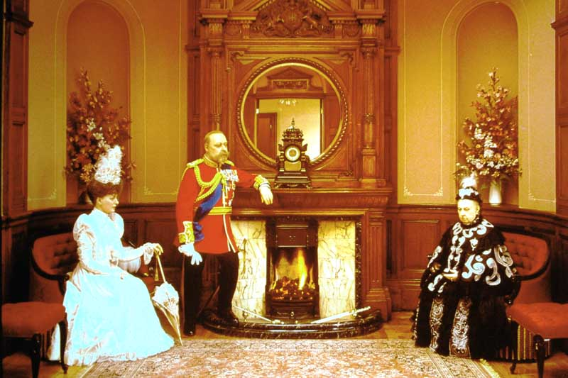
Queen Victoria, The Prince and Princess of Wales in the Royal Waiting Room.
Madame Tussaud’s Royalty & Railways Exhibition, Windsor

Slide 13
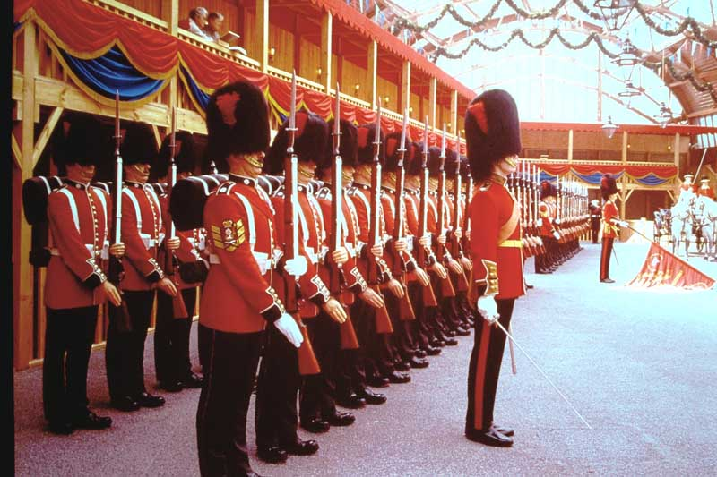
“Royal Salute Present Arms” by the Coldstream Guards. Madame Tussaud’s Royalty & Railways Exhibition, Windsor

Slide 14
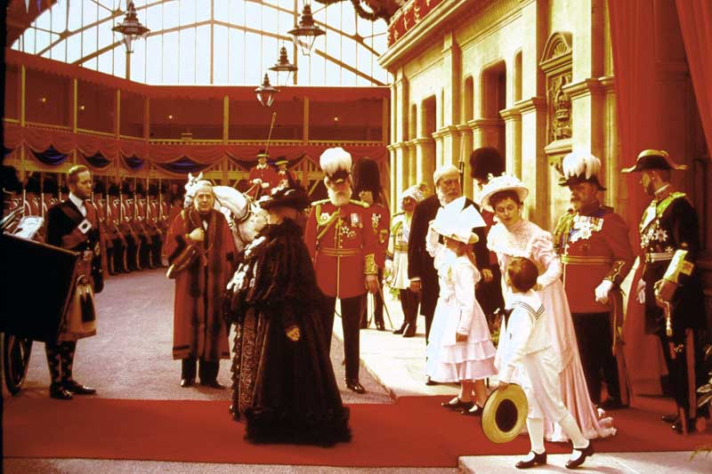
Queen Victoria and her Royal Guests approaching her carriage. Madame Tussaud’s Royalty & Railways Exhibition, Windsor

Slide 15
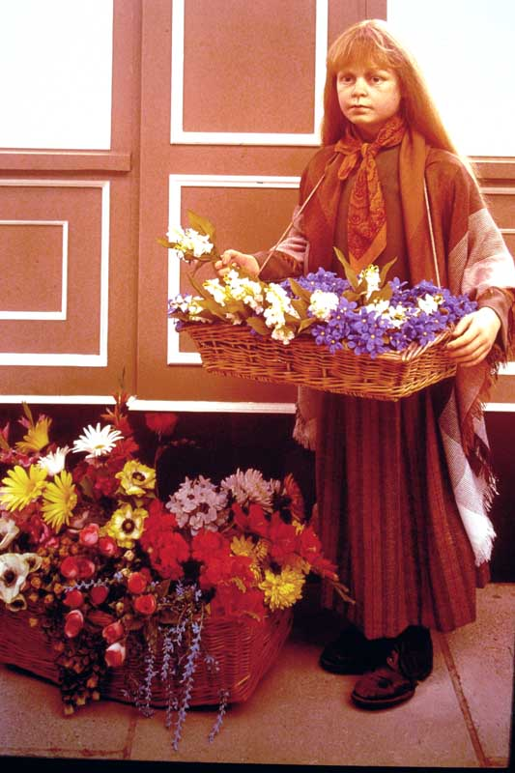
A Victorian Flower Girl. Madame Tussaud’s Royalty & Railways Exhibition, Windsor

Slide 16
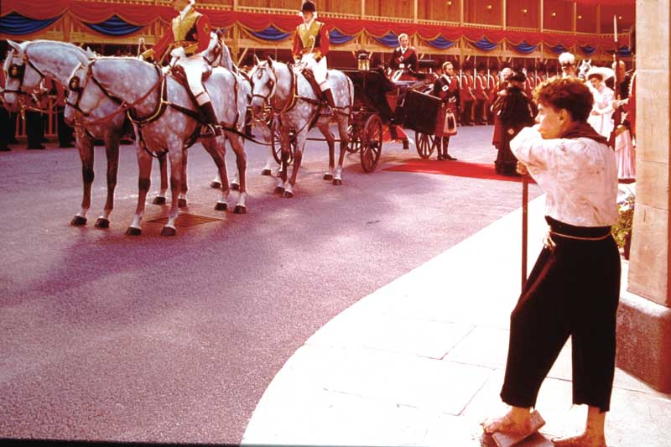
The Royal Party approaching the Queen’s Carriage, an Ascot Landau with 4 Windsor Greys. Madame Tussaud’s Royalty & Railways Exhibition, Windsor

Slide 17
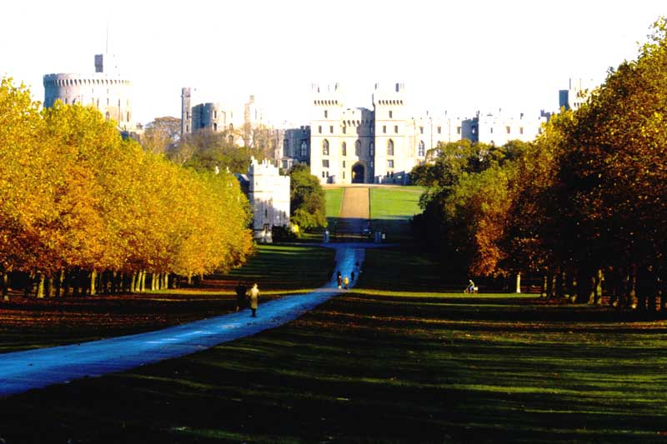
Photo # 961 WINDSOR CASTLE From Long Walk

Slide 18
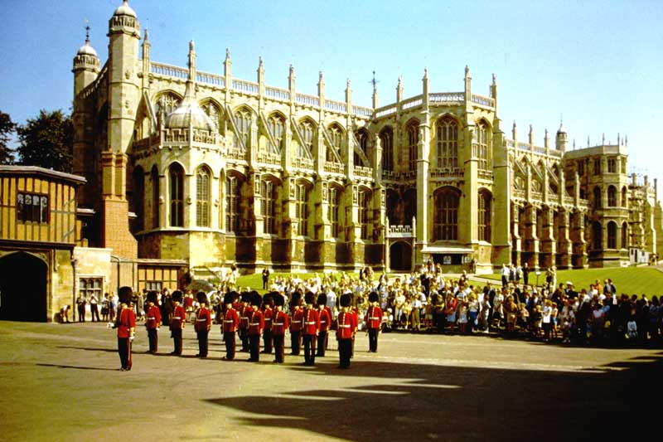
Photo # 962 WINDSOR CASTLE St George's Chapel

Slide 19
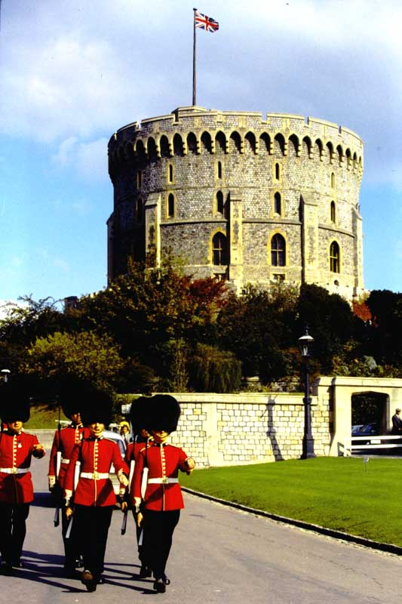
Photo # 963 WINDSOR CASTLE Round Tower

Slide 20
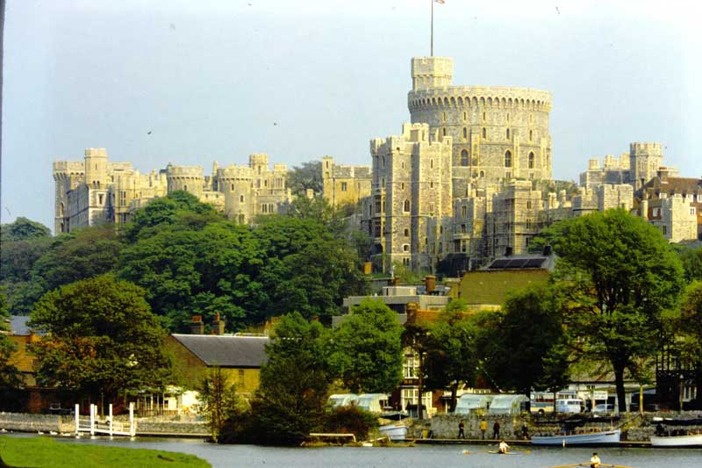
Photo # 964 WINDSOR CASTLE From River

Slide 21
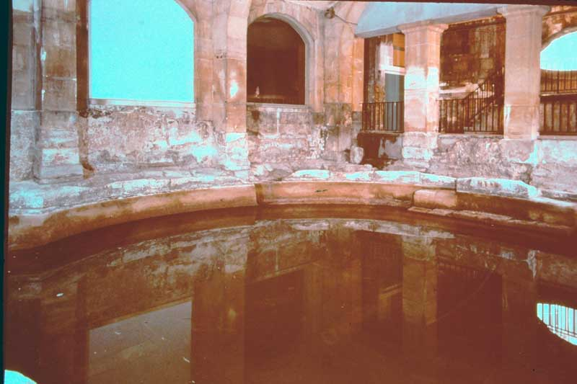
Photo # 524 The Roman Circular or Cold Bath in the Roman Baths

Slide 22
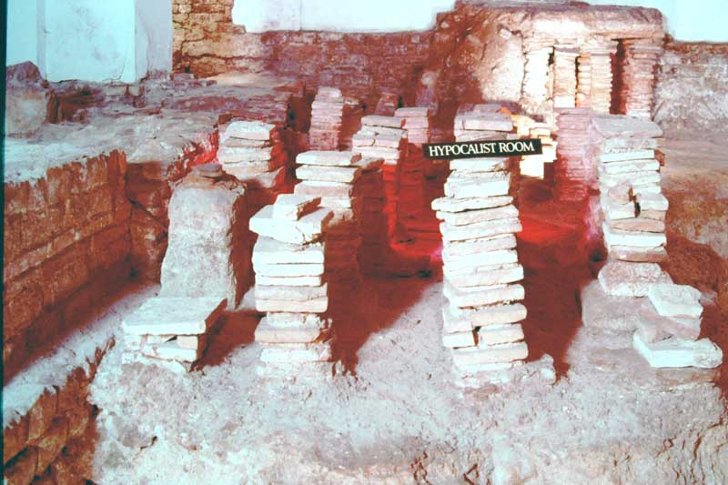
Photo # 526 The Hypocaust Room in the East Baths in the Roman Baths

Slide 23
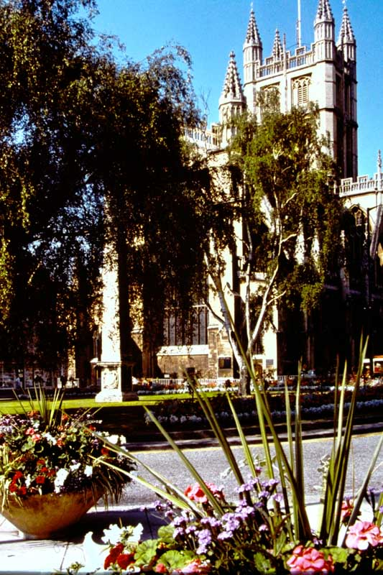
Photo # 528 The Orange Grove with view towards the Abbey

Slide 24
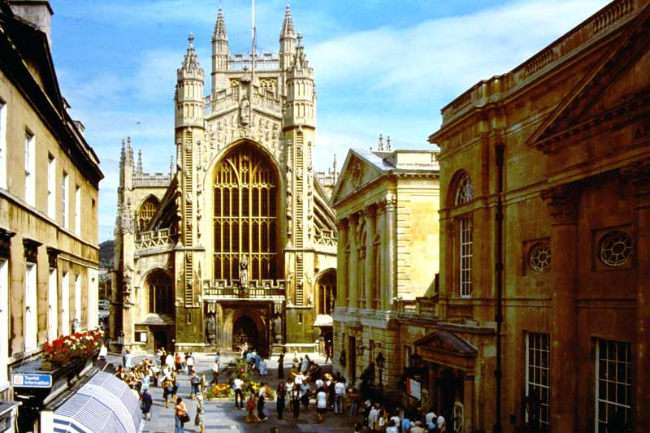
Photo # 533 The West Front of the Abbey and the Pump Room

Slide 25
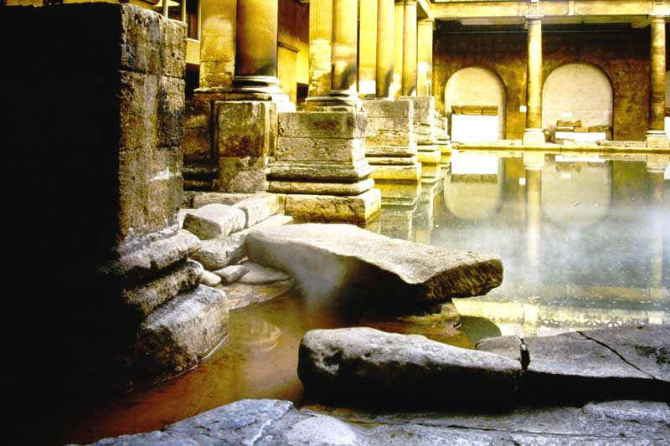
Photo # 533 The Great Bath and Diving Stone in the Roman Baths

Slide 26
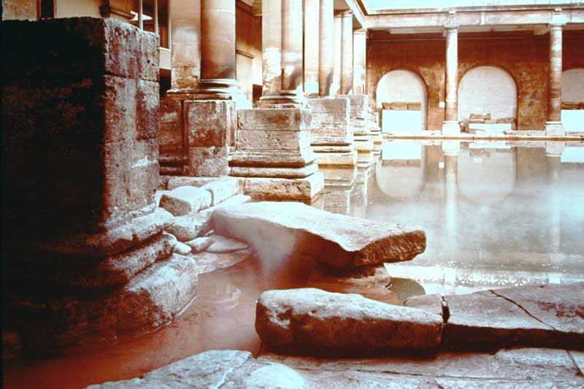
Photo # 533 The Great Bath and Diving Stone in the Roman Baths (2)

Slide 27
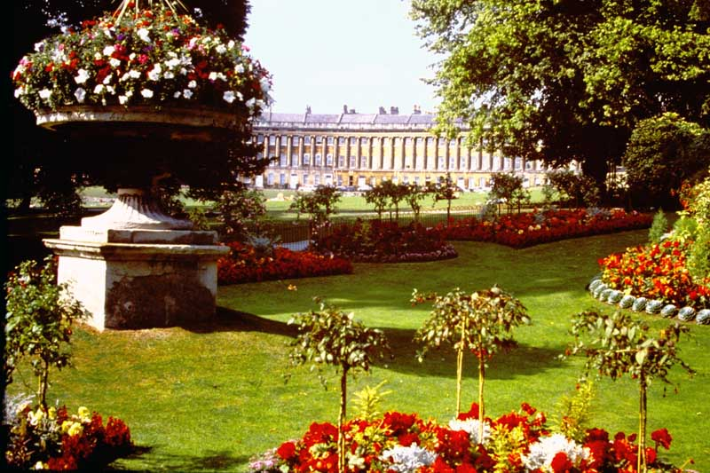
Photo # 534 The Royal Crescent from Victoria Park

Slide 28
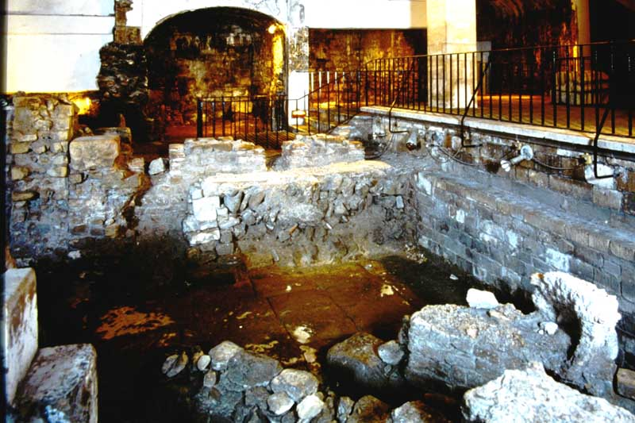
Photo # 545 The East Baths – First to Fourth Century A.D. in the Roman Baths

Slide 29
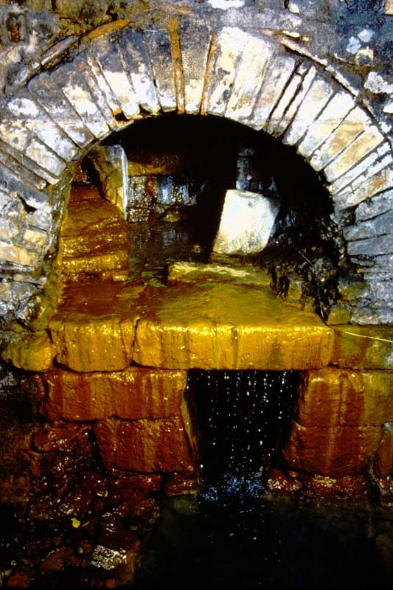
Photo # 546 The Hot Spring. Overflow from the Roman Reservoir

Slide 30
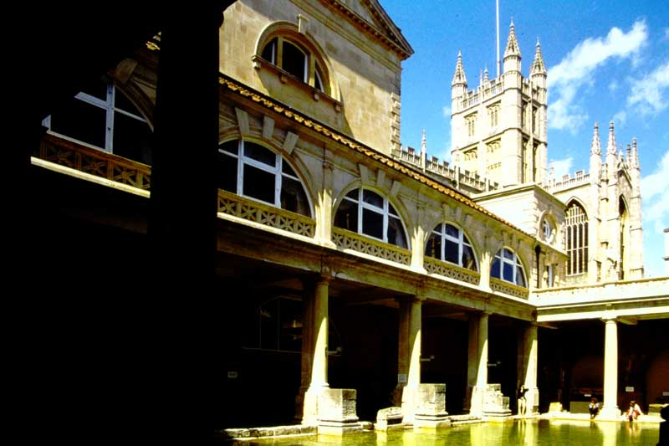
Photo # 547 The Great Bath in the Roman Baths

Slide 31
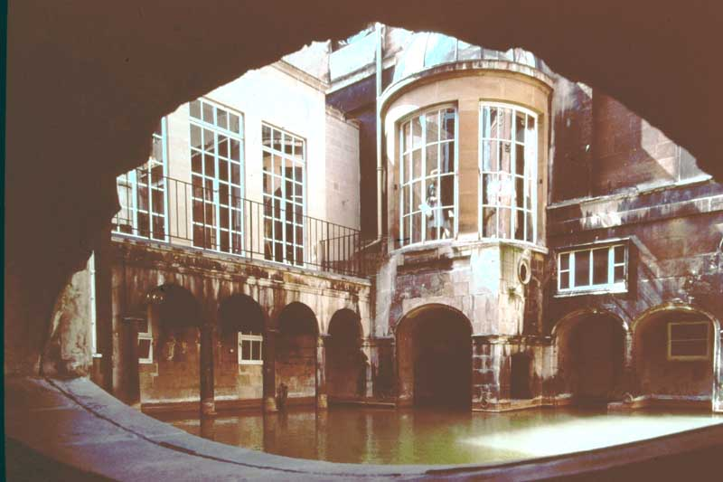
Photo # 548 The King’s Bath in the Roman Baths

Slide 32
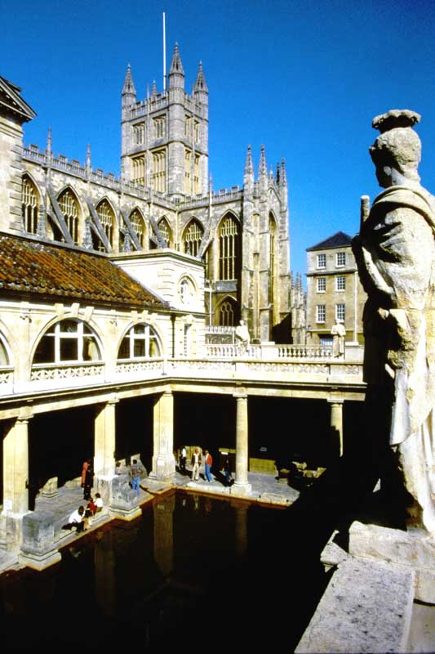
Photo # 555 The Great Bath in the Roman Baths & the Abbey

Slide 33
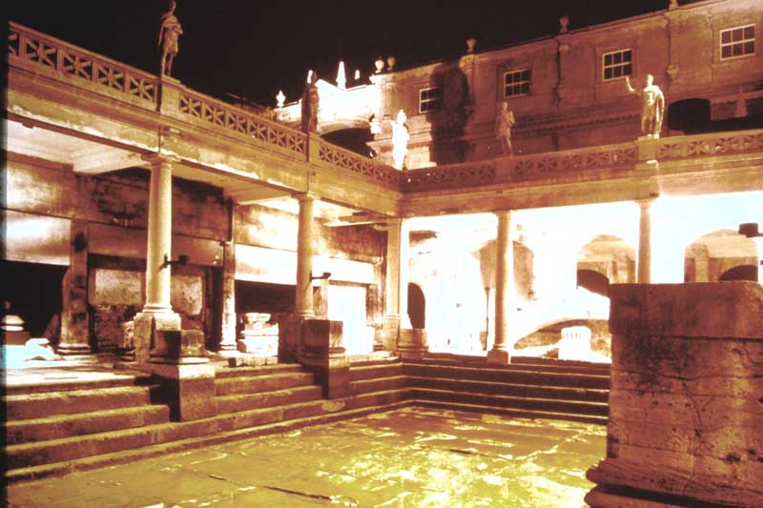
Photo # 556 The Great Baths showing the original lead sheeting.

Slide 34
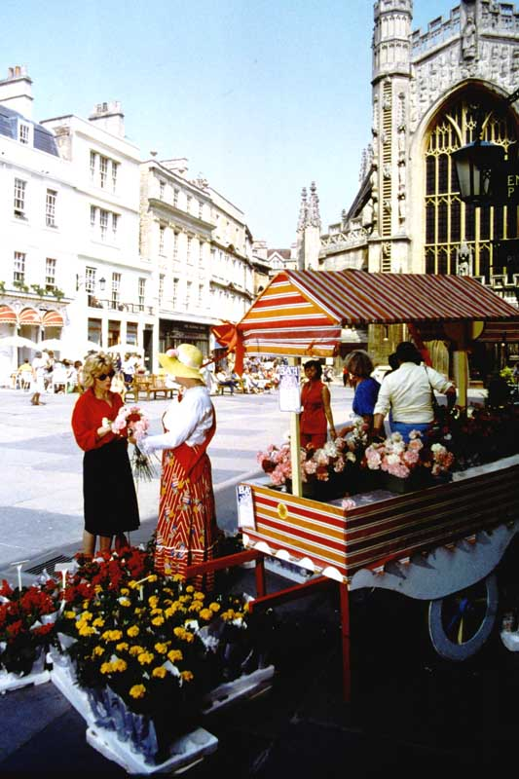
Photo # 564 The Abbey Church Yard.

Slide 35
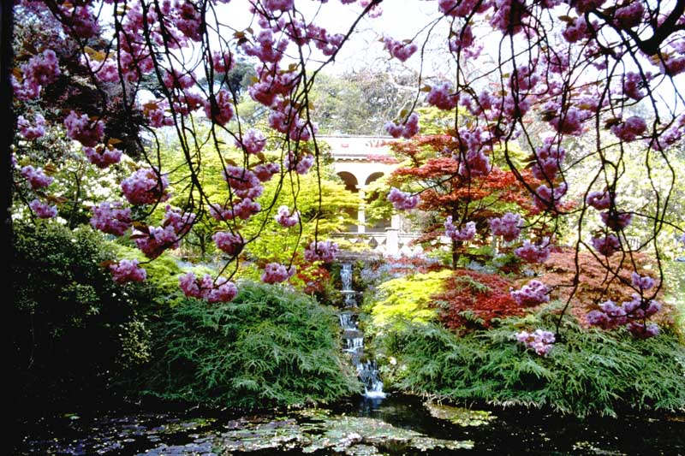
Photo # 565 Spring time in the Botanical Gardens

Slide 36
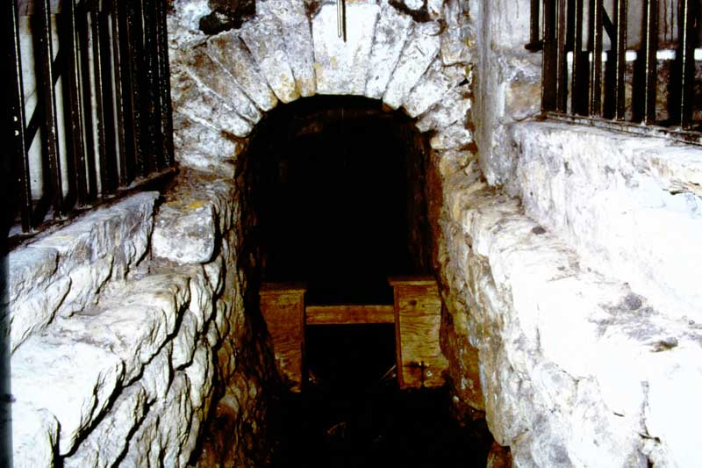
Photo # 570 The Main Drain in the Roman Baths

Slide 37
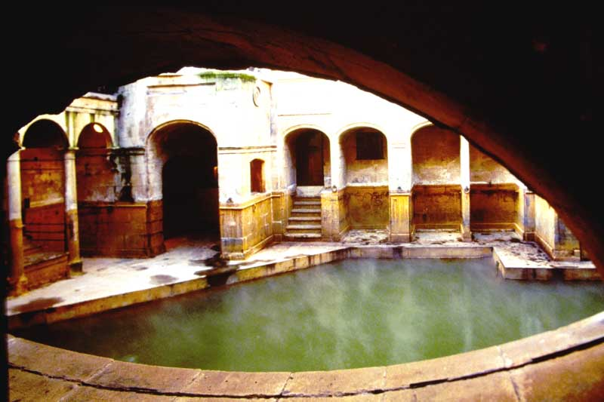
Photo # 576 The King’s Bath in the Roman Baths

Slide 38
The End of Slide Box 3

