Slide 1
Hampton Court Palace, London - Images by Department of the Environment
These slides are from the estate of Paul Berthelot who found the English culture and architecture intriguing. He acquired these images while stationed in England serving in the US Air Force.

Slide 2
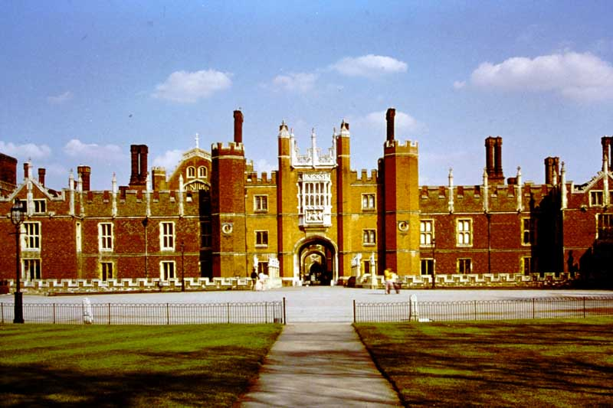
H.C.P.1 The Great Gatehouse and Moat Bridge, West Front

Slide 3
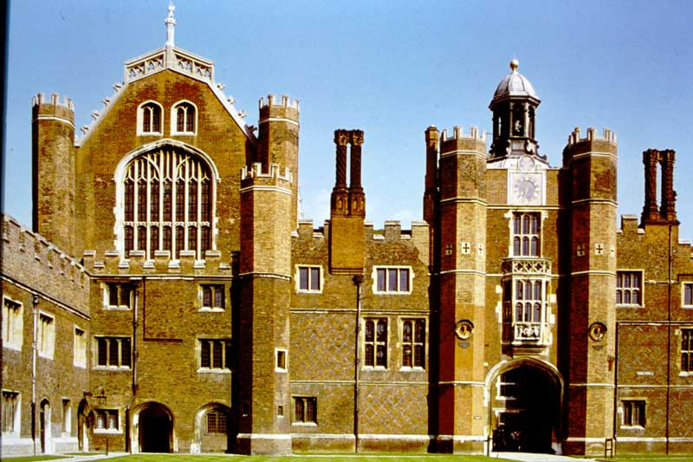
H.C.P. 2 Anne Boleyn’s Gateway and the Great Hall from the Base Court

Slide 4
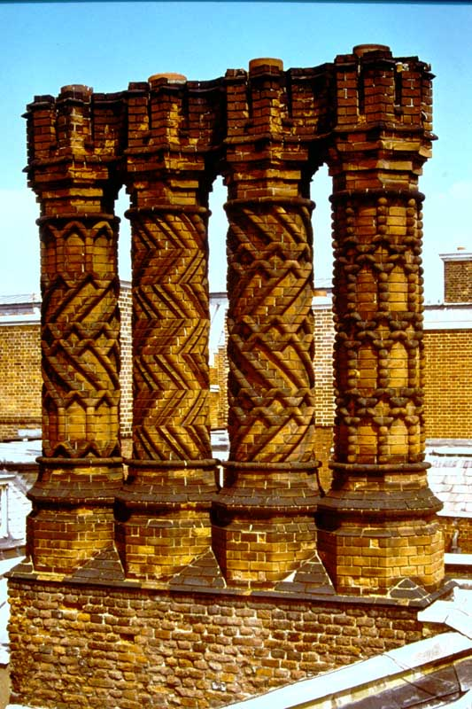
H.C.P. 3 Tudor Style Chimneys

Slide 5
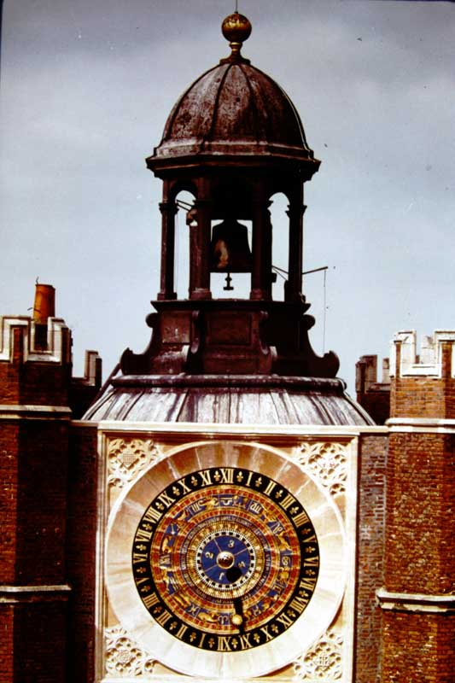
H.C.P. 4 The Astronomical Clock

Slide 6
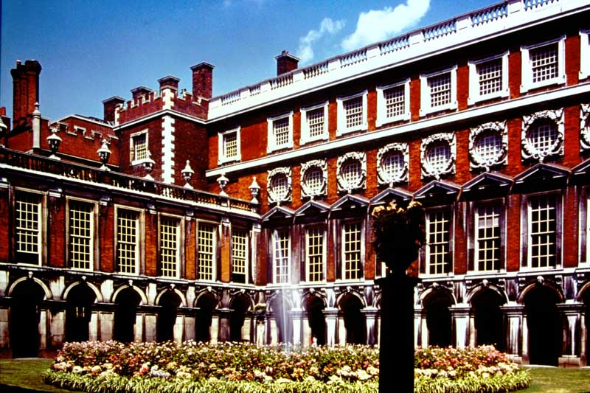
H.C.P. 5 Fountain Court, looking north-west (1689 – 1700 by Sir Christopher Wren)

Slide 7
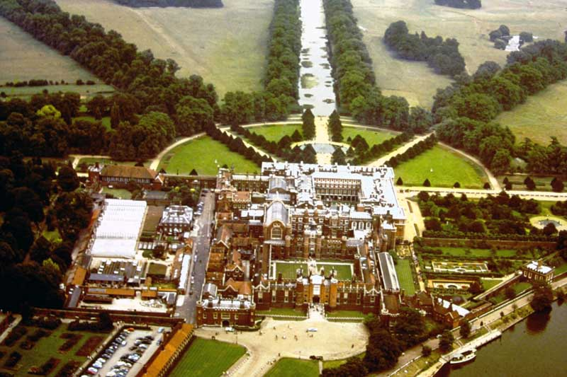
H.C.P. 6 Hampton Court Air View

Slide 8
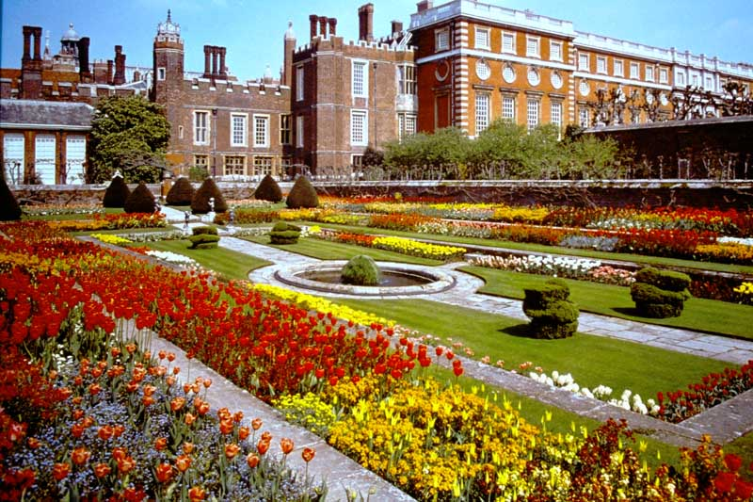
H.C.P. 7 The Palace from the Pond Garden

Slide 9
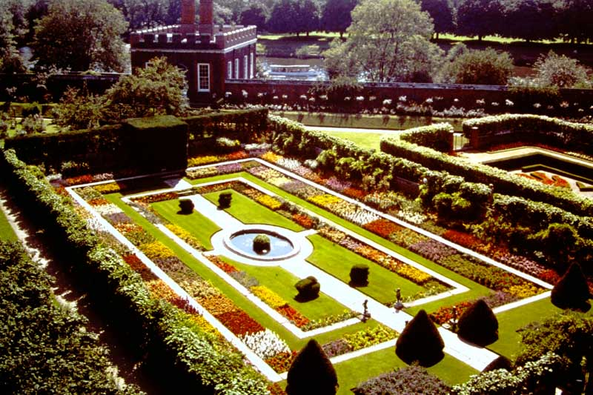
H.C.P. 8 Pond Garden and William III Banqueting House

Slide 10
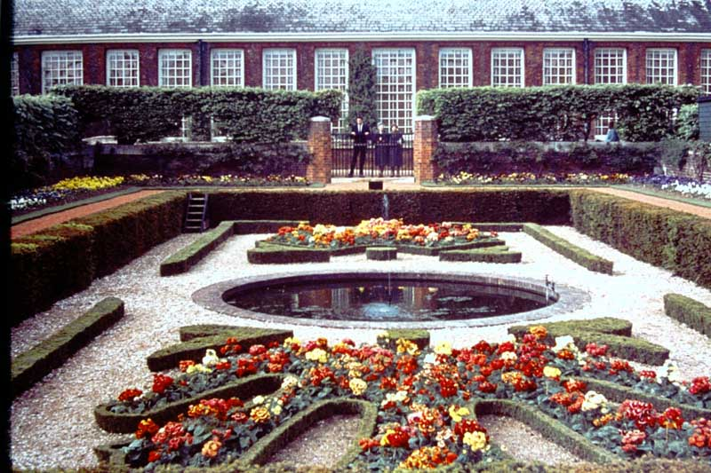
H.C.P. 9 17TH Century Formal Garden

Slide 11
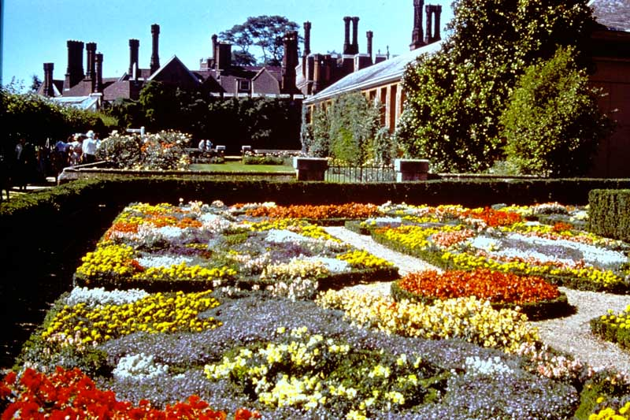
H.C.P. 10 The Knot garden

Slide 12
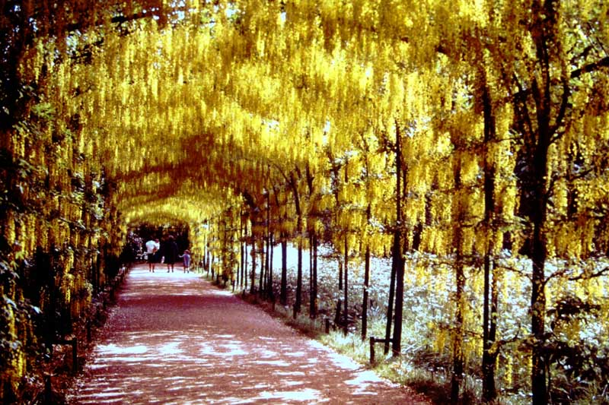
H.C.P. 11 Pleached Laburnum Alley

Slide 13
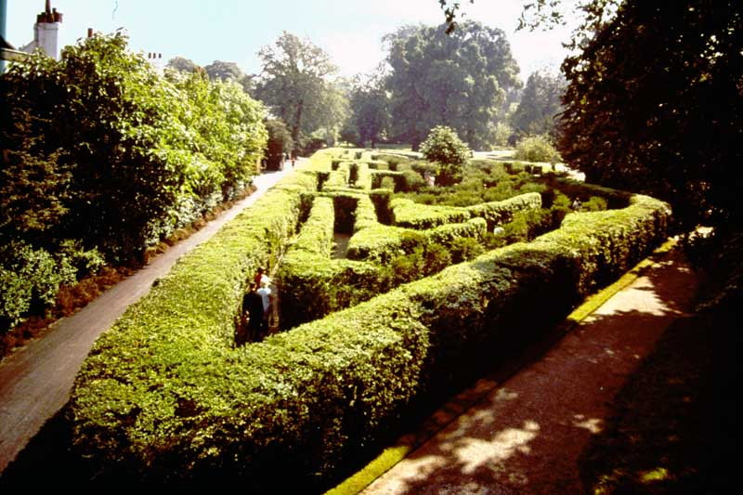
H.C.P. 12 The Maze

Slide 14
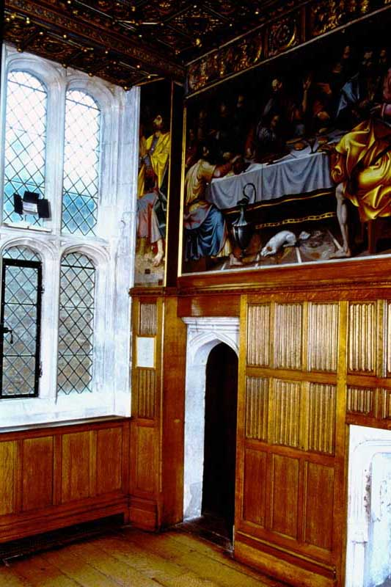
H.C.P. 13 The Painted Closet of Cardinal Wolsey

Slide 15
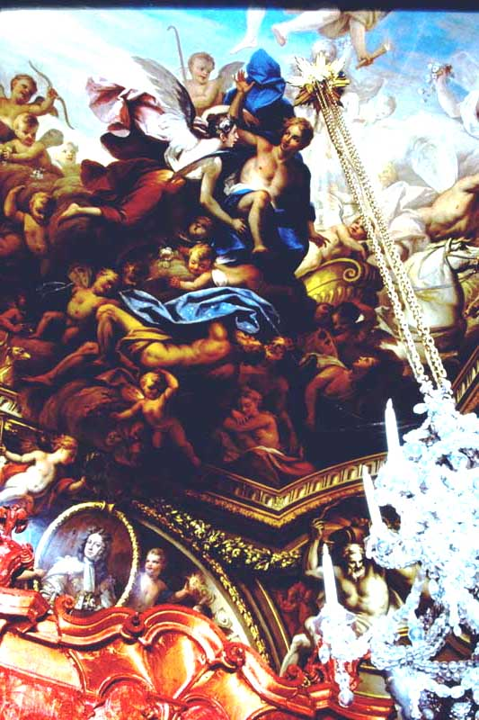
H.C.P. 14 The Queen’s Bedroom Ceiling. Aurora in her Chariot by Sir James Thornhill, 1715

Slide 16
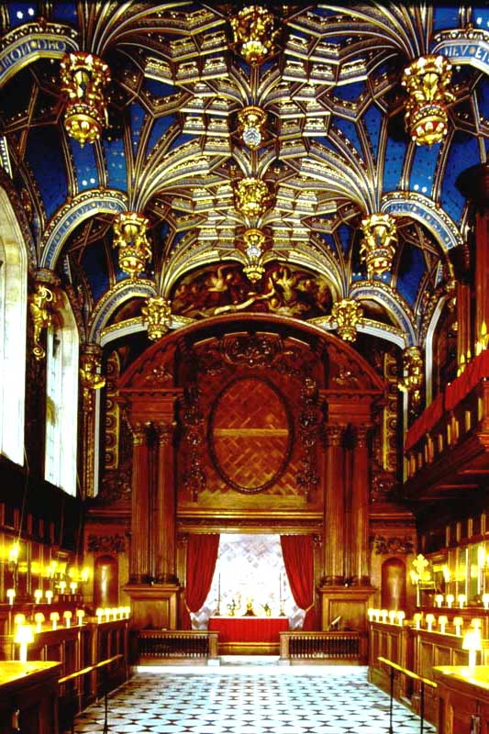
H.C.P. 15 The Chapel Royal

Slide 17
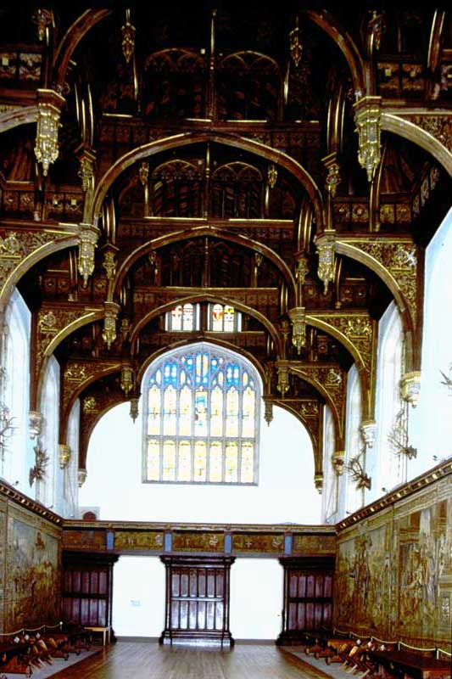
H.C.P. 16 The Ceiling of the Great Hall

Slide 18
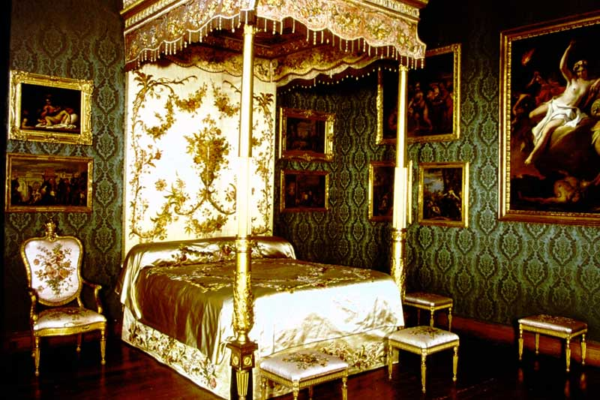
H.C.P. 17 Queen Charlotte’s Bed in the Prince of Wales Bedroom

Slide 19
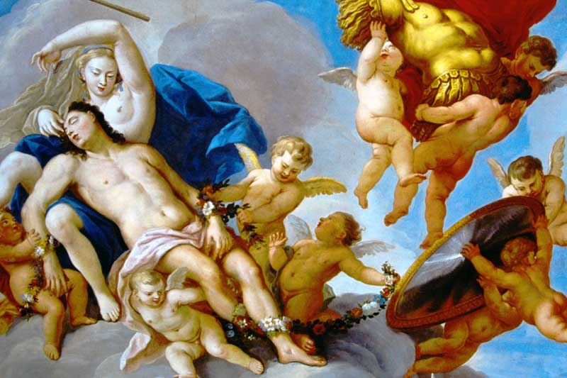
H.C.P. 18 Ceiling of the King’s Dressing Room

Slide 20
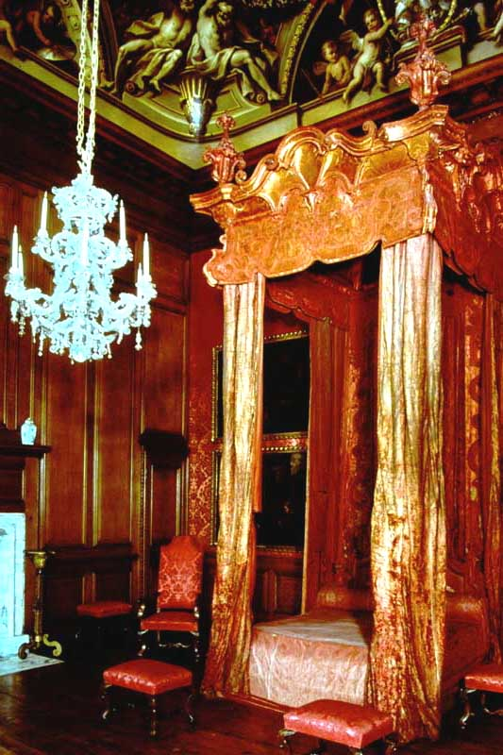
H.C.P. 19 The Queen’s Bedroom

Slide 21
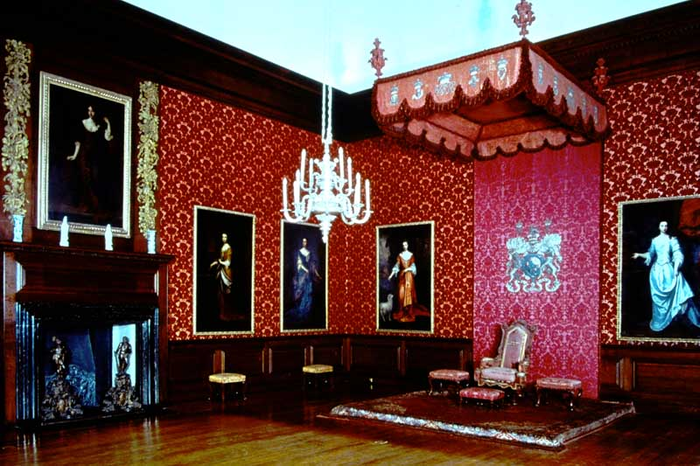
H.C.P. 20 The King’s First Presence Chamber

Slide 22
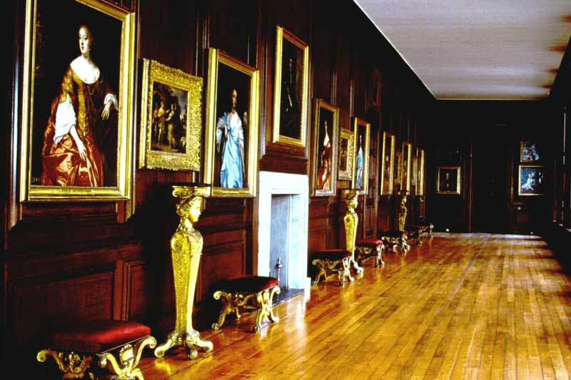
H.C.P. 21 The Communication Gallery

Slide 23
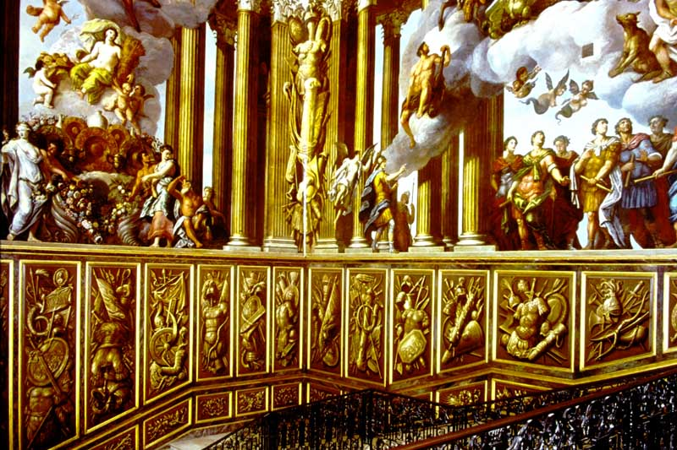
H.C.P. 22 The King’s Staircase

Slide 24
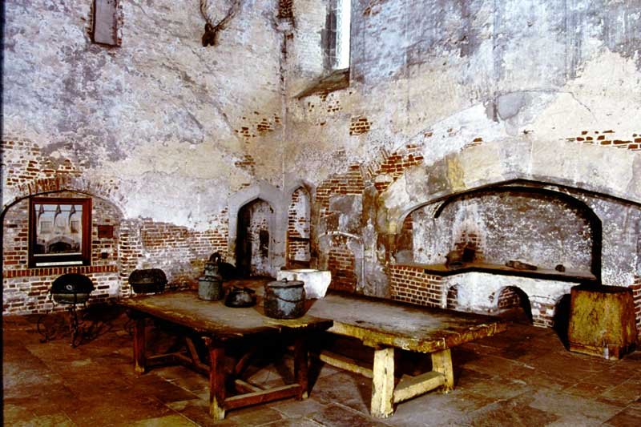
H.C.P. 23 Henry VIII’s Kitchen

Slide 25
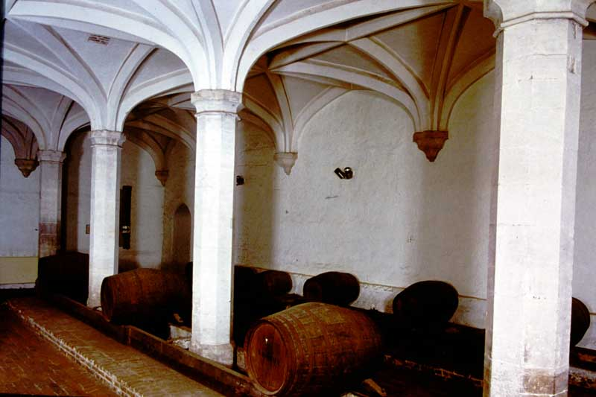
H.C.P. 24 The Wine Cellar

Slide 26
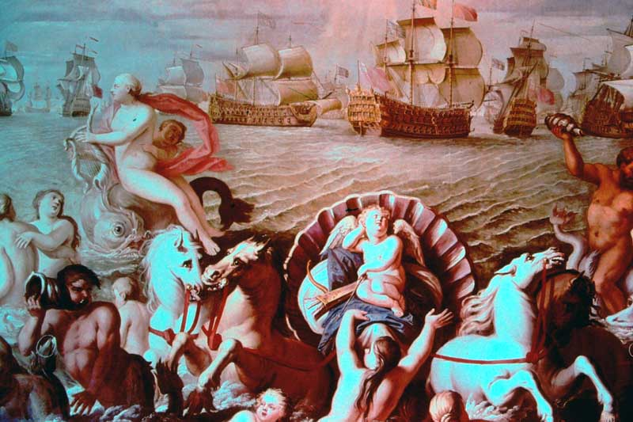
Photo # 166 Painting on the north wall of the Queen’s Drawing Room by Verrio, showing Prince George of Denmark and the British Fleet.

Slide 27
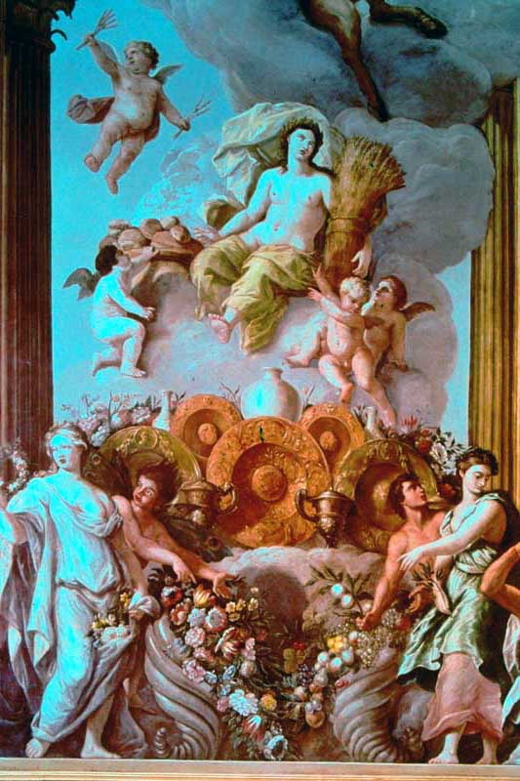
Photo # 167 North Wall of the King’s Staircase. Figures of the Muses and Goddesses of Plenty by Verrio

Slide 28
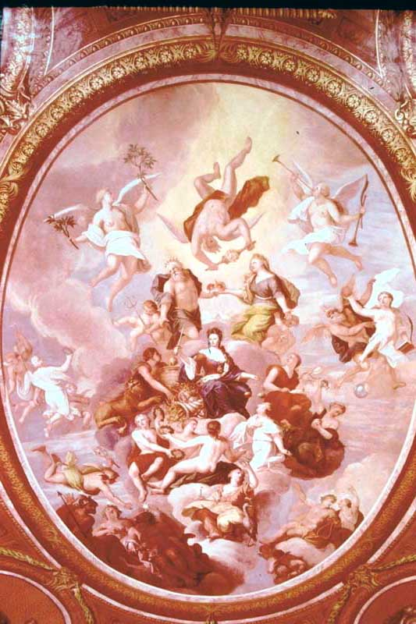
Photo # 168 The Ceiling of the Queen’s Drawing Room by Verrio

Slide 29
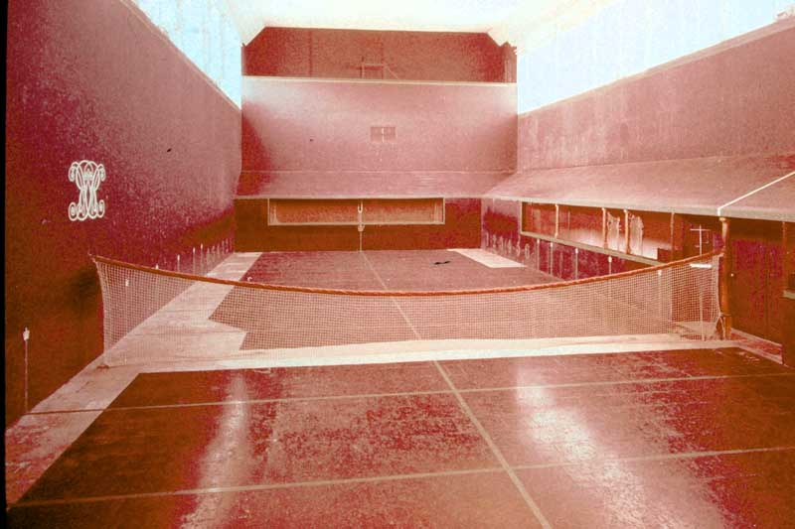
Photo # 40 The Tudor Tennis Court, Interior.

Slide 30
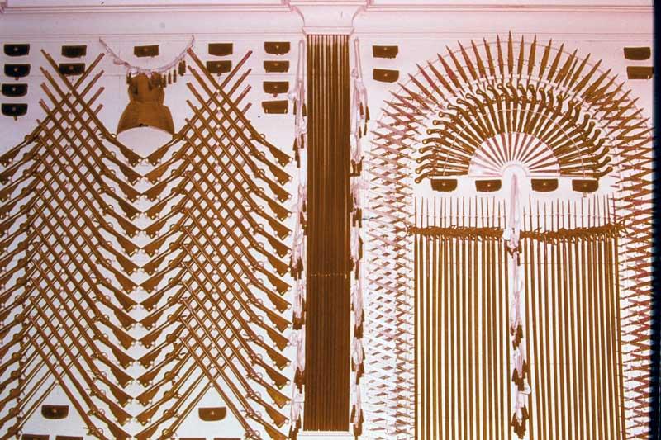
Photo # 172 The King’s Guardroom – Detail.

Slide 31
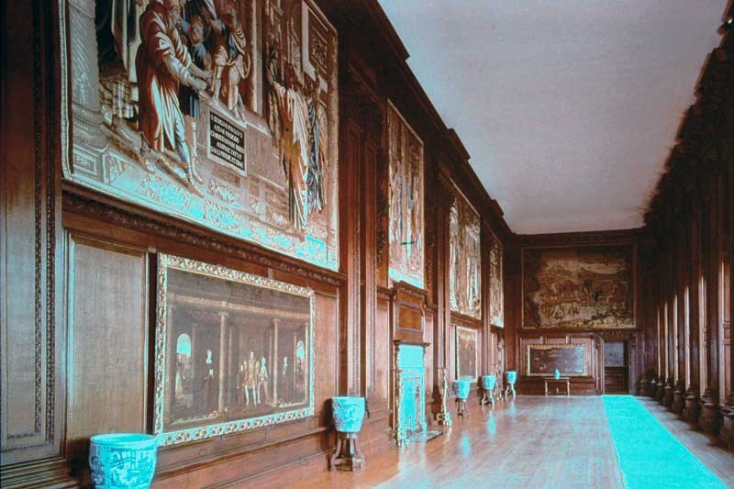
Photo # 173 The Cartoon Gallery

Slide 32
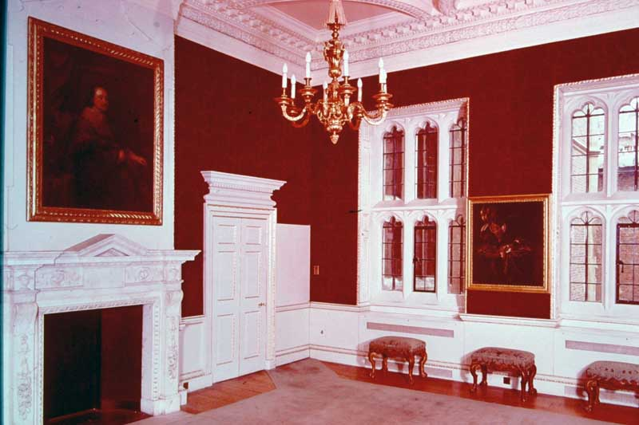
Photo # 174 The Cumberland Suite

Slide 33
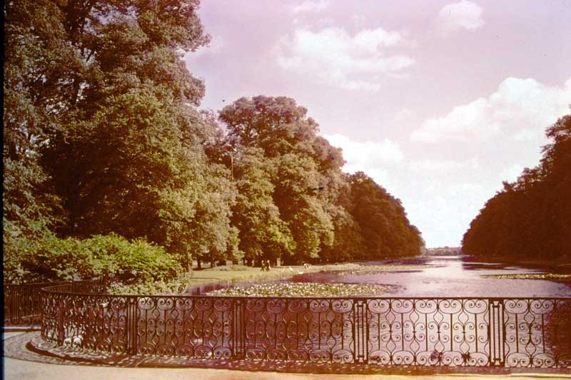
Photo # 183 The Long Water

Slide 34
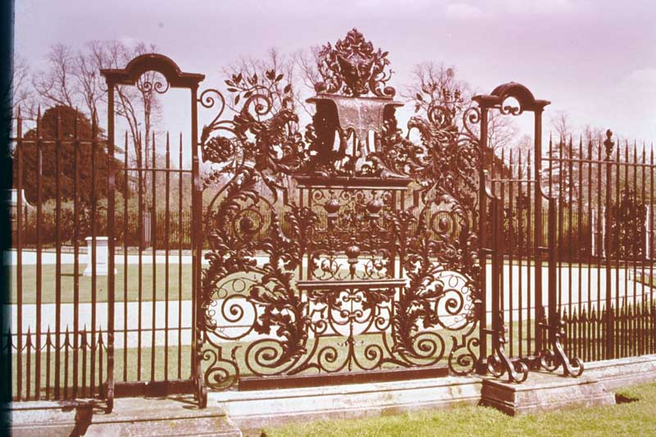
Photo # 184 The Tijou Screen

Slide 35
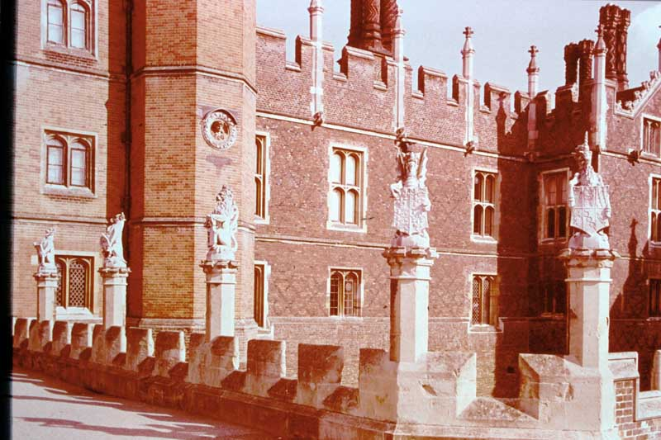
Photo # 185 The West Front. The King’s Beasts

Slide 36
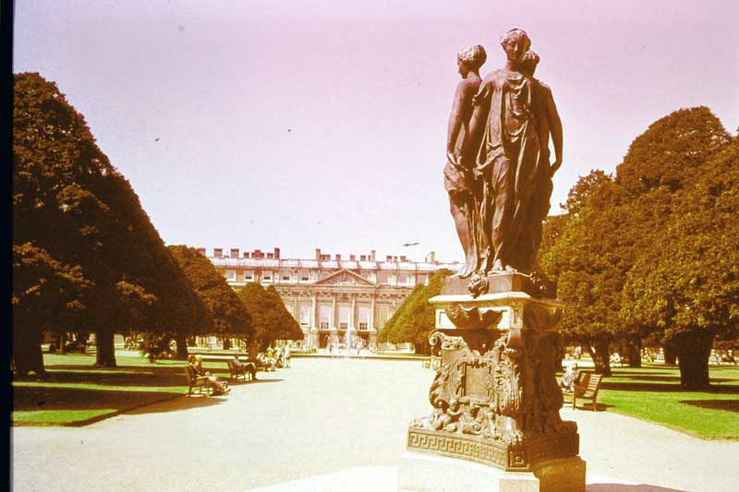
Photo # 186 Statue of the Three Graces in the Great Fountain Garden.

Slide 37
The End of Slide Box 2

