Slide 1
EDINBURGH CASTLE AND VARIOUS RUINS & ABANDON CASTLES
These slides are from the estate of Paul Berthelot who found the English culture and architecture intriguing. He acquired these images while stationed in England serving in the US Air Force.

Slide 2
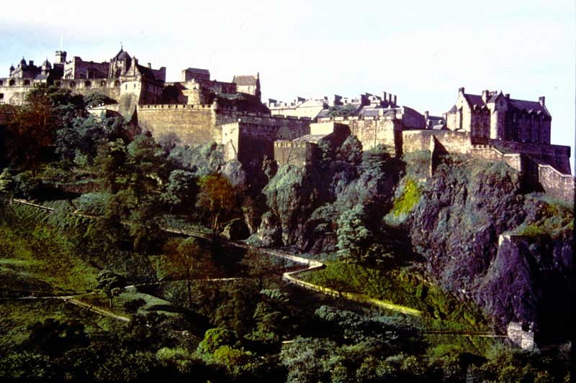
1. Edinburgh Castle – from the Mound.

Slide 3
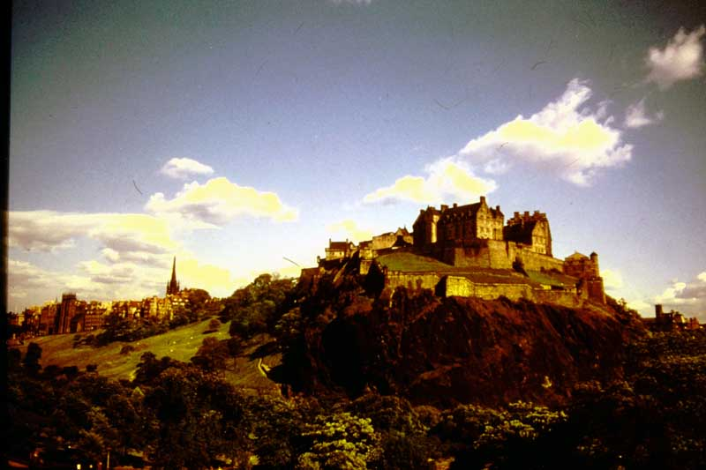
2. Edinburgh Castle – from the West End.

Slide 4
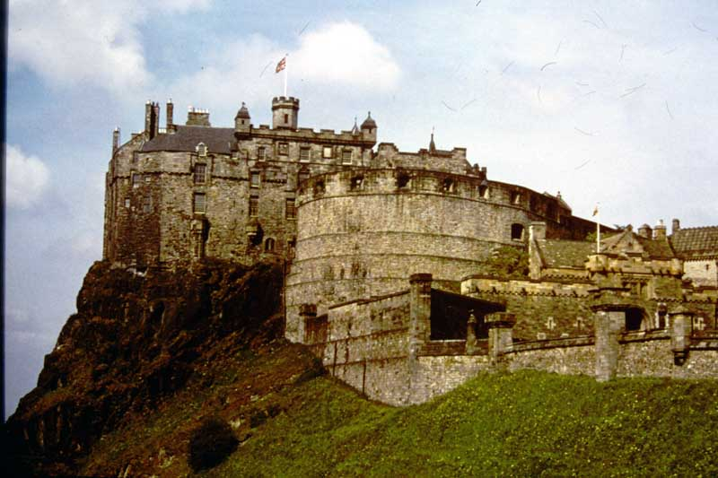
3. Edinburgh Castle - from Johnston Terrace.

Slide 5
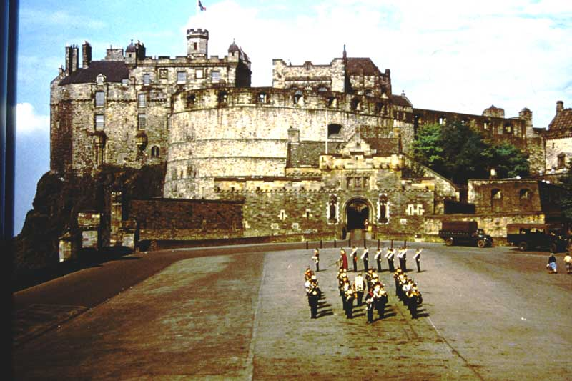
4. Edinburgh Castle – and Espanade.

Slide 6
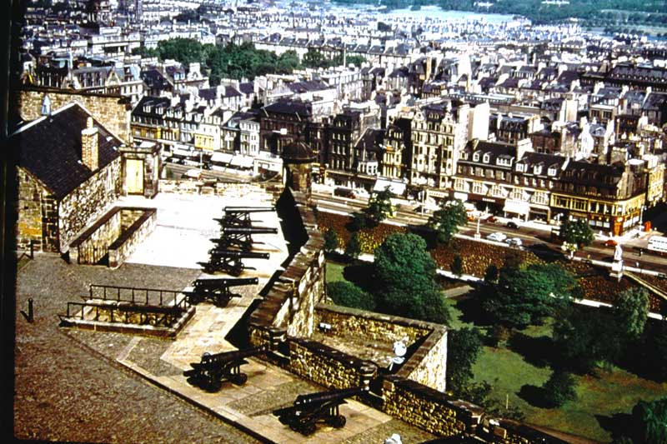
6. Edinburgh Castle – Argyle Battery.

Slide 7
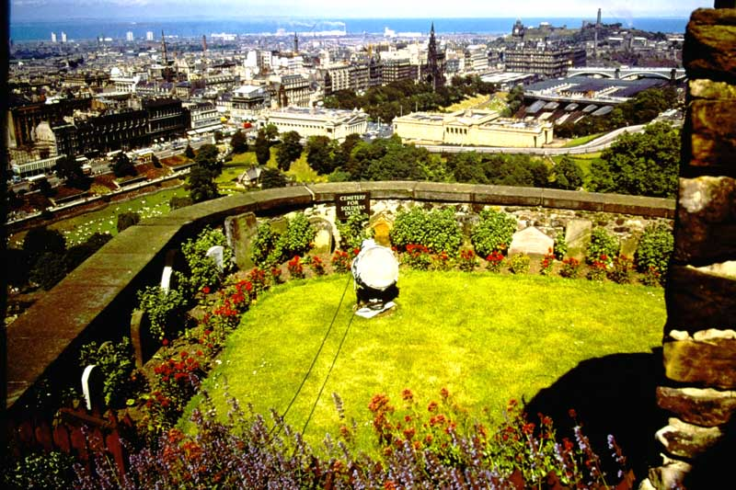
7. Edinburgh Castle – Cemetery for Soldier’s Dogs

Slide 8
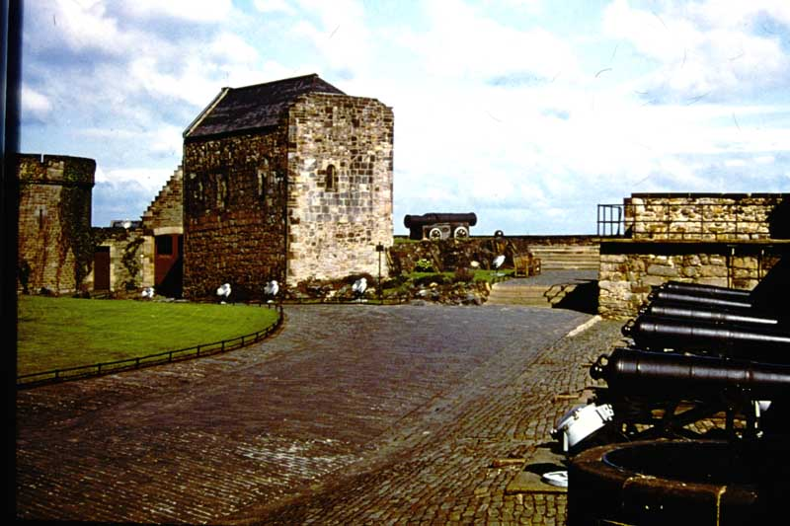
8. Edinburgh Castle – St. Margaret’s Chapel.

Slide 9
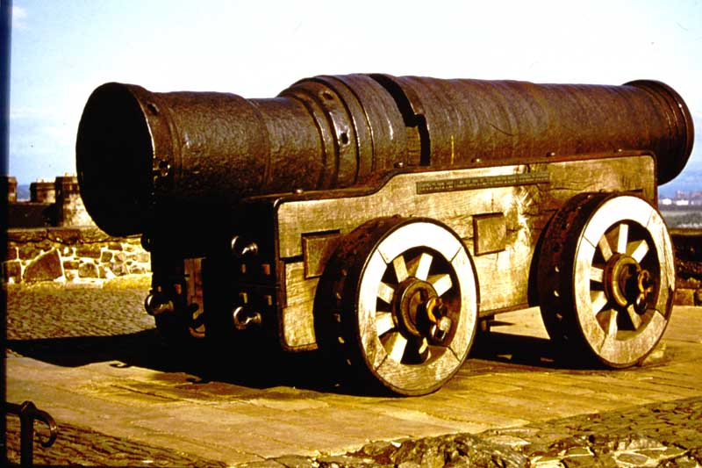
9. Edinburgh Castle – Mons Meg.

Slide 10
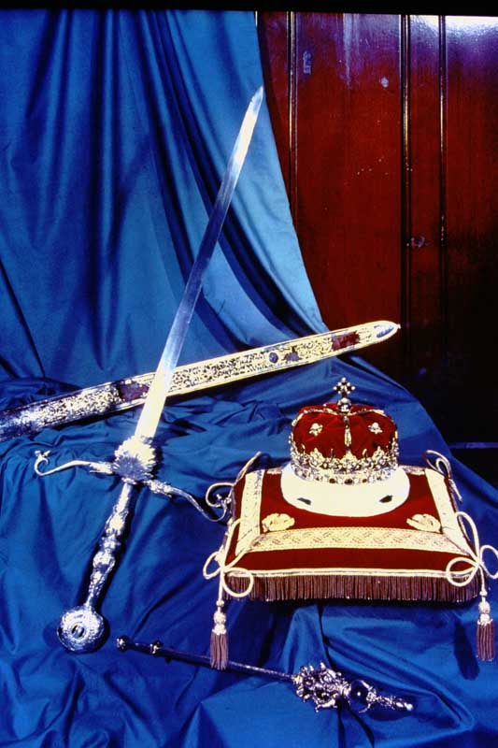
10. Edinburgh Castle – Scottish Regalia.

Slide 11
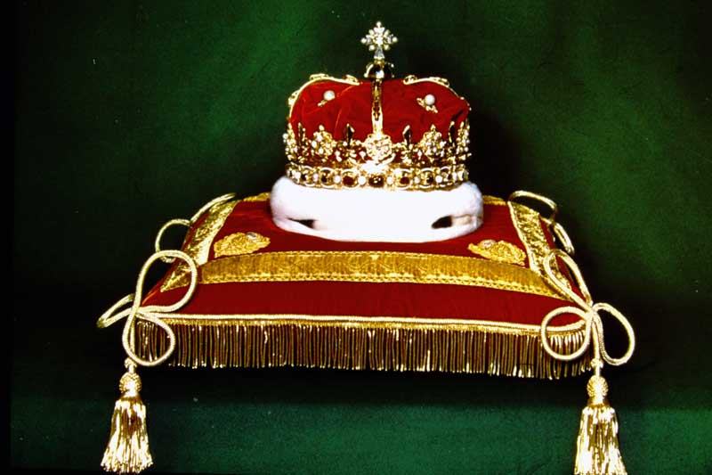
12. The Gold Crown of Scotland.

Slide 12
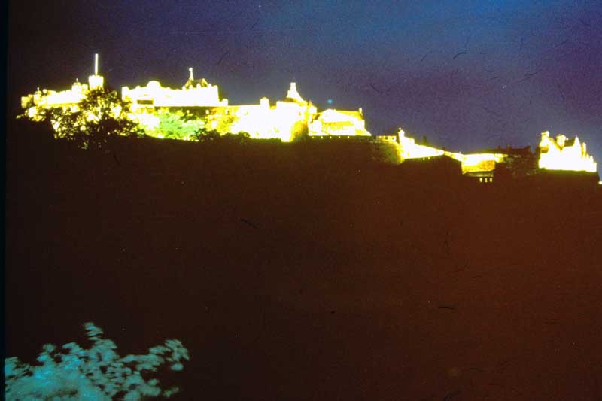
13. Edinburgh Castle – by Floodlight.

Slide 13
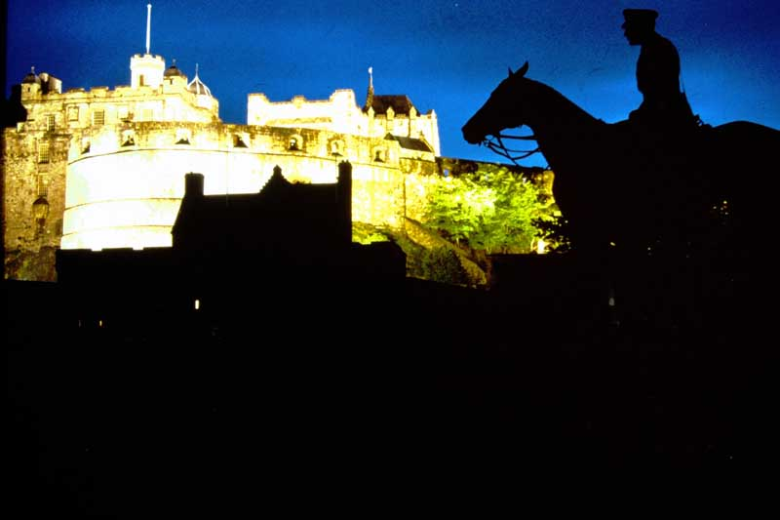
14. Edinburgh Castle – by Floodlight.

Slide 14
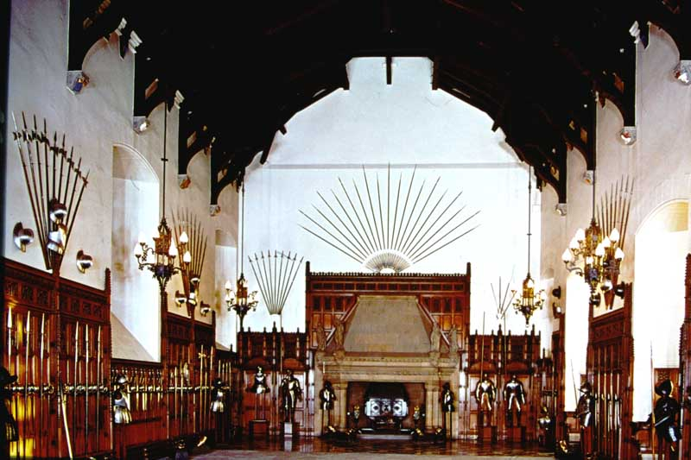
15. Edinburgh Castle – The Great Hall.

Slide 15
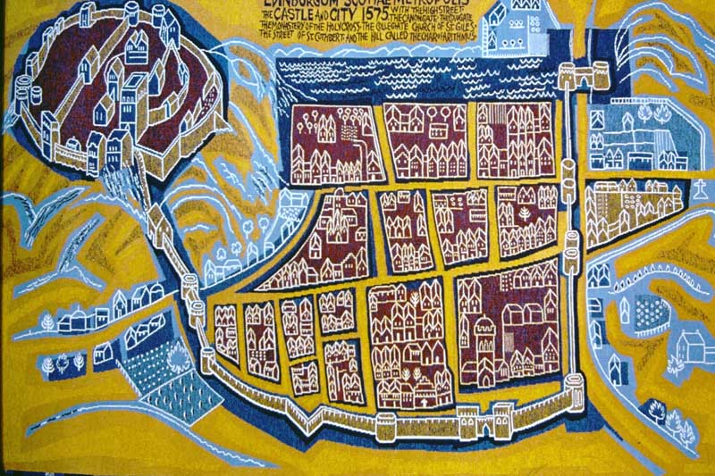
16. Edinburgh Castle – Tapestry woven in 1966 by the Edinburgh Tapestry Co. Ltd.

Slide 16
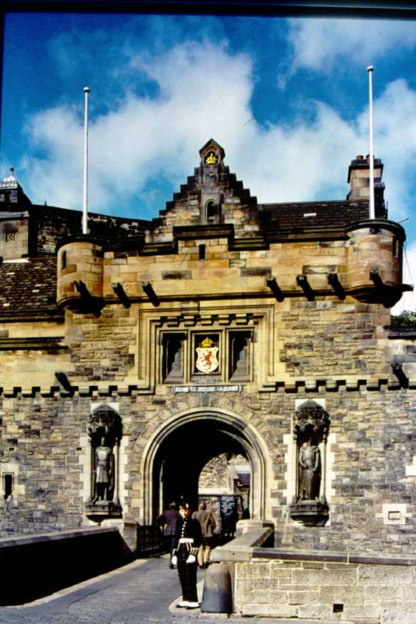
184. Edinburgh Castle – Gateway with Statues of Wallace and Bruce.

Slide 17
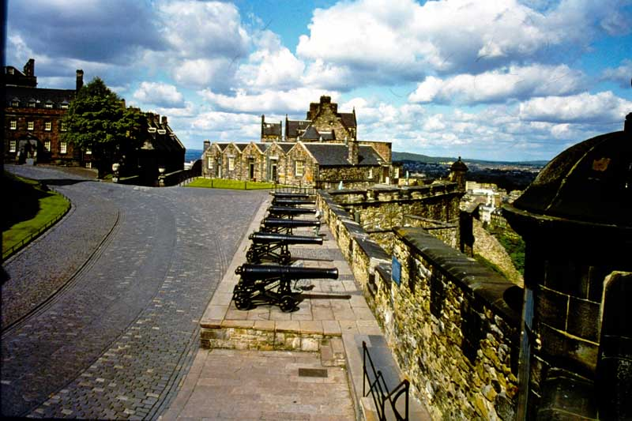
225. Edinburgh Castle – Argyle Battery and the Governor’s House.

Slide 18
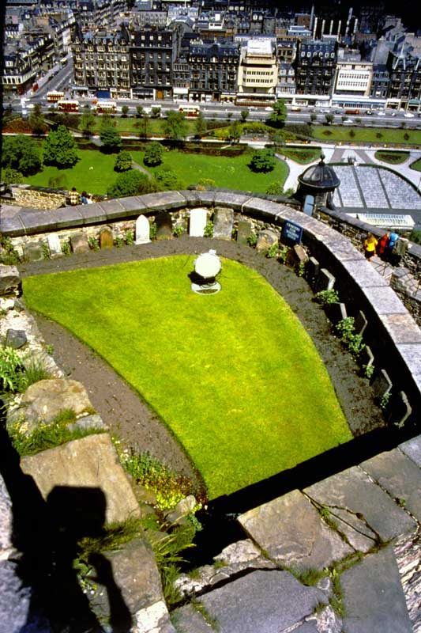
226. Edinburgh Castle – The Cemetery for soldier’s pet dogs.

Slide 19
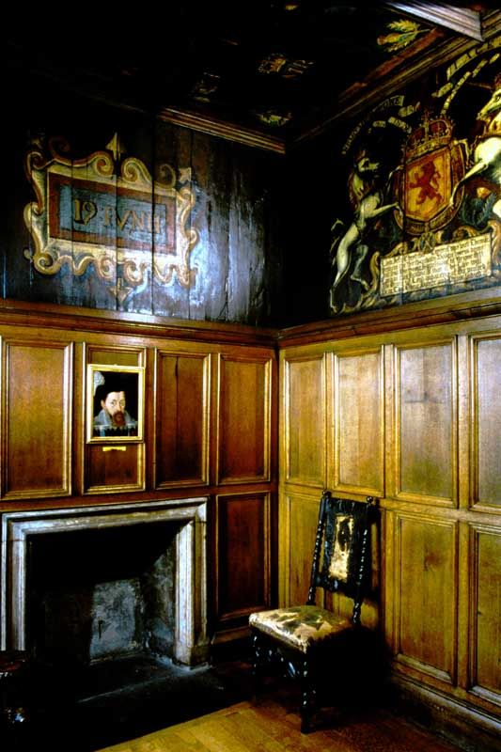
227. Edinburgh Castle – Room where James VI was born.

Slide 20
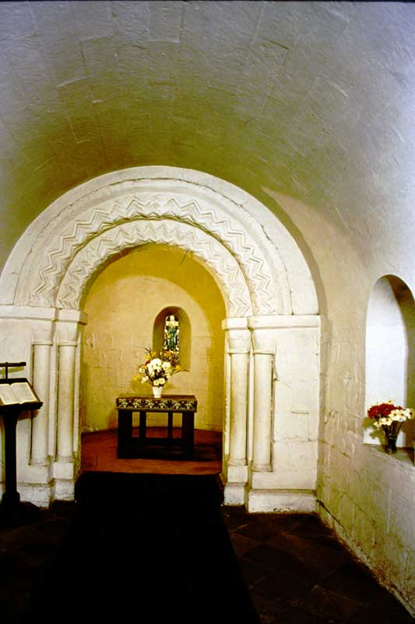
229. Edinburgh Castle – Interior of St. Margaret’s Chapel.

Slide 21
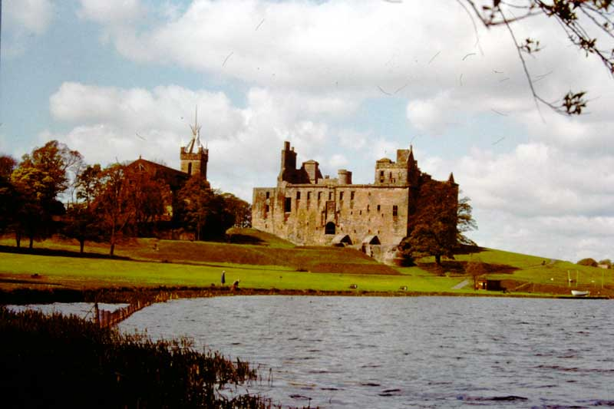
273. LINLITHGOW PALACE.

Slide 22
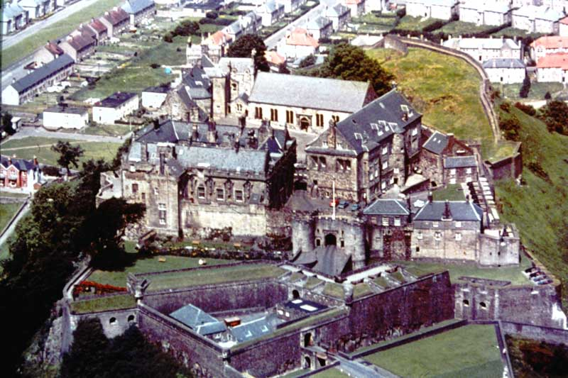
274. STERLING CASTLE

Slide 23
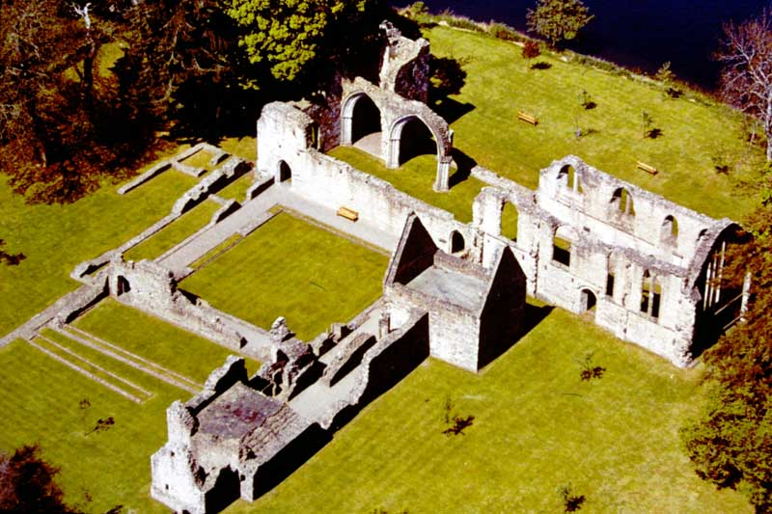
275. INCHMAHOME PRIORY

Slide 24
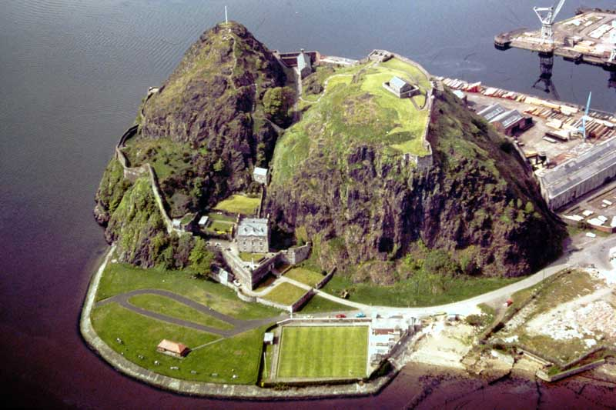
276. DUMBARTON CASTLE.

Slide 25
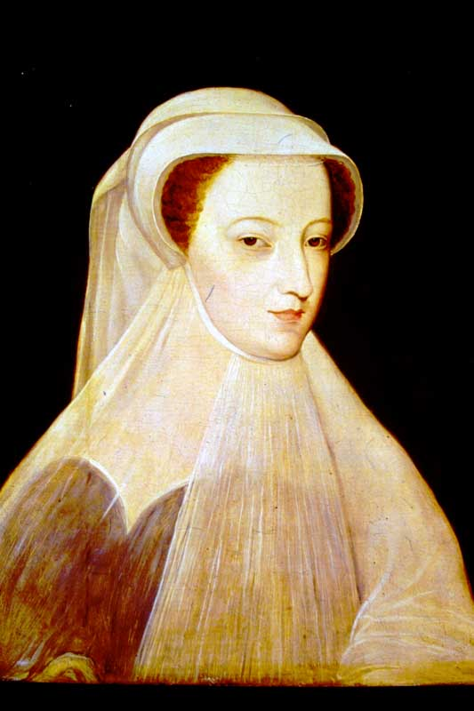
277. Mary, Queen of Scots.

Slide 26
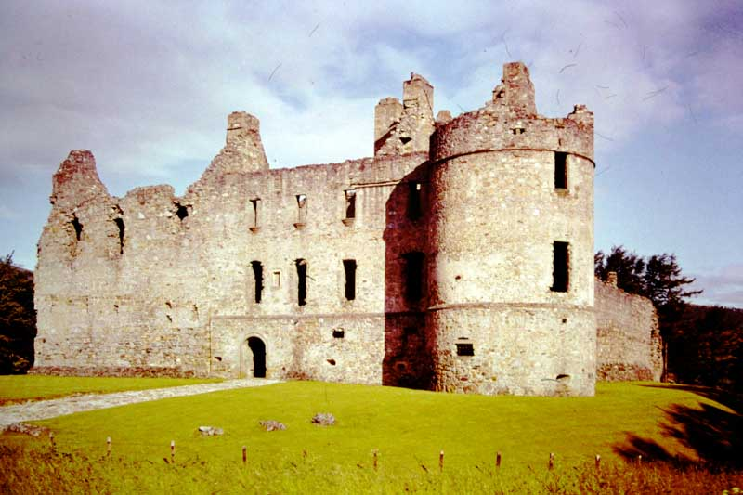
278. BALVENIE CASTLE

Slide 27
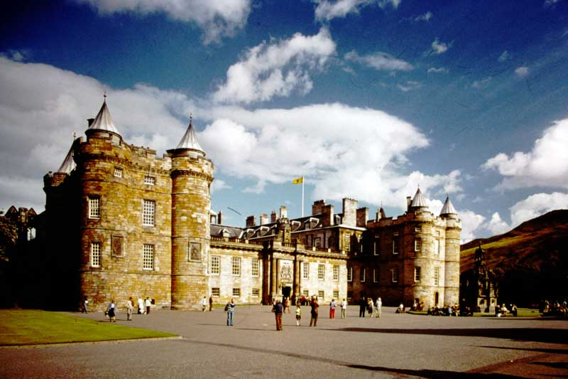
279. PALACE OF HOLYROODHOUSE

Slide 28
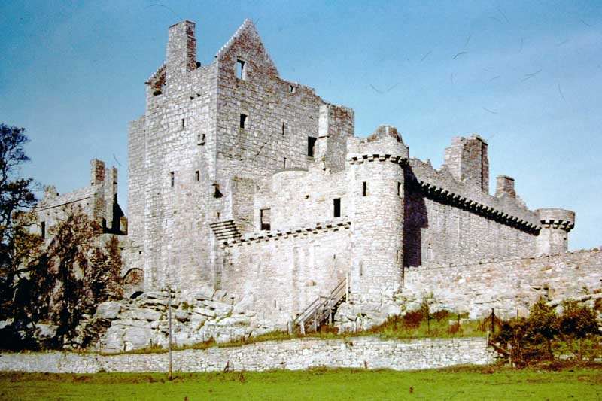
280. CRAIGMILLAR CASTLE.

Slide 29
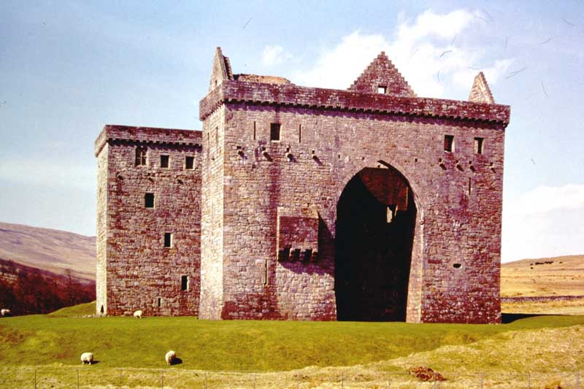
282. HERMITAGE CASTLE.

Slide 30
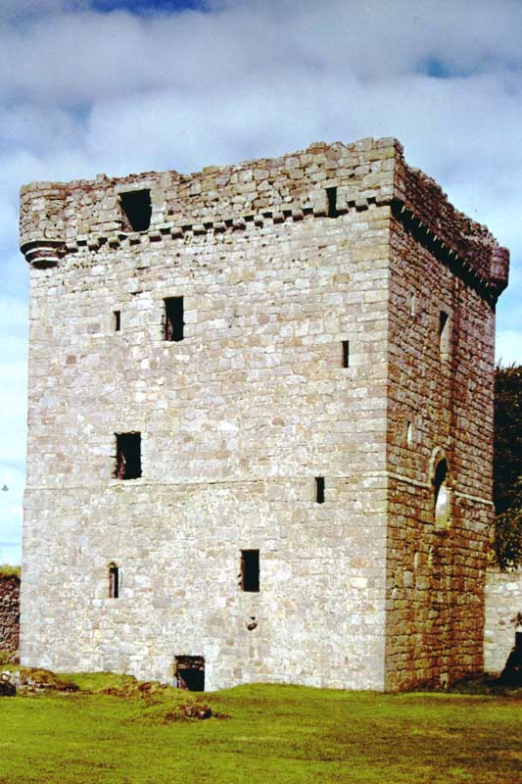
283. LOCHLEVEN CASTLE.

Slide 31
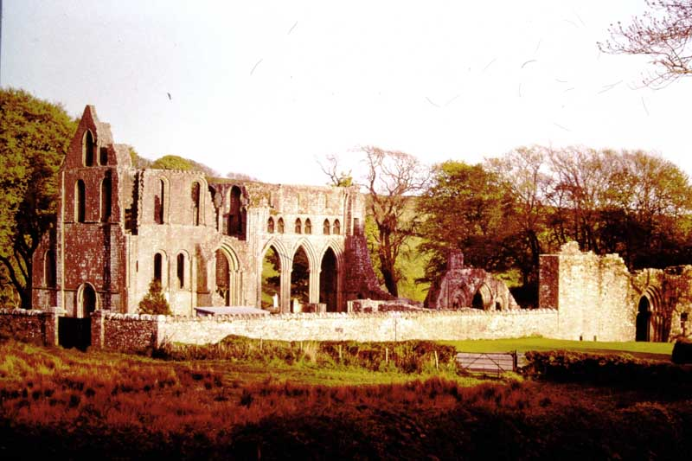
284. DUNDRENNAN ABBEY.

Slide 32
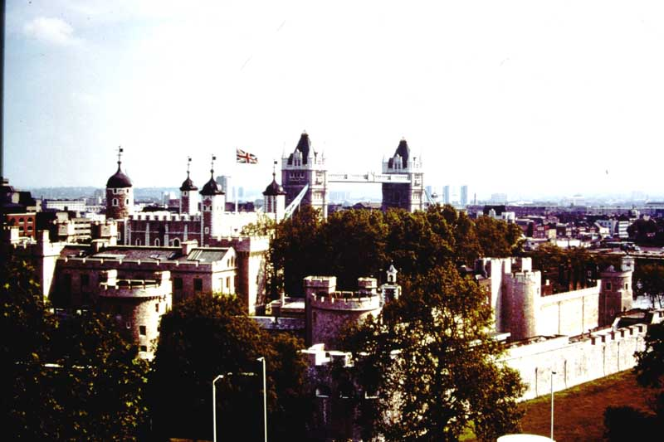
T 1. Tower of London – General view from the Northwest.

Slide 33
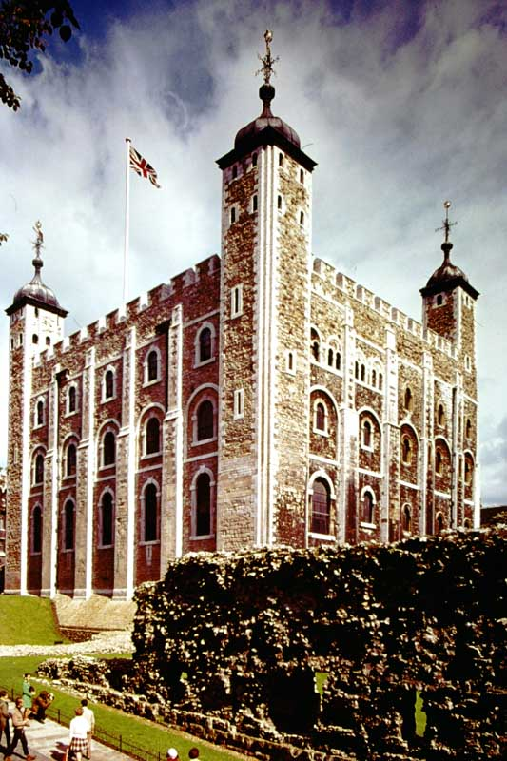
T 2. Tower of London – The White Tower.

Slide 34
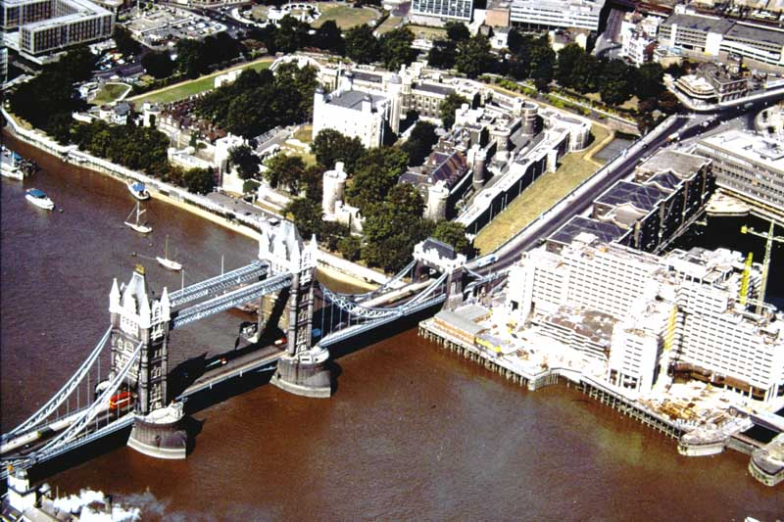
T 3. Tower of London, Air View

Slide 35
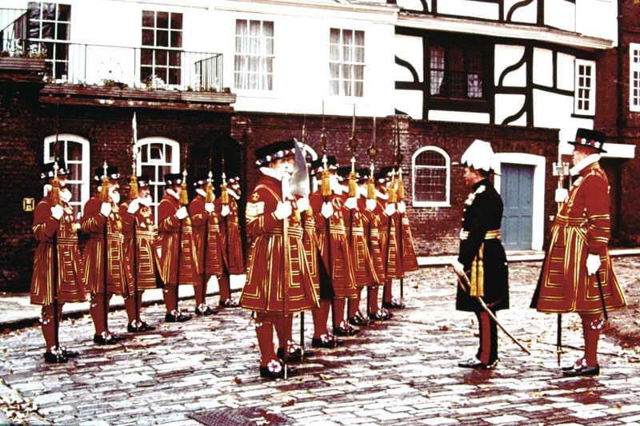
T 4. Tower of London – Yeoman Warders on Church Parade.

Slide 36
END OF SLIDE BOX 8

