Slide 1
BATTLE ABBEY, EAST SUSSEX – H.M.S. VICTORY – THE MARY ROSE
These slides are from the estate of Paul Berthelot who found the English culture and architecture intriguing. He acquired these images while stationed in England serving in the US Air Force.

Slide 2
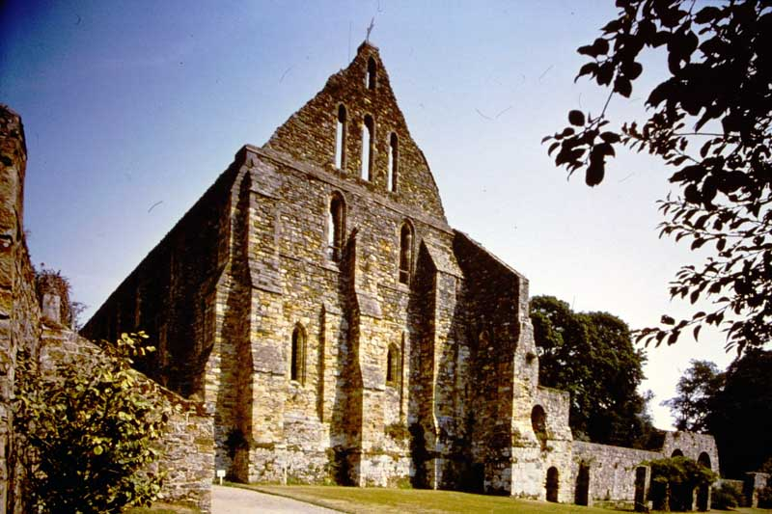
772. Battle Abbey, East Sussex. South end of east range (dormitory) from the south-west.

Slide 3
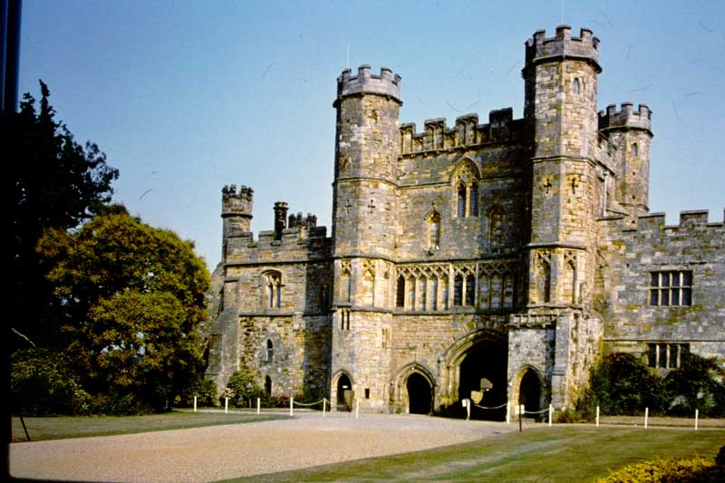
773. Battle Abbey, East Sussex. Gatehouse from the south.

Slide 4
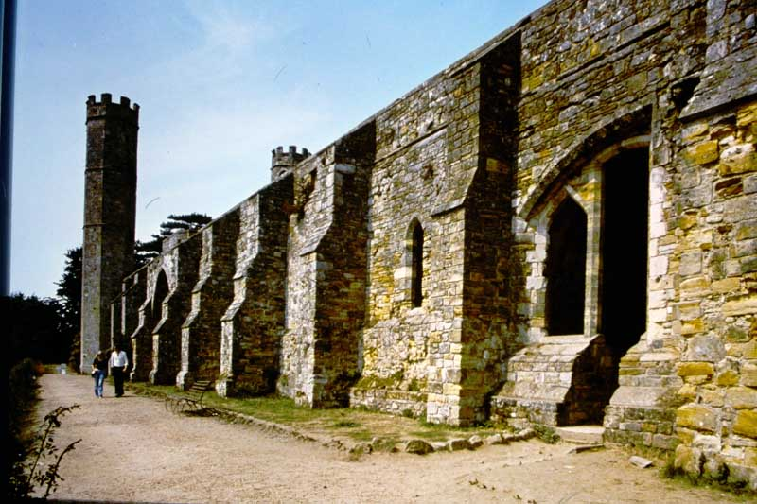
774. Battle Abbey, East Sussex. Guesthouse range from the south-east.

Slide 5
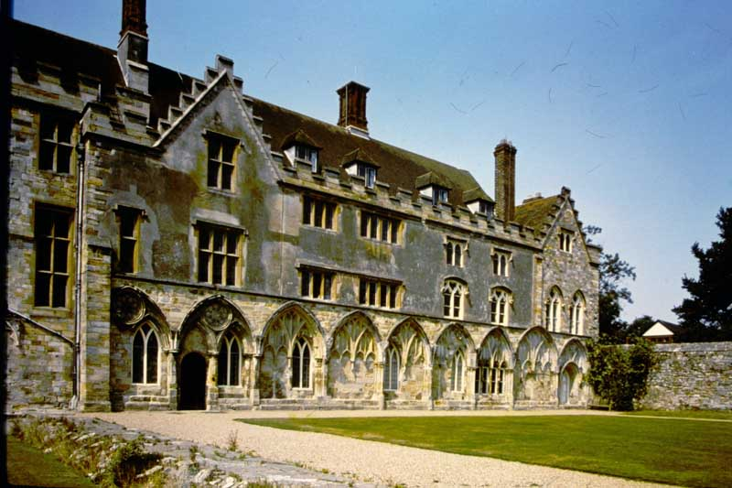
775. Battle Abbey, East Sussex. East front of Abbot’s House.

Slide 6
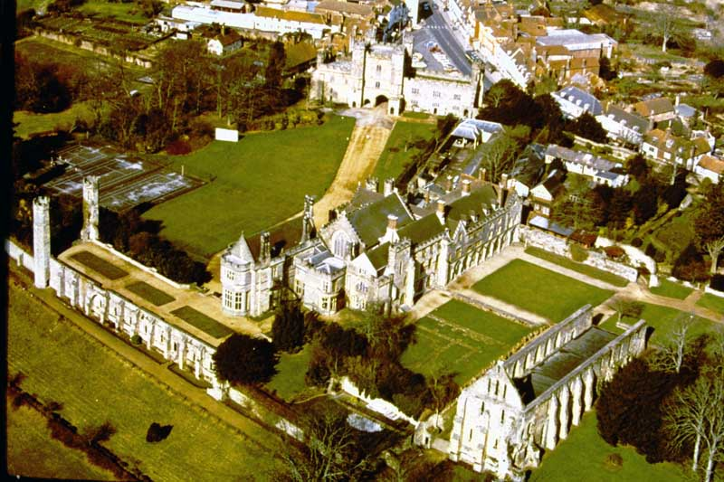
767. Battle Abbey, East Sussex. Arial view.

Slide 7
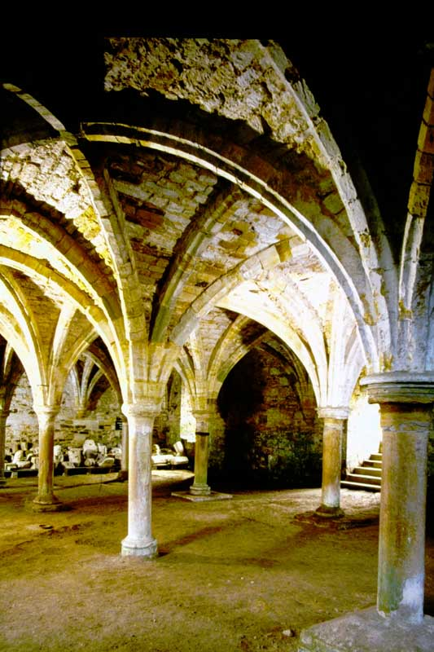
S85-18. Battle Abbey, East Sussex.
Interior, The Monk’s Common Room.

Slide 8
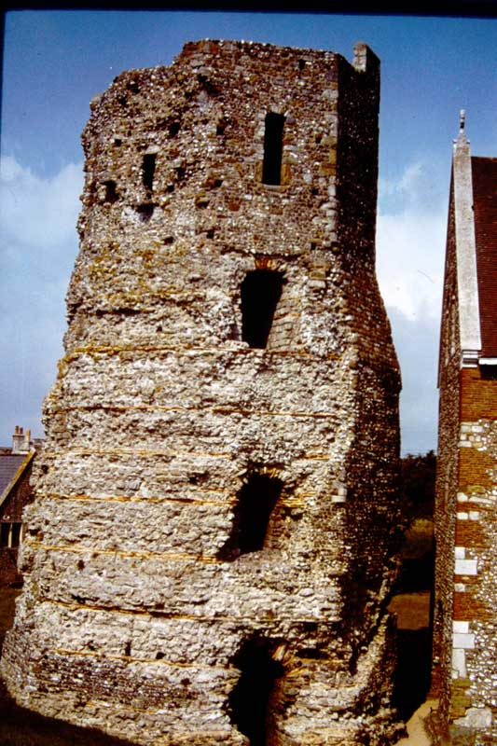
54. Dover Castle. Kent. Roman Lighthouse.

Slide 9
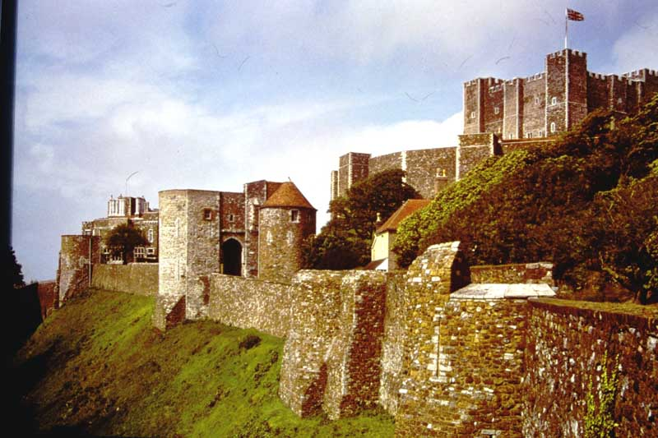
55. Dover castle. Kent. From the south-west showing (left to right) the Constable’s Tower, Peverell’s Tower, Inner Curtain and Keep.

Slide 10
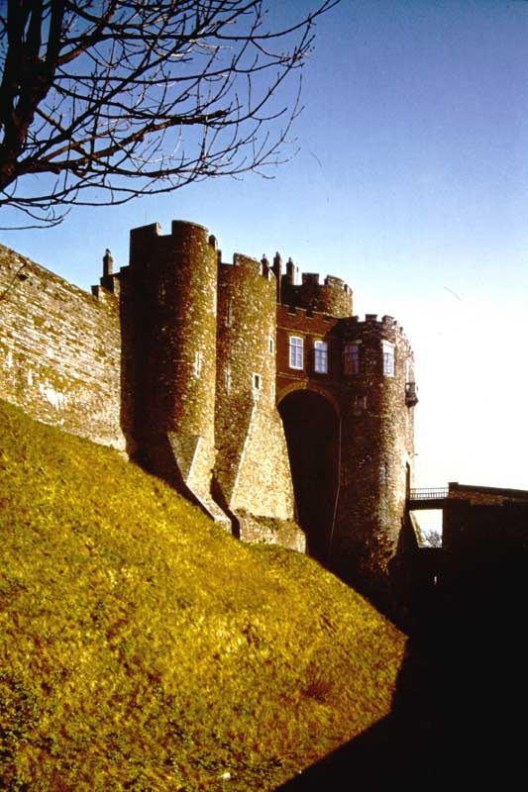
56. Dover Castle, Kent. Constable’s Tower.

Slide 11
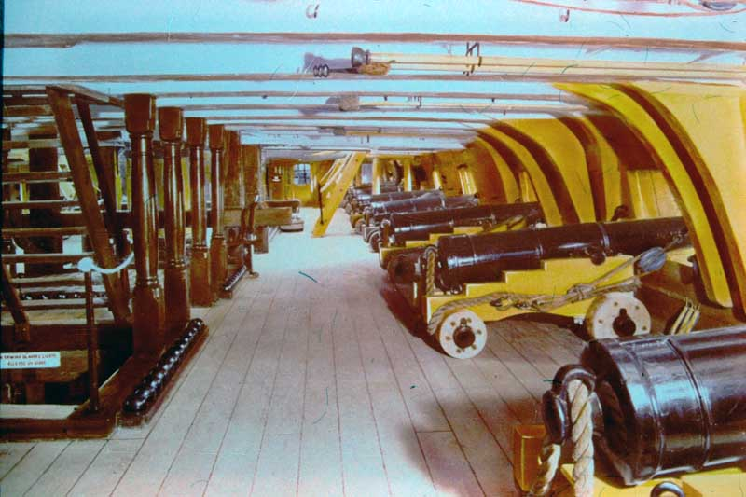
H.M.S. VICTORY – Upper Gun Deck.

Slide 12
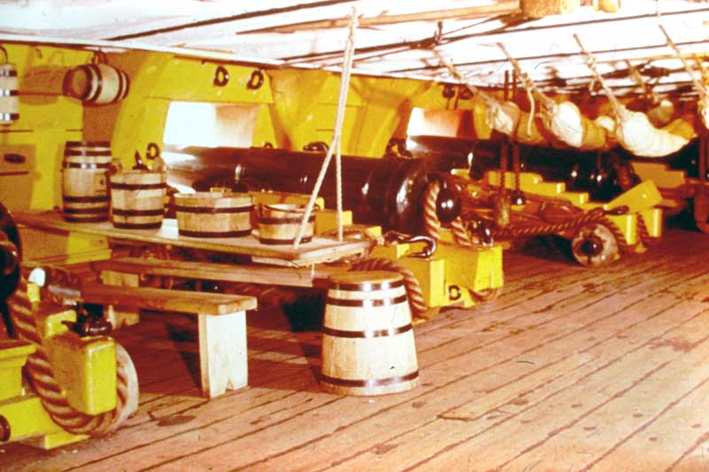
H.M.S. VICTORY – Men’s Mess, Lower Gun Deck.

Slide 13
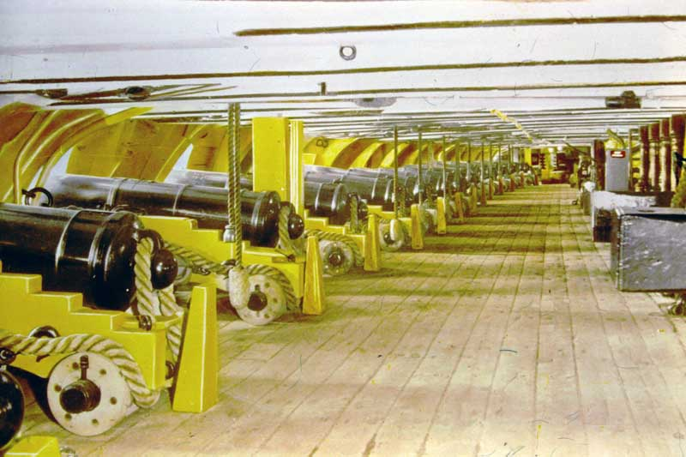
H.M.S. VICTORY – Lower Gun Deck.

Slide 14
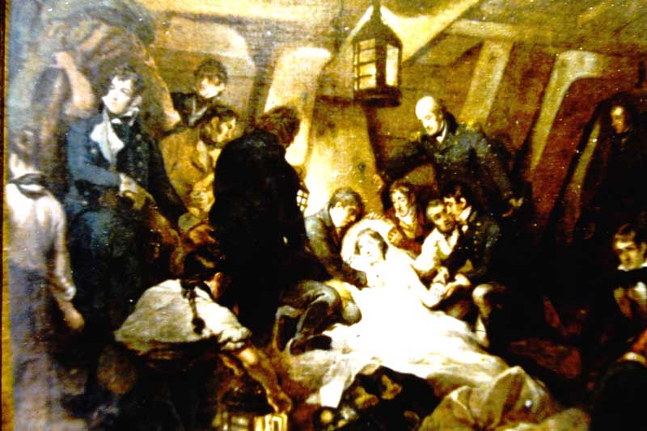
H.M.S. VICTORY – Death of Nelson

Slide 15
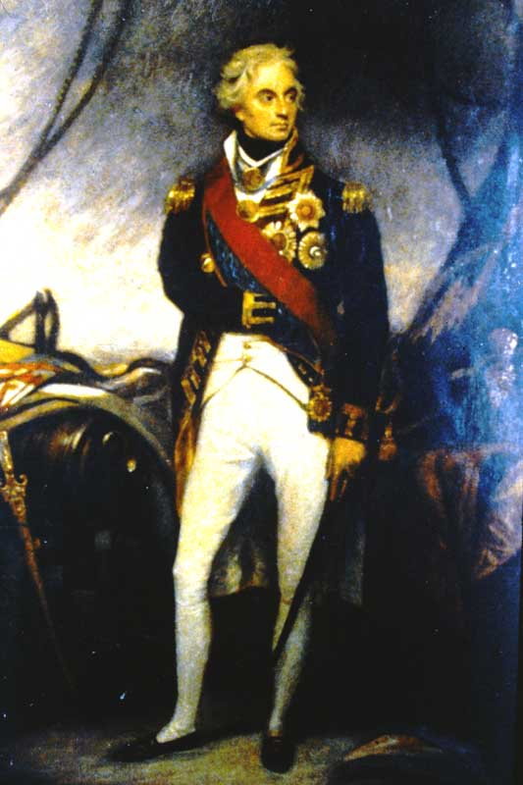
H.M.S. VICTORY – “Lord Nelson” by Beechy

Slide 16
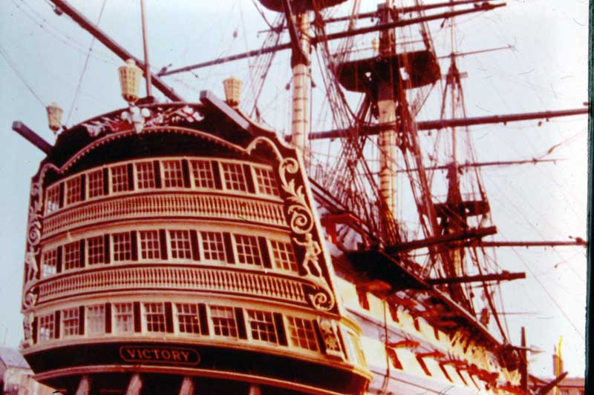
H.M.S. VICTORY – The Gingerbreads.

Slide 17


Slide 18
The Mary Rose: 1511-1545
There’s a common misconception that the Mary Rose sank on her maiden voyage.
In fact, she was a successful warship for Henry VIII for 34 years: almost the entire duration of his reign.

Slide 19
The following slides must be salvage recovered from The Mary Rose. There are 4 sets of slides each labeled with the numbers 1 to 6 and no other information about them.

Slide 20
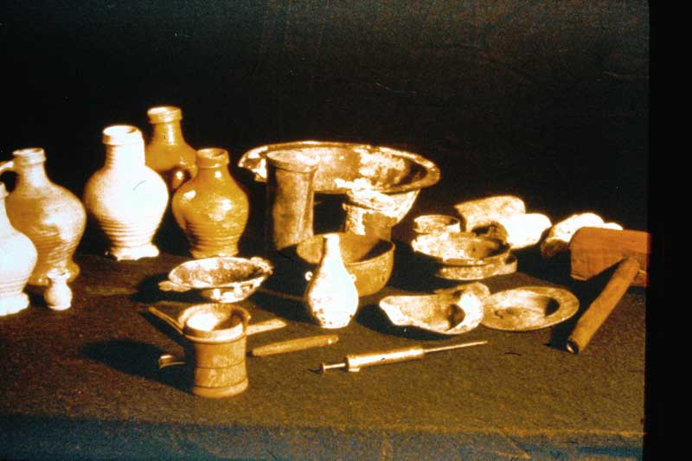

Slide 21
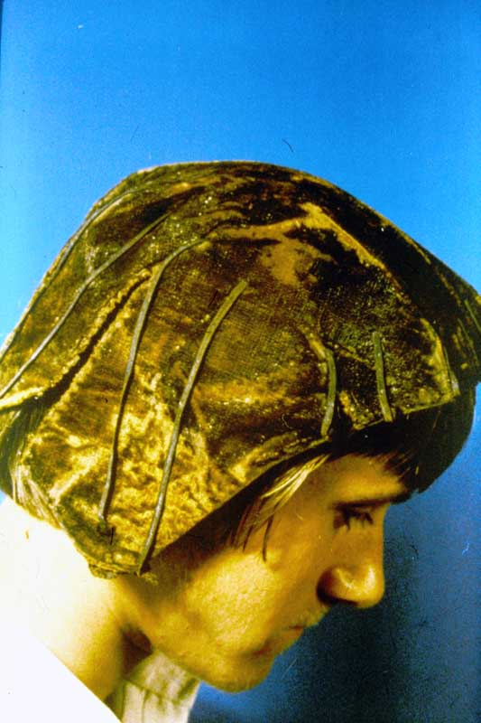

Slide 22
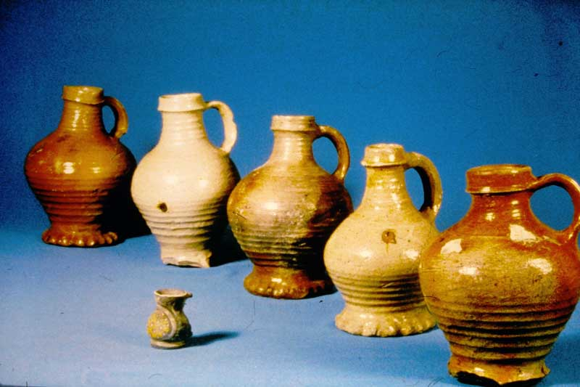

Slide 23
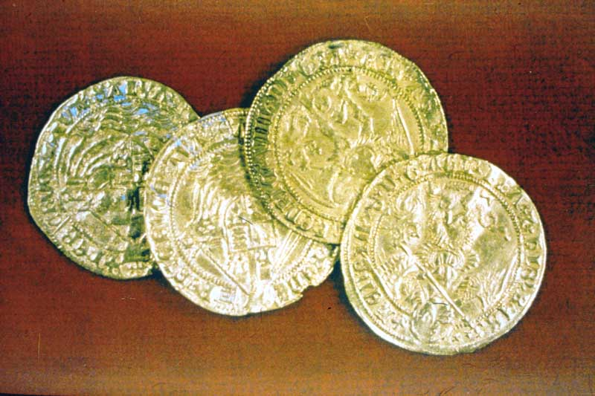

Slide 24
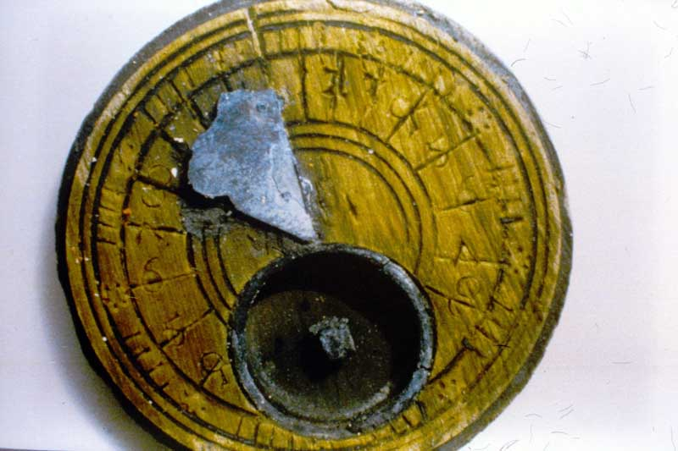

Slide 25
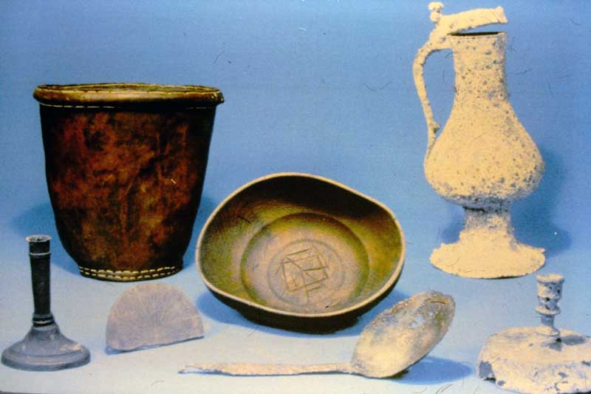

Slide 26
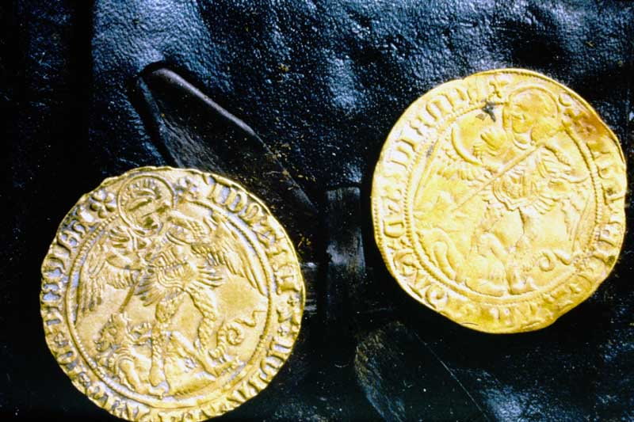

Slide 27
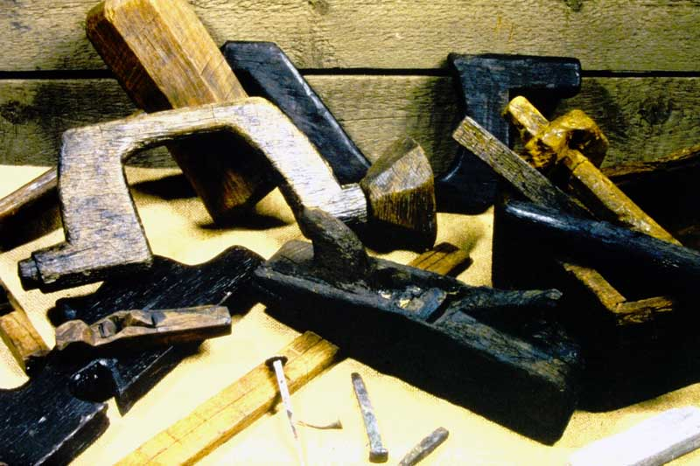

Slide 28
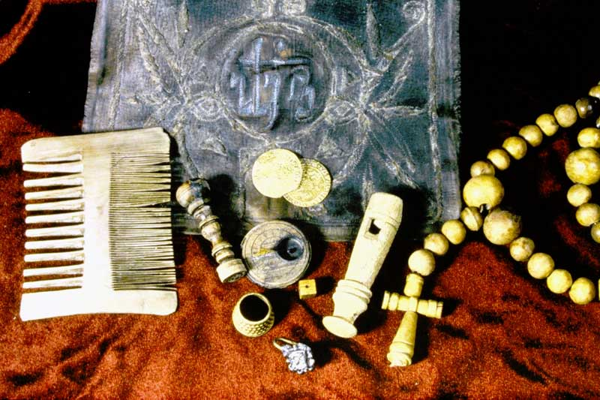

Slide 29
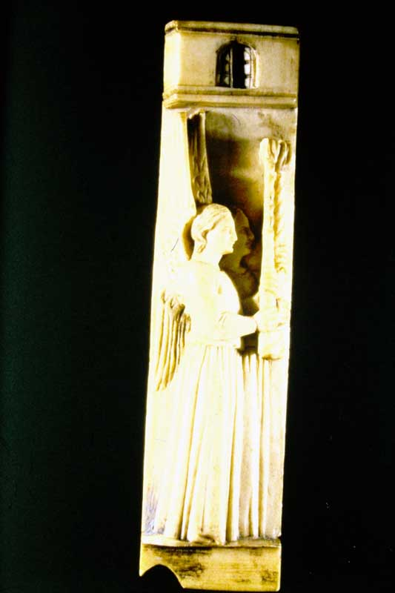

Slide 30
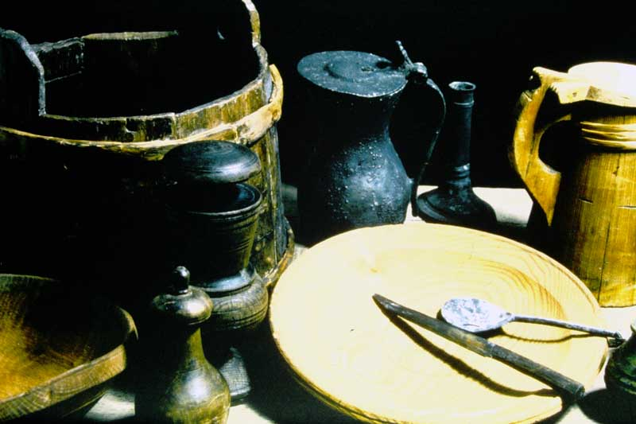

Slide 31
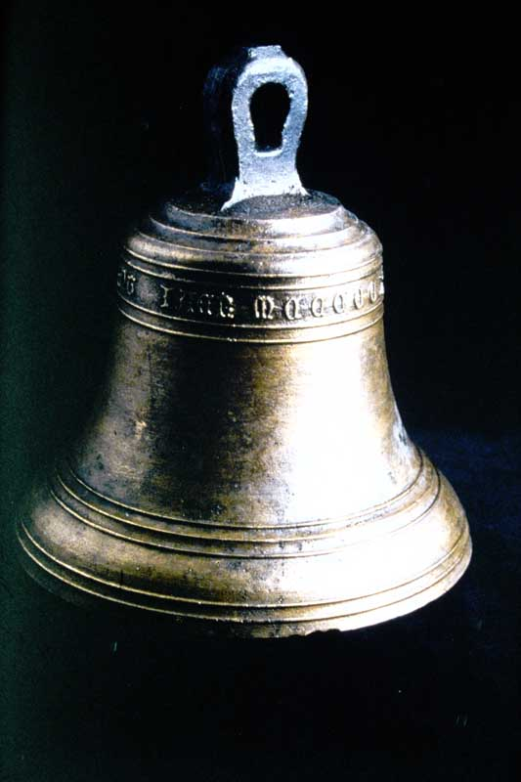

Slide 32
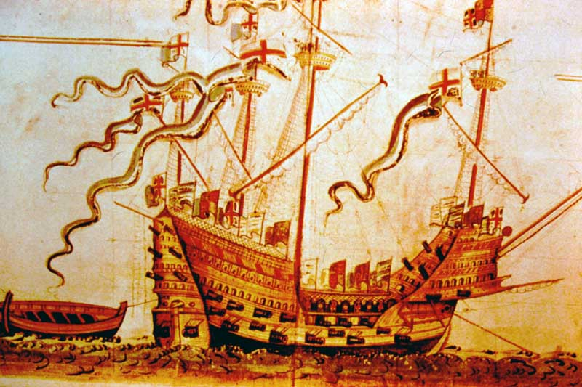

Slide 33
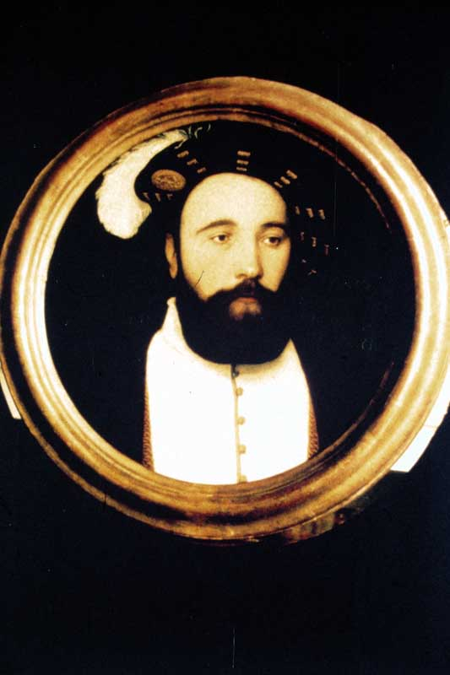

Slide 34
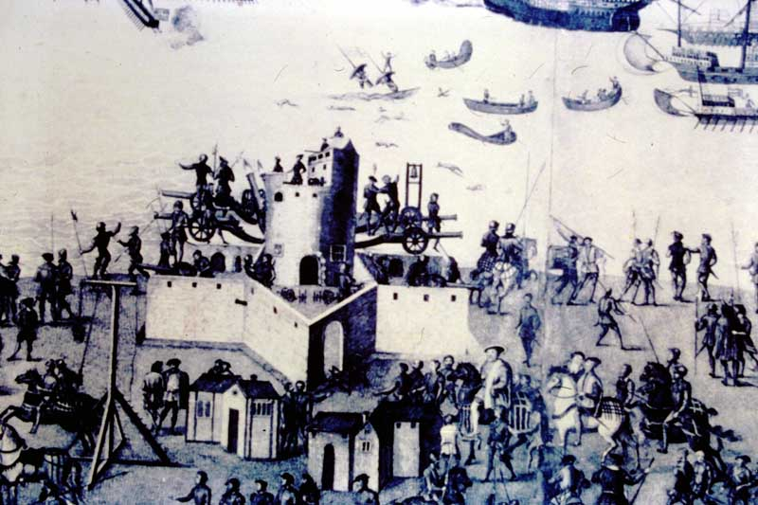

Slide 35
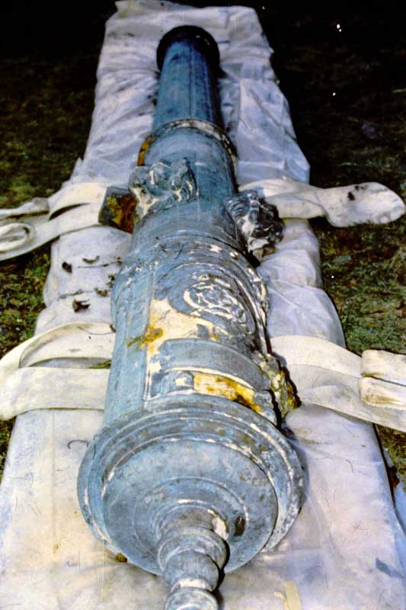

Slide 36
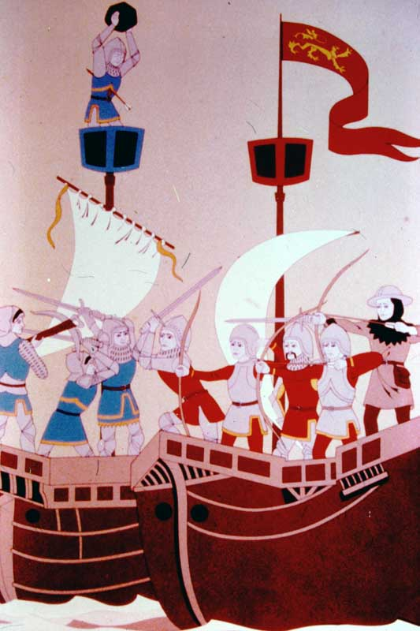

Slide 37
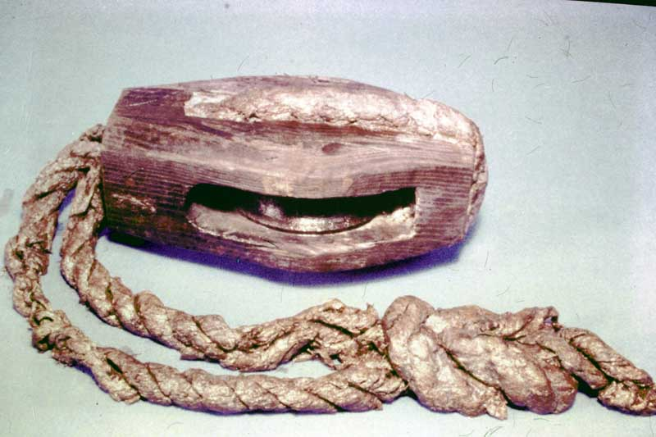

Slide 38
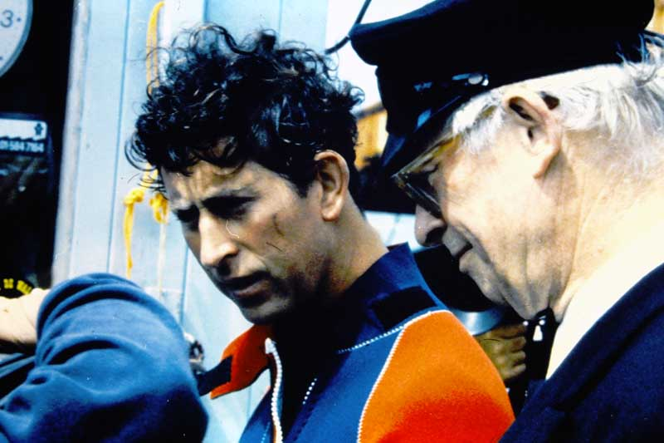

Slide 39
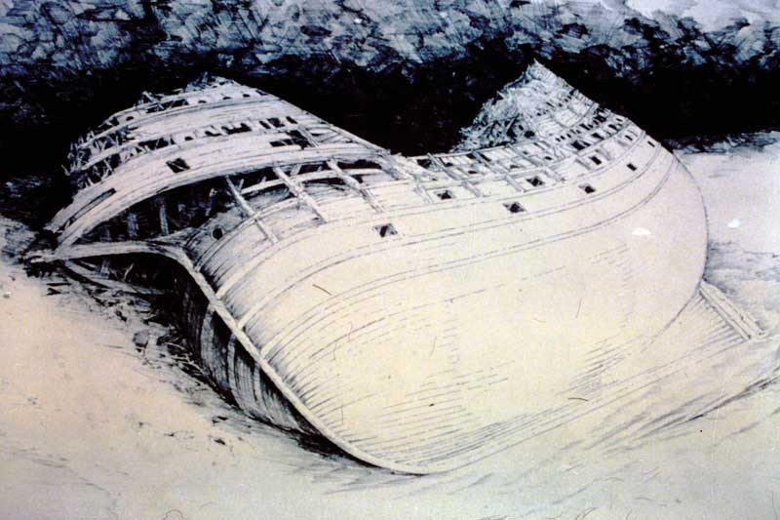

Slide 40
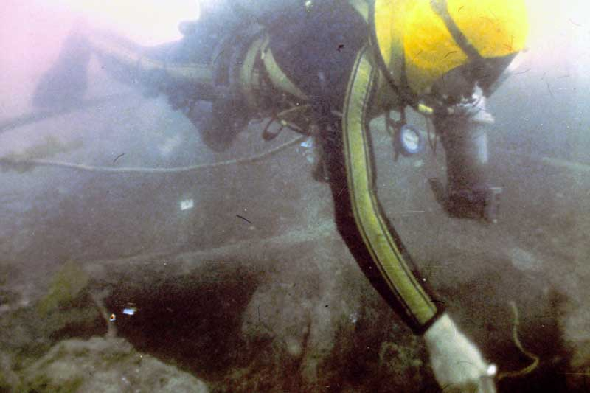

Slide 41
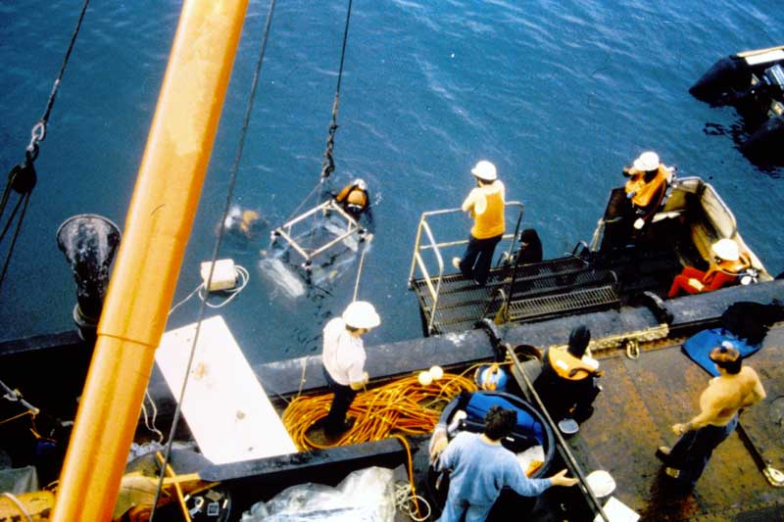

Slide 42
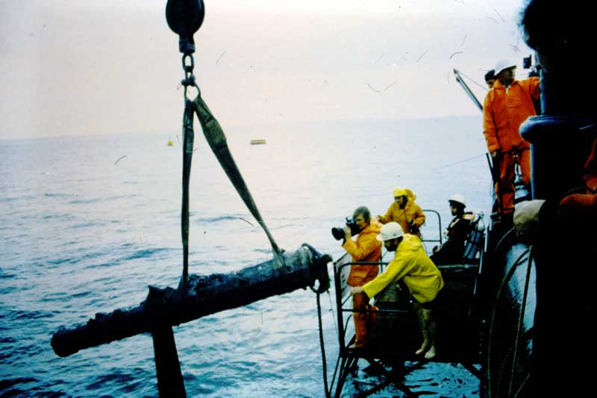

Slide 43
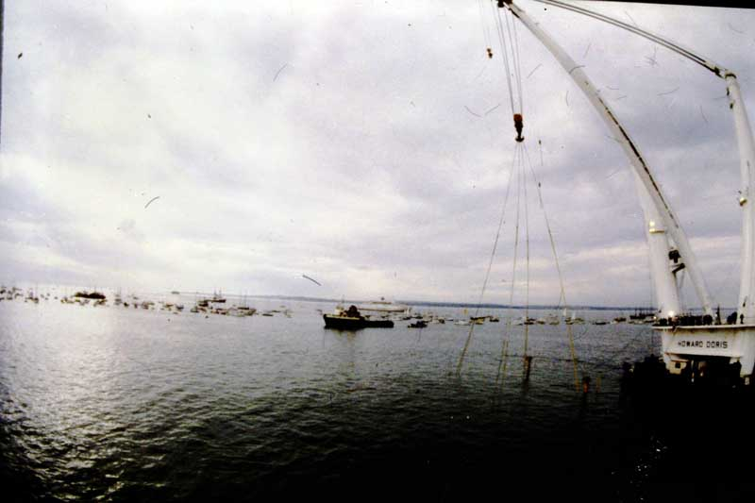

Slide 44
END OF BOX 10

