Slide 1
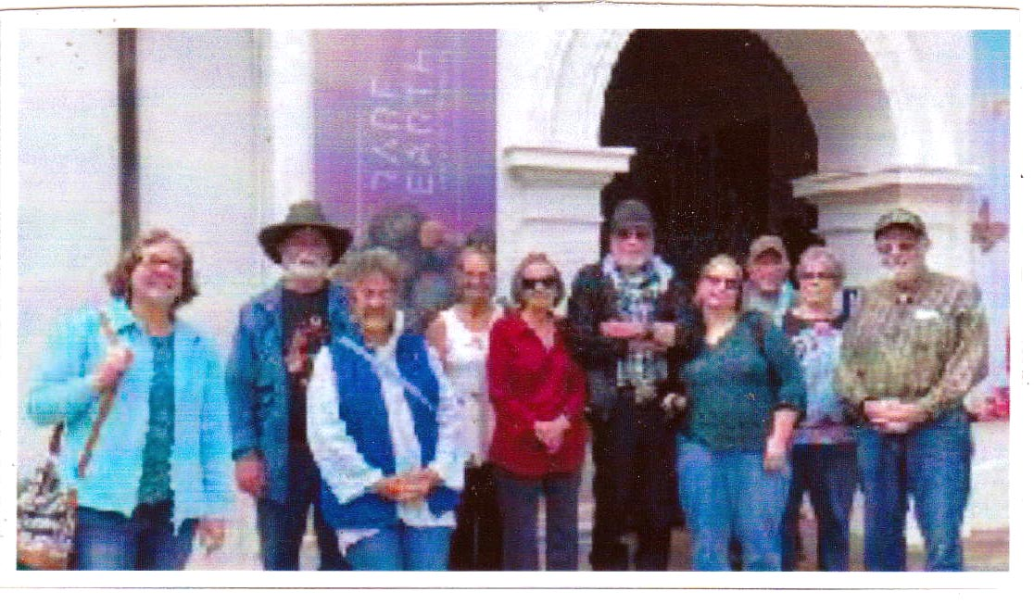
FIELD TRIP TO THE SANTA BARBARA MUSEUM OF NATURAL HISTORY
20 AUGUST, 2022
Presented by Wes Lingerfelt

Slide 2
A little history:
Santa Barbara Museum of Natural History is a natural history museum in Santa Barbara, California. It reconnects more than 150,000 people each year to nature indoors and outdoors. Uniquely nestled in nature, the museum is located along Mission Creek in the Mission Canyon area. The museum has ten indoor exhibit halls focusing on regional natural history including astronomy, birds, insects, geology, mammals, marine life, paleontology, plant life, and the Chumash Indians. Also, the museum is home to the only full-dome planetarium on the Central Coast, a research library, and the John & Peggy Maximus Art Gallery. The early roots of the museum date back to the 1880s, when a group of professional and amateur scientists, including botanist Caroline Bingham, started the Santa Barbara Natural History Society and an accompanying museum at 1226 State Street.

Slide 3
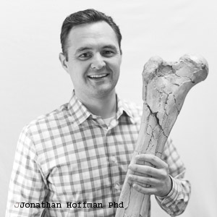
We were met by this young man who gave us a thorough background on the Rare Earth display. It was surprising that he knew Ralph Bishop very well.

Slide 4
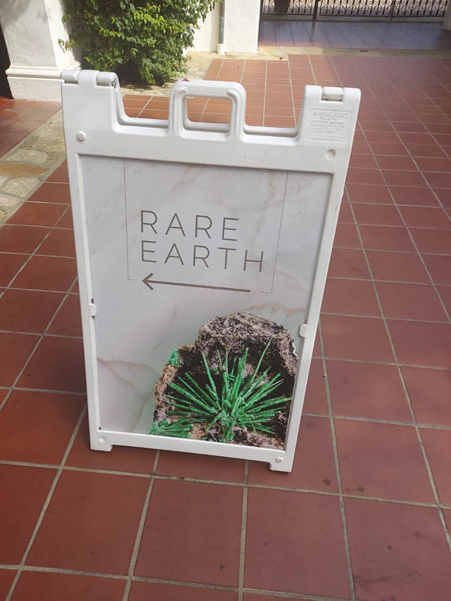

Slide 5
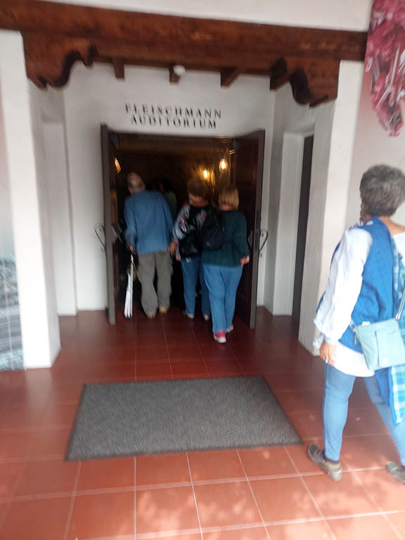

Slide 6
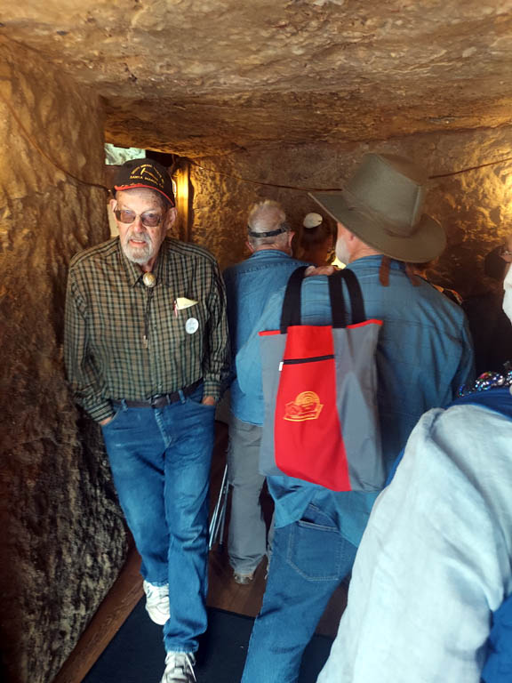

Slide 7
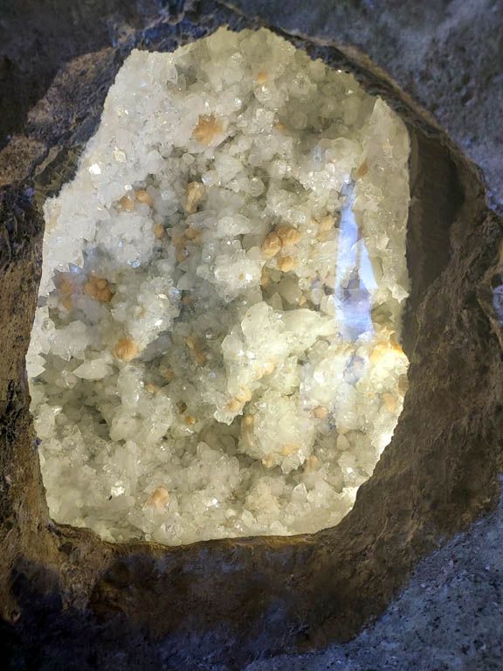

Slide 8
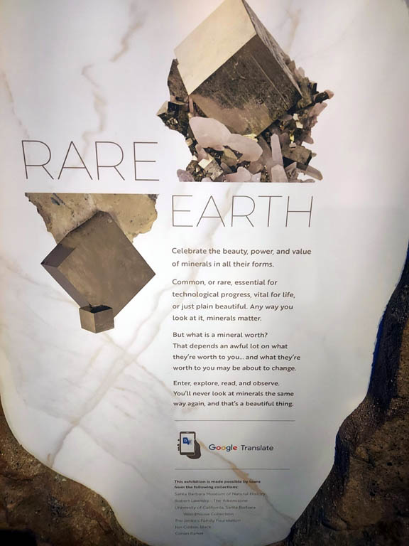

Slide 9
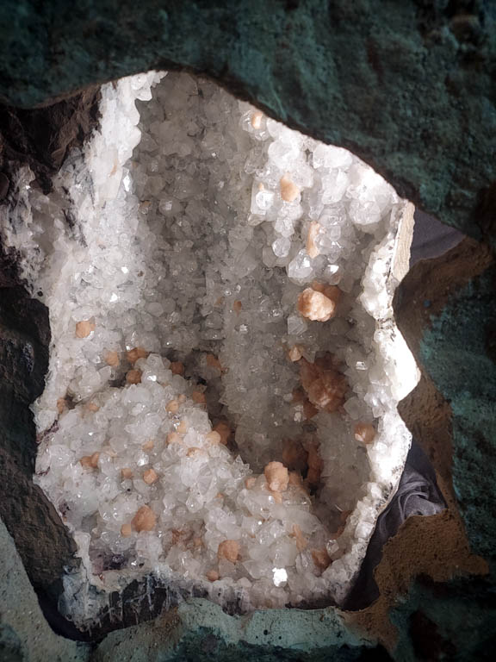

Slide 10
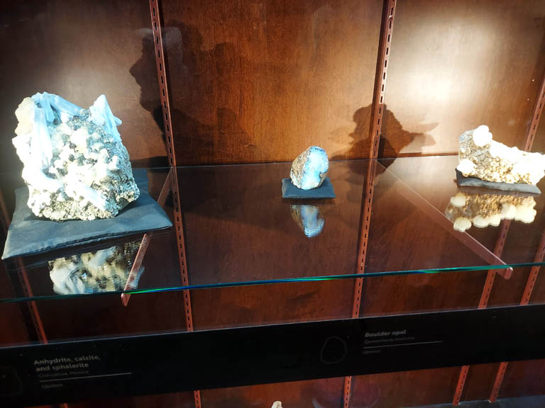

Slide 11
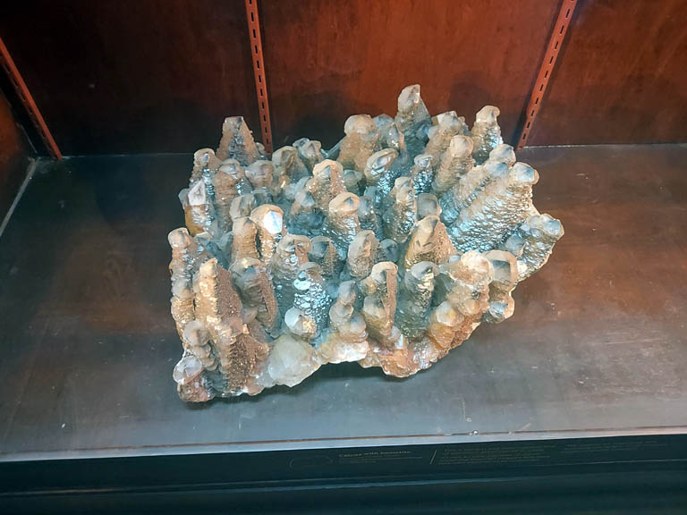

Slide 12
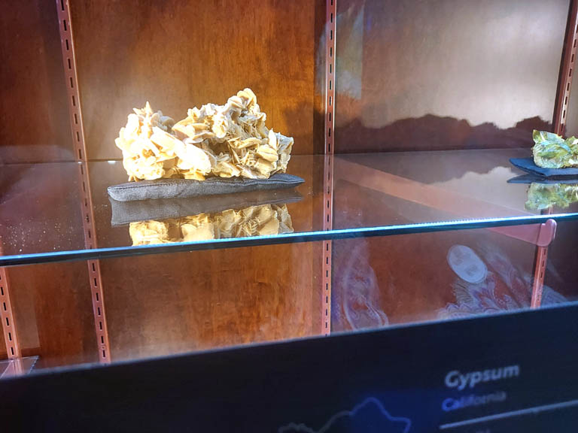

Slide 13
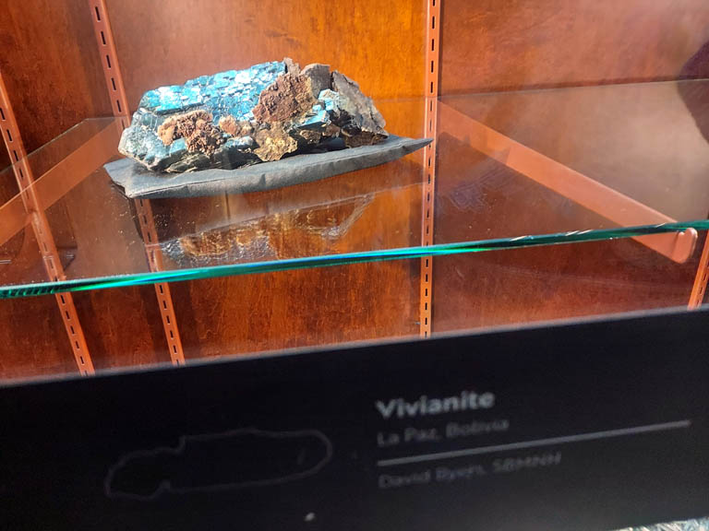

Slide 14
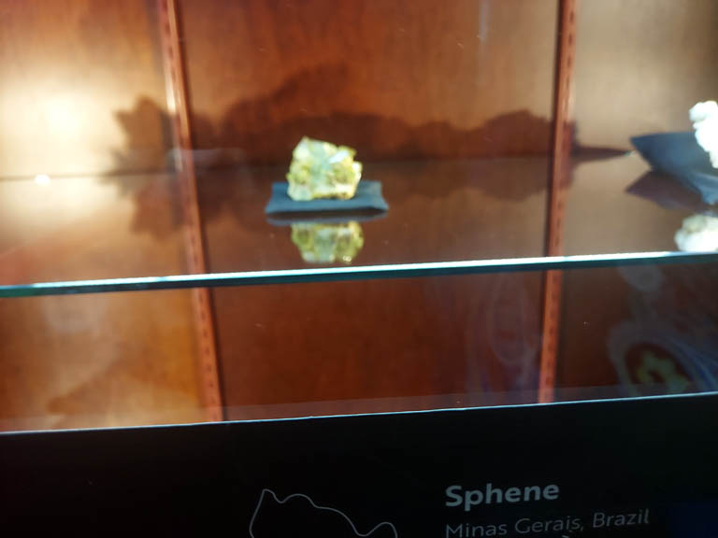

Slide 15
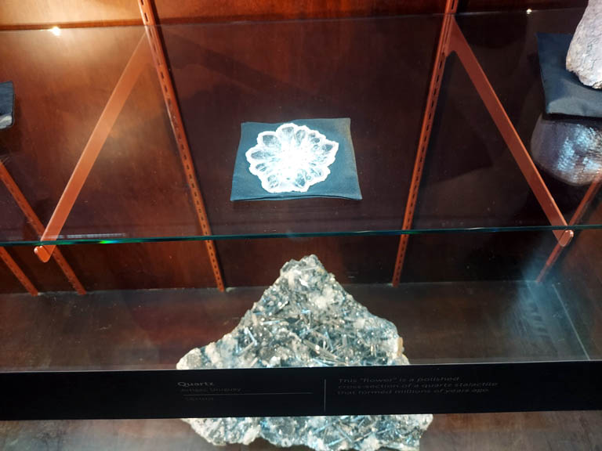

Slide 16
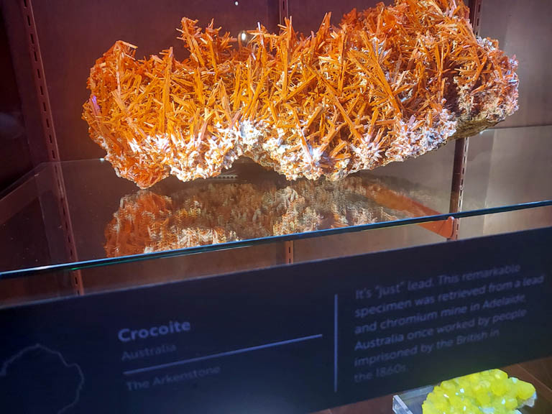

Slide 17
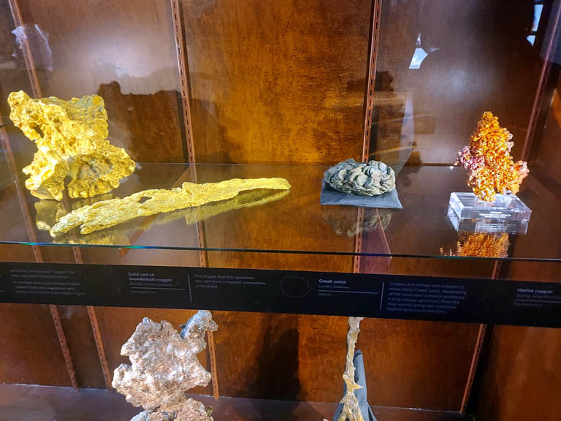

Slide 18
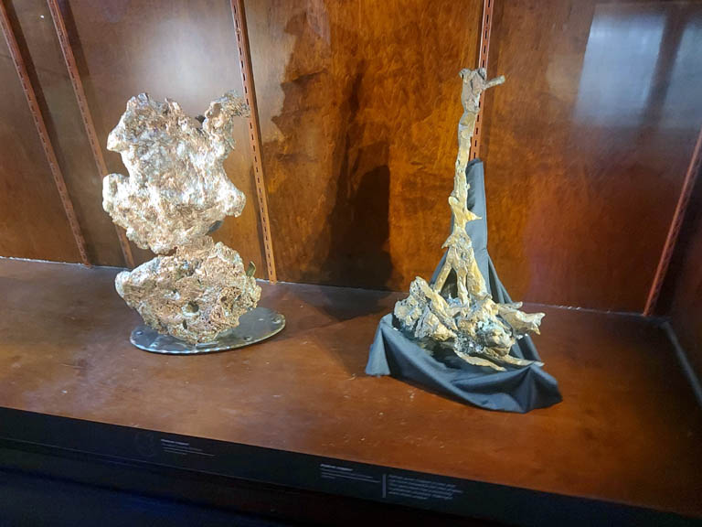

Slide 19
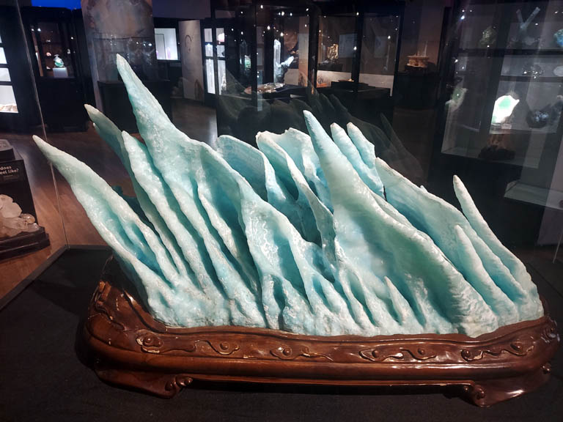

Slide 20
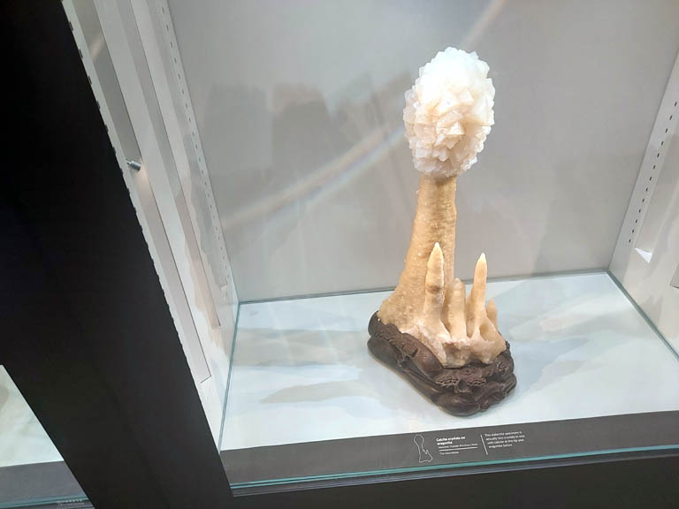

Slide 21
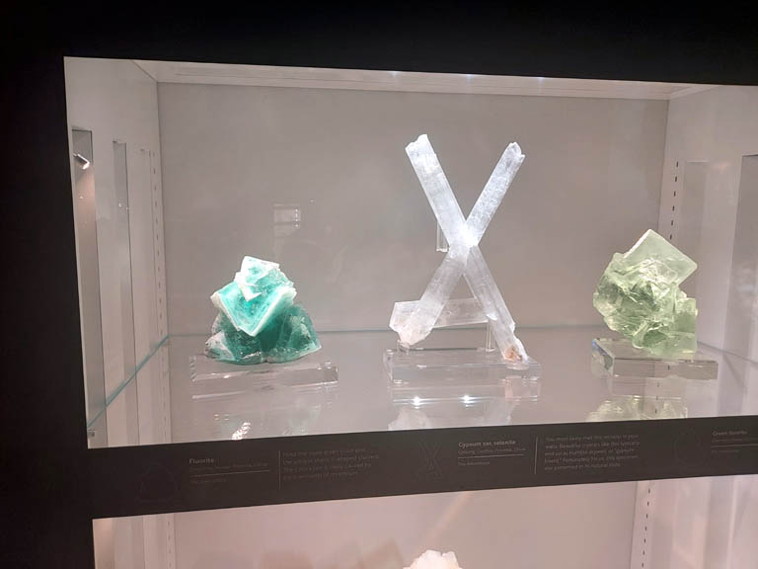

Slide 22
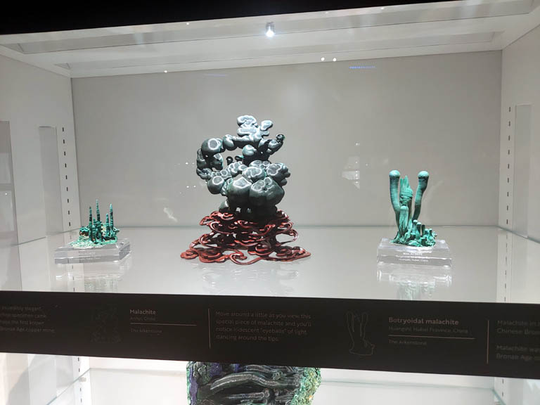

Slide 23
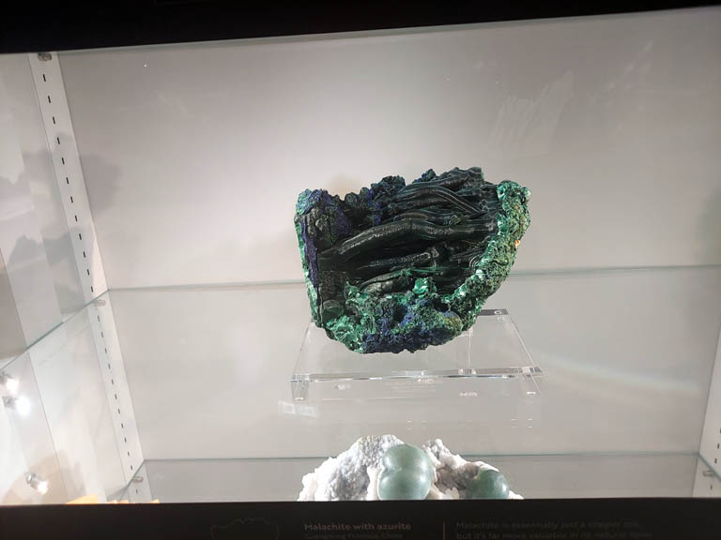

Slide 24
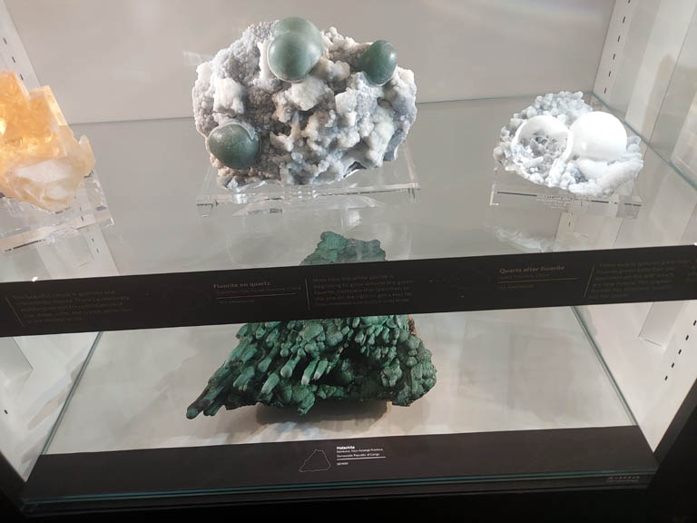

Slide 25
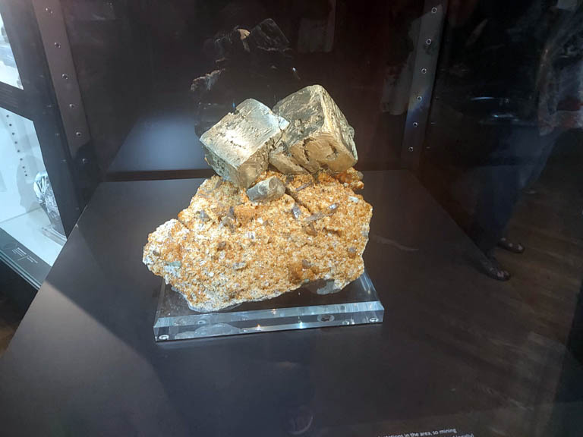

Slide 26
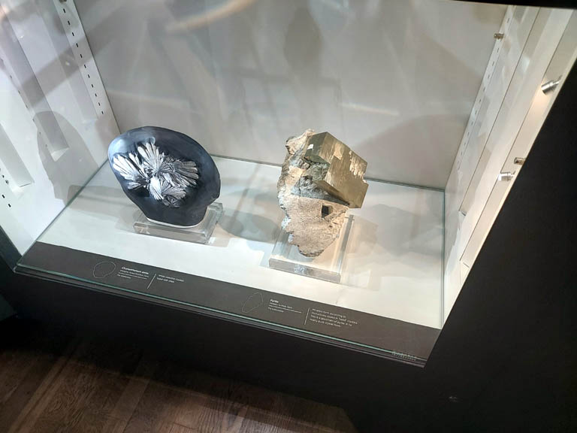

Slide 27
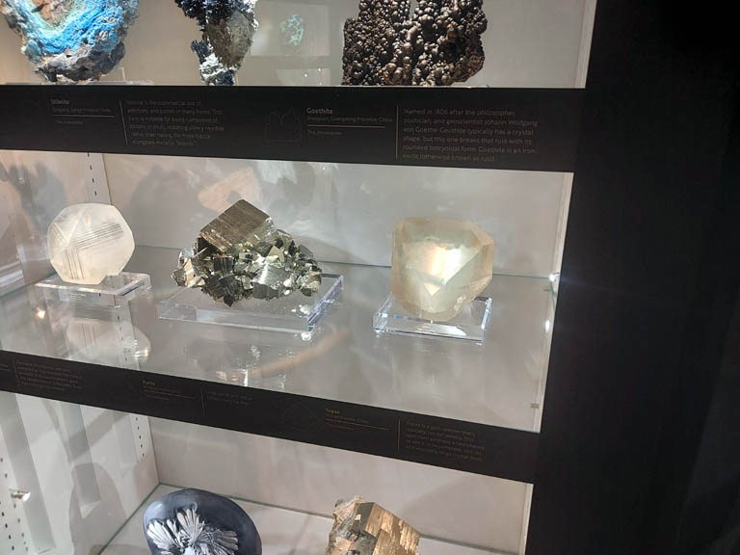

Slide 28
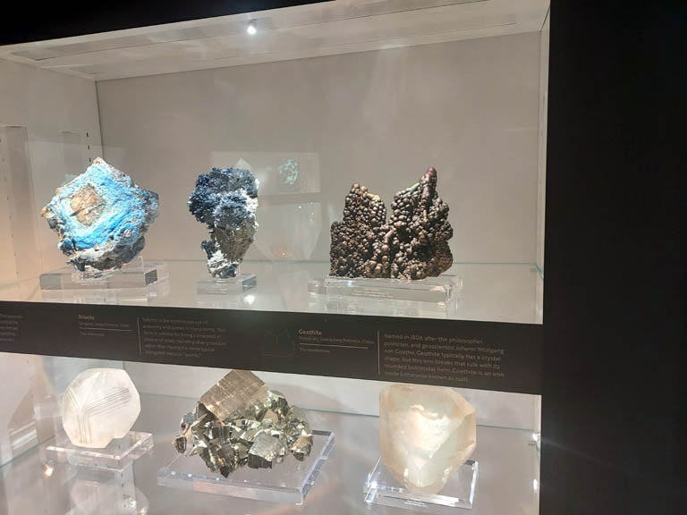

Slide 29
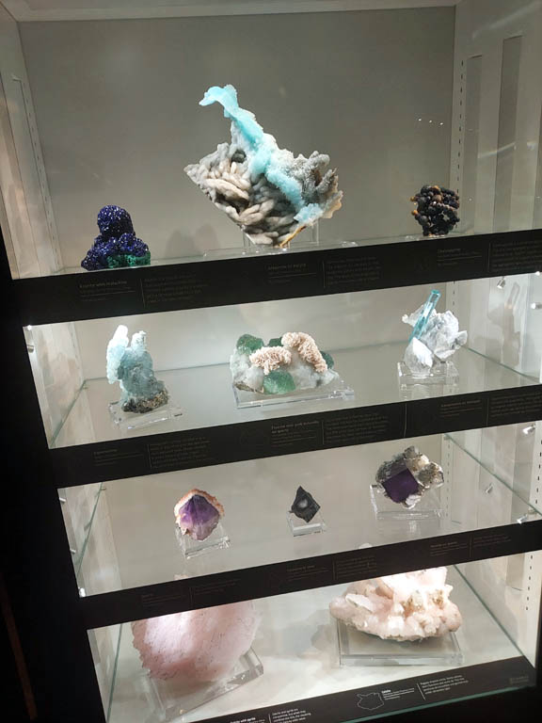

Slide 30
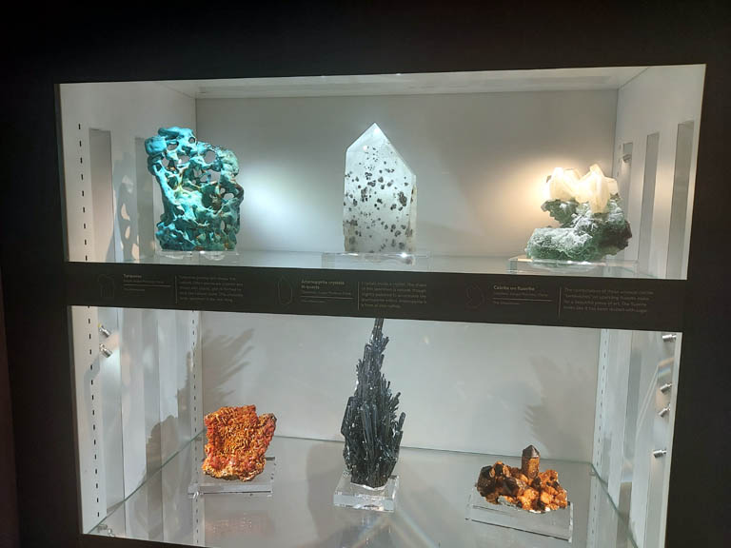

Slide 31
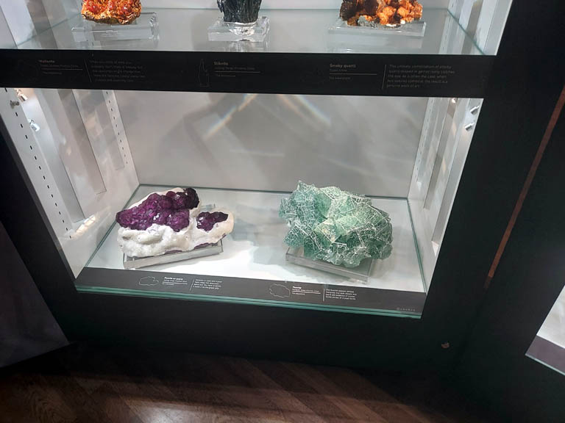

Slide 32
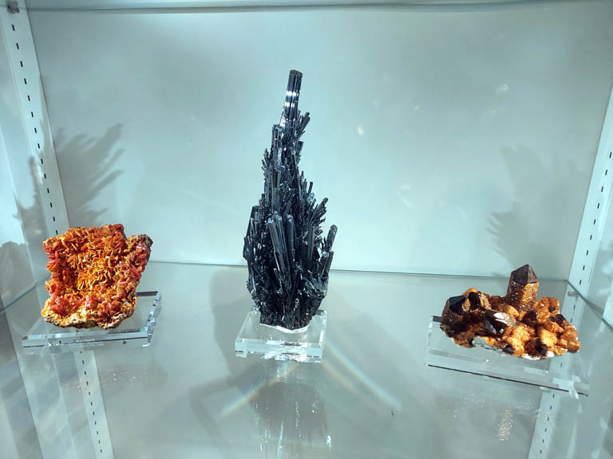

Slide 33
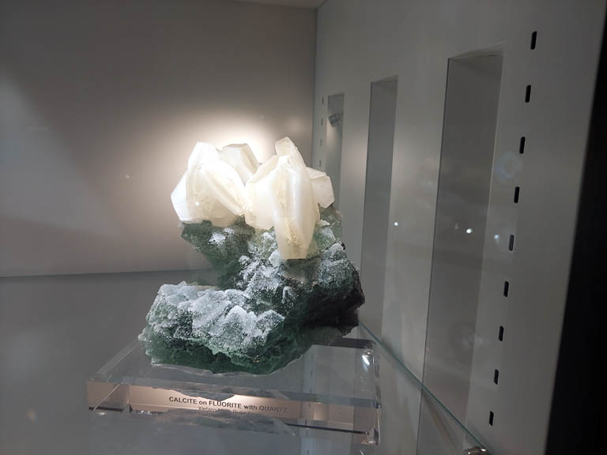

Slide 34
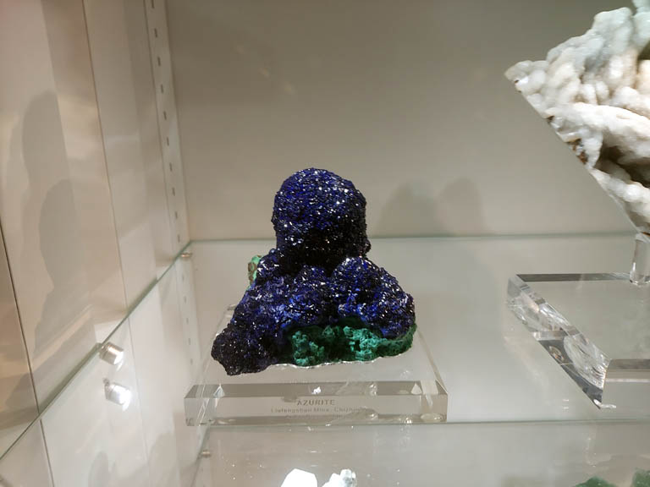

Slide 35
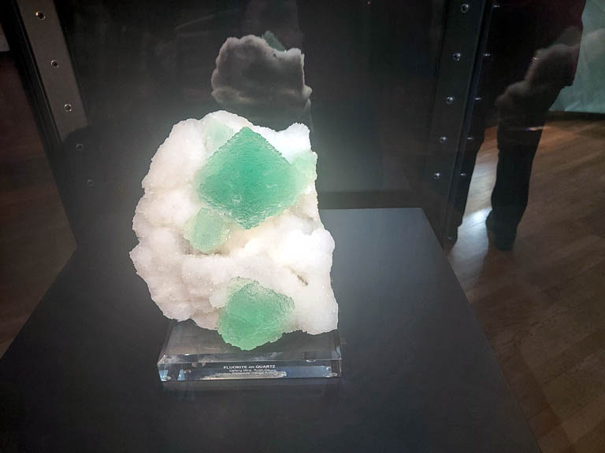

Slide 36
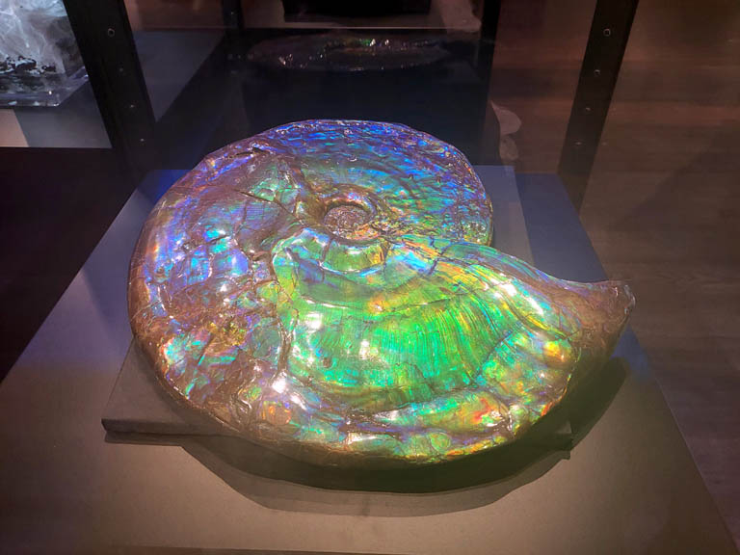

Slide 37
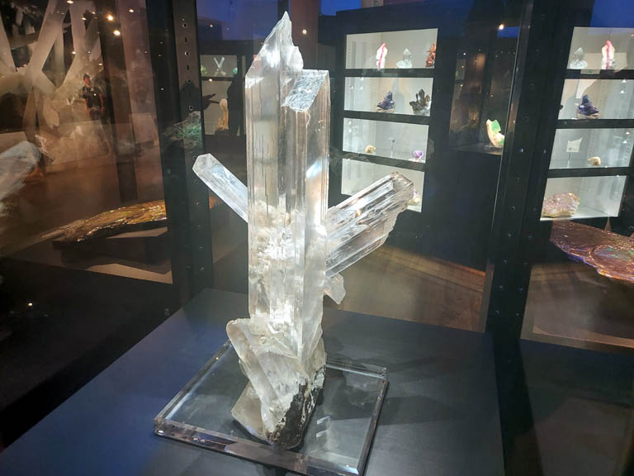

Slide 38
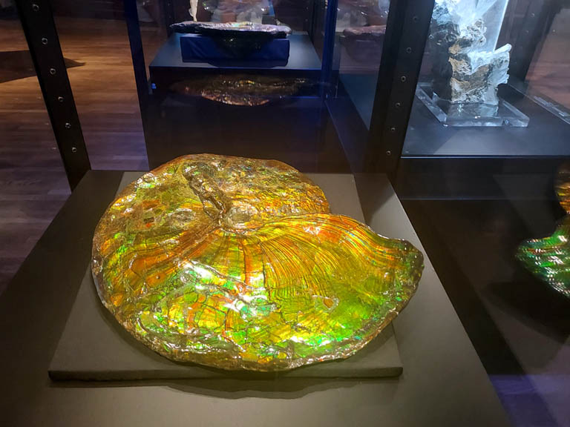

Slide 39
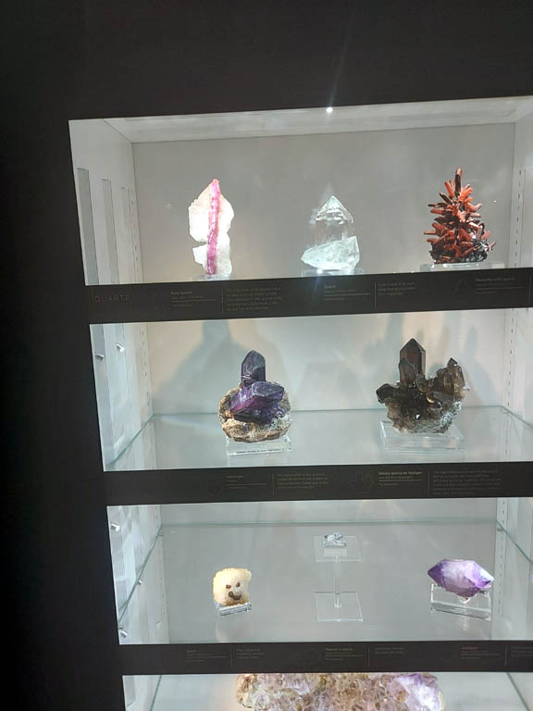

Slide 40
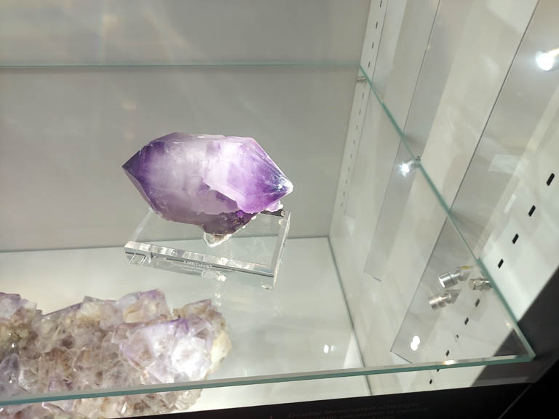

Slide 41
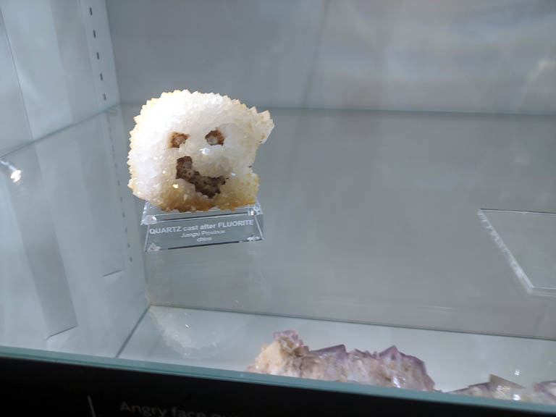

Slide 42
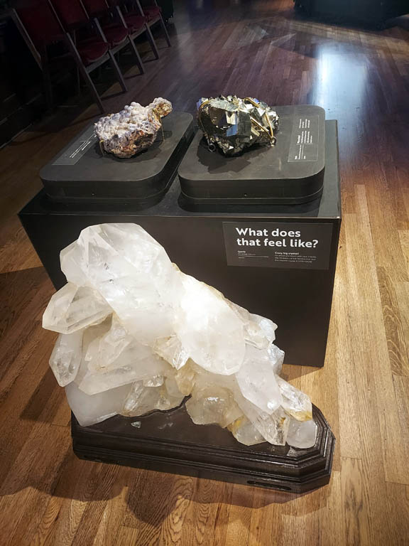

Slide 43
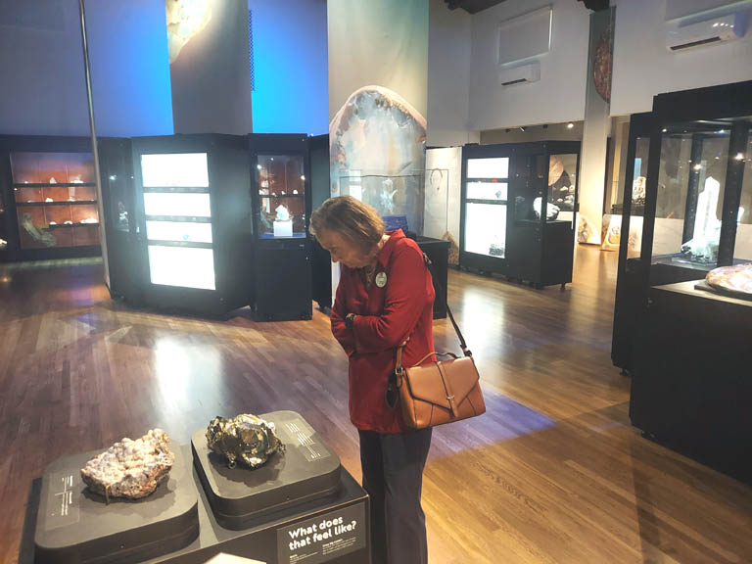

Slide 44
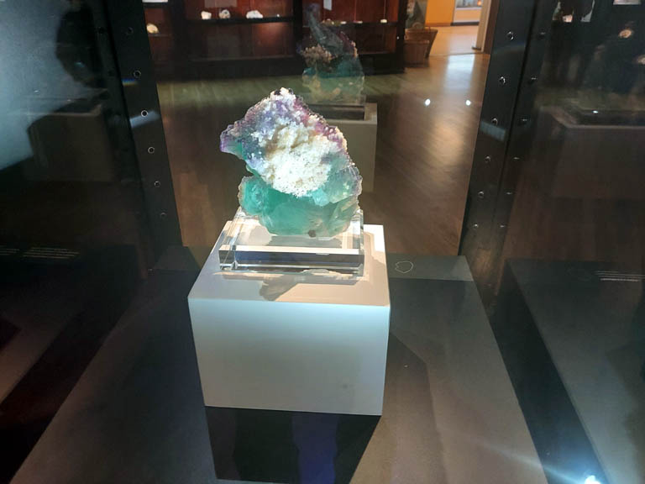

Slide 45
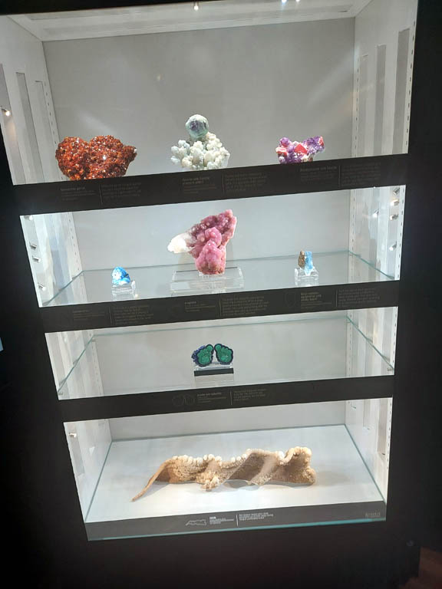

Slide 46
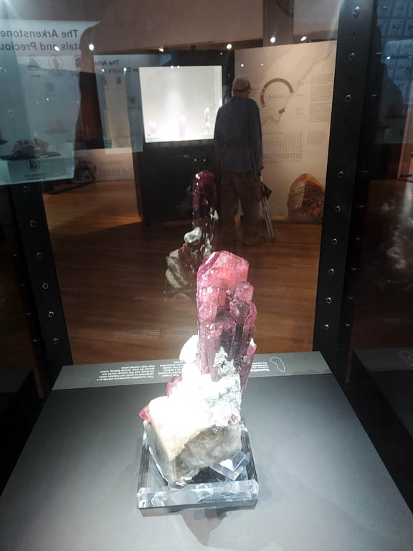

Slide 48
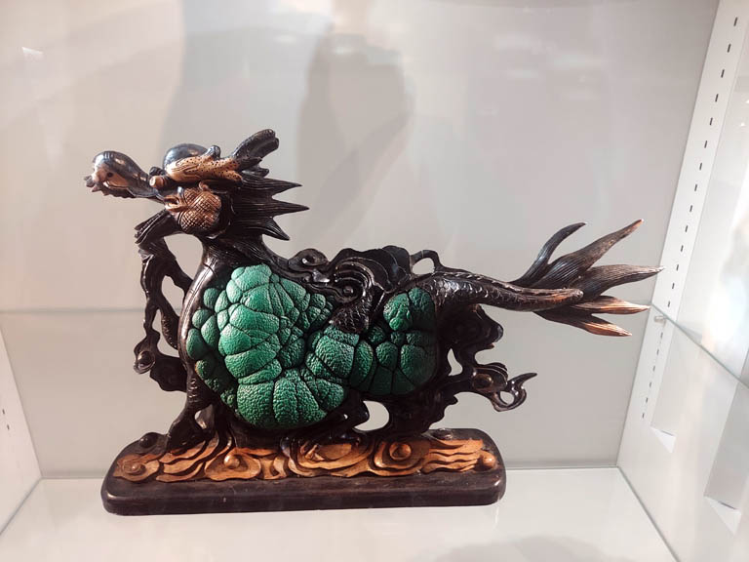

Slide 49
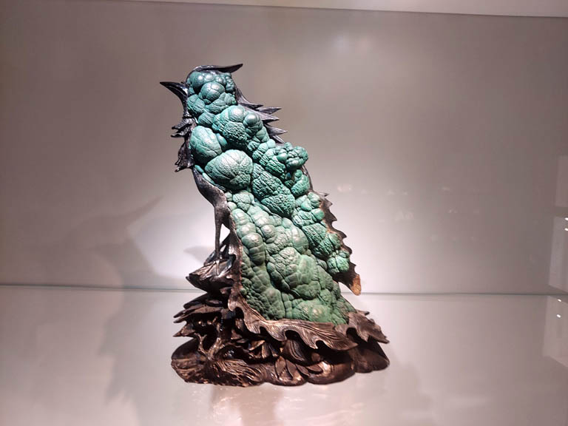

Slide 50
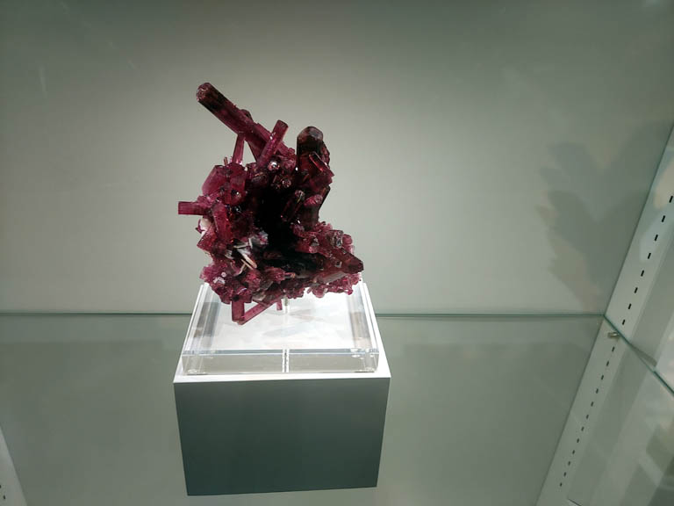

Slide 51
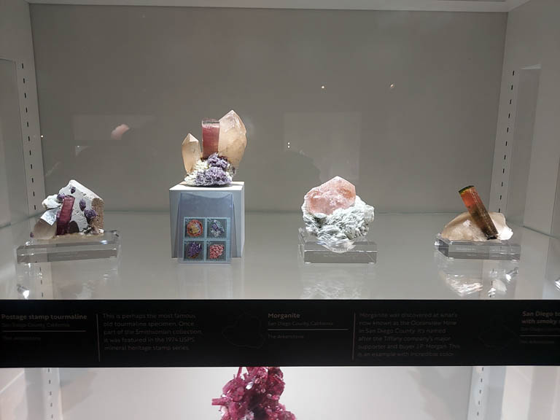

Slide 52
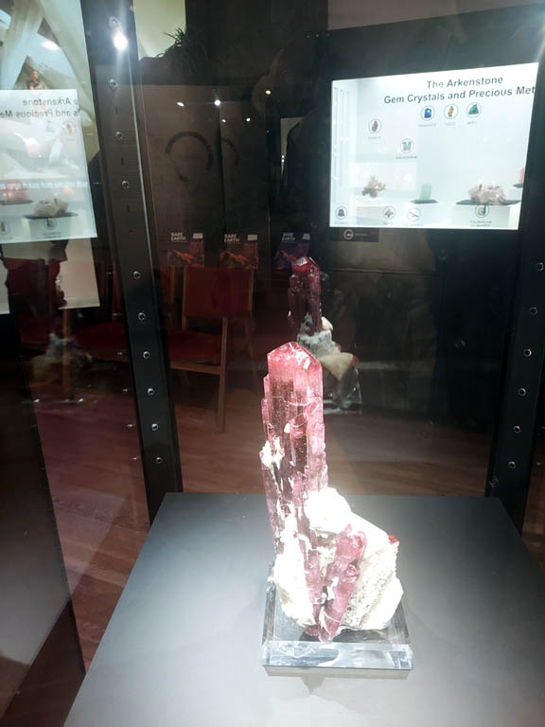

Slide 91
This field trip was one of the very best I have ever attended. It was over whelming to say the least. I enjoyed the long conversation we had with Dr. Jonathan Hoffman discussing the exhibits as well as the stories about Ralph Bishop. I want to thank Peter Dettelis for alerting us to the exhibit. Also Sally Griffith for making the arrangements to attend. It was the event of a lifetime!
If you missed it I am truly sorry for you!
THE END

