Slide 1
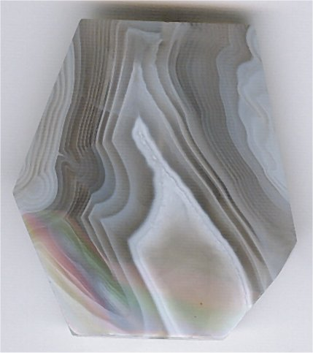
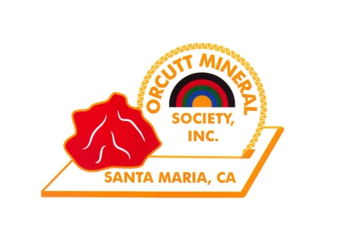
AGATES
A slide Show presented by Wes Lingerfelt – January 8, 2019
A Nice Botswana Agate

Slide 2
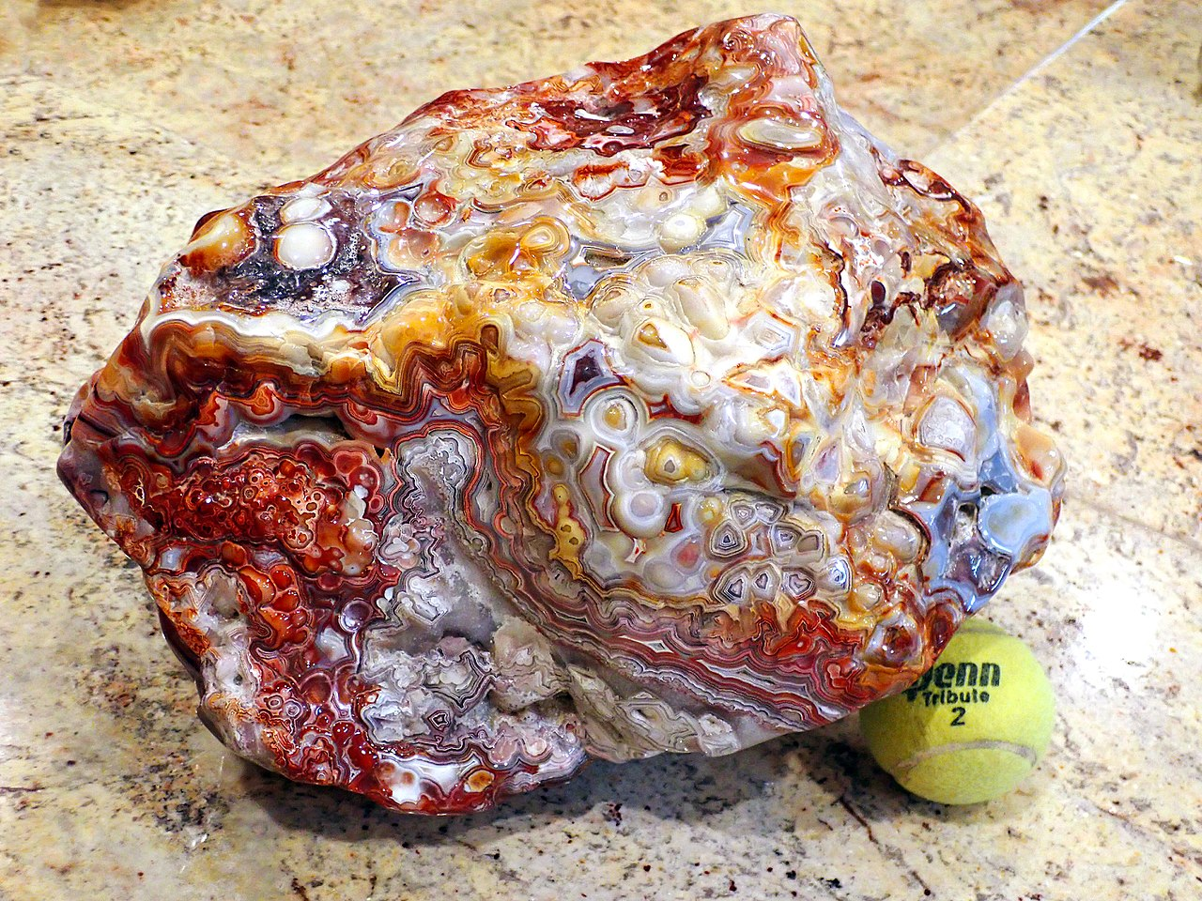

Slide 3
Etymology and History -
The stone was given its name by Theophrastus, a Greek philosopher and naturalist, who discovered the stone along the shore line of the river Achates (Ancient Greek) in Sicily, sometime between the 4th and 3rd centuries BC. Colorful agates and other chalcedonies were obtained over 3,000 years ago from the Achates River, now called Dirillo.

Slide 4
Historically, Agate has been discovered with the artifacts of Neolithic people, and was used as healing amulets and ornamentation dating back to Babylon. Its medicinal uses continued through the ancient Greek and Egyptian civilizations, and spread throughout Africa and the Middle East into Russia. Agate sparked a world renowned stonecutting and polishing industry in Germany that flourished from the 15th to the 19th century, and exists today.

Slide 5
Ancient Romans valued the Agate for its reputed medicinal and talismanic properties. Powdered and mixed with water, it was said to counteract serpents' venom. Pliny, a Roman historian, quoted the Magii as teaching in Persia that storms might be averted by burning Agates.

Slide 6
Formation and Characteristics
Most agates occur as nodules in volcanic rocks or ancient lavas, in former cavities produced by volatiles in the original molten mass, which were then filled, wholly or partially, by siliceous matter deposited in regular layers upon the walls. Agate has also been known to fill veins or cracks in volcanic or altered rock underlain by granitic intrusive masses. Such agates, when cut transversely, exhibit a succession of parallel lines, often of extreme tenuity, giving a banded appearance to the section. Such stones are known as banded agate, riband agate and striped agate.

Slide 7
In the formation of an ordinary agate, it is probable that waters containing silica in solution—derived, perhaps, from the decomposition of some of the silicates in the lava itself—percolated through the rock and deposited a siliceous gel in the interior of the vesicles. Variations in the character of the solution or in the conditions of deposition may cause a corresponding variation in the successive layers, so that bands of chalcedony often alternate with layers of crystalline quartz. Several vapor-vesicles may unite while the rock is still viscous, and thus form a large cavity which may become the home of an agate of exceptional size; thus a Brazilian geode lined with amethyst and weighing 35 tons was exhibited at the Düsseldorf Exhibition of 1902.

Slide 8
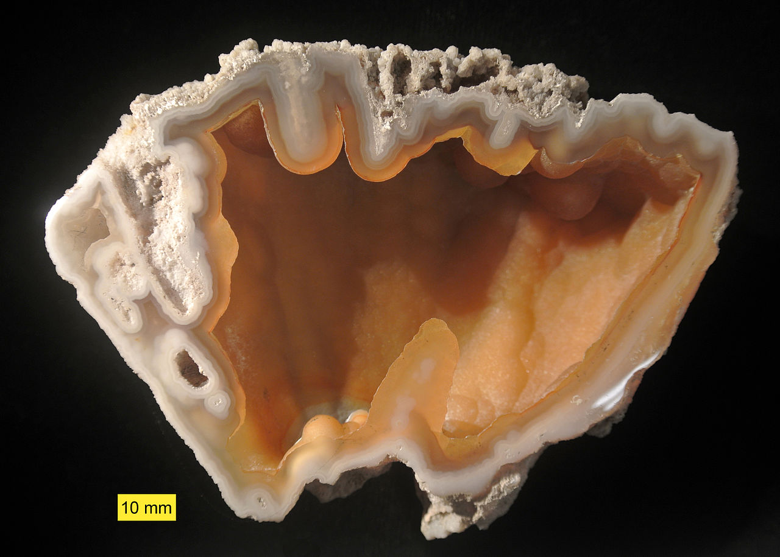

Slide 9
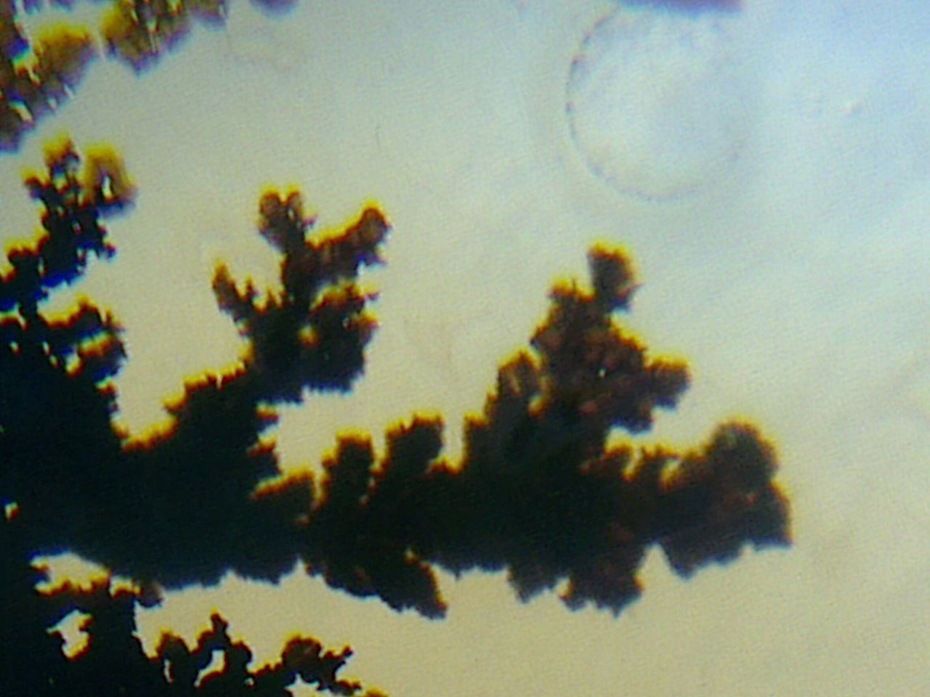
Dendritic agates have fern like patterns in them formed due to the presence of manganese and iron oxides.

Slide 10
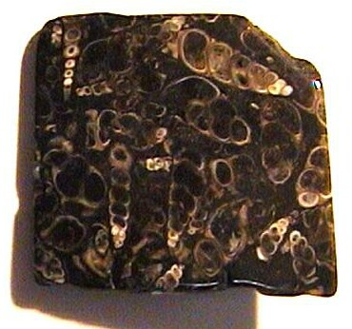
Turritella agate is formed from silicified fossil Elimia tenera (erroneously considered Turritella) shells. E. tenera are spiral freshwater gastropods having elongated, spiral shells composed of many whorls. Similarly, coral, petrified wood and other organic remains or porous rocks can also become agatized. Agatized coral is often referred to as Petoskey stone or agate.

Slide 11
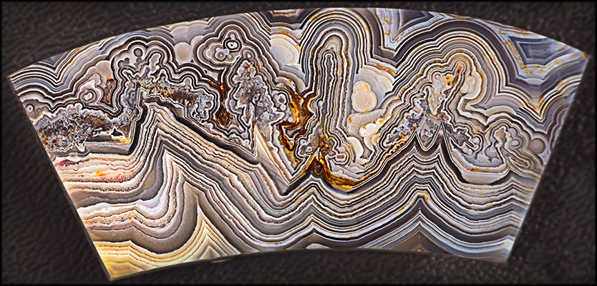
A Mexican Agate

Slide 12
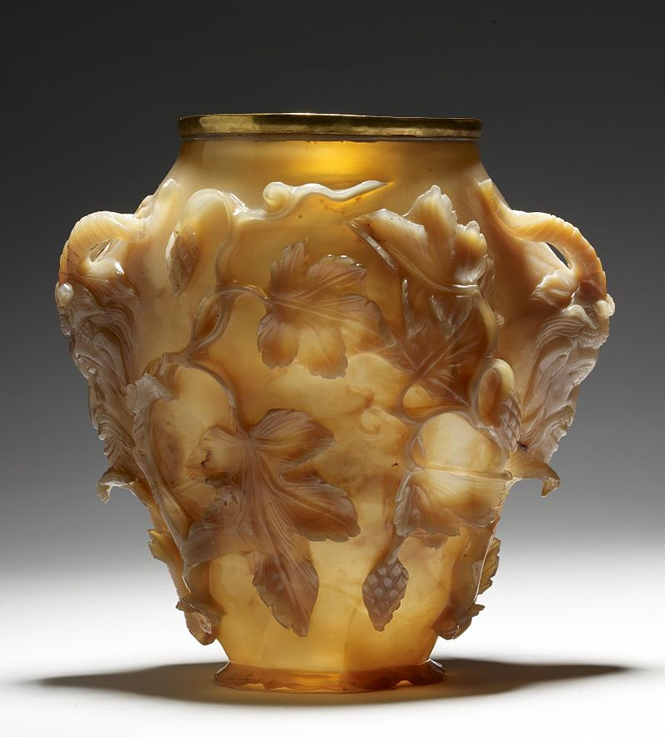
The "Rubens Vase" (Byzantine Empire). Carved in high relief from a single piece of agate, most likely created in an imperial workshop for a Byzantine emperor

Slide 13
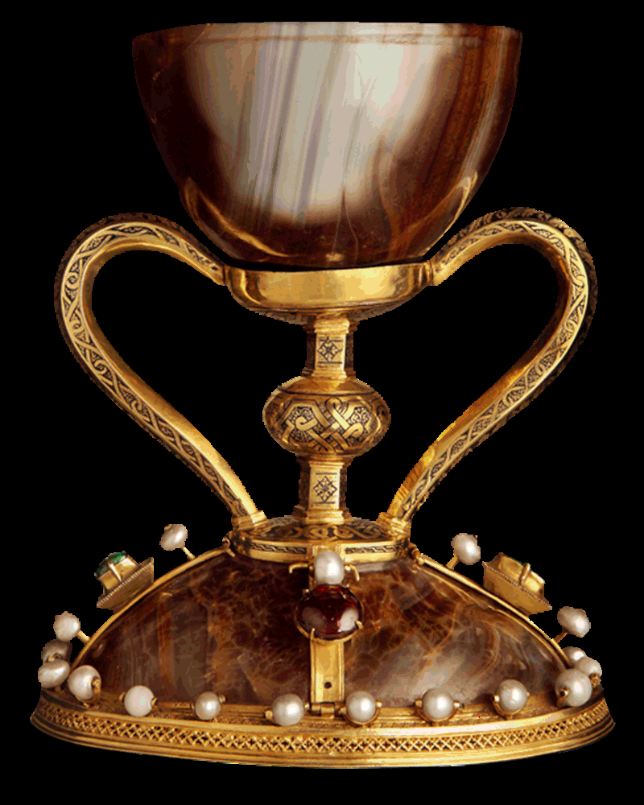
The Holy Grail of Valencia, the cup made from agate carved during the time of Christ

Slide 14
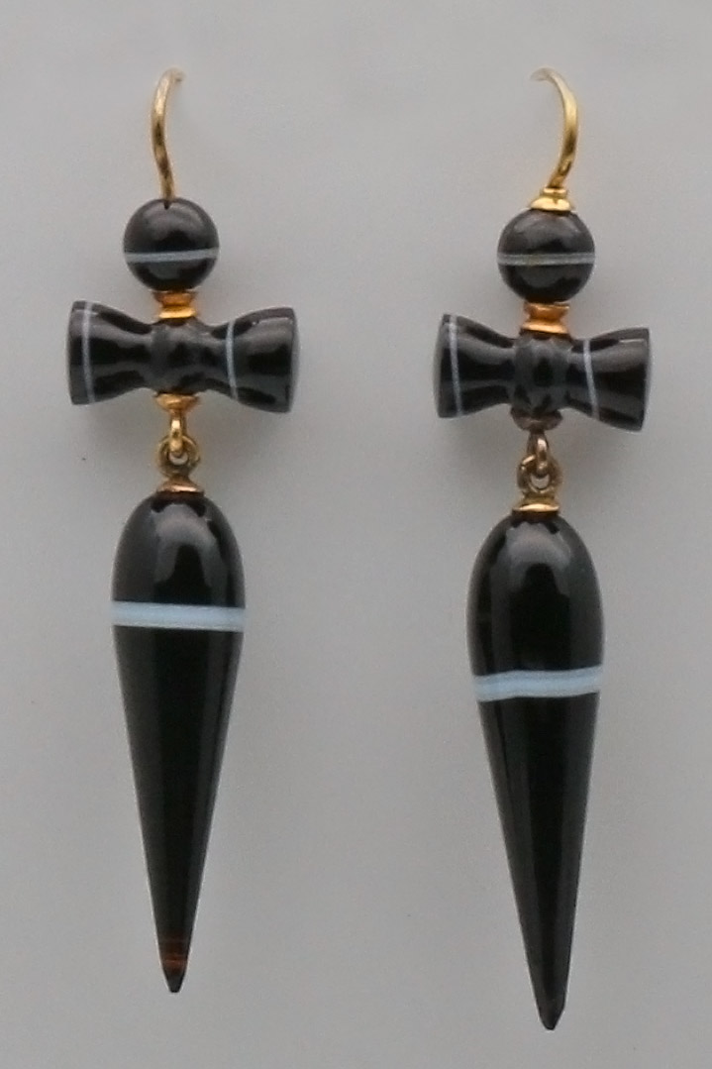
Victorian banded agate ear rings.

Slide 15
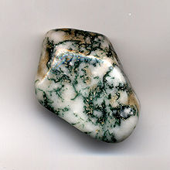
Included matter of a green, golden, red, black or other color or combinations embedded in the chalcedony and disposed in filaments and other forms suggestive of vegetable growth, gives rise to dendritic or moss agate

Slide 16
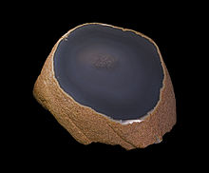
Enhydro agates are nodules, agates, or geodes with water trapped inside its cavity. Enhydros are closely related to fluid inclusions, but are composed of chalcedony. The formation of enhydros is still an ongoing process, with specimens dated back to the Eocene Epoch. They are commonly found in areas with volcanic rock

Slide 17
Other types of included matter deposited during agate-building include sagenitic growths (radial mineral crystals such as Goethite) and chunks of entrapped detritus (such as sand, ash, or mud). Occasionally agate fills a void left by decomposed vegetative material such as a tree limb or root and is called limb cast agate due to its appearance.

Slide 18
Coldwater Agates such as the Lake Michigan Cloud Agate, did not form under volcanic processes, and instead formed within the limestone and dolostone bedrock of ancient oceans. Like volcanic-origin agates, Coldwater Agates" formed from silica gels that lined pockets and seams within the bedrock. These agates are typically less colorful, with banded lines of grey and white chalcedony

Slide 19
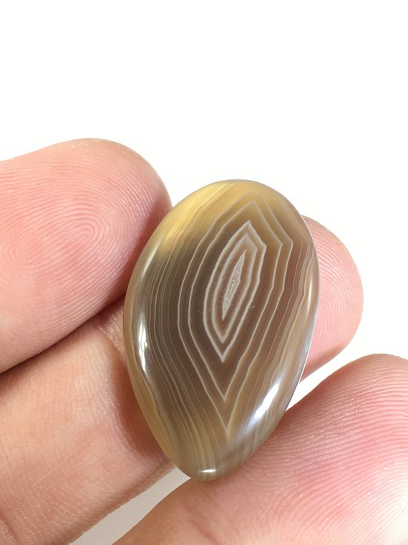

Slide 20
Certain stones, when examined in thin sections by transmitted light, show a diffraction spectrum due to the extreme delicacy of the successive bands, whence they are termed rainbow or Iris agates. Often agate coexists with layers or masses of opal, jasper or crystalline quartz due to ambient variations during the formation process.

Slide 21
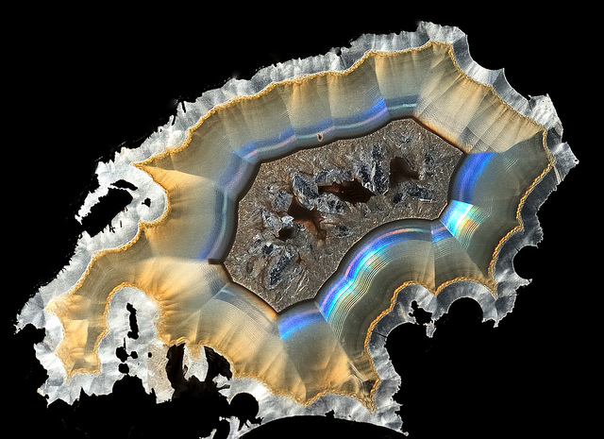

Slide 22
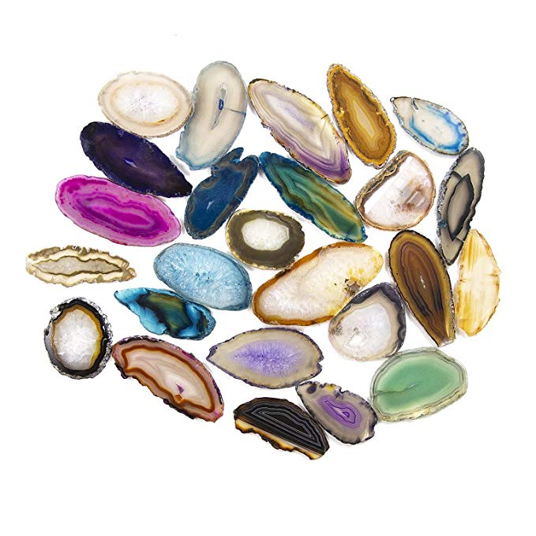
Brazilian Agate

Slide 23
Polyhedroid agate is agate which has grown in a flat-sided shape similar to a polyhedron. When sliced, it often shows a characteristic layering of concentric polygons. Polyhedroid agate is thought to be found only in Paraíba State, Brazil. It has been suggested that growth is not crystallographically controlled but is due to the filling-in of spaces between pre-existing crystals which have since dissolved.

Slide 24
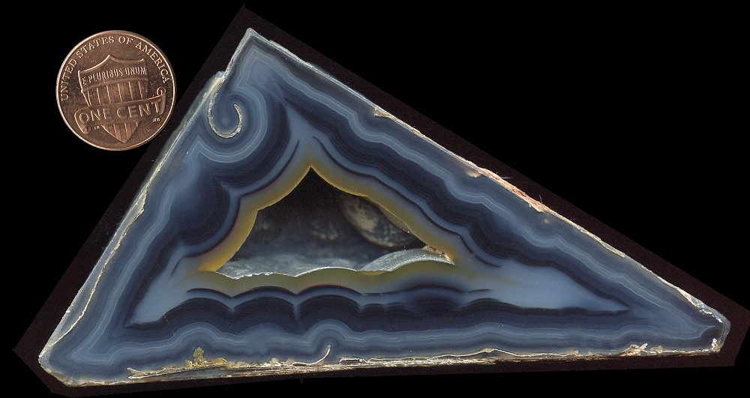
POLYHEDROID AGATE

Slide 25
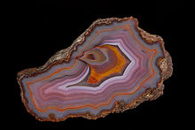
Condor agate was discovered and named by Luis de los Santos in 1993. It is found in the mountains near San Rafael, in Mendoza Province, Argentina. This agate exhibits colorful bands and patterns, and has become a popular stone among collectors and jewelry designers.

Slide 26
Fire agate, a variety of chalcedony, is a semi-precious natural gemstone discovered so far only in certain areas of central and northern Mexico and the southwestern United States (New Mexico, Arizona and California). Approximately 24-36 million years ago these areas were subjected to massive volcanic activity during the Tertiary Period. The fire agates were formed during this period of volcanism when hot water, saturated with silica and iron oxide, repeatedly filled cracks and bubbles in the surrounding rock.

Slide 27
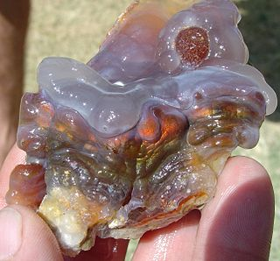

Slide 28
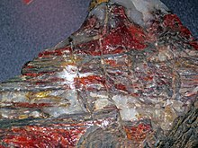
Binghamite (also called silkstone and cuyunite) is a type of agate stone found only on the Cuyuna iron range (near Crosby) in Crow Wing County, Minnesota. The formation of the stone occurs near deposits of iron ore.

Slide 29
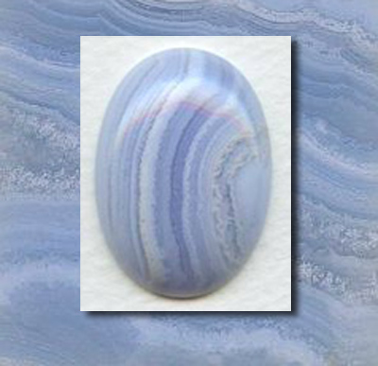
Blue Lace Agate has a soft, soothing elegance; like sky-blue waters released from winter's grasp. Its graceful, circular design has a stimulating, positive effect on emotions and attitude. It is not a stone of protection, but rather of encouragement and support. Its circular flowing energy calms, uplifts and elevates.

Slide 30
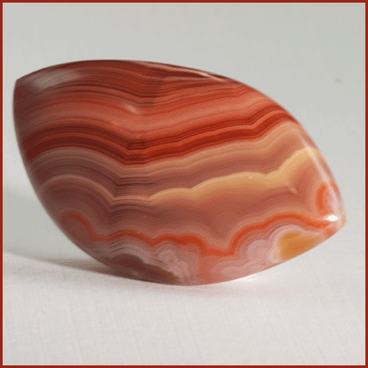
Laguna Agate is the most highly praised banded agate in the world. It is known for its extremely tight banding and vibrant shades of red and scarlet. Laguna Agate is found in an area covering roughly four square miles in a remote mountain range in the state of Chihuahua, Mexico.

Slide 31
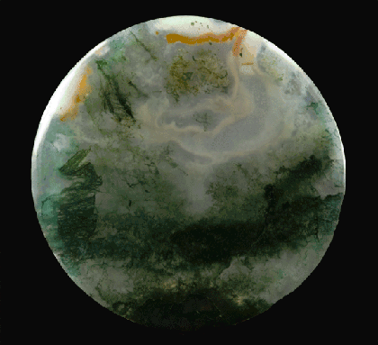
Moss Agate is not banded, and therefore not strictly an Agate in scientific terms; but is included in the Agate family. Agate is a variety of Chalcedony, a mineral of the Quartz family. It is clear to milky white, with dendritic inclusions of manganese or iron that has grown into patterns similar to moss or lichen. Spots of red may occur in some specimens, and occasionally the crystal is dark green with bluish inclusions.

Slide 32
Industrial uses of agate exploit its hardness, ability to retain a highly polished surface finish and resistance to chemical attack. It has traditionally been used to make knife-edge bearings for laboratory balances and precision pendulums, and sometimes to make mortars and pestles to crush and mix chemicals. It has also been used for centuries for leather burnishing tools.

Slide 33
The decorative arts use it to make ornaments such as pins, brooches or other types of jewelry, paper knives, inkstands, marbles and seals. Agate is also still used today for decorative displays, cabochons, beads, carvings and Intarsia art as well as face-polished and tumble-polished specimens of varying size and origin.

Slide 34
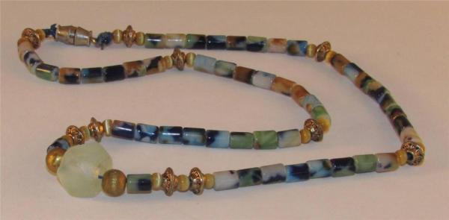
AGATE BEADS

Slide 35
Idar-Oberstein was one of the centers which made use of agate on an industrial scale. Where in the beginning locally found agates were used to make all types of objects for the European market, this became a globalized business around the turn of the 20th century: Idar-Oberstein imported large quantities of agate from Brazil, as ship's ballast. Making use of a variety of proprietary chemical processes, they produced colored beads that were sold around the globe. Agates have long been used in arts and crafts. The sanctuary of a Presbyterian church in Yachats, Oregon, has six windows with panes made of agates collected from the local beaches.

Slide 36
What can you do with Agate?
Answer: Just about anything! You can make jewelry; you can make beautiful displays; you can make coasters; you can make wind chimes, just to name a few things.

Slide 37
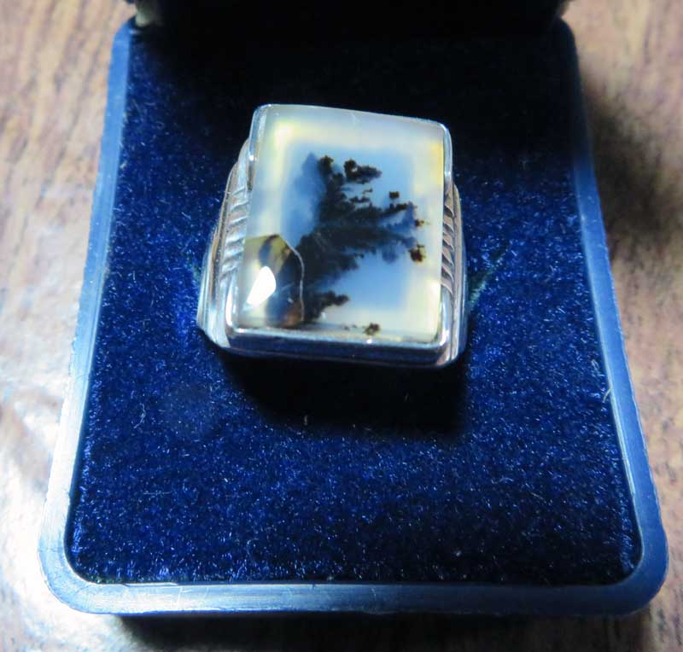
Here are a couple of things I made:

Slide 38
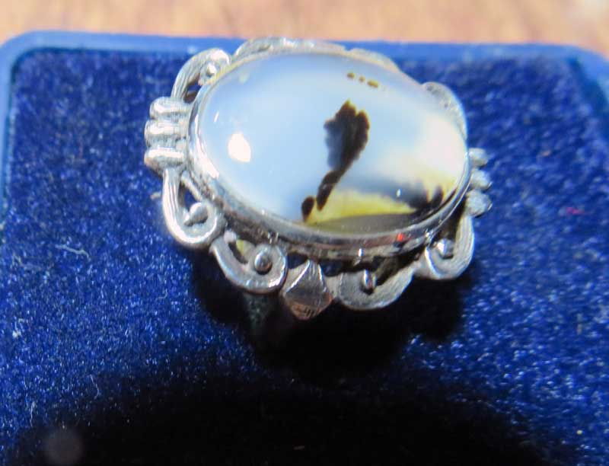

Slide 39
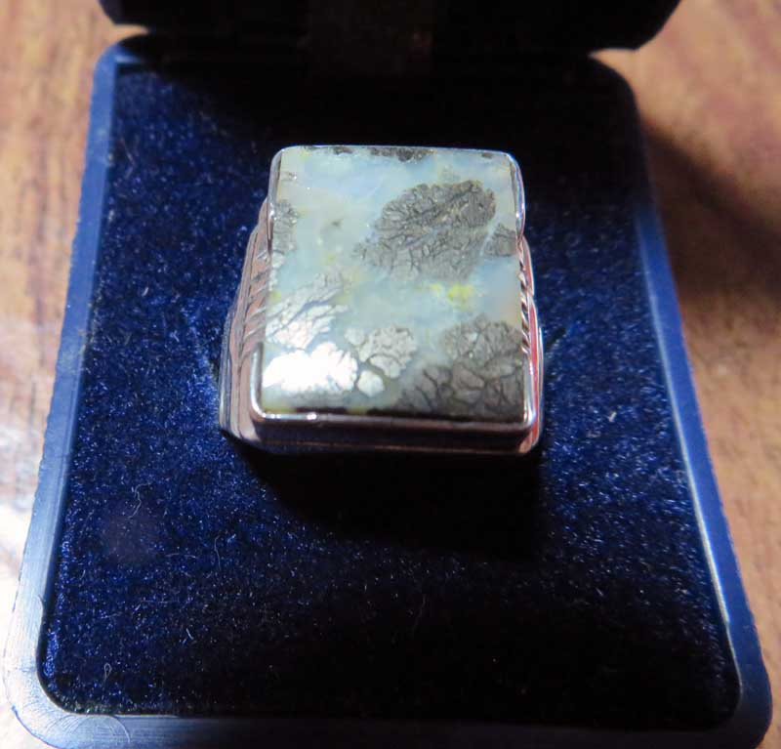

Slide 40
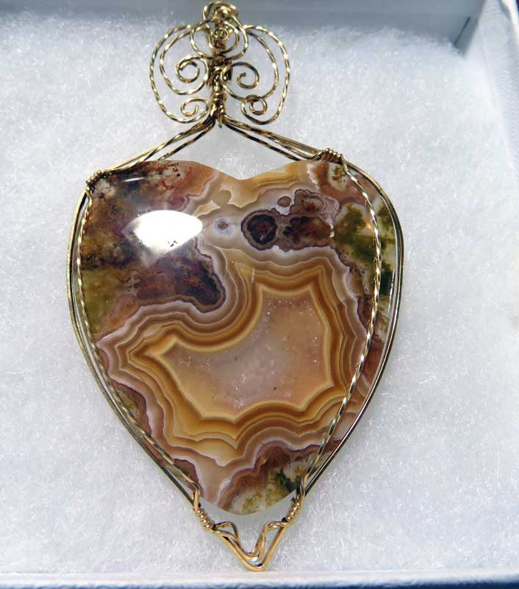
Here are a couples of things Jeannie made with Agate:

Slide 41
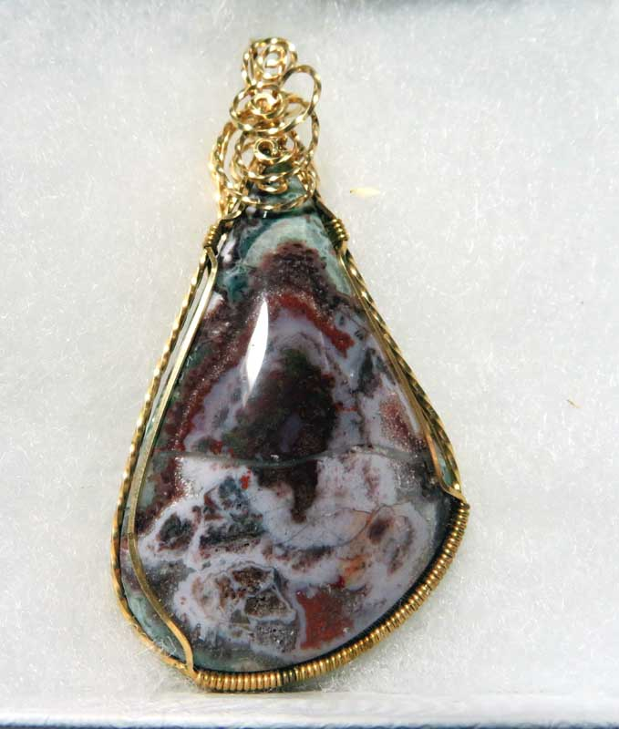

Slide 42
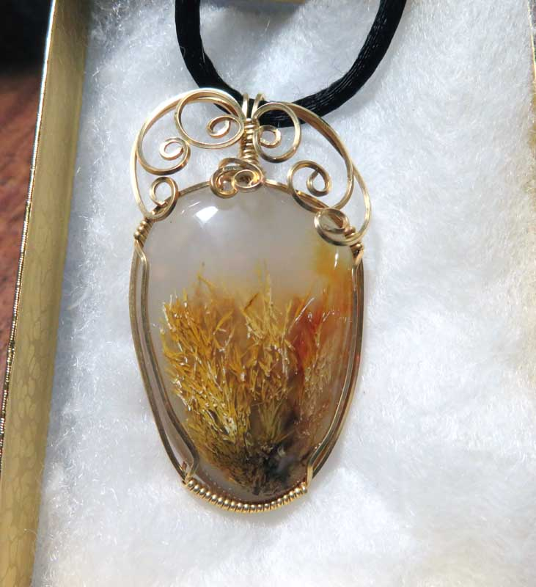

Slide 43
Care must be exercised when grinding agate; always use water to eliminate dust.
Respiratory diseases such as silicosis and higher incidence of tuberculosis among workers involved in the agate industry has been reported from India and China.

Slide 44
THE END – I HOPE YOU ENJOYED THE SHOW!

