Slide 1
54th Annual Gem Show
Orcutt Mineral Society
2022
Presented by Wes Lingerfelt

Slide 2
The show was a huge success! Thanks to those who provided their energy and time to the Show! The community is better for it! The school is better for it! The club is better for it! I am assuming the club made a profit.

Slide 3
There were a few hick-ups!
Hick-up # 1 Lack of several food vendors (Caused by the Pandemic).
Hick-up #2 Poor scheduling of the muscle workers, especially at shows end.
Hick-up #3 Tables were stacked in the locker top up instead of top down.
Hick-up #4 A course is needed on how to setup and tear down the club cases.
Hick-up # 5 The tables need to be moved first to the Olympic Hall so skirting can begin.

Slide 4
Overall there were no major incidents or worrisome events (except the vendor who threatened to shoot the shoplifter!) No Fire trucks were needed this year!
The show was well attended all 3 days. This allows vendors a better chance to “Make Space”.
There were many requests for member applications.
The guest exhibitors brought museum class displays.
The Thursday night dinner was well attended and appreciated. The OMS show is like a mini Quartzsite with a widespread reputation. Sales of tote bags were good.
Well Done fellow members!

Slide 5
Let’s take a look at some of the pictures available in the OMS website archives. Margaret Henson took 69 and I took 95 pictures of the show.
Here are a few of them:

Slide 6
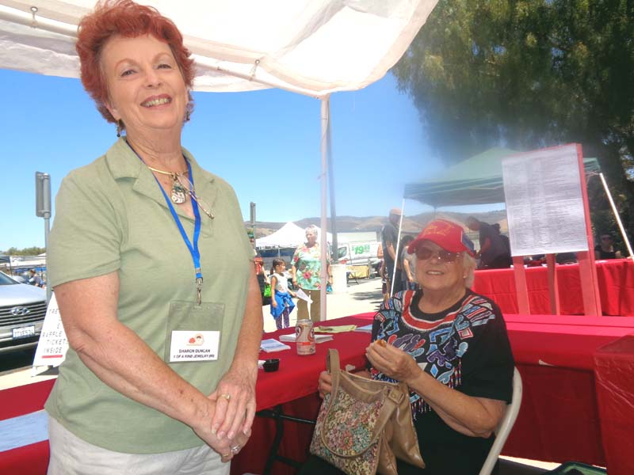

Slide 7
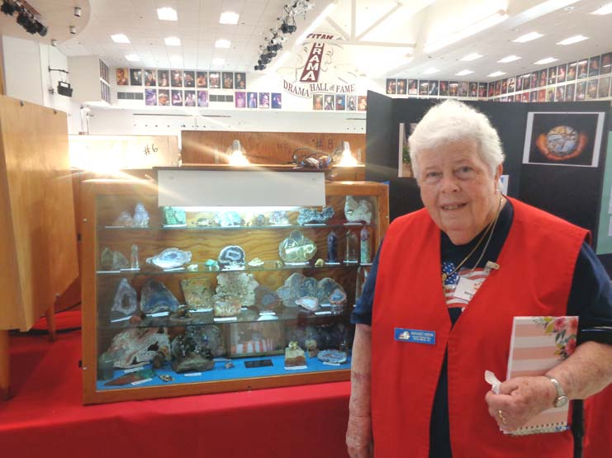

Slide 8
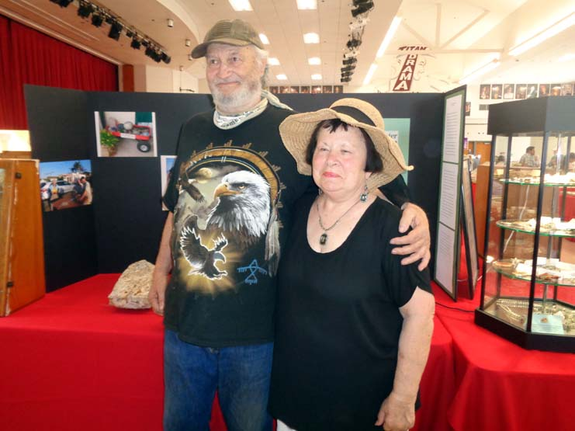

Slide 9
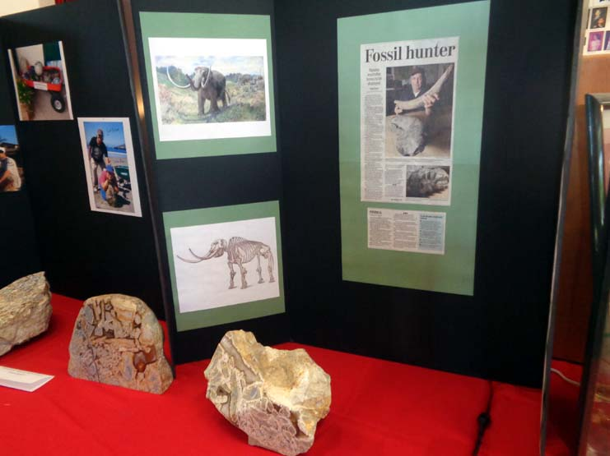

Slide 10
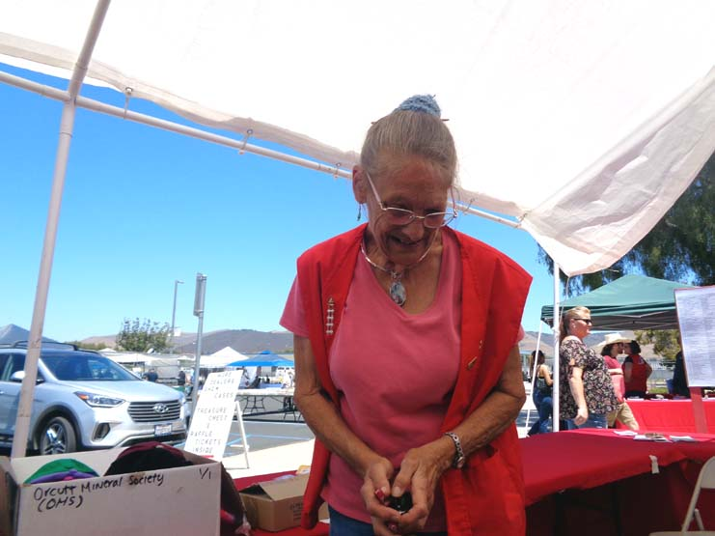

Slide 11
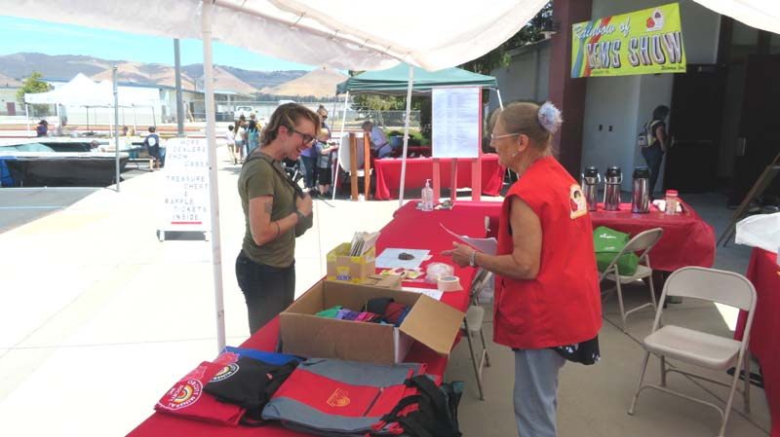

Slide 12
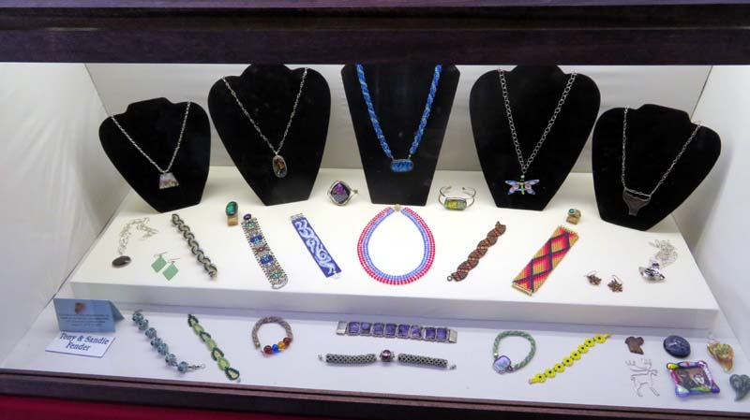

Slide 13
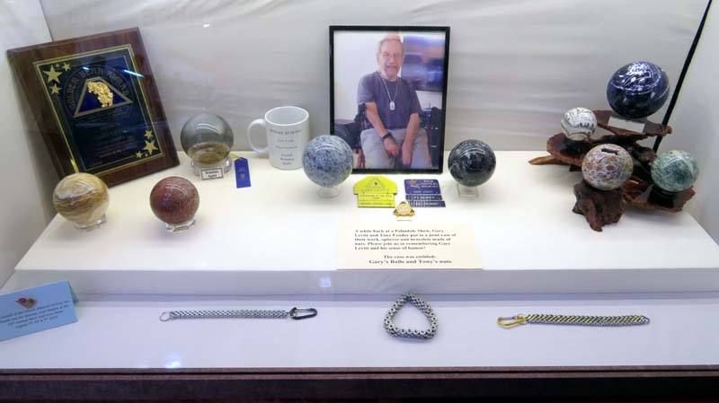

Slide 14
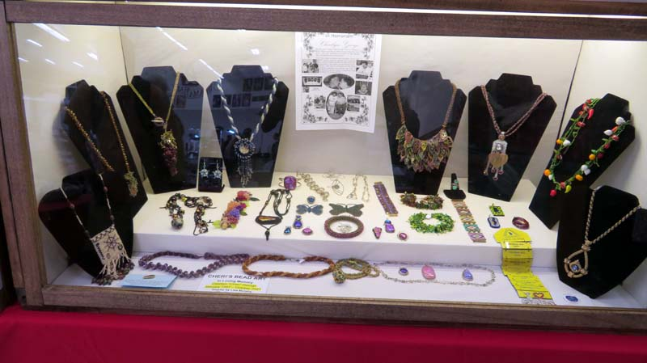

Slide 15
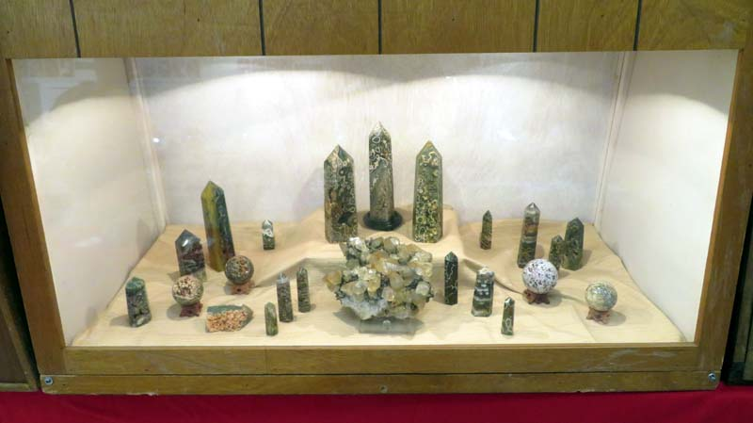

Slide 16
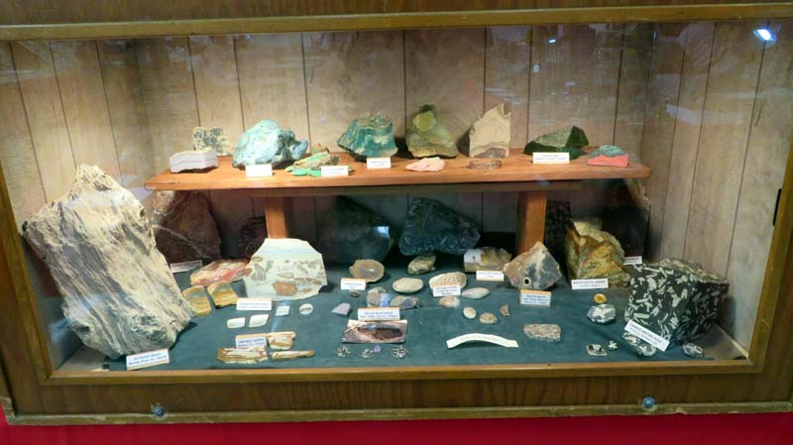

Slide 17
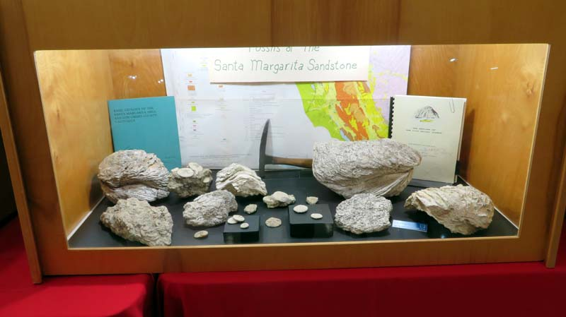

Slide 18
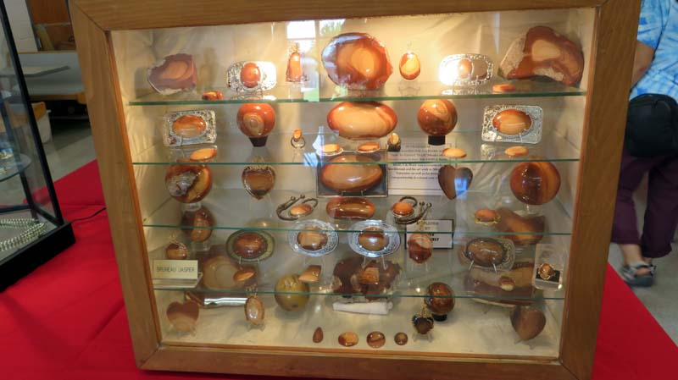

Slide 19
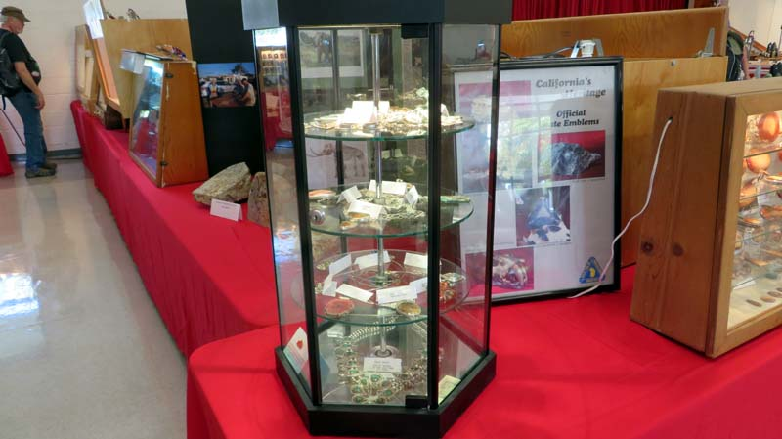

Slide 20
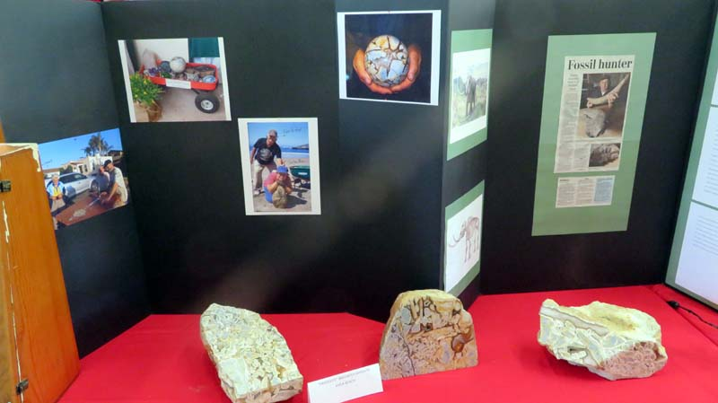

Slide 21
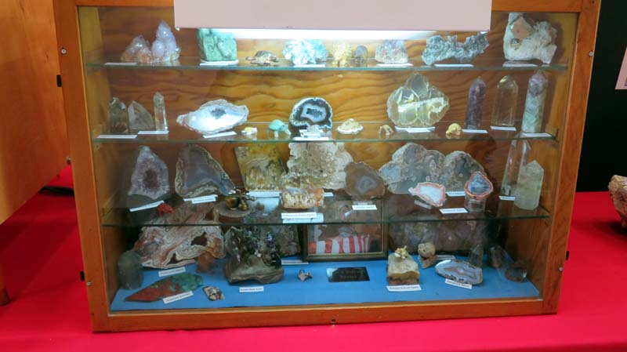

Slide 22
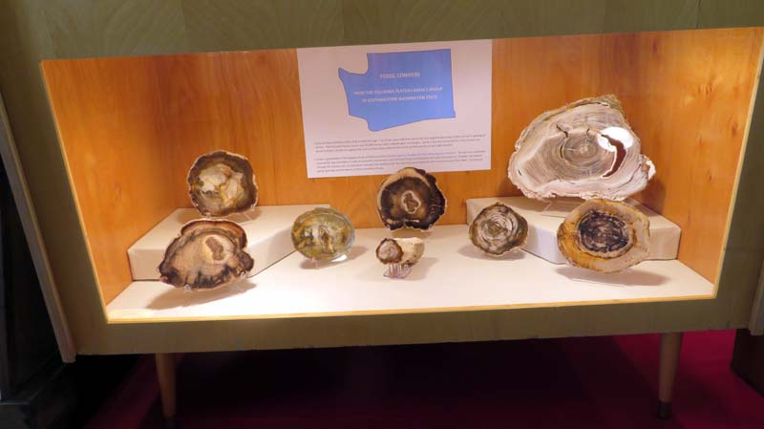

Slide 23
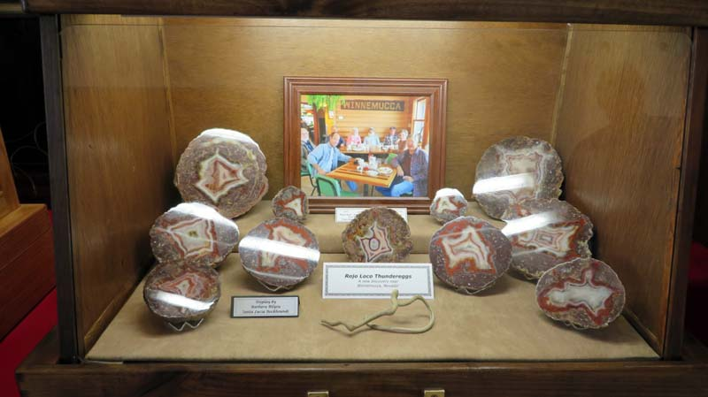

Slide 24
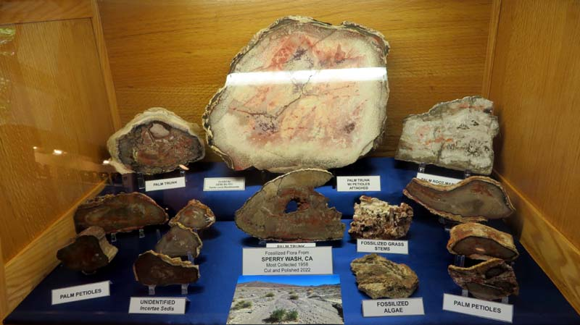

Slide 25
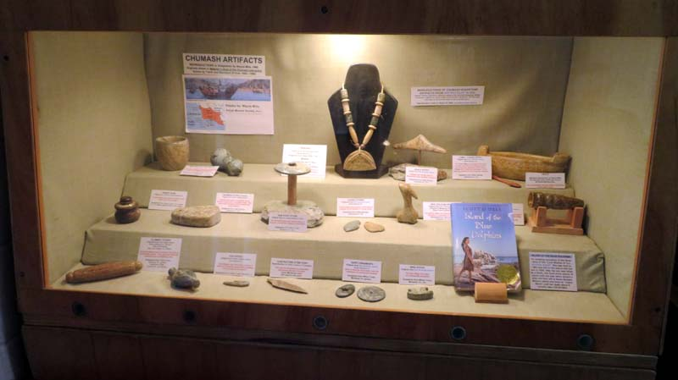

Slide 26
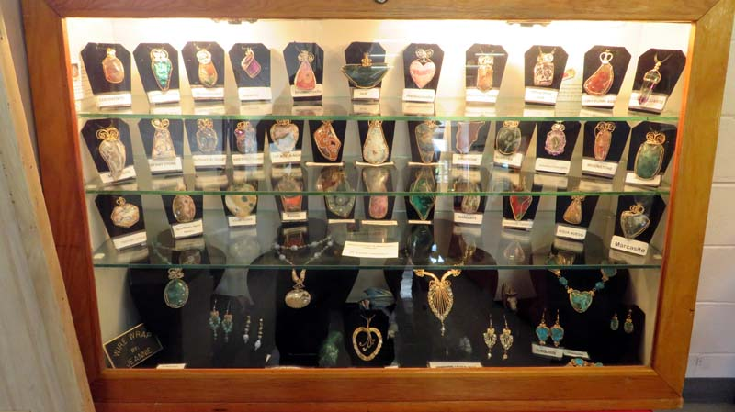

Slide 27
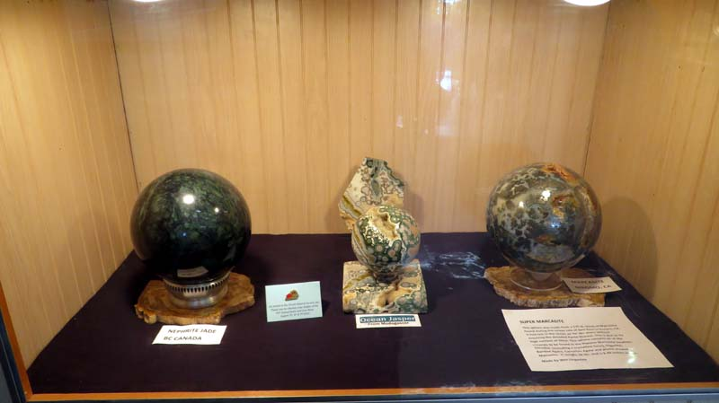

Slide 28
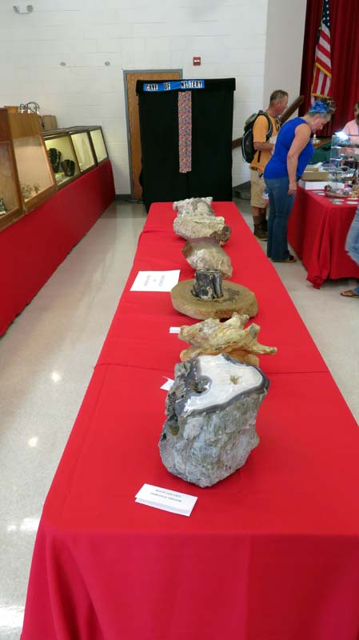

Slide 29
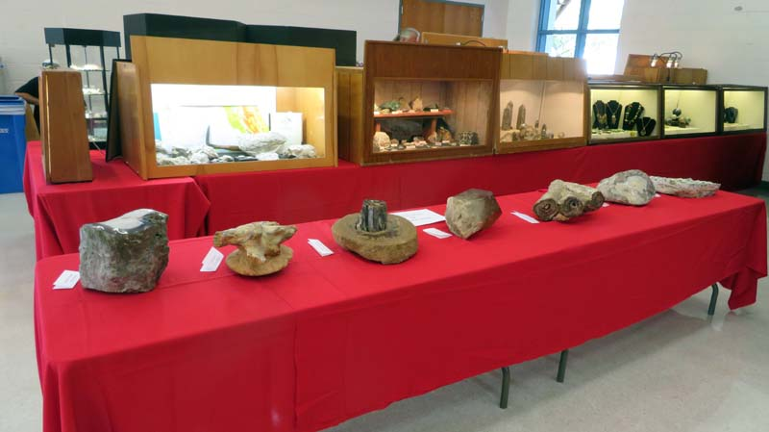

Slide 30
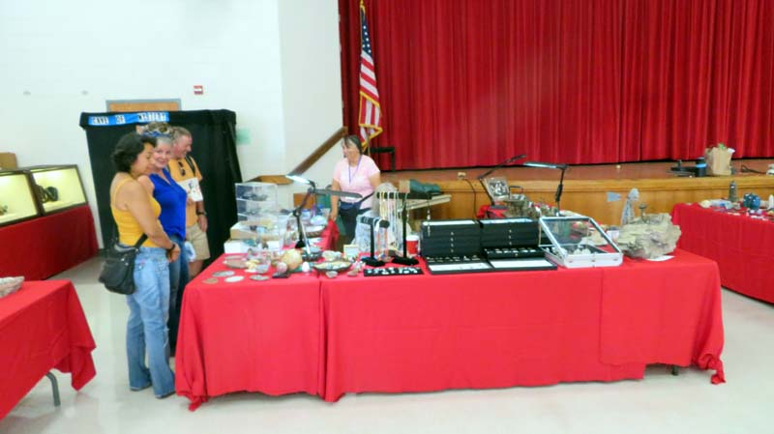

Slide 31
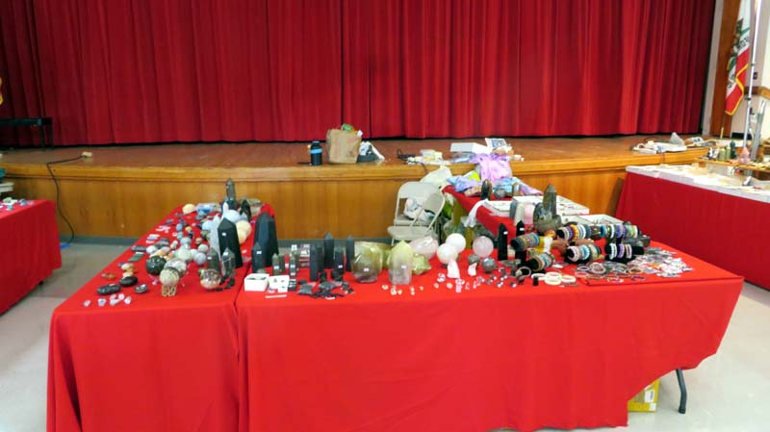

Slide 32
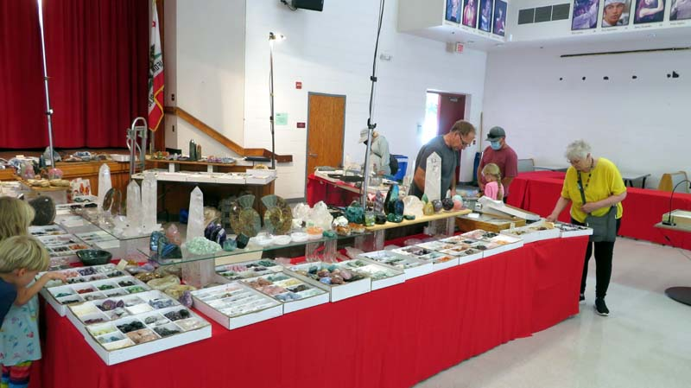

Slide 33
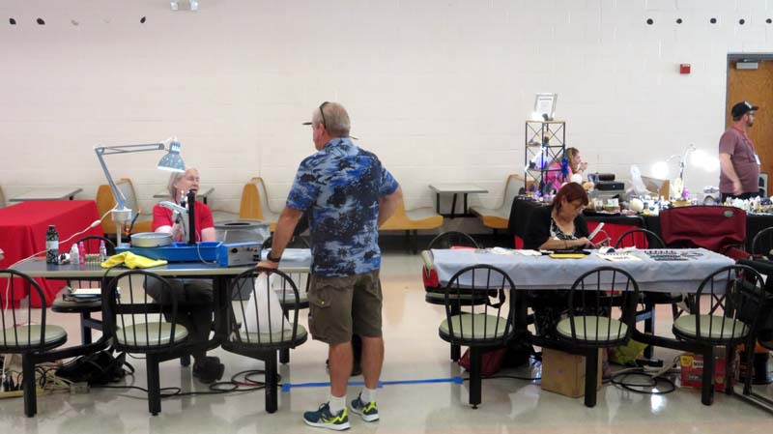

Slide 34
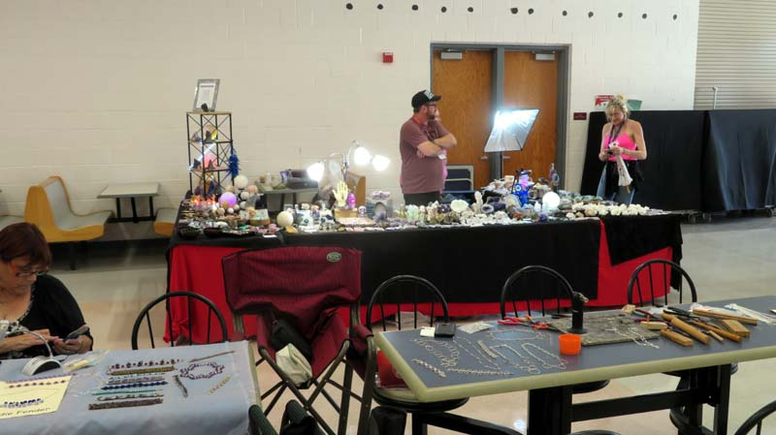

Slide 35
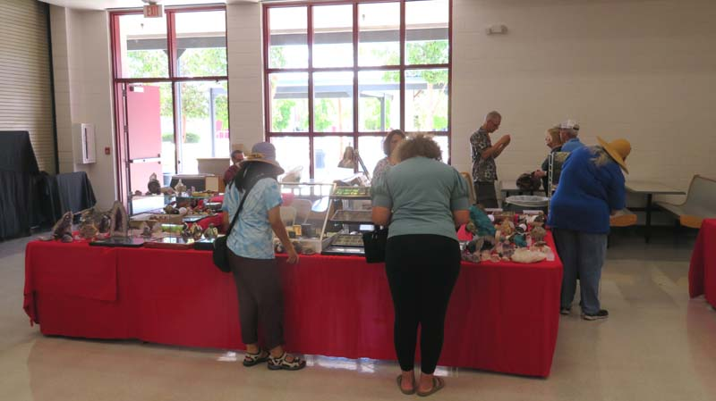

Slide 36
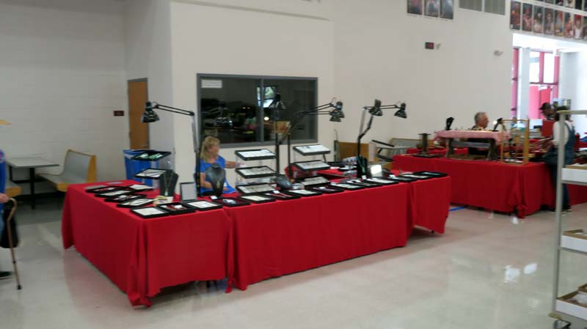

Slide 37
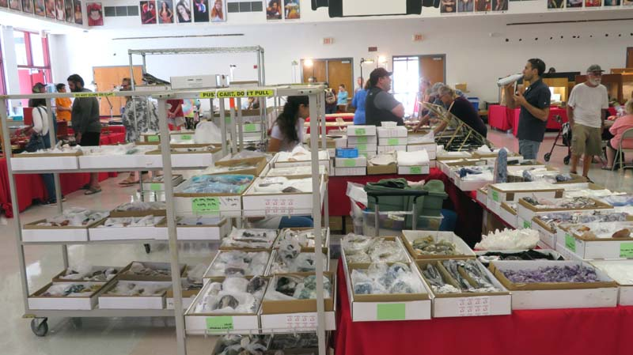

Slide 38
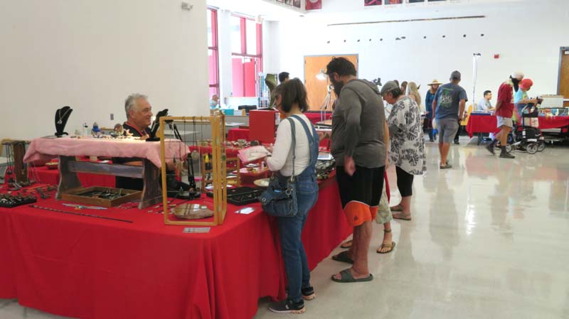

Slide 39
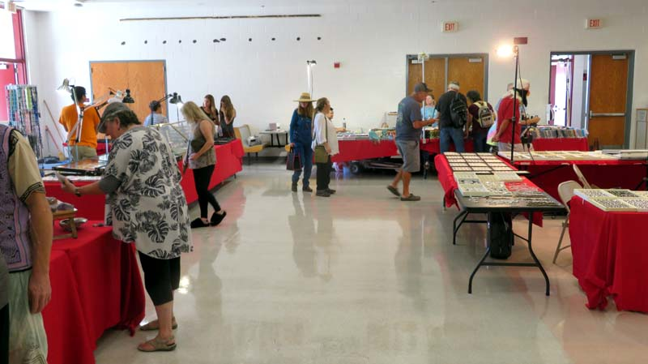

Slide 40
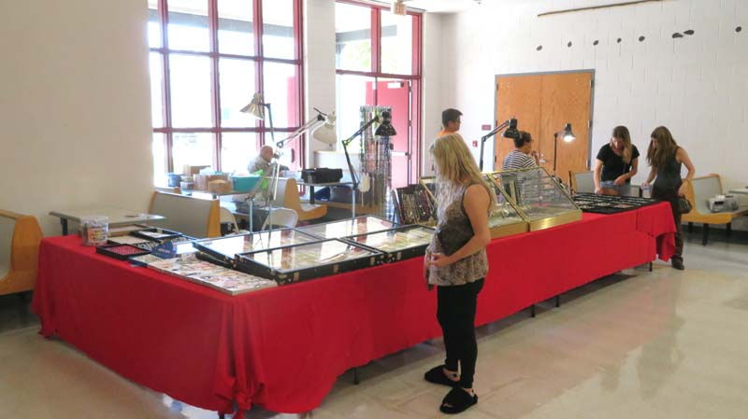

Slide 41
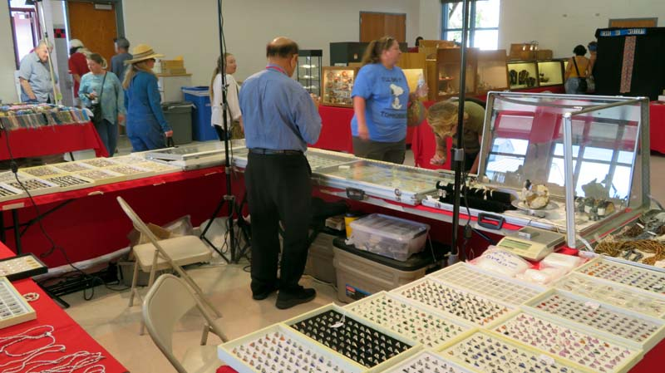

Slide 42
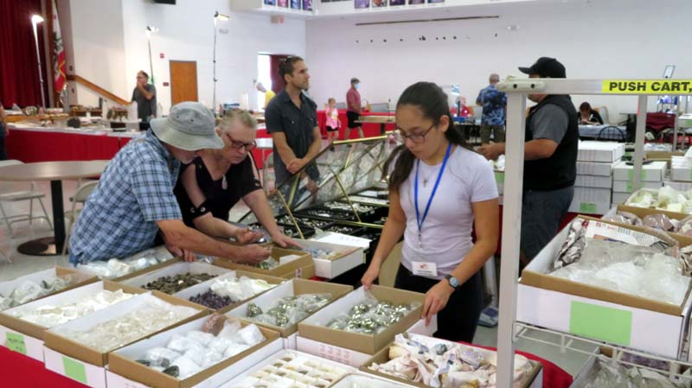

Slide 43
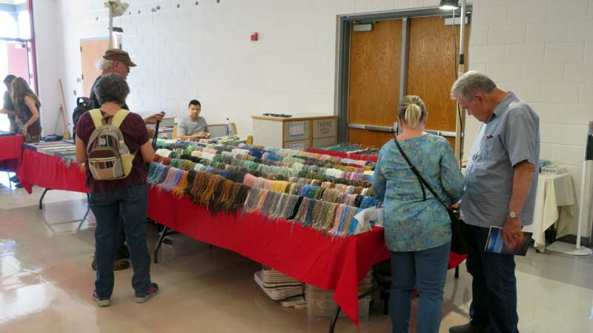

Slide 44
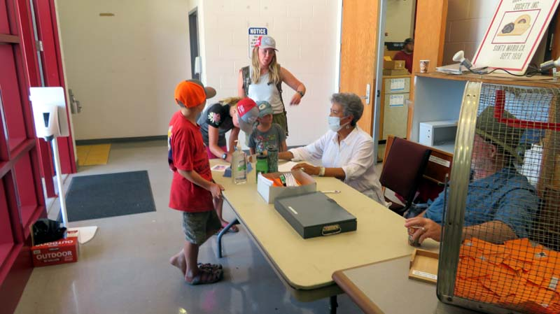

Slide 45
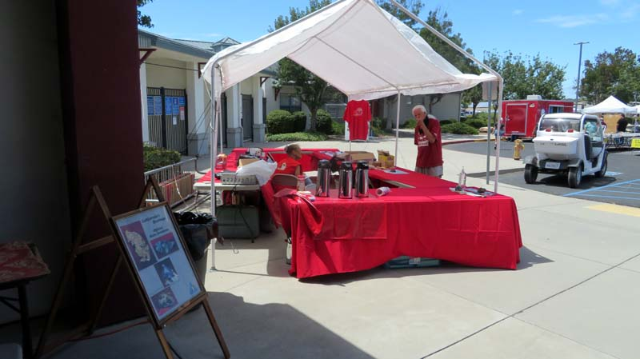

Slide 46
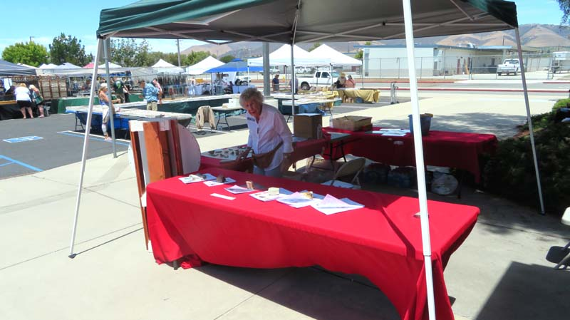

Slide 47
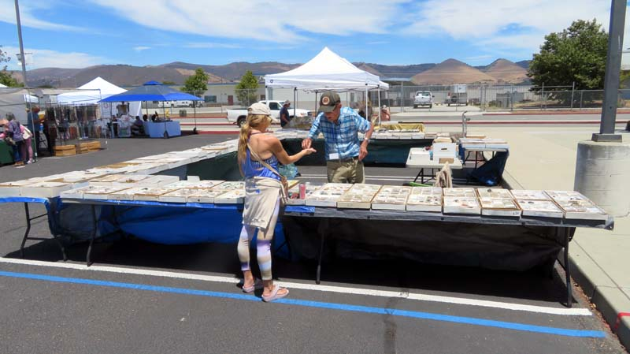

Slide 48
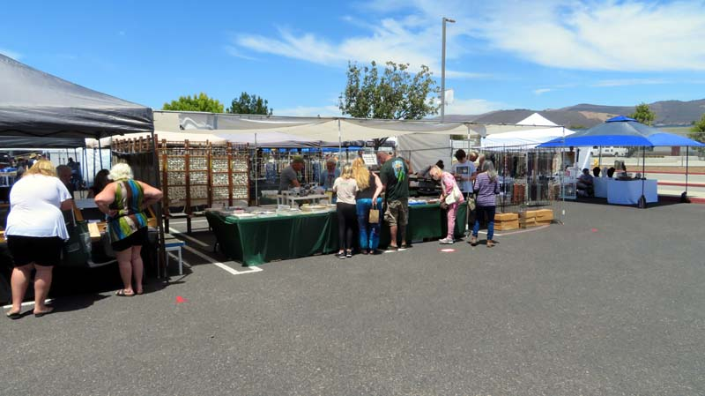

Slide 49
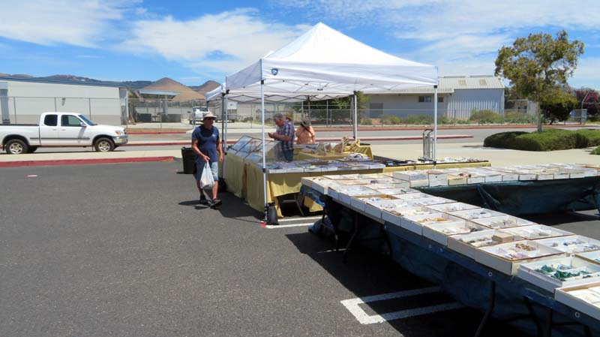

Slide 50
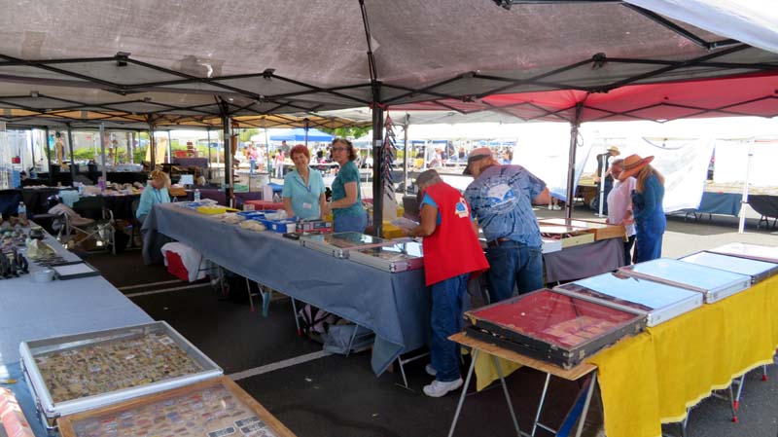

Slide 51
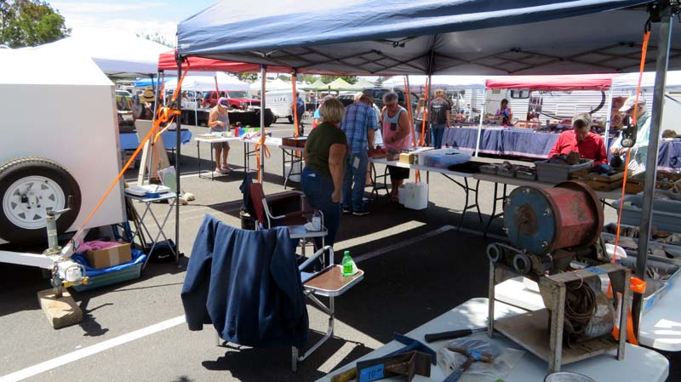

Slide 52
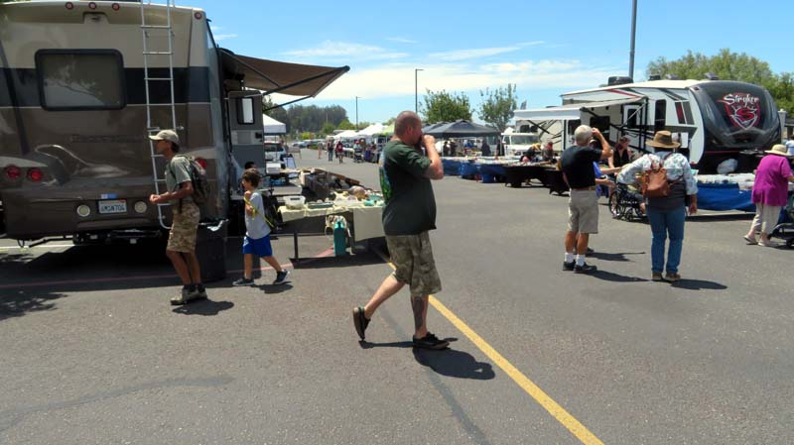

Slide 53
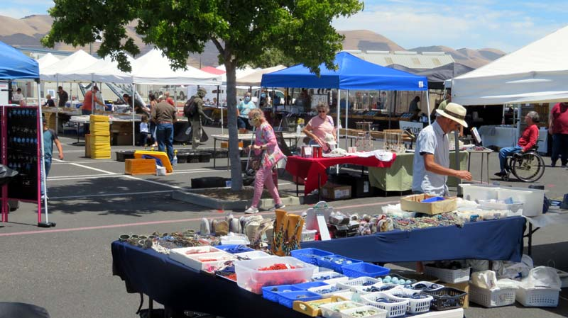

Slide 54
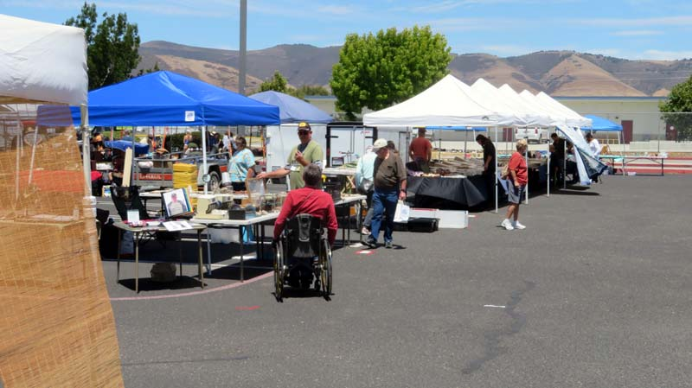

Slide 55
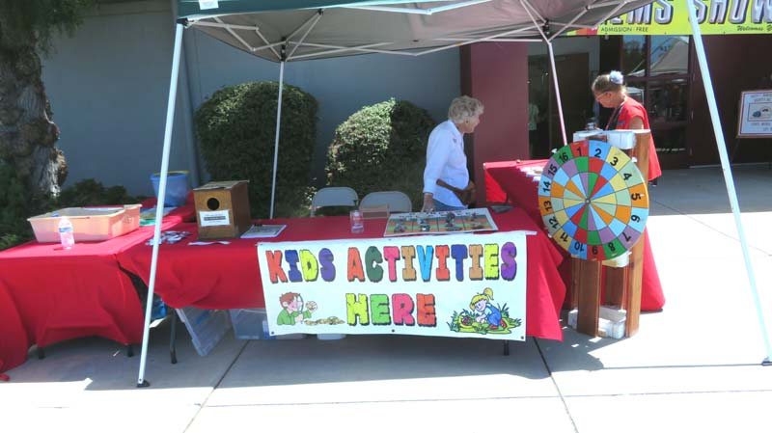

Slide 56
In closing here are quotes from Margaret's note book:
“Do you know how many people you have made happy!”
Dr. Walter Johnson
“What a Gem of a Show!”
Azel & Aurore – 108 W Clarksville St. Jefferson, TX 75657

Slide 57
We showed the world we can do it. Let’s plan on doing it a again!
The End!

