Slide 1

ORCUTT MINERAL SOCIETY, INC.
THE 57TH ANNUAL GEM & MINERAL SHOW

Slide 2
THE SHOW WAS A SUCCESS IN MANY WAYS:
IT LETS THE PUBLIC KNOW ABOUT US
SEVERAL MEMBER APPLICATIONS WERE GIVEN AWAY
NO ONE WAS SERIOUSLY INJURED OR NEEDED EMERGENCY ASSISTANCE
ALL THE DEALERS APPEARED TO BE SATISFIED
VISITORS ALL WANT TO RETURN NEXT YEAR
THE SHOW WAS WELL ATTENDED ALL THREE DAYS
THE PUBLICITY FOR THE SHOW WAS EFFECTIVE
THE FOOD VENDORS HAD A NICE ARRAY OF CHOICES
DEALERS HAD A FABULOUS ARRAY OF PRODUCTS TO SELL
SALLY’S T-SHIRTS WERE A BIG HIT
The Pizza dinner was well done
AND BEST OF ALL I WON THE 1ST PRIZE IN THE RAFFLE

Slide 3
AND NOW LET’S LOOK AT SOME PROBLEMS:
THERE WAS NO COFFEE EACH DAY BY 8AM
There were no Bungies for the tent
Renea was left by her self on the last locker run
The Hospitality Booth needs better signage
The Olympic Hall floor was deeply grooved
The display cases were not cleaned and checked prior to the show – We should start replacing them
David Nelson never received an invite to display
The show has expanded, the sound system has not
A shoplifter was active during the show
We need a work party to clean the tables
More table skirters are needed during setup

Slide 4
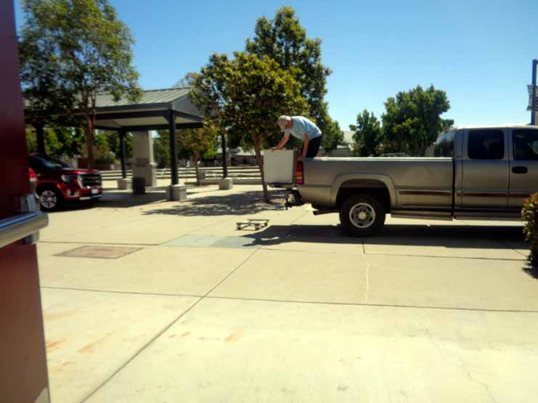
The following are some of the 219 pictures taken by Margaret Henson at the show:
This lady has set the standard for putting on a show. Renea is a very hard worker!

Slide 5
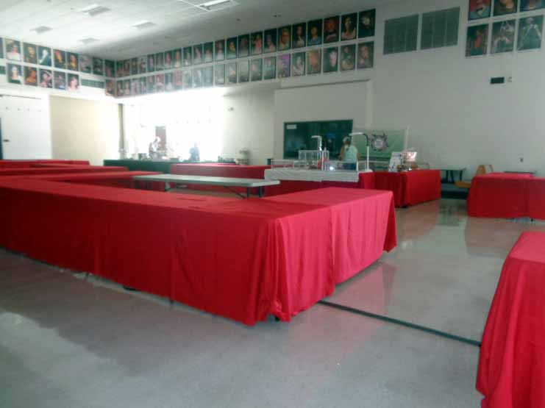
More helpers would be nice during skirting!

Slide 6
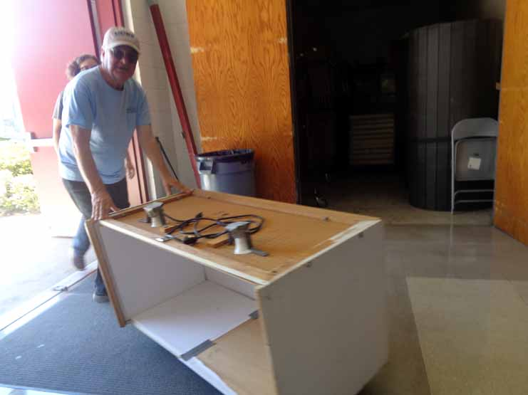
We need to build newer lighter display cases

Slide 7
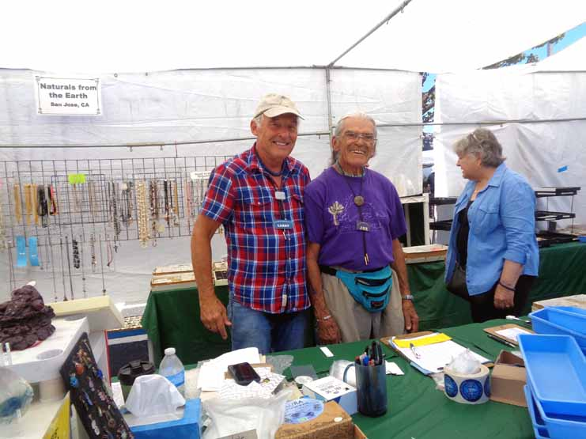
We had a Vendor complain about being shorted 3 feet of space

Slide 8
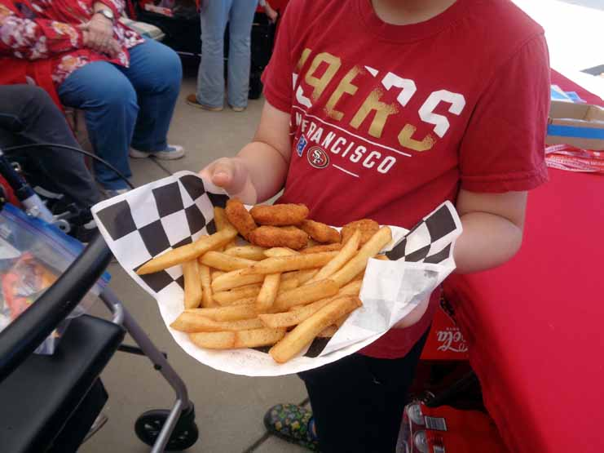
The food vendors were great this year

Slide 9
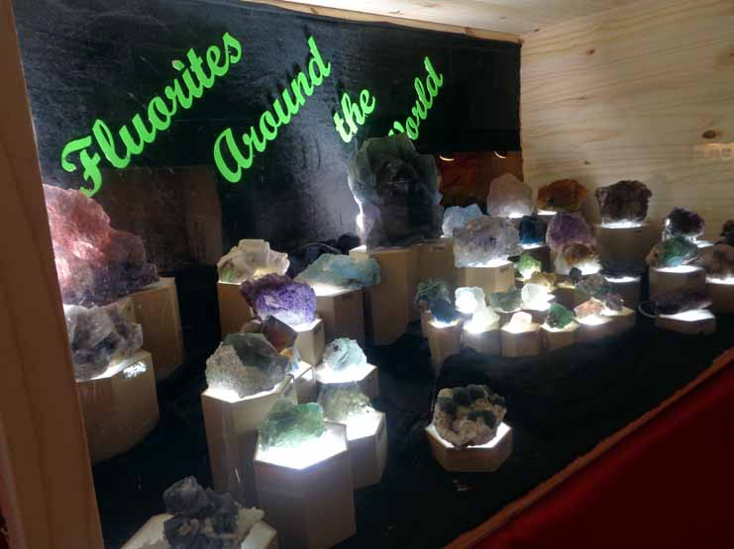
The Peoples Choice award winner – a great idea! Thanks, Joe Goetz!

Slide 10
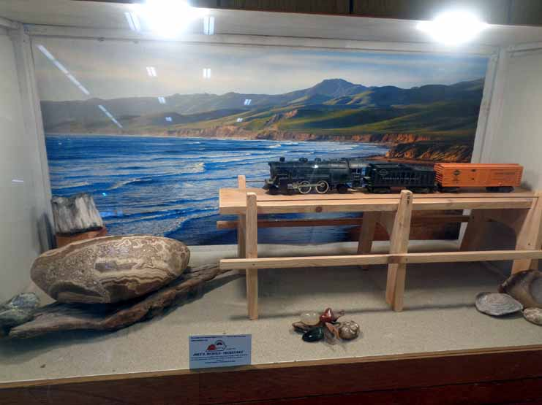
The Exhibitors really came through this year

Slide 11
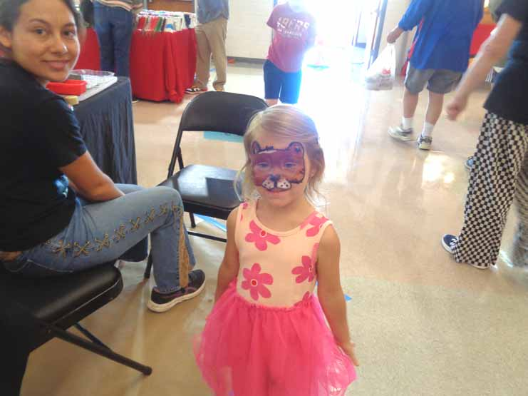
Face painting was new this year

Slide 12
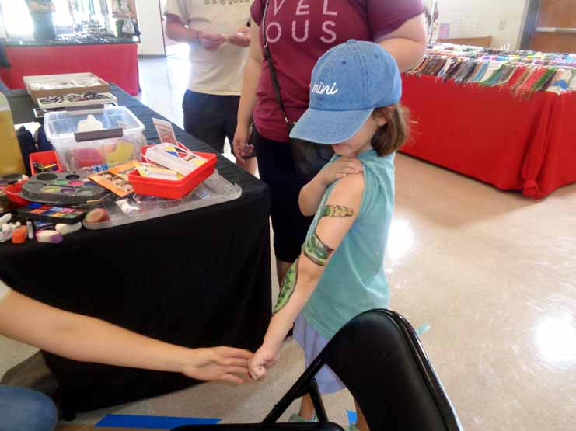

Slide 13
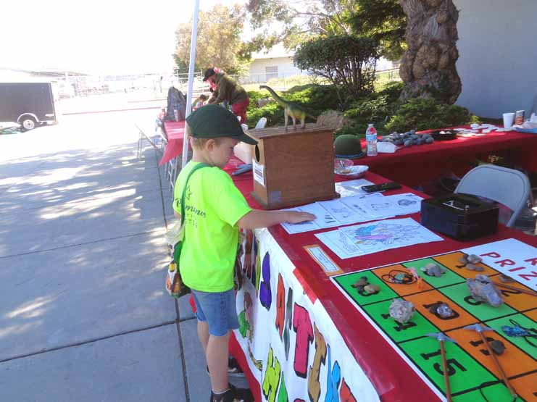
The Kids booth was always busy!

Slide 14
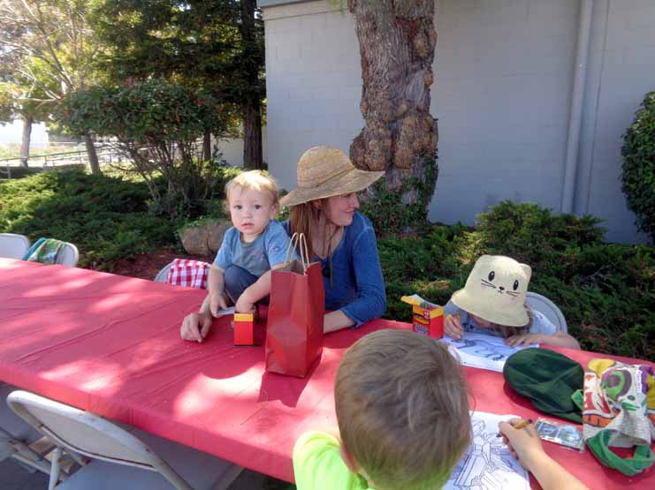

Slide 15
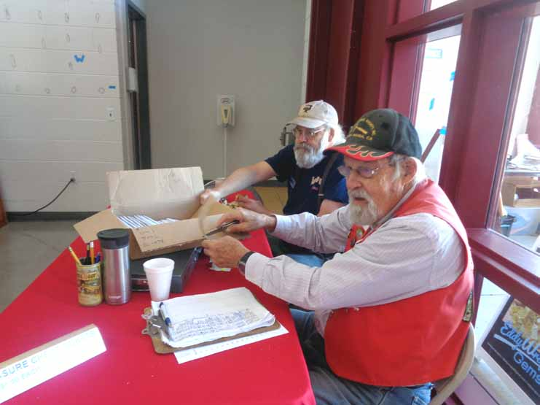
The Treasure Chest sold lots of Tickets!

Slide 16
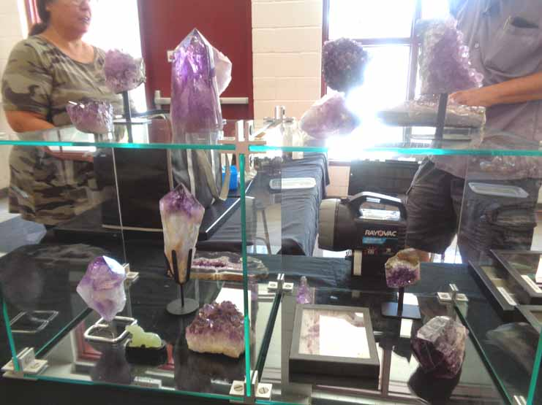
It amazes me how they bring such beautiful things so far without breaking them!

Slide 17
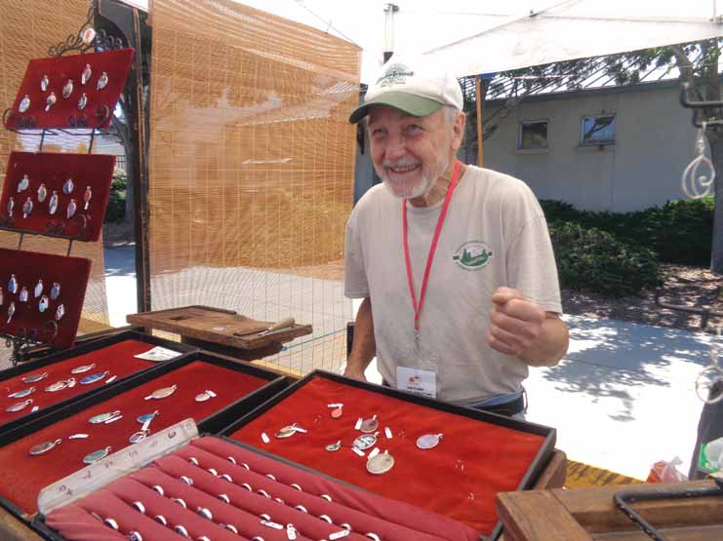
This Vendor comes all the way from Ashland, Oregon

Slide 18
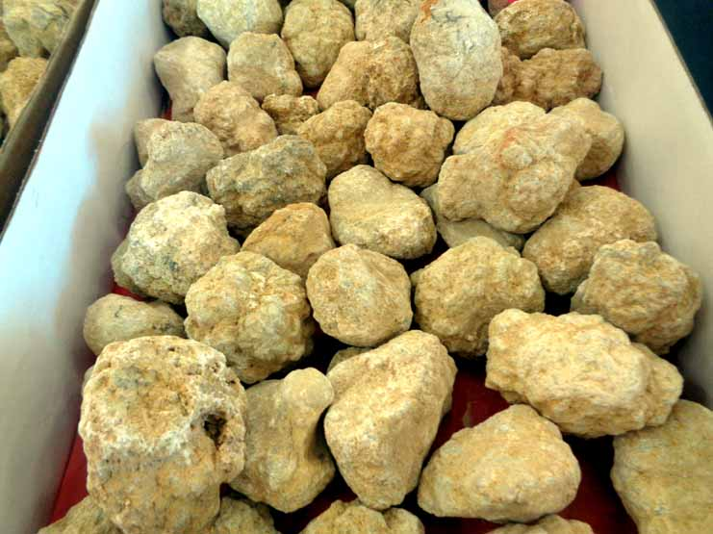
We didn’t cut a lot of Geodes this year.

Slide 19
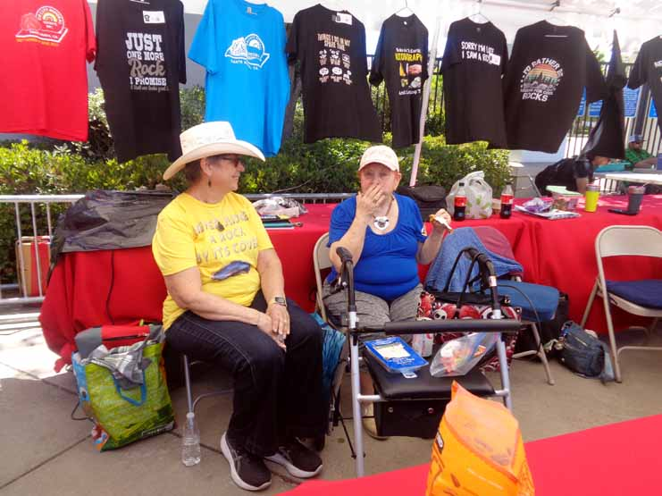
The T-Shirts drew a lot of attention!

Slide 20
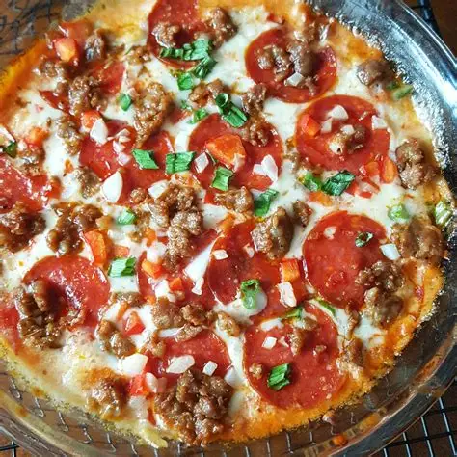
Everyone enjoyed the Thursday night Pizza Dinner!

Slide 21
IN SUMMARY – WHAT MAKES OUR SHOW SUCCESSFUL?
THE DEDICATION OF THE MEMBERS
THE VENUE AT THE HIGHSCHOOL
THE VENDORS AND THEIR PRODUCTS
THE LARGE AREA TO DRAW ATTENDEES
GETTING THE WORD OUT ABOUT THE SHOW
THE LEGACY OF PAST SHOWS
IT IS NOT TOO EARLY TO BEGIN THINKING ABOUT THE 58TH ANNUAL SHOW. NO SHOW AND WE HAVE NO CORPORATION!
THE COMMUNITY NEEDS OUR SHOW SO LET’S DO IT AGAIN! GOOD WORK OMS! WE CAN DO IT!

