Slide 1
ORCUTT MINERAL SOCIETY, INC.
50TH ANNUAL RAINBOW OF GEMS SHOW
AN IMPRESSIVE MILESTONE
SLIDE PROGRAM PRODUCED BY WES LINGERFELT

Slide 2
THESE FIRST SET OF PICTURES WERE PROVIDED BY BILL HOOD.
I CAN ONLY PRESENT A SUBSET HERE; HOWEVER, ALL THE PICTURES WILL BE AVAILABLE ON THE CLUB WEBSITE IN THE ARCHIVES.

Slide 3
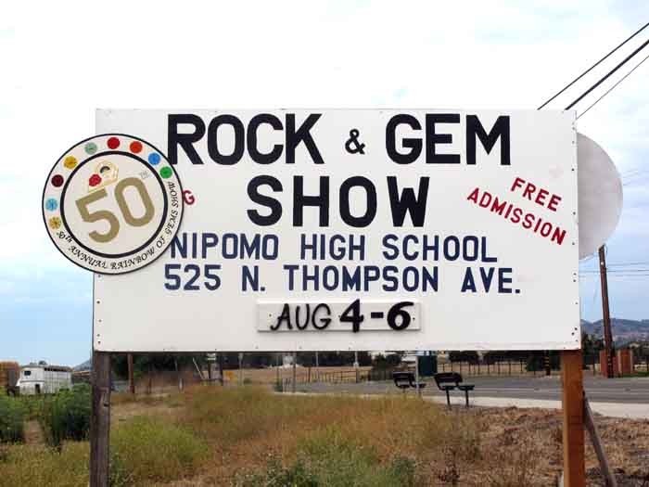
Renea Sutcliff Did a Superb job on the signs.

Slide 4
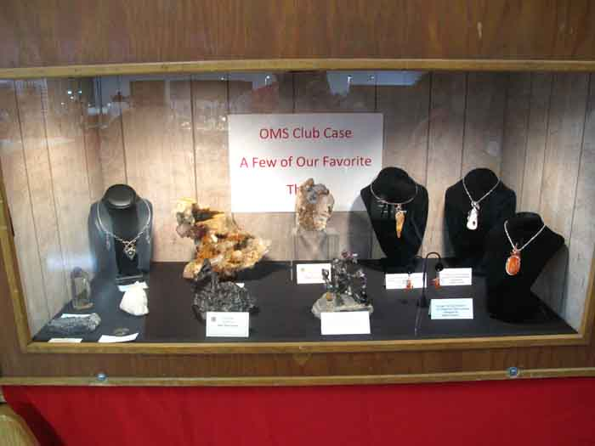
This member case allows everyone to participate who wants to.

Slide 5
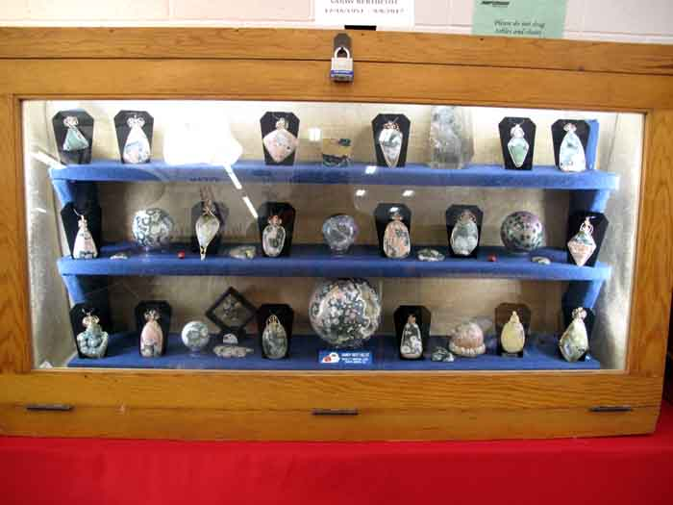
Jeannie put together this memorial case of Ocean Jasper from Sandy Berthelot’s collection.

Slide 6
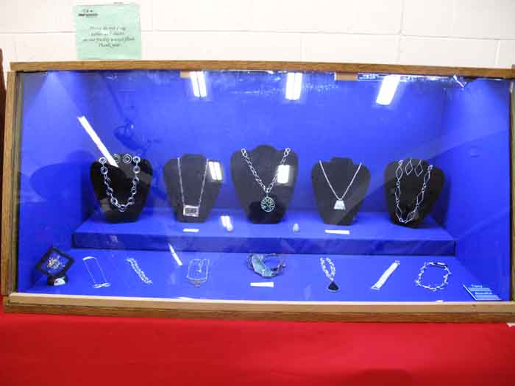
This case belongs to Tony & Sandi Fender who came from the LA area.

Slide 7
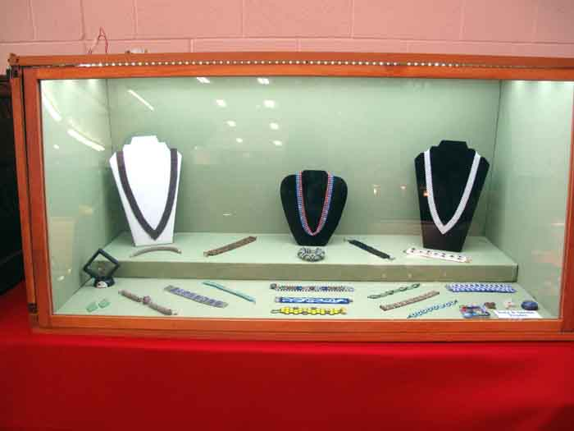
Some of Sandi Fender’s bead work.

Slide 8
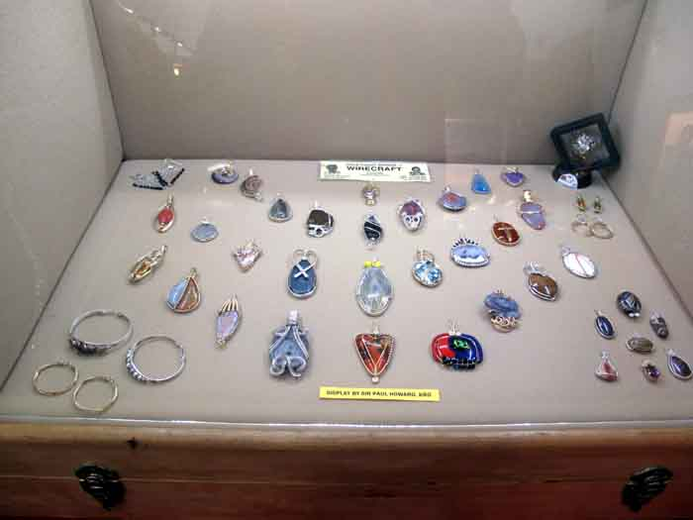
SIR PAUL HOWARD Who flew half way around the world to attend our show.

Slide 9
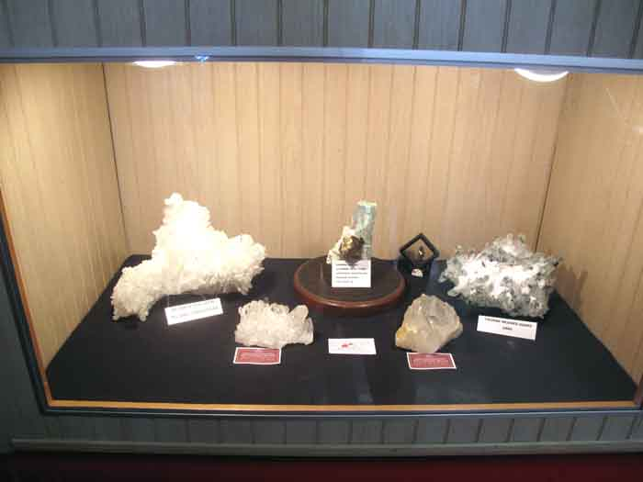
A Collection of Crystals by Wes Lingerfelt

Slide 10
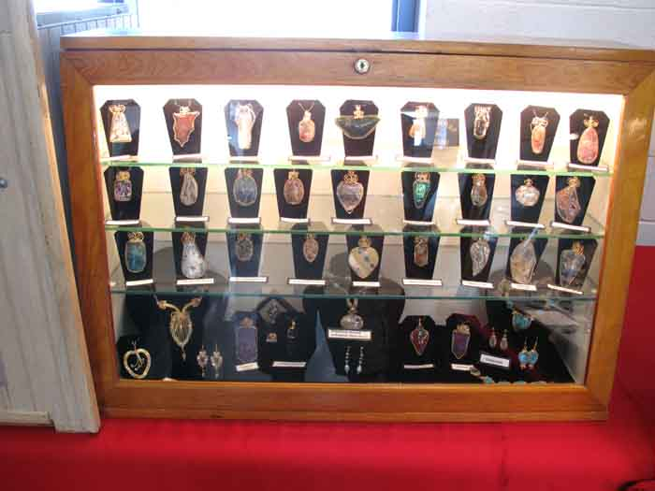
Jeannie’s Wire Wrap case – Sir Paul got her started.

Slide 11
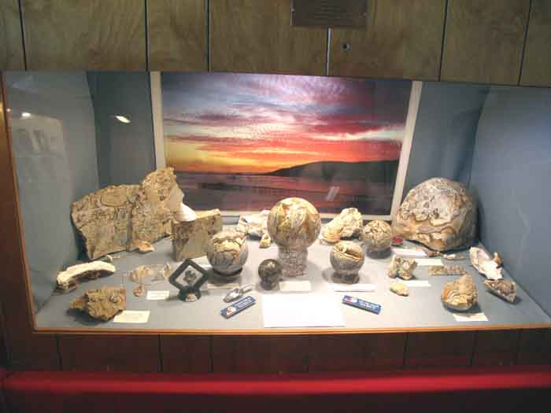
Local rock called Deedeeite from Avila Beach by DeeDee Magri & Sharon Duncan.

Slide 12
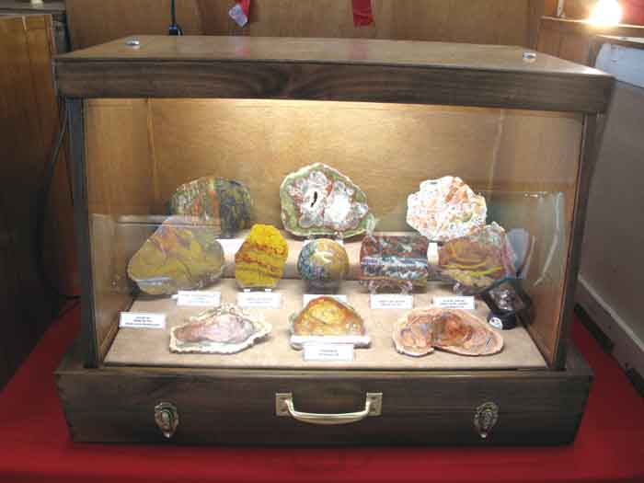
An impressive display by Gene Bilyeu from the Paso Robles club.

Slide 13
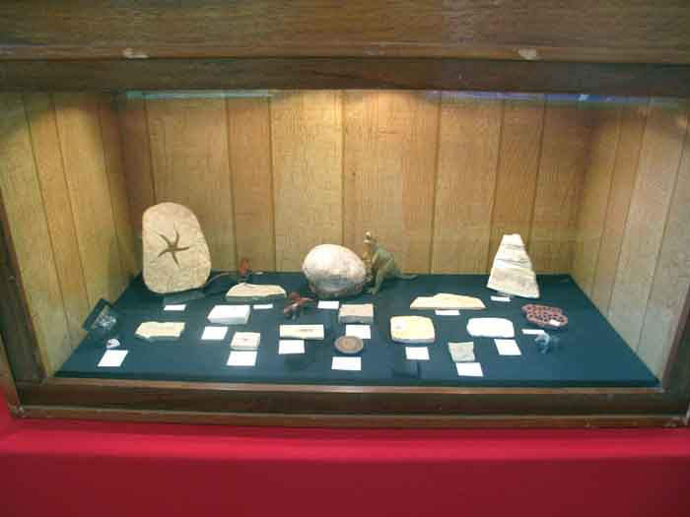
A Case of Fossils by Nancy Bird, one of our dealers.

Slide 14
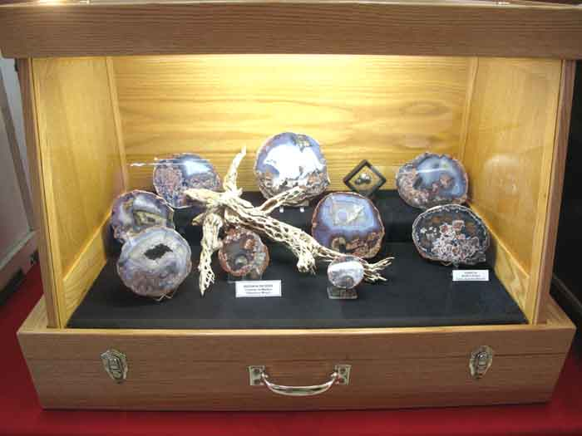
A case of Thunder Eggs by Barbara Bilyeu from the Paso Robles club.

Slide 15
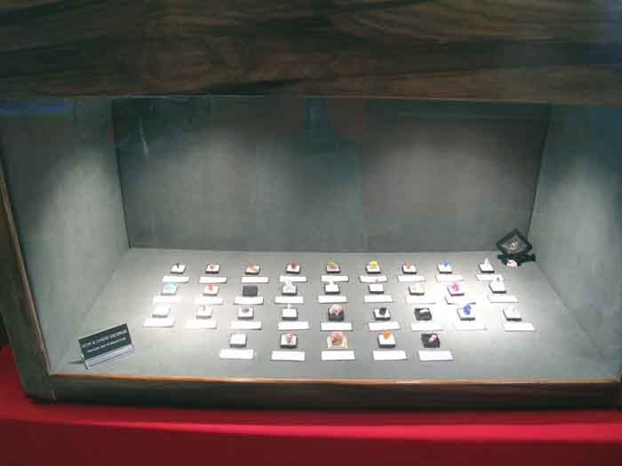
Don & Cheri George brought this case of Miniature Minerals.

Slide 16
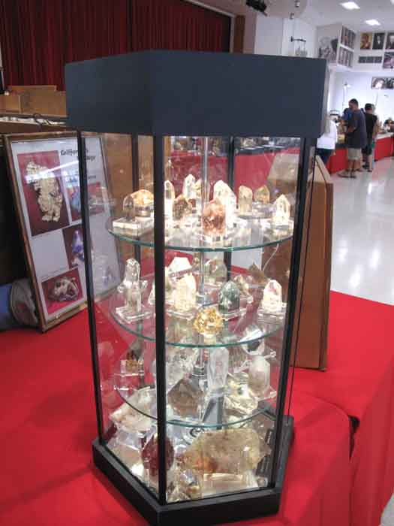
A beautiful case of Crystals presented by Jan Ferguson.
You can see a lot of very interesting things in these crystals.

Slide 17
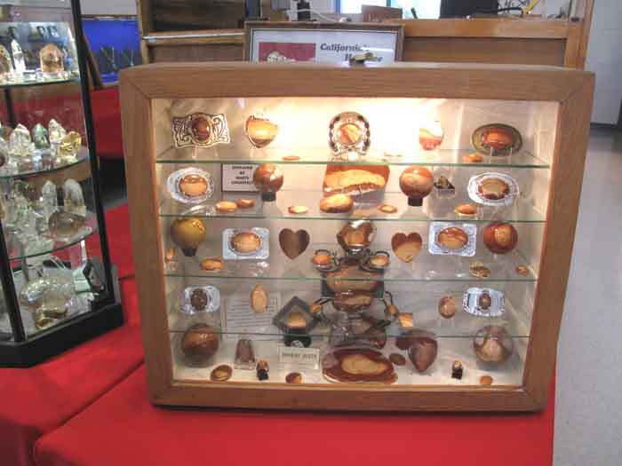
Marty Lingerfelt acquired this material from Buck Strader and displays it in his memory.

Slide 18
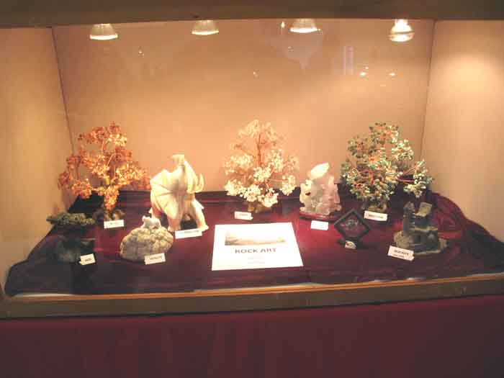
Dyanna Cridelich & Alexis Van Natta show off their collection of Rock Art.

Slide 19
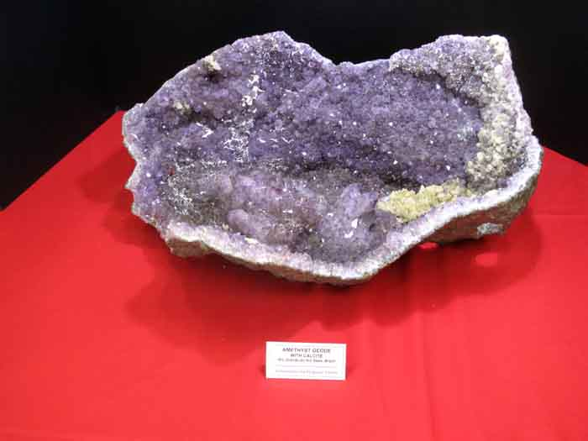
A very nice Amethyst Plate presented by Jan & Stan Ferguson.

Slide 20
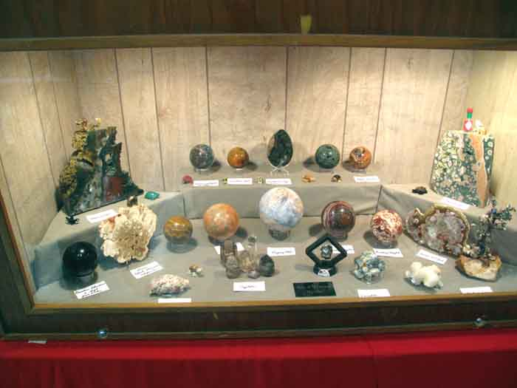
Mike & Margaret Henson’s collection, they also like Ocean Jasper.

Slide 21
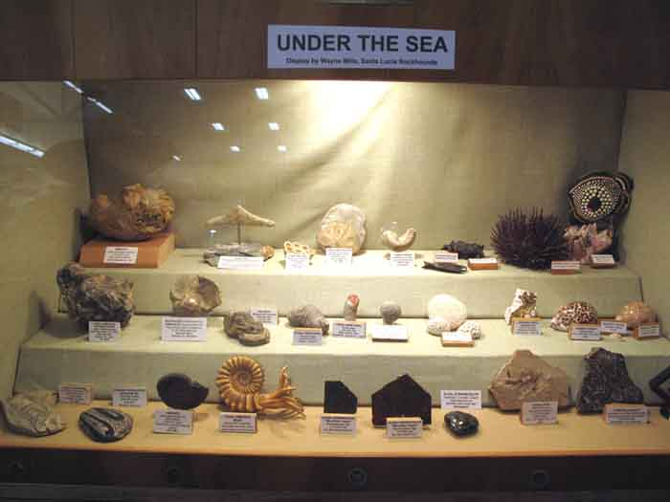
A collection of Fossils by Wayne Mills – AWESOME!

Slide 22
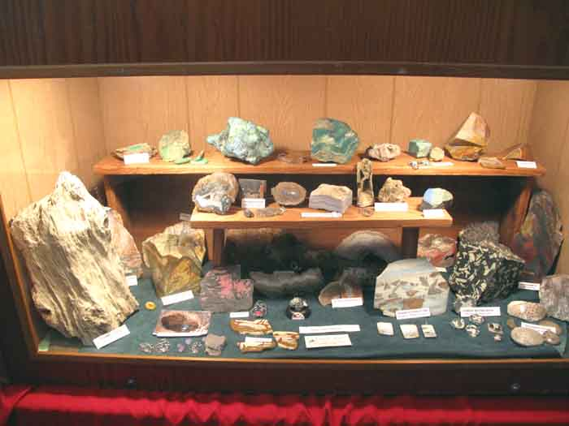
Dan Clark from Oregon brought this display for us to enjoy!

Slide 23
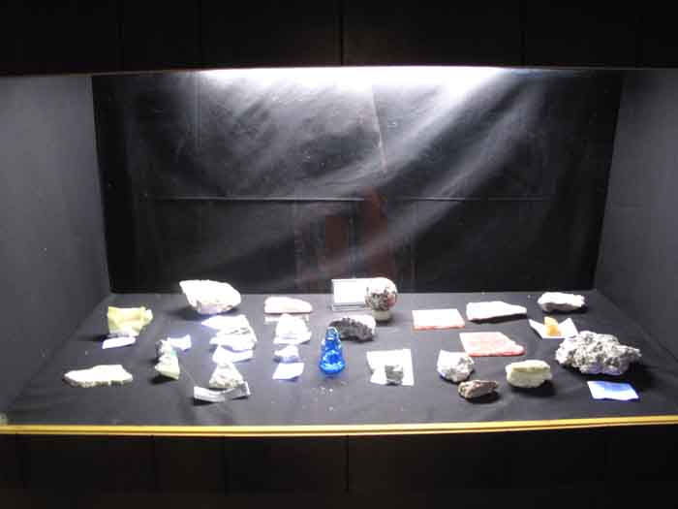
This Black Light display is by Dave Nelson from the Paso Robles club.

Slide 24
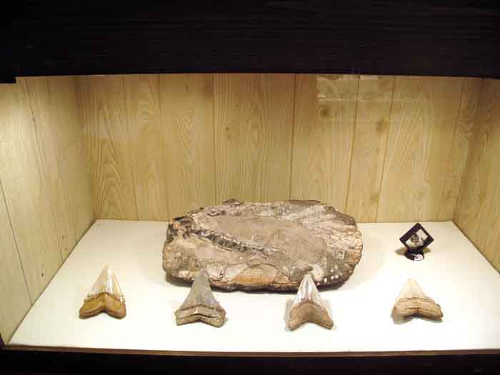
This priceless display is by Honorary Member Ralph Bishop.

Slide 25
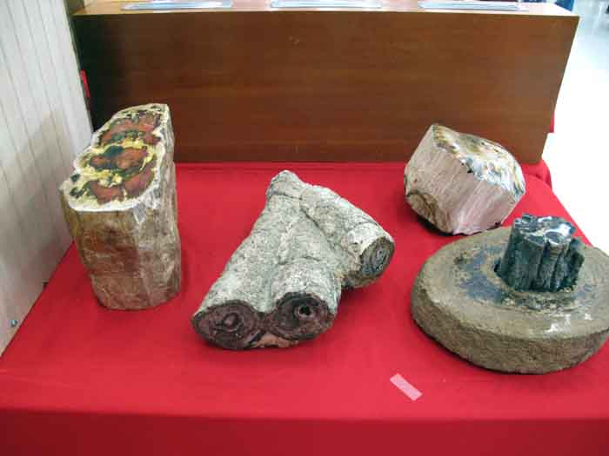
More great display items by Ralph Bishop. Be sure to read his stories!

Slide 26
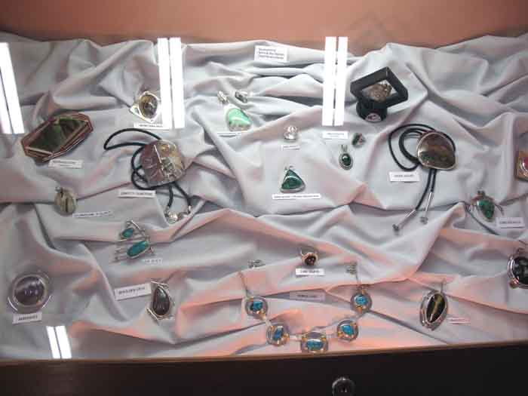
Don & Sylvia Nasholm’s case of excellent Silversmith work.

Slide 27
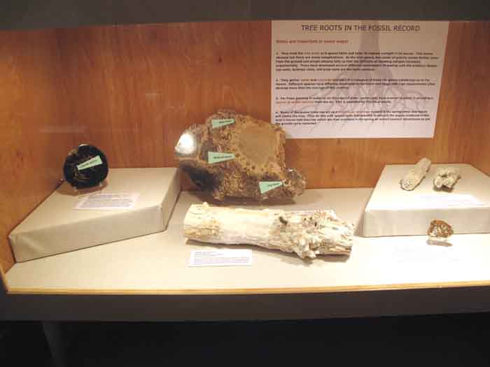
An educational Fossil case by Jim Mills & Beth Myers from the Paso Robles club.

Slide 28
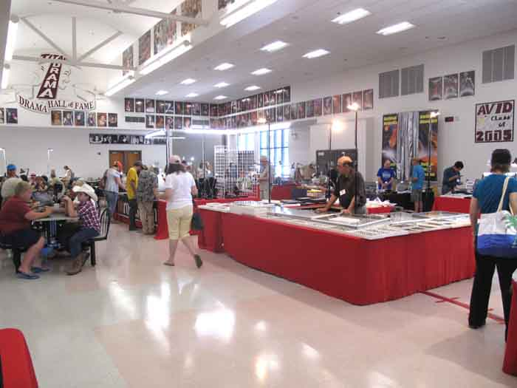
The inside layout worked well this year

Slide 29
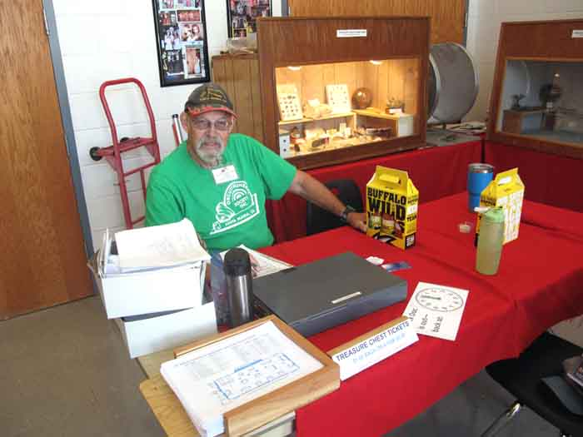
Wayne Mills handled the Treasure Chest and sold tickets made by Wes Lingerfelt

Slide 30
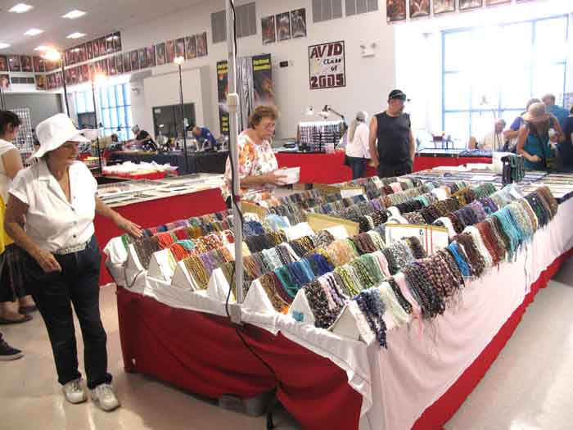
BEADS! BEADS! AND MORE BEADS!

Slide 31
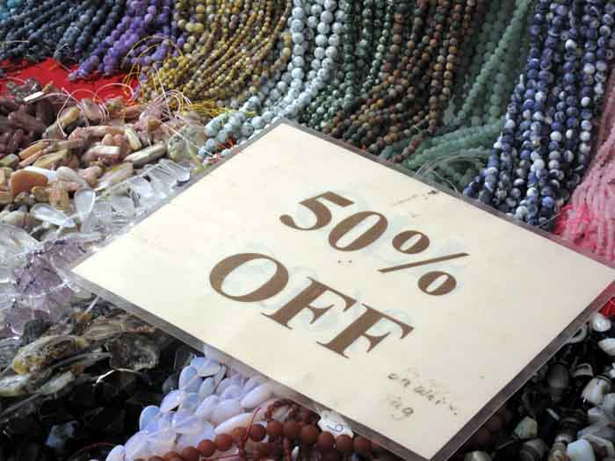
The beads were bargain priced.

Slide 32
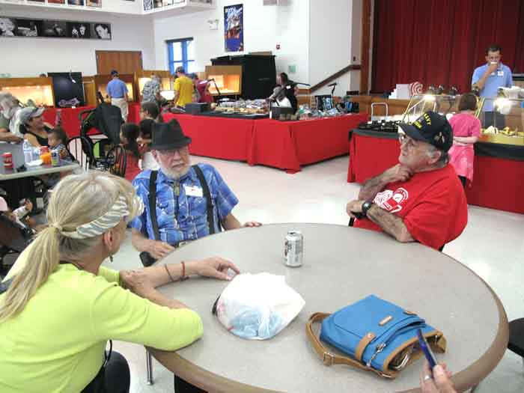
This is what I call retirement! Re-connected with an old friend.

Slide 33
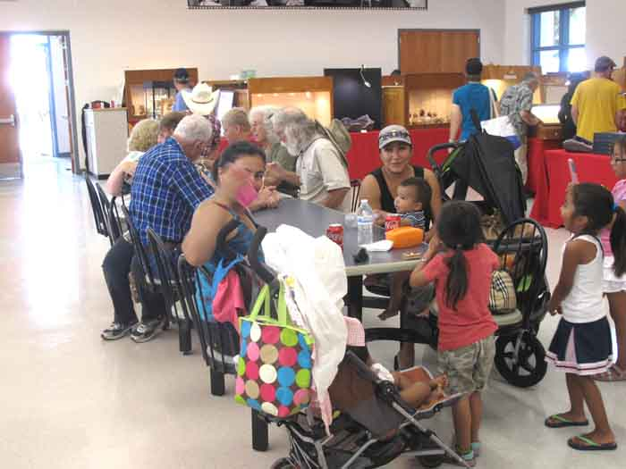
The inside rest areas as well as the parking lot was always full.

Slide 34
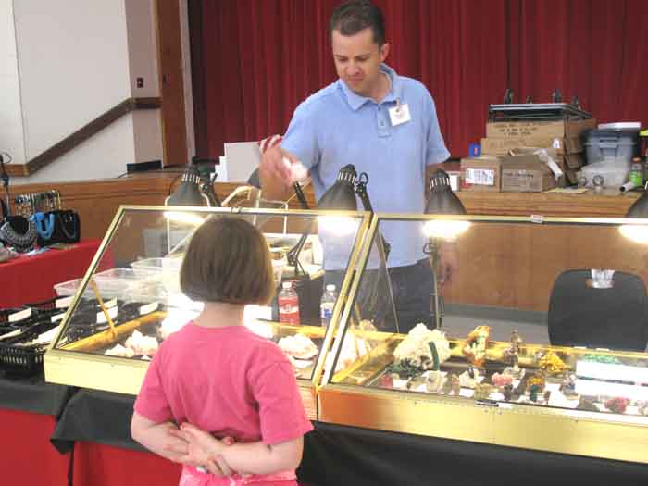
Jeff Lines was featured in the Mineralogical Record August California Supplement.

Slide 35
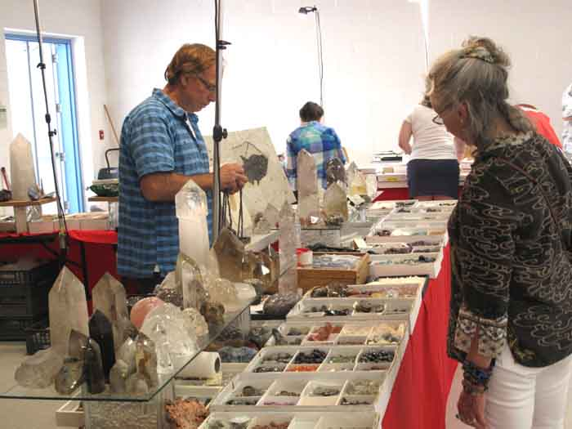
Dave Richter, one of two dealers who really miss Sandy Berthelot.

Slide 36
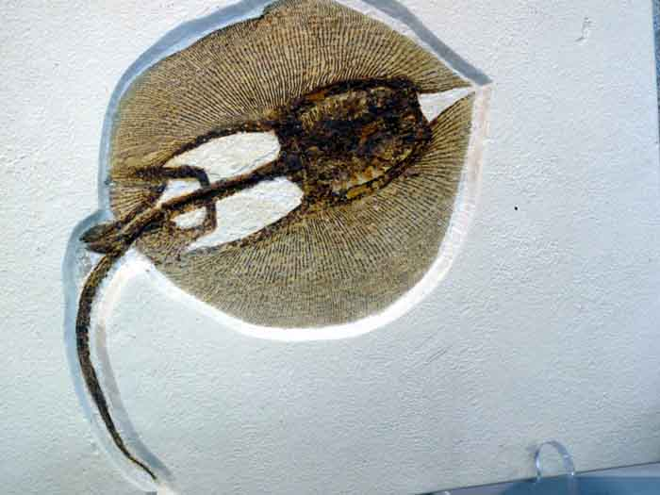
An unusual fossil. I wonder what it is?

Slide 37
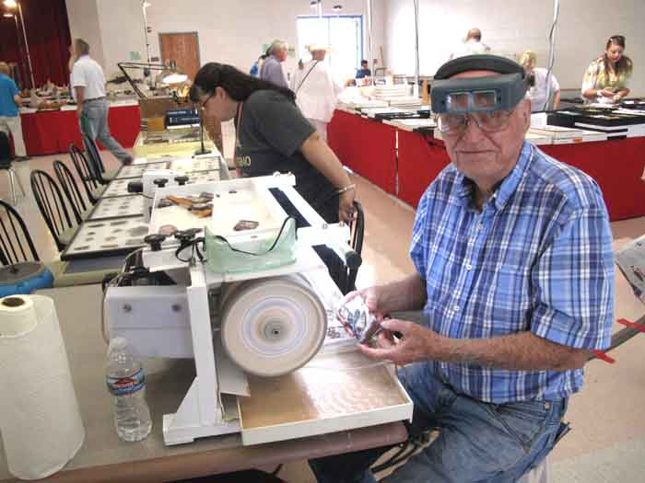
Bill Depue, Diamond Pacific Corp President brought an extra new machine.

Slide 38
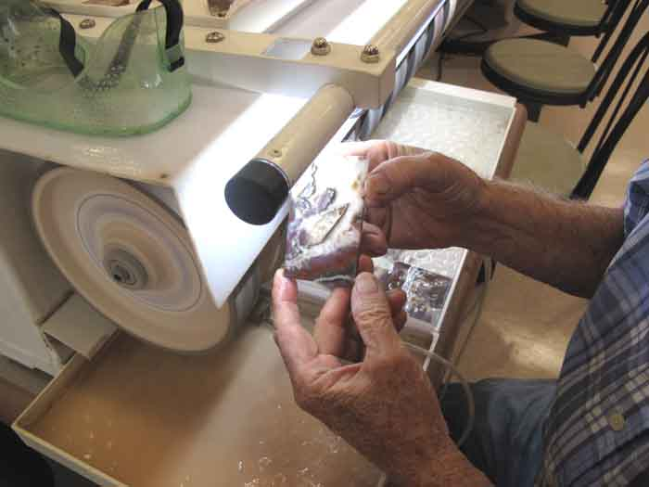
The new X-88 has more advanced features and is fun to use.

Slide 39
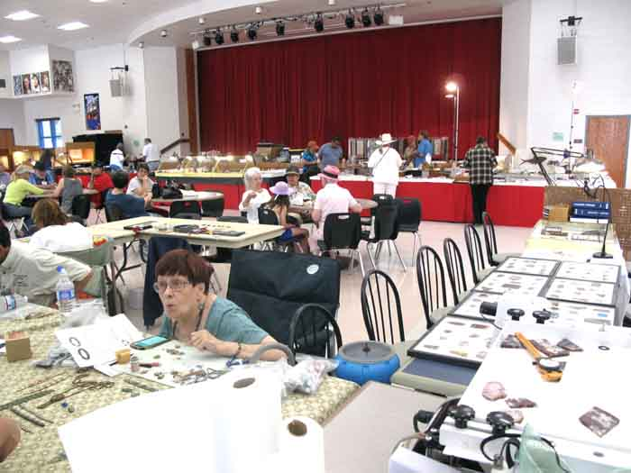
Cheri George demonstrates with a flair for the good times.

Slide 40
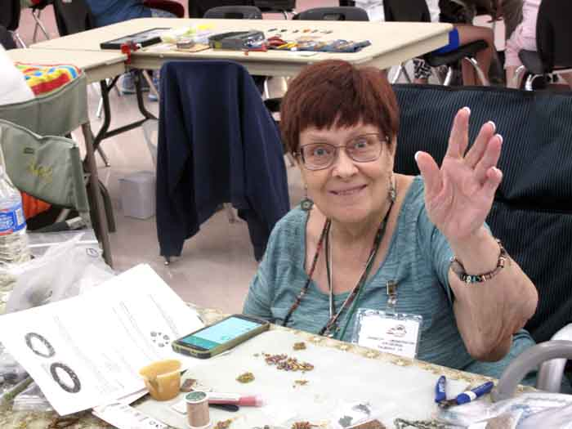
Hi ya Kido! Says Cheri George.

Slide 41
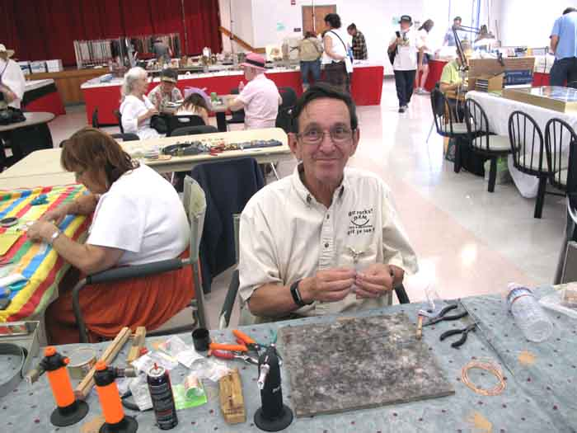
Demonstrators Tony & Sandi Fender have been long term attendees.

Slide 42
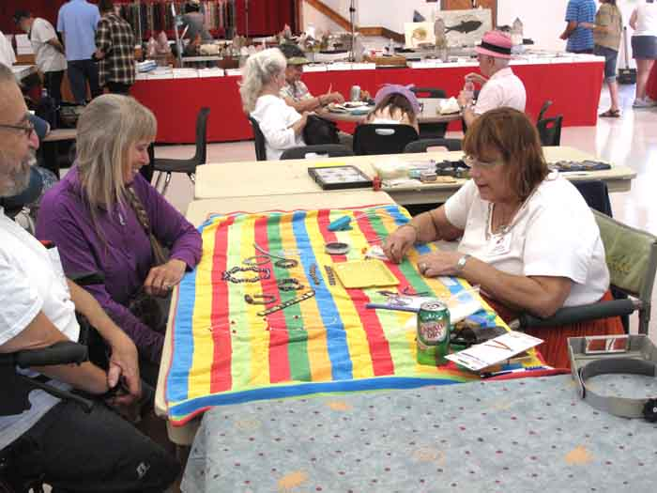
Sandi Fender works her beading magic.

Slide 43
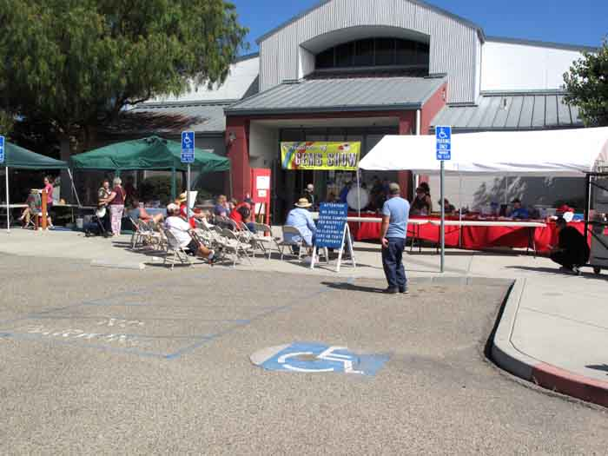
The Treasure Chest drawing went off without a hitch.

Slide 44
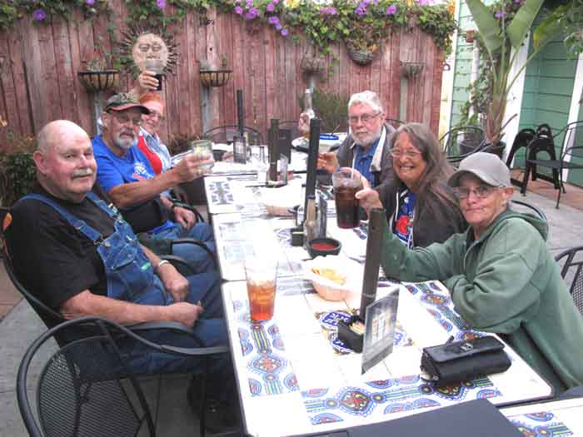
We expected a better turnout at the celebration party.

Slide 45
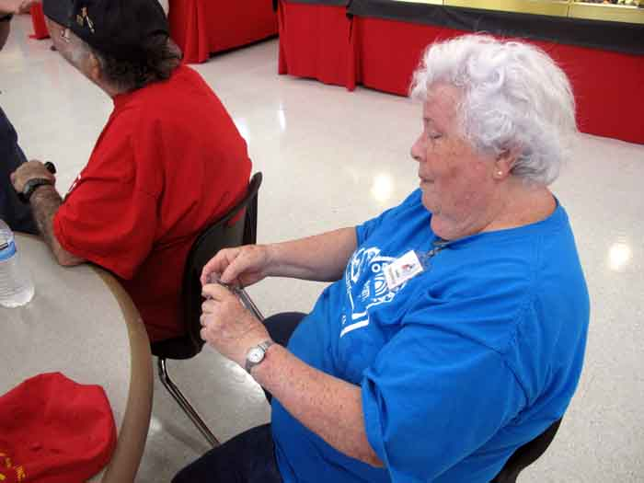
THE FOLLOWING PICTURES WERE PROVIDED BY MARGARET HENSON

Slide 46
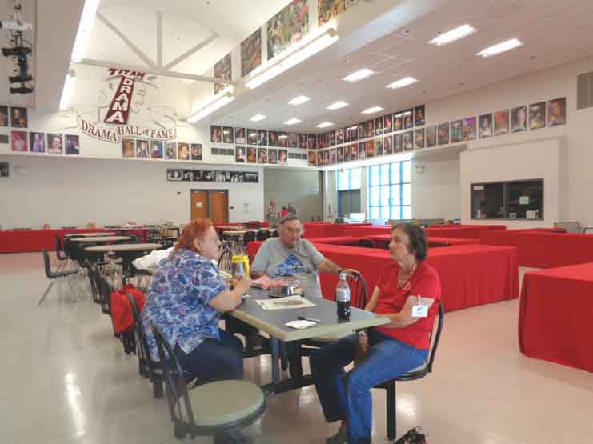
Thursday setup break time.

Slide 47
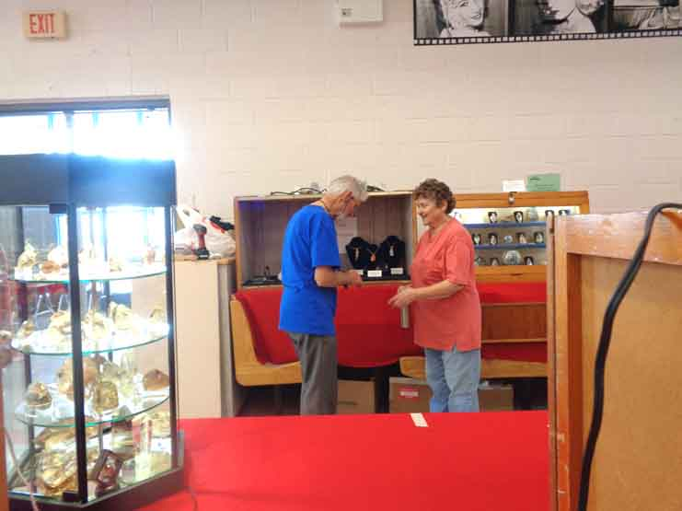
Sir Paul consults with Sylvia about his display case.

Slide 48
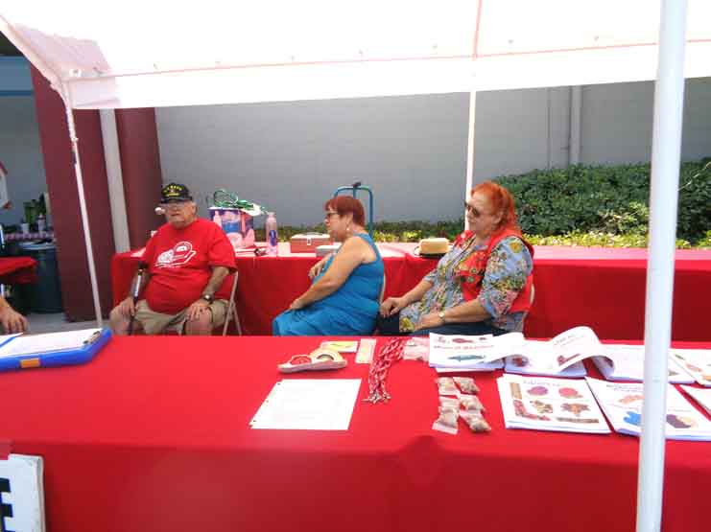
Mike Henson, DeeDee Magri, and Debbie Hood man the Hospitality Booth.

Slide 49
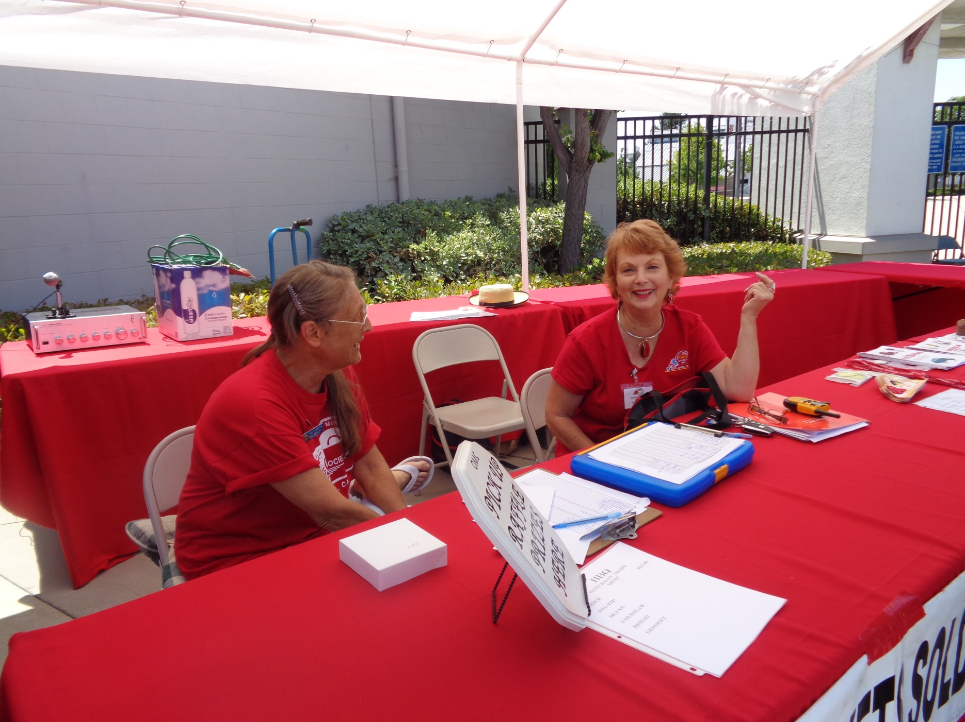
Sally Griffith & Sharon Duncan manning the Hospitality Booth. These two ladies really worked hard during the show.

Slide 50
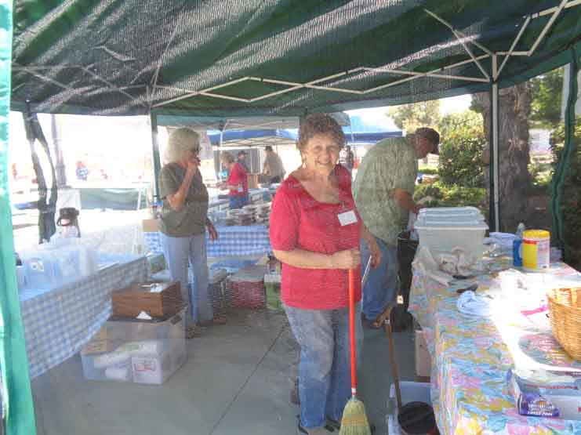
Virginia Rogers, Don & Sylvia work behind the fly net of the Pie Booth.

Slide 51
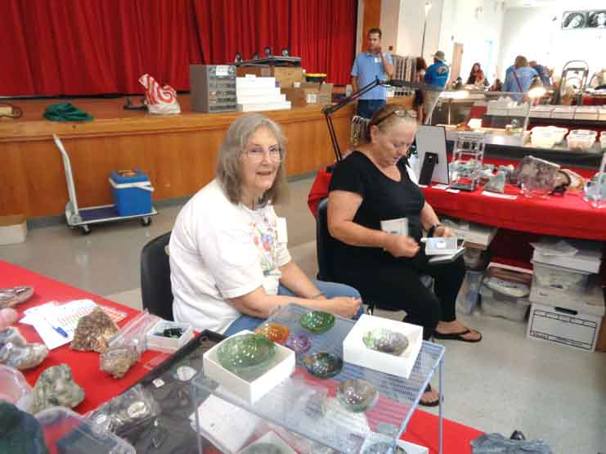
Dealer Kathryn Davis & Associate from the Ventura club.

Slide 52
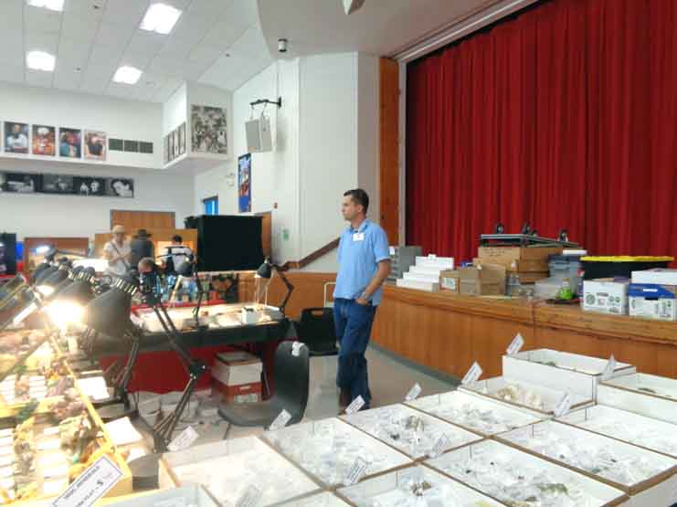
Dealer Jeff Lines from the San Francisco bay area.

Slide 53
Former members & good friends Roger and Donna Lehman

Slide 54
Mary Rafferty from the San Luis Obispo club demonstrated Faceting.

Slide 55
Dealer Chair person and show organizer Sharon Duncan – Great Job!

Slide 56
Lucky Virgin’s grandson; No mug shots please!

Slide 57
Sir Paul Howard demonstrated Wire Wrapping. He also made several donations to the club of books and videos.

Slide 58
The search for gold was very appealing to the kids!

Slide 59
The menu was limited but it was tasty! And the guacamole was very hot!

Slide 60
Dan Clark always comes early from Oregon and helps with the show setup.

Slide 61
Lots of wonderful merchandise to choose from everywhere.

Slide 62
Something for anyone and everyone.

Slide 63
The kids booth was manned by Alexis Van Natta and Bill Brown, A Big Hit!

Slide 64
Polychrome jasper was featured by Gary Grisham

Slide 65
The newest member of our family. She’s a 4 year old Cavalier King Charles Spaniel, Lhasa Apso mix and her name is Penny.

Slide 66
AND SO ANOTHER ANNUAL SHOW IS HISTORY. OVER THE YEARS WE HAVE LEARNED WHAT IT TAKES TO MAKE THE SHOW A SUCCESS. WE CAN COUNT THIS, OUR 50TH ANNUAL SHOW AS A GREAT SUCCESS. THE MOST IMPORTANT ELEMENT FOR A SUCCESSFUL SHOW IS A GROUP OF PEOPLE WITH THE DEDICATION AND WILLINGNESS TO CONTRIBUTE THEIR TIME AND ENERGY.
THE SHOW IS THE SINGLE MOST IMPORTANT ACTIVITY THIS SOCIETY UNDERTAKES EACH YEAR.
THE END

